Slide 1

Unit 8: Food
Review & Practice 2
Page 123

Slide 2
Lesson Outline
Warm-up
Speaking
Consolidation
Wrap-up

Slide 3
Objectives
By the end of this lesson, students will be able to…
Vocabulary: review all vocabularies learnt in Unit 8.
Speaking: Practice asking and answering questions, playing a board game.

Slide 4

WARM UP

Slide 5
WHAT’S NEXT?
No__ __ __ __ __
Noodles
Cu__ __ __ __ __
Cupcake
Ba__ __ __ __
Banana
Ca__ __ __ __
Carrot
Do__ __ __
Donut

Slide 6
WHAT’S NEXT?
Pi__ __ __
Pizza
Ch__ __ __ __ __
Chicken
Ca__ __
Cake
Ap__ __ __
Apple
On__ __ __
Onion
To__ __ __ __
Tomato

Slide 7

It’s time to learn …

Slide 8

Speaking

Slide 9
PRE-SPEAKING
Rearrange these words to make a sentence.
bananas are there There
There are three bananas

Slide 10
PRE-SPEAKING
Rearrange these words to make a sentence.
like some would pizza you
Would you like some pizza?

Slide 11
PRE-SPEAKING
Rearrange these words to make a sentence.
carrots are some Yes there
Yes, there are some carrots.

Slide 12
PRE-SPEAKING
Rearrange these words to make a sentence.
there No, apples are three
No, there are three apples

Slide 13
PRE-SPEAKING
Rearrange these words to make a sentence.
a there potato? Is
Is there a potato?

Slide 14
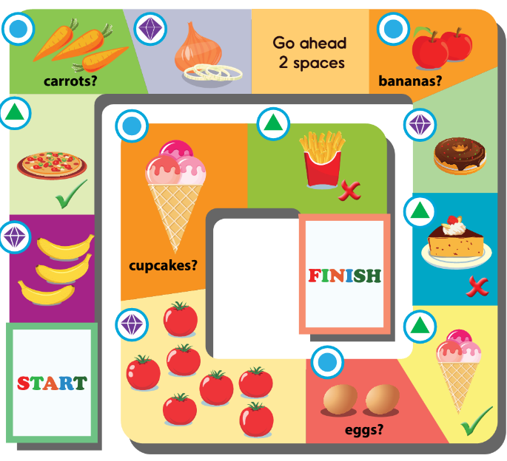
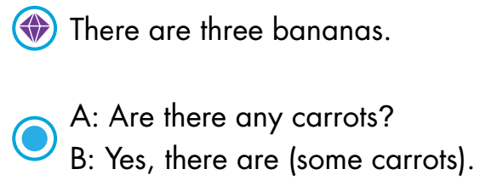
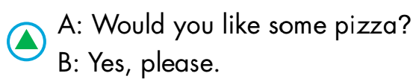
WHILE-SPEAKING
See the next slide to know how to play the game

Slide 15
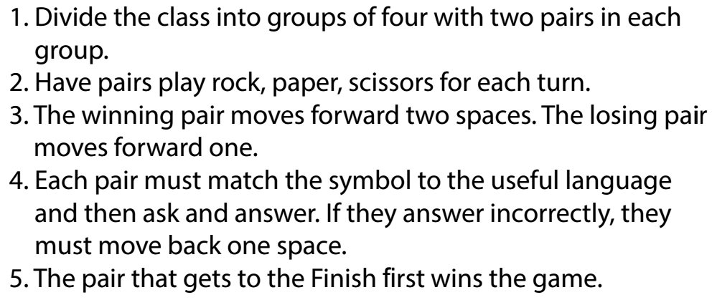
HOW TO PLAY?

Slide 16
WHILE-SPEAKING

Slide 17

CONSOLIDATION

Slide 18


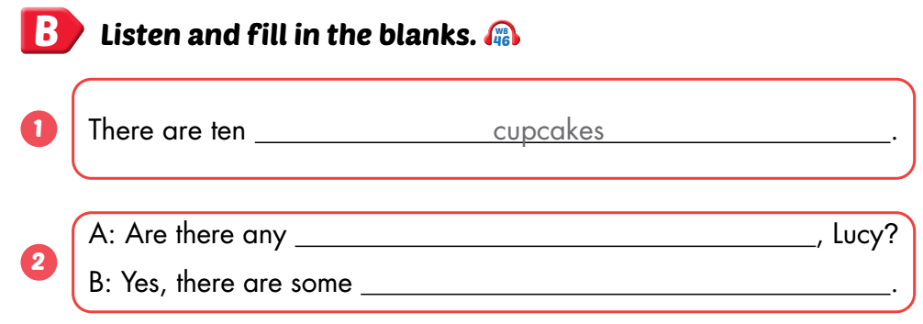
Workbook, p.87
POST-SPEAKING
eggs
eggs

Slide 19

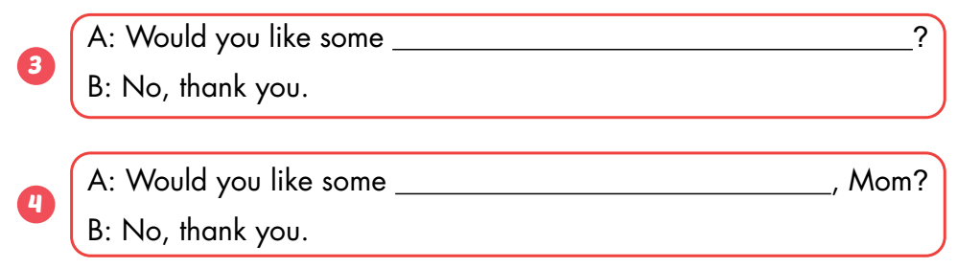
Workbook, p.87
cake
fries

Slide 20
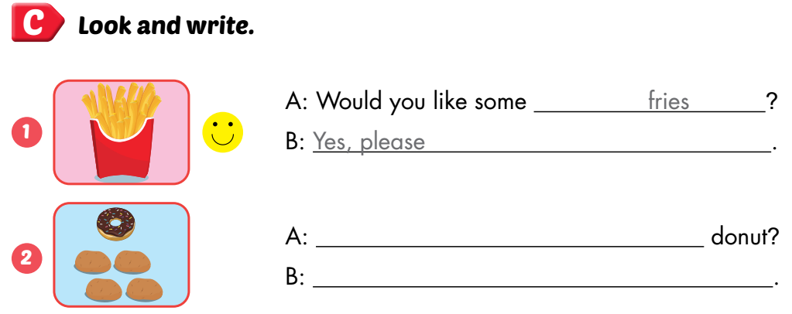
Workbook, p.87
Is there a
Yes, there is a donut

Slide 21

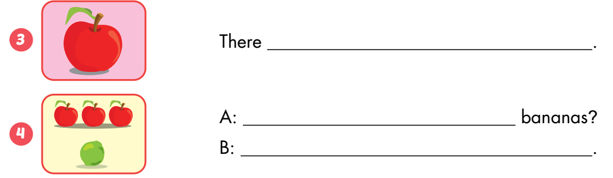
Workbook, p.87
is an apple
Are there any
No, there aren’t

Slide 22

WRAP-UP

Slide 23
Lesson 3
Today’s lesson
Vocabularies
Review all vocabularies learnt in Unit 8
Speaking
Practice asking and answering questions by playing a board game

Slide 24
Lesson 3
Homework
Review the vocabularies and structure; and make sentences using them.
Do the exercises in Tiếng Anh 3 i-Learn Smart Start WB (page 87)
Do the exercises in Tiếng Anh 3 i-Learn Smart Start Notebook (page 57)
Prepare the next lesson (page 124 SB)
Play games in Tiếng Anh 3 i-Learn Smart Start DHA App on www.eduhome.com.vn

Slide 25
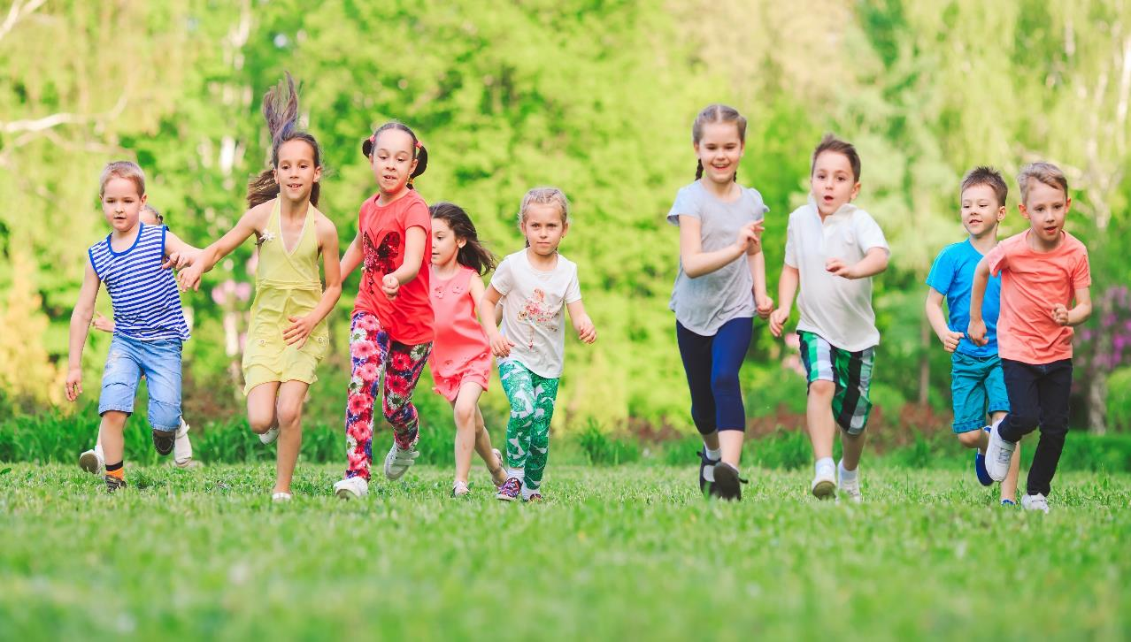
Have a nice day!

