Slide 1

Unit 8: Food
Review& Practice 1
Page 122

Slide 2
Lesson Outline
Warm-up
Reading
Listening
Consolidation
Wrap-up

Slide 3
Objectives
By the end of this lesson, students will be able to…
Vocabulary: Review vocabularies about food.
Listening: Listen to people ask and answer about food.
Reading: Read and answer questions about food.

Slide 4

WARM UP

Slide 5

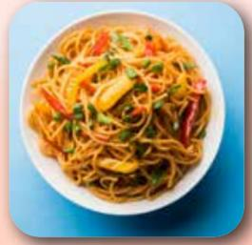
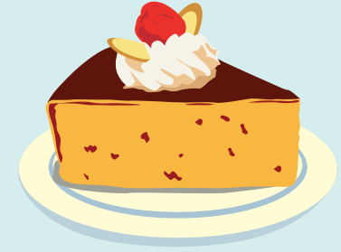
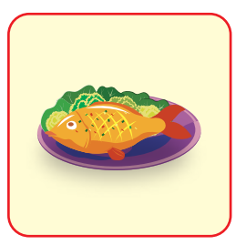


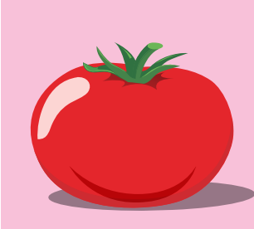
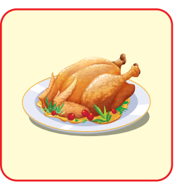

What food do you remember? Click here. There are 8 kinds of food.

Slide 6
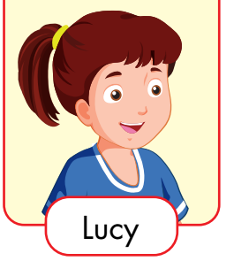
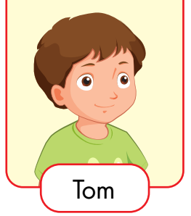
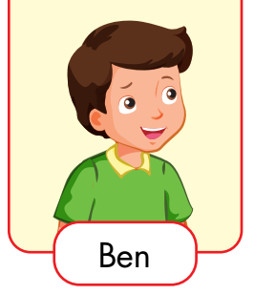
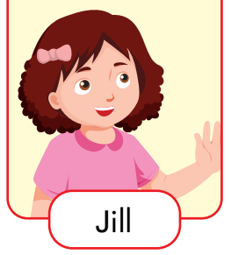
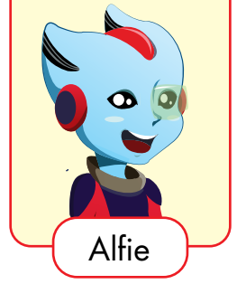
Who is she/ Who is he?

Slide 7

It’s time to learn …

Slide 8

Listening

Slide 9


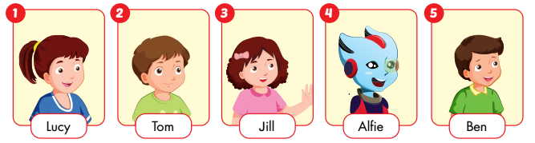
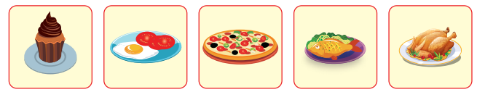
1
2
3
4
5
Click on track 68 to hear the sound
Click on the number to see the answer.
Notes:
Bấm vào: Listen and draw lines để nghe âm thanh

Slide 10
Listen and fill in the blanks:
Mr. Brown: Kids, would you like some food? We have lots of food here.
Lucy:__________________? I love chicken!
Mr. Brown: Yes, there is some chicken.
Lucy: Great!
Is there any chicken

Slide 11
Listen and fill in the blanks:
Mr. Brown: And you, Tom?
Tom:__________________? I want some eggs and tomatoes.
Mr. Brown: Eggs and tomatoes? OK, here you are.
Tom: Thanks!
Are there any eggs

Slide 12
Listen and fill in the blanks:
Mr. Brown: Would you like some pizza, Jill? You love pizza.
Jill:_____________. I really love pizza.
Mr. Brown: OK.
Yes, please

Slide 13
Listen and fill in the blanks:
Mr. Brown: How about you, Alfie? Would you like some pizza too?
Alfie:____________. Is there any fish?
Mr. Brown: Yes, there is some fish.
Alfie:_______________________?
Mr. Brown: OK
No, thanks
Can I have fish please

Slide 14
Listen and fill in the blanks:
Ben: Are there any cupcakes, Dad?
Mr. Brown:_____________________.
Ben: Can I have two cupcakes?
Mr. Brown: Just cupcakes? OK
There are ten cupcakes

Slide 15

Post-Listening

Slide 16
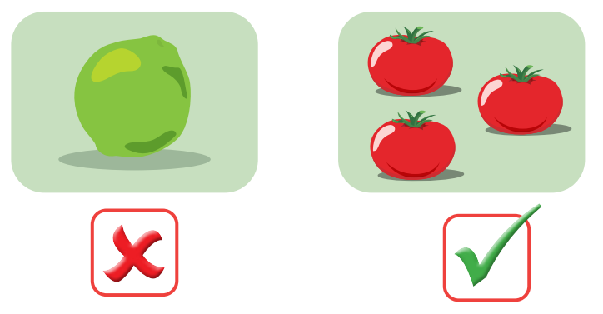
PRACTICE ASKING AND ANSWERING
Student A: Ask:
1. Is there a_____?/
2. Are there any_____?
Student B: Answer:
1. No, there____
2. Yes, There are______

Slide 17
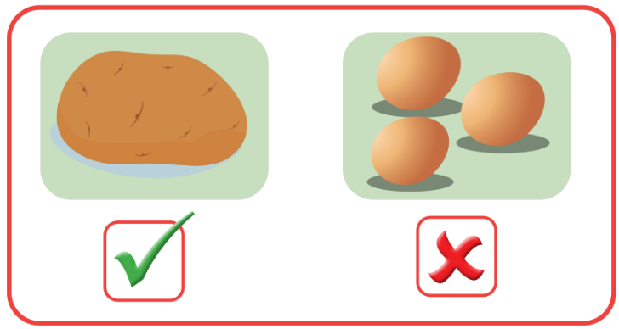
TAKE TURNS ASKING AND ANSWERING.
Student B: Ask:
1. Is there a_____?/
2. Are there any_____?
Student A: Answer:
1. Yes, there ____
2. No, there _____

Slide 18


ASK YOUR FRIEND WHAT FOOD HE/SHE WANTS
Student A: Asks
Student B: Answers

Slide 19

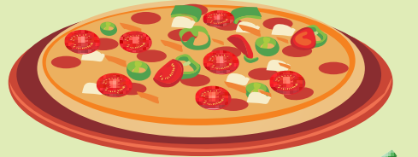
TAKE TURN-ASK YOUR FRIEND WHAT FOOD HE/SHE WANTS
Student B: Asks
Student A: Answers

Slide 20

Reading

Slide 21
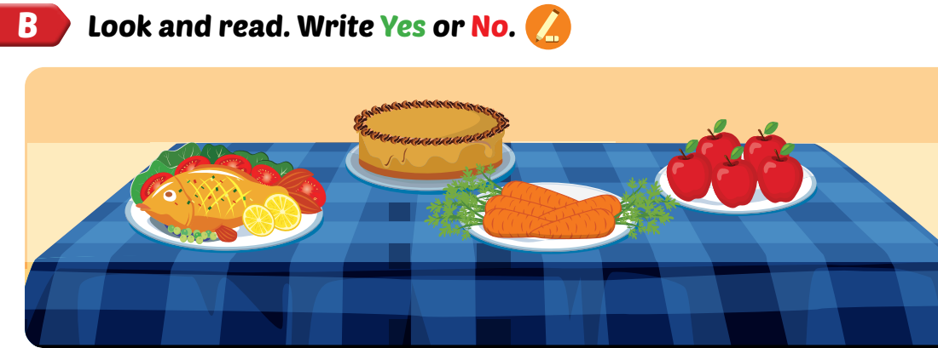

Slide 22
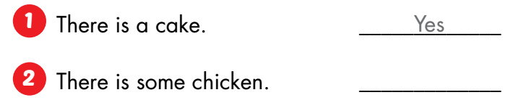
No

Slide 23
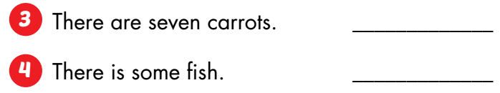
No
Yes

Slide 24
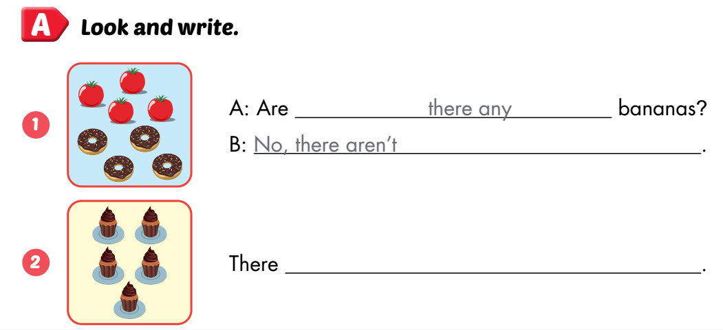
Workbook, p.86
five cupcakes

Slide 25
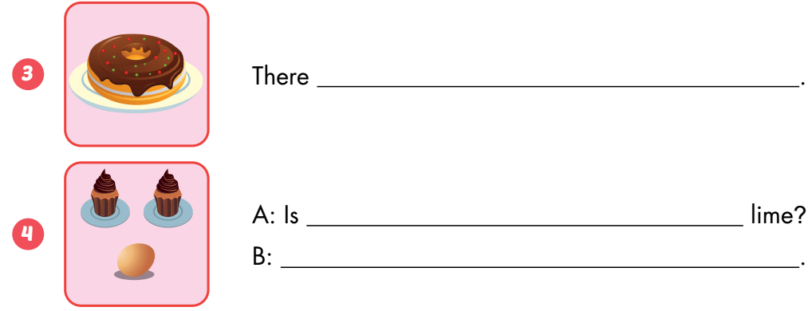
Workbook, p.86
is a donut
there a
No, there isn’t

Slide 26
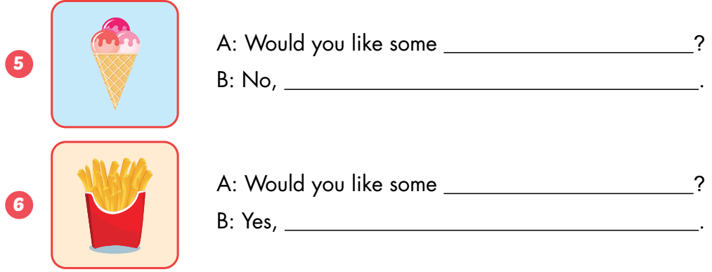
Workbook, p.86
ice cream
thank you
fries
please

Slide 27

CONSOLIDATION

Slide 28
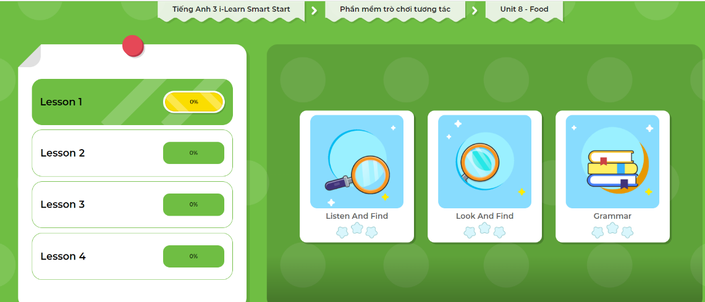
Extra Practice
DHA on Eduhome
LET’S PLAY!
Click on the picture below to play the games.

Slide 29

WRAP-UP

Slide 30
Lesson 3
Today’s lesson
Vocabulary
Review vocabularies about food.
Reading
Read and answer questions about food.
Listening
Listen to people ask and answer about food.

Slide 31
Lesson 3
Homework
Practice the vocabularies and structure; and make sentences using them.
Do the exercises in Tiếng Anh 3 i-Learn Smart Start WB (page 86)
Do the exercises in Tiếng Anh 3 i-Learn Smart Start Notebook (page 56)
Prepare the next lesson (page 123 SB)
Play the consolidation games in Tiếng Anh 3 i-Learn Smart Start DHA App on www.eduhome.com.vn

Slide 32
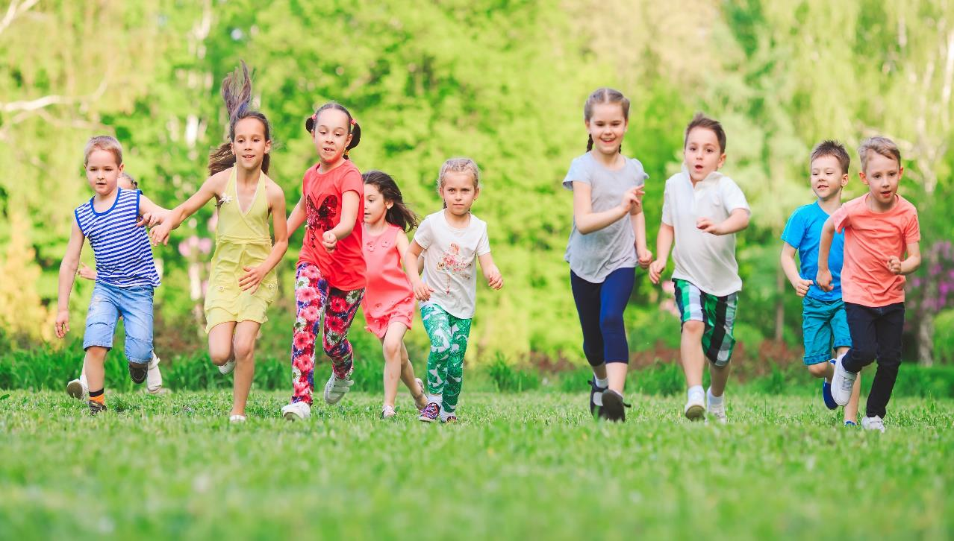
Have a nice day!

