Slide 1

Unit 8: Food
Lesson 4.3
Page 121

Slide 2
Lesson Outline
Warm-up
Reading
Writing
Consolidation
Wrap-up

Slide 3
Objectives
By the end of this lesson, students will be able to…
Reading: Read information about eating in Vietnam.
Writing: Write about eating in students’ house.

Slide 4

WARM UP

Slide 5
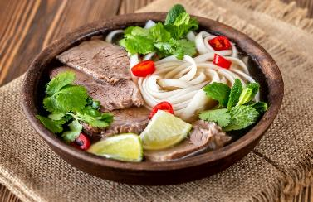
What food is behind these boxes?
Phở

Slide 6
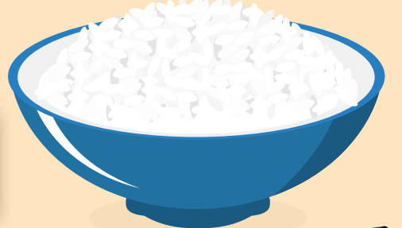
What food is behind these boxes?
Rice
rice

Slide 7
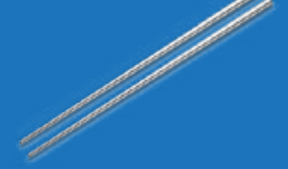
What is behind these boxes?
chopsticks
chopstick

Slide 8

Which country is behind these boxes?
Vietnam

Slide 9

It’s time to learn …

Slide 10

Reading

Slide 11

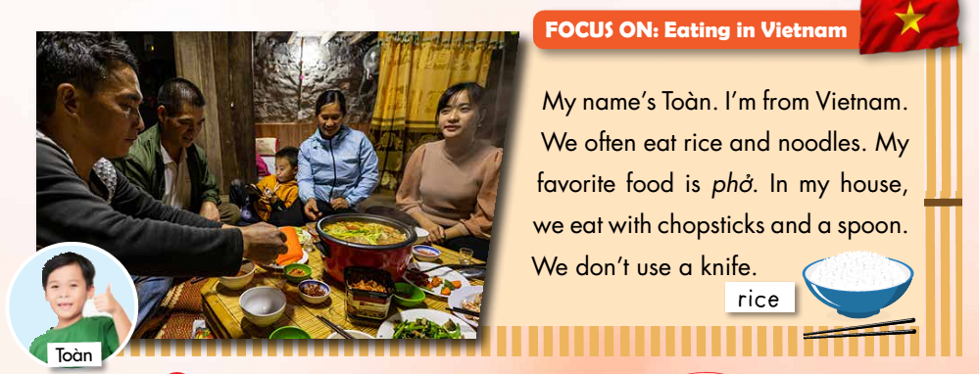

Slide 12
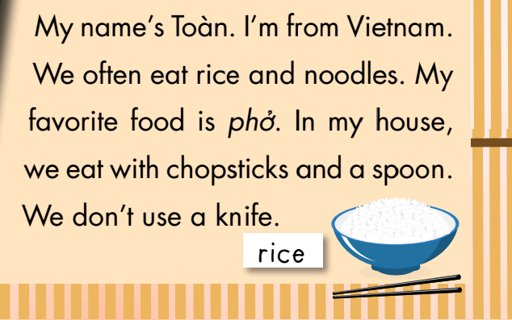


Notes:
Giáo viên hướng dẫn học viên cách làm câu hỏi True False

Slide 13
You have 5 minutes to read and remember the text.

Slide 14
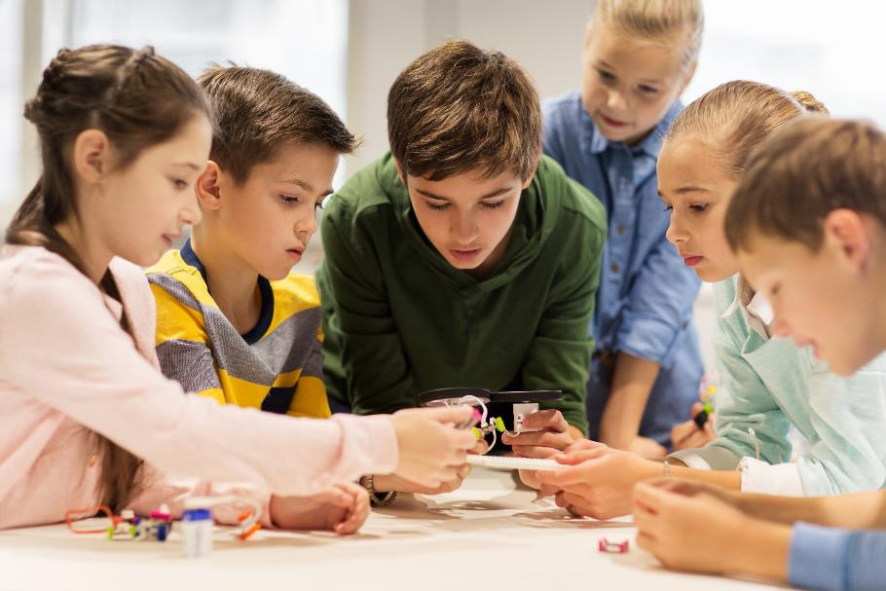
Let’s play a game

Slide 15
Continue the lesson
3
4
2
1
7
8
5
6
The class is divided into 2 groups.
Each group takes turn to choose the star.
Teacher click on each star chosen by students. Students answer the questions. If they have the correct answer, they earn the points for each question.
There is one lucky and one unlucky star
LUCKY STAR

Slide 16
They often eat steak.
TRUE
FALSE
10 POINT

Slide 17
They don’t eat noodles.
TRUE
FALSE
15 POINT

Slide 18

CONGRATULATION. YOU EARN 30 POINTS

Slide 19
His favorite food is phở.
TRUE
FALSE
10 POINT

Slide 20
They eat with chopsticks.
TRUE
FALSE
15 POINT

Slide 21

OH, NO.YOU LOSE 20 POINTS

Slide 22
They don’t use a spoon.
TRUE
FALSE
10 POINT

Slide 23
They use a knife.
TRUE
FALSE
15 POINT

Slide 24

Writing

Slide 25
Matching – click on each box on the left to see the answer.
Pre-Writing
My favorite food is____
eat pizza
I don’t use a____
chopsticks
I eat fish with____
fork
I often _____
noodles

Slide 26

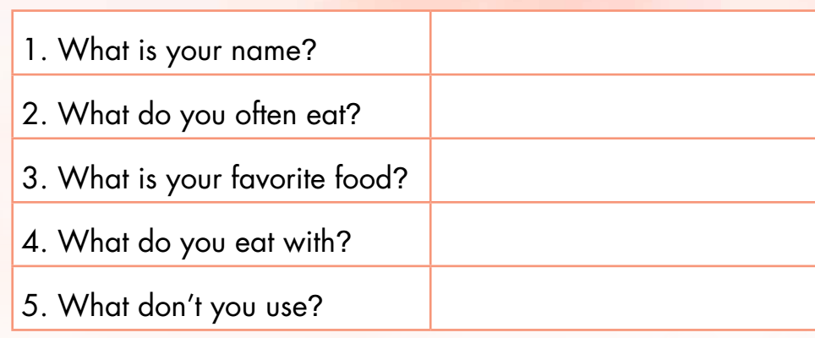
Answer the questions about you.

Slide 27
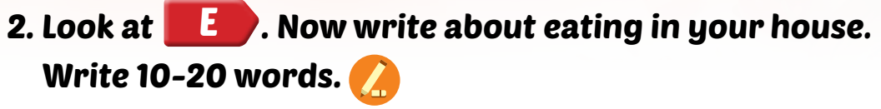



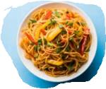

Slide 28

Hello, my name is……..I’m from……………………………………………………………………………………………………………………………………………………………………………………………………………..

Slide 29

CONSOLIDATION

Slide 30
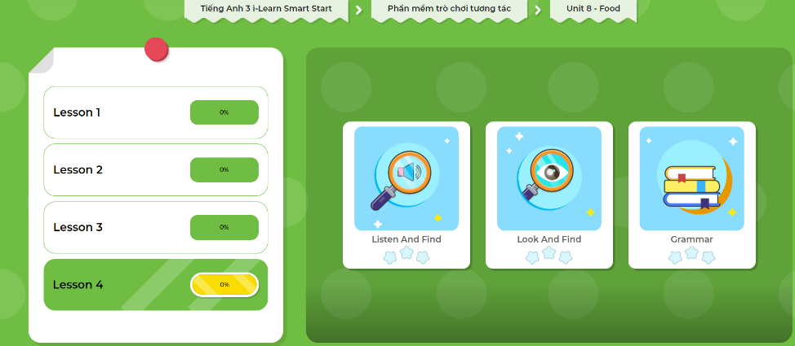
Extra Practice
DHA App
LET’S PLAY!
Click here to play the games

Slide 31

WRAP-UP

Slide 32
Lesson 3
Today’s lesson
Reading
Eating in Vietnam
Writing
Students’ eating at home

Slide 33
Lesson 3
Homework
Practice the vocabularies and structure; and make sentences using them.
Do the exercises in Tiếng Anh 3 i-Learn Smart Start WB (page 85)
Do the exercises in Tiếng Anh 3 i-Learn Smart Start Notebook (page 55)
Prepare the next lesson (page 122 SB)
Play the consolidation games in Tiếng Anh 3 i-Learn Smart Start DHA App on www.eduhome.com.vn

Slide 34

Enjoy your day!

