Slide 1

Unit :8 Food
Lesson 4.2
Page 120

Slide 2
Lesson Outline
Warm-up
Reading
Listening
Consolidation
Wrap-up

Slide 3
Objectives
By the end of this lesson, students will be able to…
Reading: Read to know about eating in the USA.
Listening: Listen to friends talking about food.

Slide 4

WARM UP

Slide 5
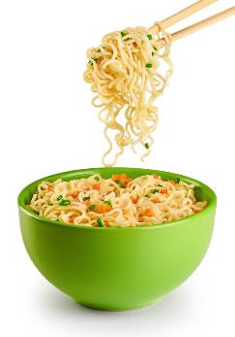
What do you see?
noodles
is
My favorite food
Answer: My favorite food is noodles.
Notes:
Click vào ô”what do you see” để chữ chạy ra 2 lần. Sau khi chữ chạy ra 2 lần, click choột để ra kết quả

Slide 6
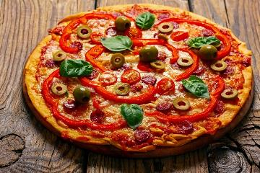
What do you see?
pizza
I often
eat
I often eat pizza.
Notes:
Click vào ô”what do you see” để chữ chạy ra 1 lần (do chữ đơn nên chạy 1 lần). Rồi click chuột sẽ ra đáp án

Slide 7
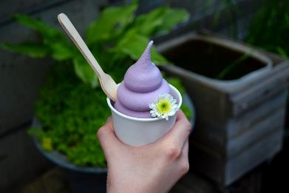
What do you see?
Ice cream
with a spoon
We eat
We eat ice cream with a spoon.
Notes:
Click vào ô”what do you see” để chữ chạy ra 1 lần (do chữ đơn nên chạy 1 lần). Rồi click chuột sẽ ra đáp án

Slide 8
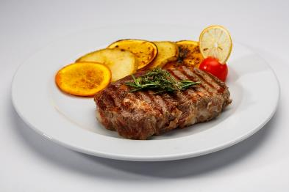
What do you see?
steak
steak
Notes:
Click vào ô”what do you see” để chữ chạy ra 1 lần (do chữ đơn nên chạy 1 lần). Rồi click chuột sẽ ra đáp án

Slide 9
What do you see?
a fork, a knife & a spoon
a fort, a knife & a spoon
Notes:
Click vào ô”what do you see” để chữ chạy ra 1 lần (do chữ đơn nên chạy 1 lần). Rồi click chuột sẽ ra đáp án

Slide 10

It’s time to learn …

Slide 11

Reading

Slide 12

Pre-reading
Which country is it?

Slide 13

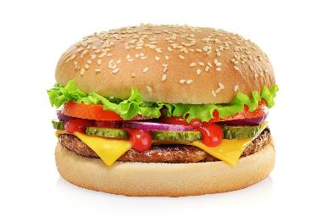
Pre-reading
What do people in America usually eat?

Slide 14
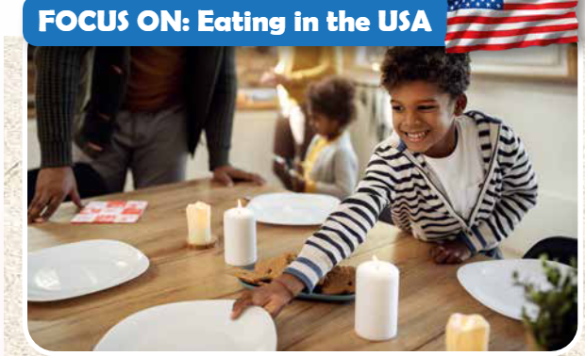
Pre- Reading
Where is he from?
He’s from America/ the USA.

Slide 15
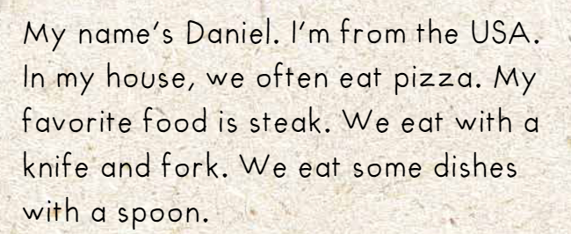
While-Reading

Slide 16

Choose the correct answer.

Slide 17
Choose the correct answer.

Slide 18

Choose the correct answer.

Slide 19

Choose the correct answer

Slide 20
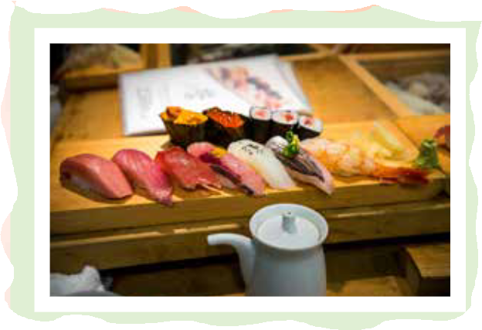
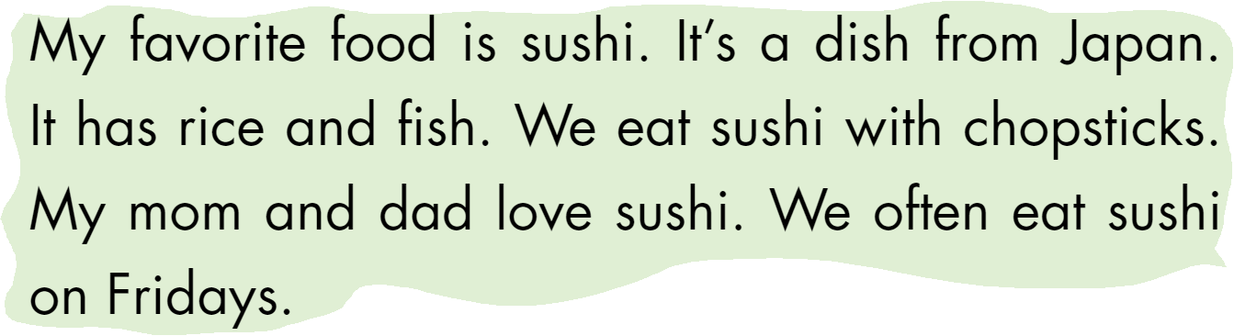
Extra Practice
Workbook- P. 84

Slide 21
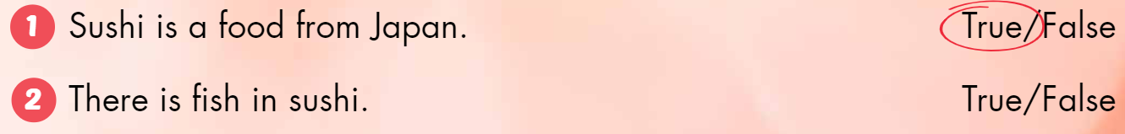
Choose the correct answer.

Slide 22
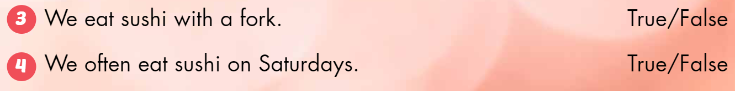
Choose the correct answer

Slide 23

Listening

Slide 24



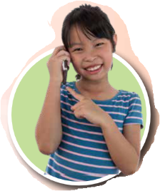
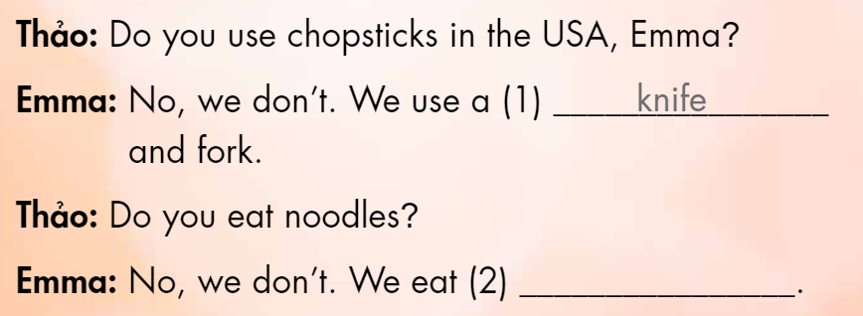
Listen and fill in the blank.
steak
Notes:
Click vào:Look and listen để nghe âm thanh

Slide 25

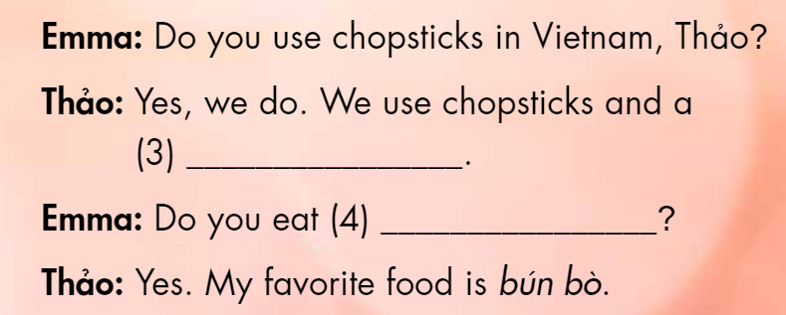
Listen and fill in the blank.
spoon
noodles

Slide 26

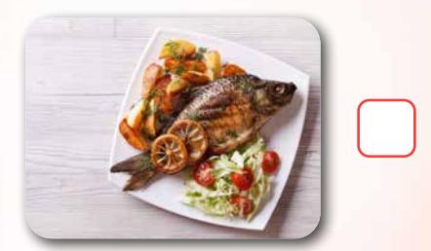
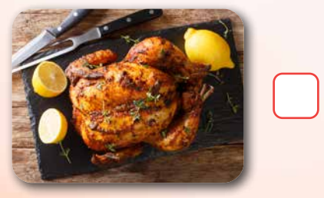
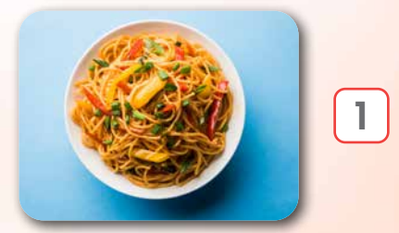
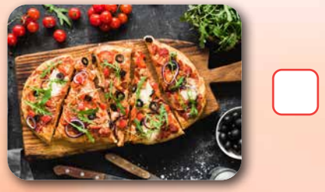
Workbook, p.85
3
4
Click on each picture to see the answer
2

Slide 27

CONSOLIDATION

Slide 28
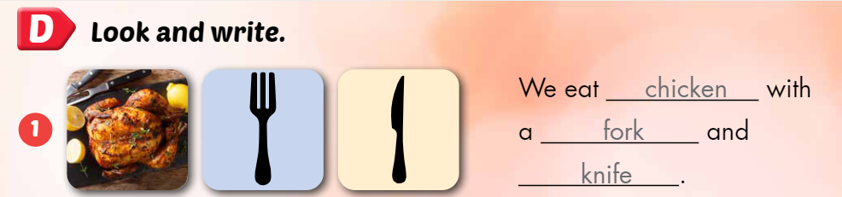
Workbook-p.85

Slide 29
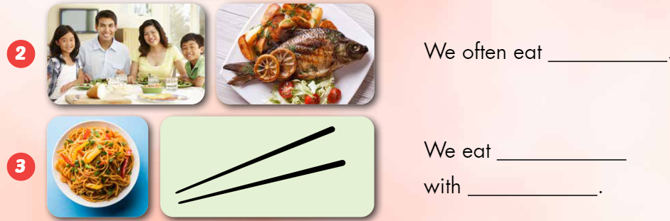
fish
noodles
chopsticks

Slide 30
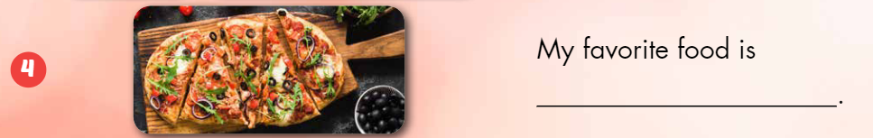
pizza

Slide 31
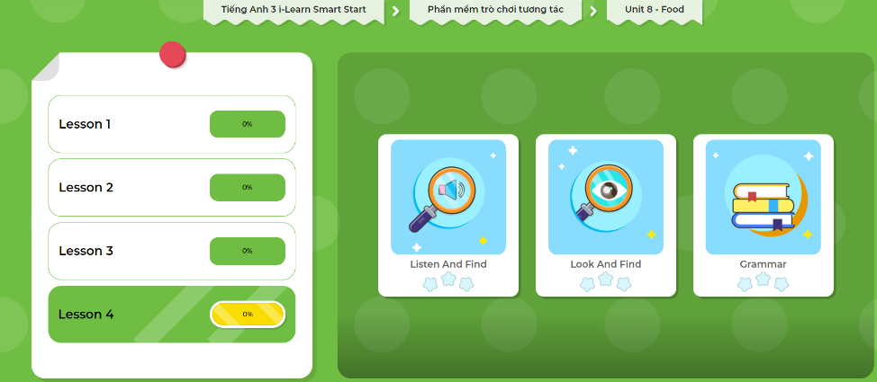
Extra Practice
DHA App
LET’S PLAY!
Click here to play the games

Slide 32
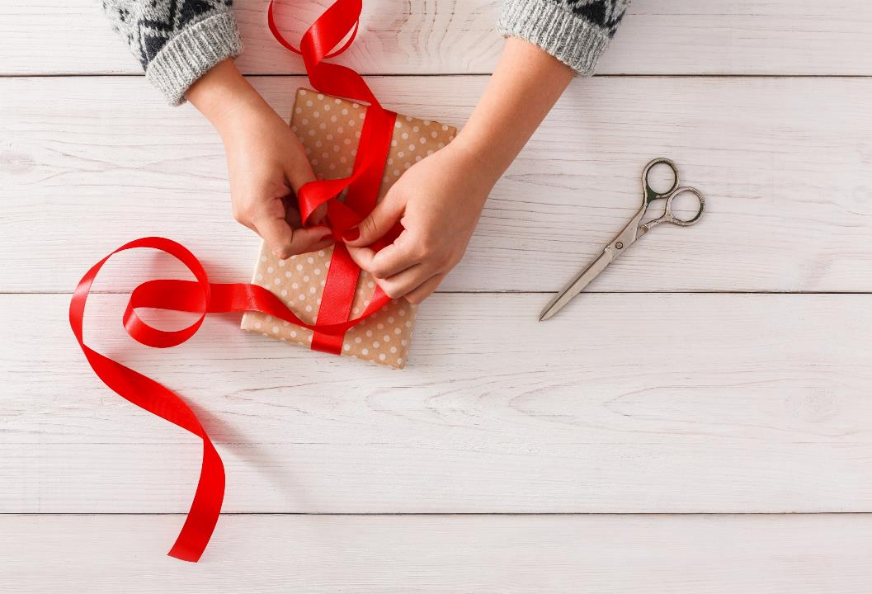
WRAP-UP

Slide 33
Lesson 3
Today’s lesson
Reading
Read to know about eating in the USA
Listening
Listen to friends talking about food.

Slide 34
Lesson 3
Homework
Practice the vocabularies and structure; and make sentences using them.
Do the exercises in Tiếng Anh 3 i-Learn Smart Start WB (page 85)
Do the exercises in Tiếng Anh 3 i-Learn Smart Start Notebook (page 55)
Prepare the next lesson (page 121 SB)
Play the consolidation games in Tiếng Anh 3 i-Learn Smart Start DHA App on www.eduhome.com.vn

Slide 35
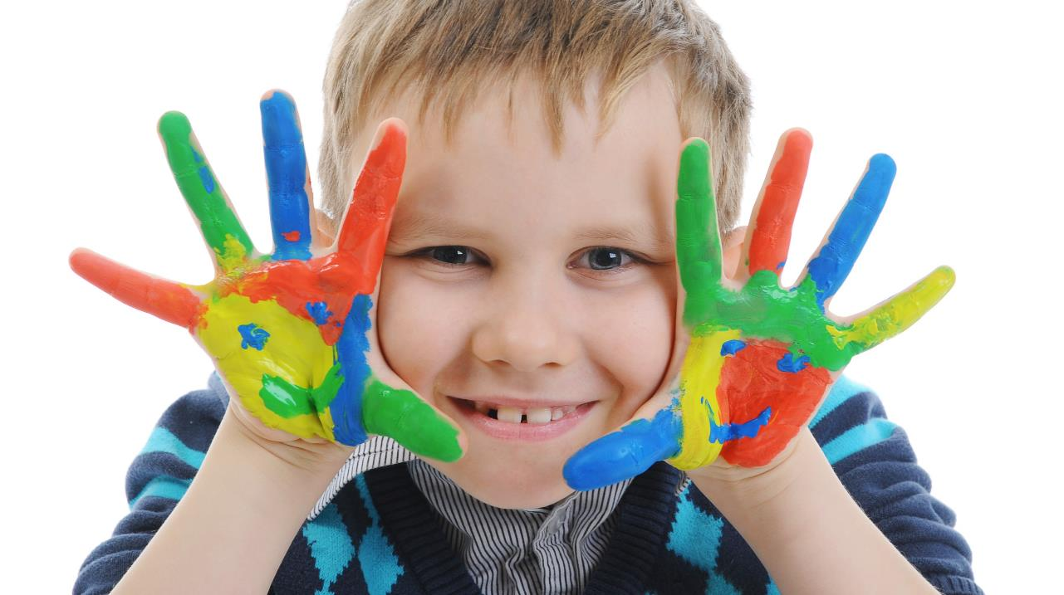
Enjoy your day!

