Slide 1

Unit 8: FOOD
Lesson 3.2
Page 117

Slide 2
Lesson Outline
Warm-up
Listening
Consolidation
Wrap-up

Slide 3
Objectives
By the end of this lesson, students will be able to…
Phonics: Pronounce /aɪ/ and /ʊə/ correctly.
Structure: Review: Would you like some fries?
Yes, please./Sure, thanks!
No, thank you.
Listen: Listen to friends talking about food choice at a party.
Practice: Practice the conversations with friends.

Slide 4

WARM UP

Slide 5
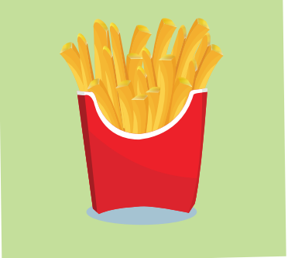
What is behind these beautiful squares?
fries
Click on each square

Slide 6
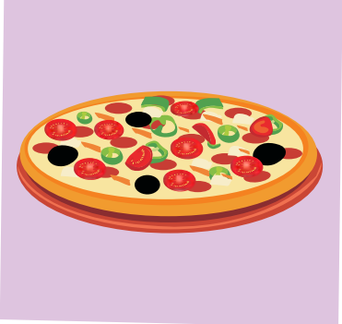
What is behind these beautiful squares?
pizza
Click on each square

Slide 7
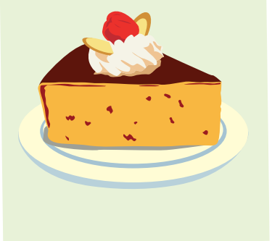
What is behind these beautiful square?
cake
Click on each square

Slide 8

What is behind these beautiful squares?
ice cream
Click on each square

Slide 9
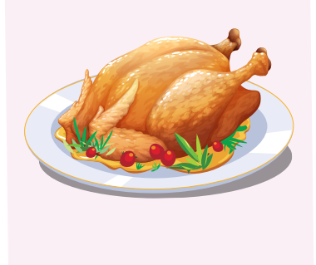
What is behind these beautiful squares?
chicken
Click on each square

Slide 10

It’s time to learn …

Slide 11

Phonics
/aɪ/
/ʊə/

Slide 12
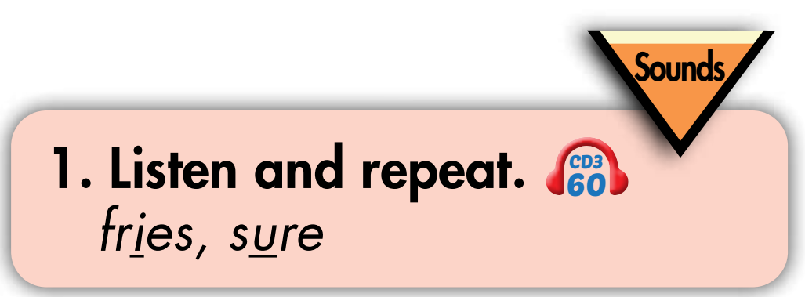


Slide 13
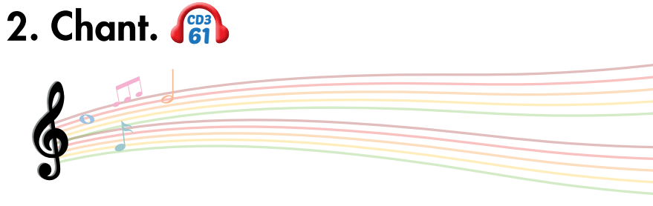
/aɪ/, /ʊə/, /aɪ/, /aɪ/, /ʊə/, /aɪ/,
fries, sure,
/aɪ/, /ʊə/, /aɪ/.
(x2)

Slide 14

Listening

Slide 15
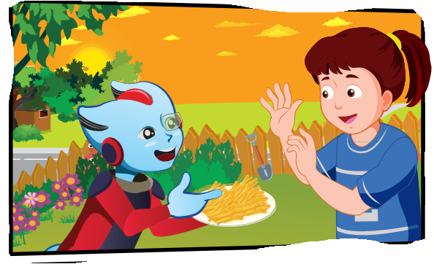
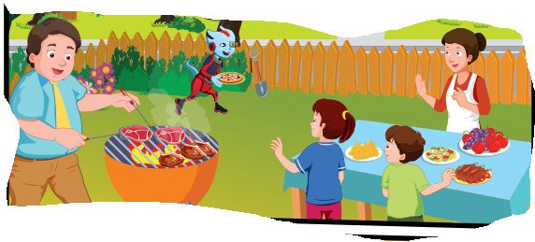
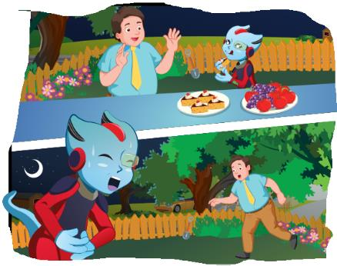
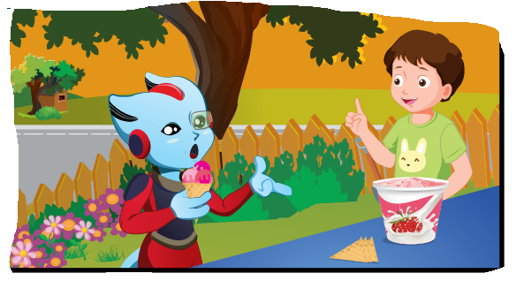
BEFORE LISTENING
LOOK

Slide 16


BEFORE LISTENING
What food can you see?
fries
meat
Ice cream
apples
cake
pizza
carrots
onion

Slide 17
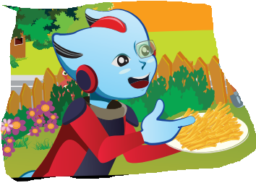
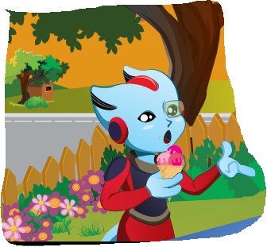
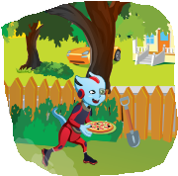
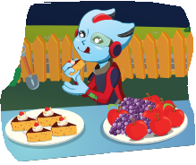
BEFORE LISTENING
What does Alfie eat?
fries
meat
apples
Ice cream
cake
pizza

Slide 18
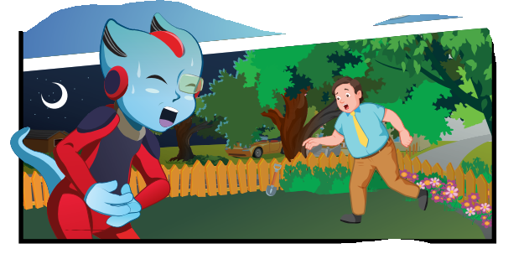
BEFORE LISTENING
What’s the matter with Alfie?
He has a stomachache.

Slide 19

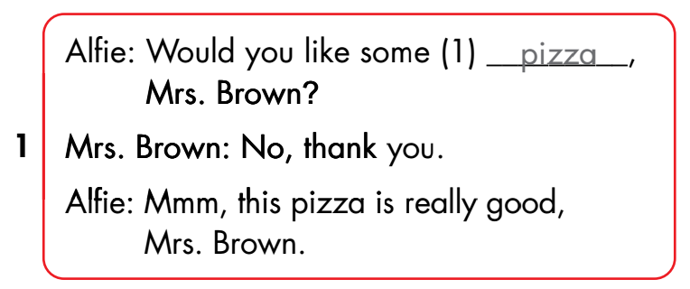
Click on the number to play the audio

Slide 20
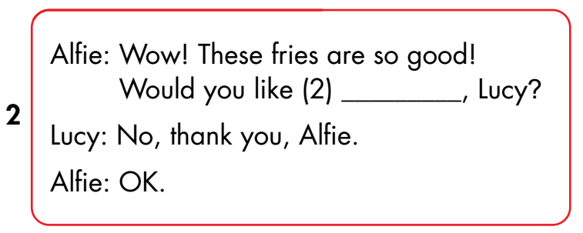
some fries
Click on the number to play the audio

Slide 21
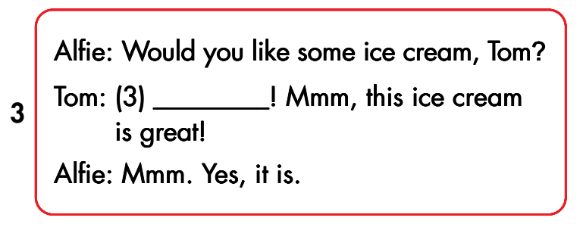
Yes, please
Click on the number to play the audio

Slide 22
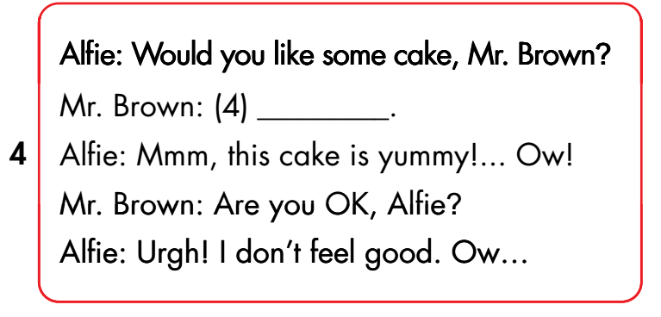
Click on the number to play the audio
No, thank you

Slide 23

Extra practice

Slide 24

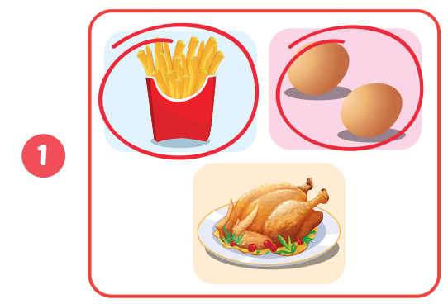
Wordbook, p.83
Click on the picture to play the audio

Slide 25
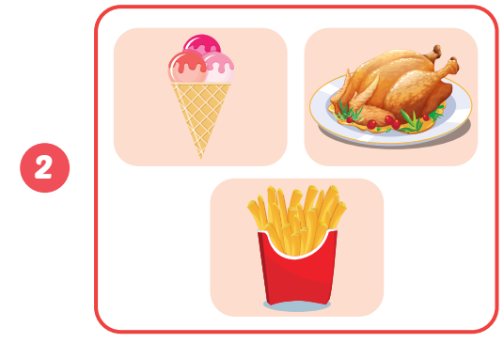
Wordbook, p.83
Click on the picture to play the audio

Slide 26
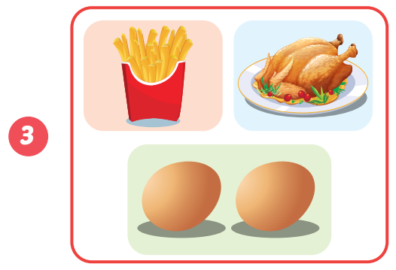
Wordbook, p.83
Click on the picture to play the audio

Slide 27
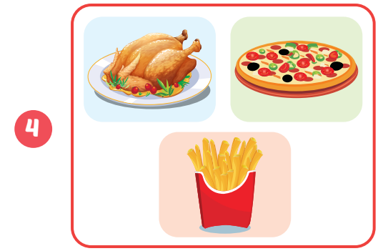
Wordbook, p.83
Click on the picture to play the audio

Slide 28

AFTER LISTENING
Wordbook, p.83
Let’s write

Slide 29
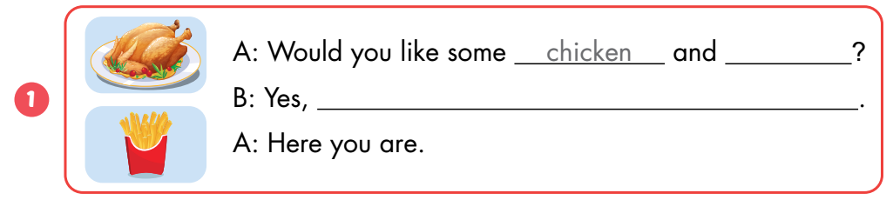
fries
please

Slide 30
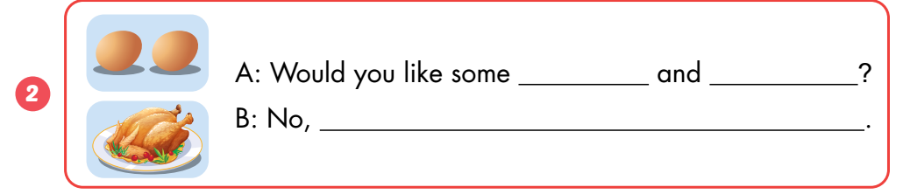
eggs
chicken
Thank you

Slide 31
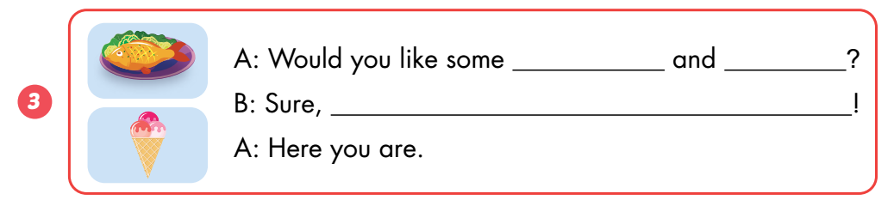
fish
ice cream
thanks

Slide 32
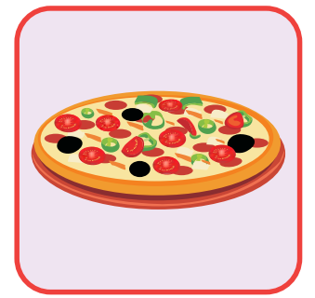
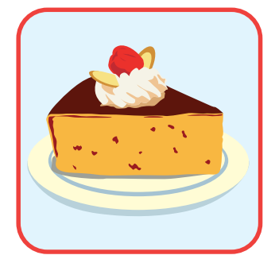

Which food do you hear?
Notes:
Click on yellow shape to hear the sound

Slide 33


Which food do you hear?

Slide 34
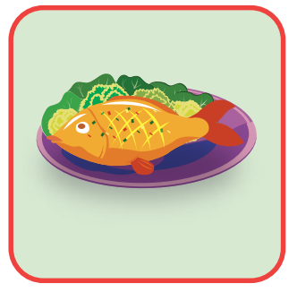
Which food do you hear?
Notes:
Click on yellow shape to hear the sound

Slide 35
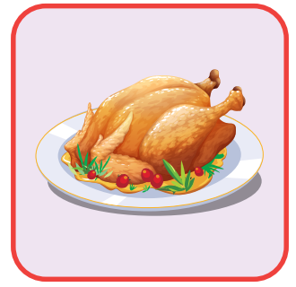

Which food do you hear?
Notes:
Câu 4 cắt”would you like some cake

Slide 36
Rearrange these words to make a complete sentence.
you pizza Would some like?
Would you like some pizza?

Slide 37
Rearrange these words to make a complete sentence
good is pizza really This
This pizza is really good.

Slide 38
Rearrange these words to make a complete sentence
fries good These so are
These fries are so good!

Slide 39
Rearrange these words to make a complete sentence
ice cream you Would some like?
Would you like some ice cream

Slide 40



Slide 41
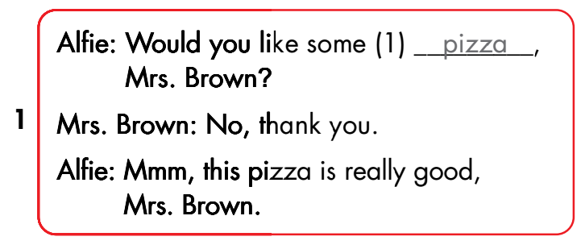

Slide 42
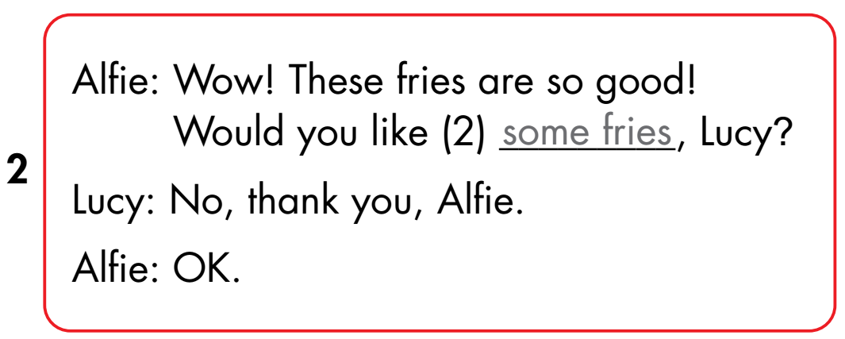

Slide 43
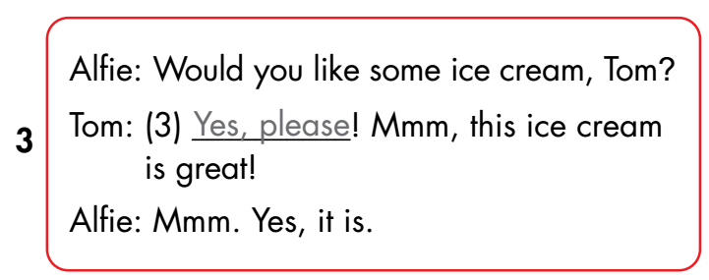

Slide 44
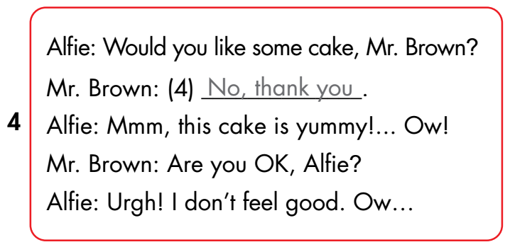

Slide 45

CONSOLIDATION

Slide 46
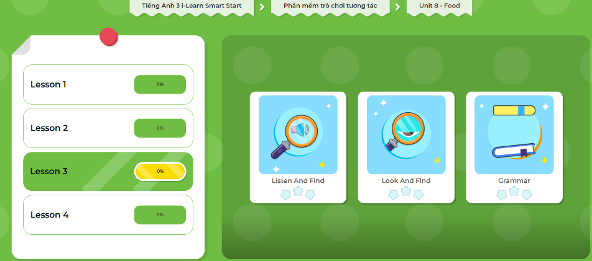
Extra Practice
DHA App
LET’S PLAY!
Click here to play the games

Slide 47
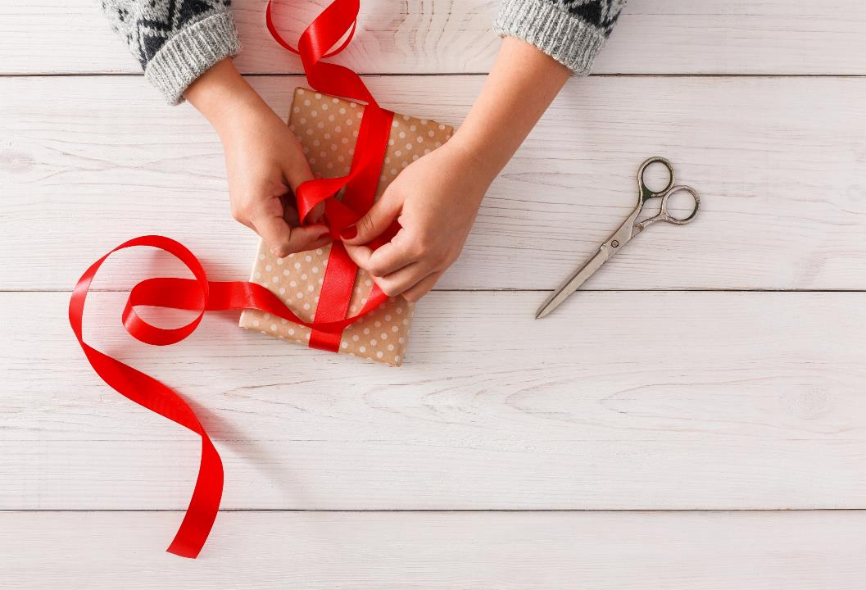
WRAP-UP

Slide 48
Today’s lesson
Sentence patterns
Would you like some fries?
Yes, please/Sure, thanks!
No, thank you.
Phonics:
/aɪ/ and /ʊə/
Listening
Listen to friends talking about food choice at a party.

Slide 49
Homework
Practice the vocabularies and structure; and make sentences using them.
Do the exercises in Tiếng Anh 3 i-Learn Smart Start WB (page 83)
Prepare the next lesson (page 118 SB)
Play the consolidation games in Tiếng Anh 3 i-Learn Smart Start DHA App on www.eduhome.com.vn

Slide 50
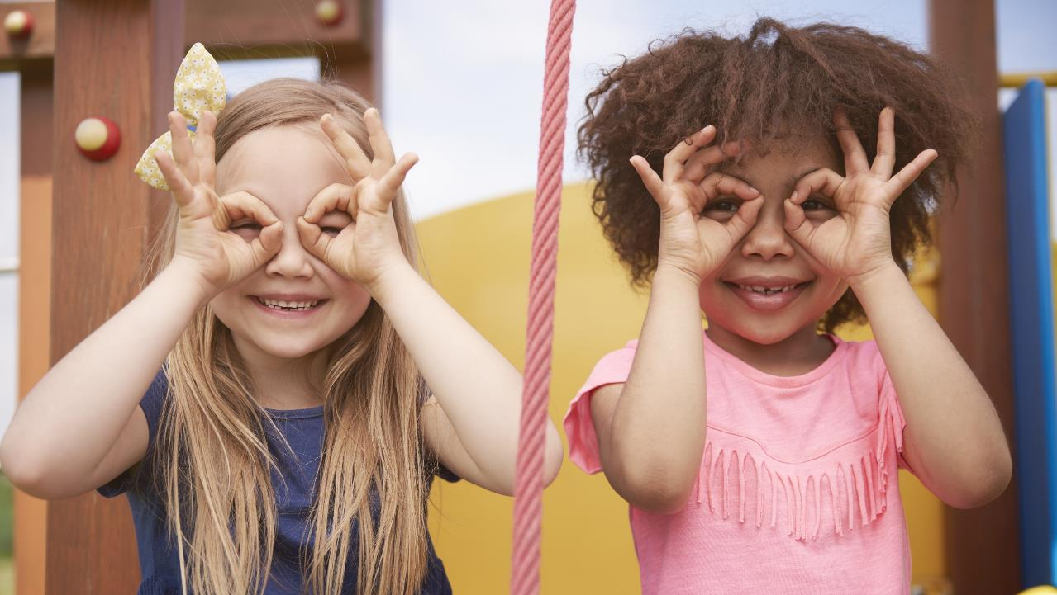
Enjoy your day!

