Slide 1

Unit 6: Clothes
Review & Practice 1
Page 94

Slide 2
Lesson Outline
Warm-up
Listening
Reading
Consolidation
Wrap-up

Slide 3
Objectives
By the end of this lesson, students will be able to review talking about what clothes they want, talking about what they're wearing, and asking and answering about their clothes.
Vocabulary: Review vocabularies about clothes.
Listening: Listen to people ask and answer about clothes.
Reading: Read and answer questions about what they are wearing, about their clothes.

Slide 4

WARM UP

Slide 5






WORDSNAKE
Look and find 5 words about clothes.
socbootstenkym
pajamask
anfdressallb
sweaterdnvoll
hunifromfr
Click on the number to check the answers.
◆
❖
⬥


Click on the animal to show the answers.
Notes:
Click vào dấu mũi tên sau khi thực hiện xong trò chơi

Slide 6
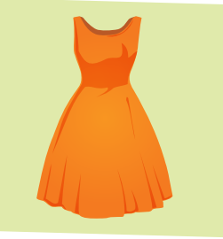

Click on the picture to see the word.
dress
Click here to return to the game.

Slide 7

Click on the picture to see the word.
boots
Click here to return to the game.

Slide 8
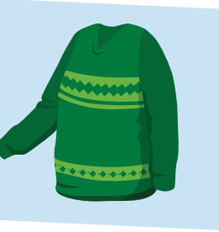
Click on the picture to see the word.
sweater
Click here to return to the game.

Slide 9

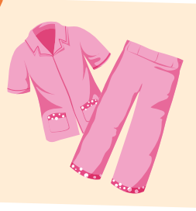
Click on the picture to see the word.
pajamas
Click here to return to the game.

Slide 10

Click on the picture to see the word.
uniform
Click here to return to the game.

Slide 11

It’s time to learn …

Slide 12

Listening

Slide 13

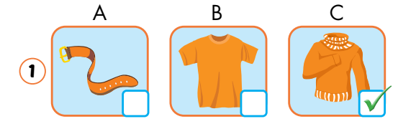
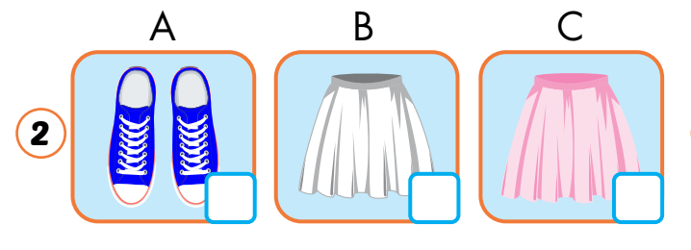

Click on the earphone to hear the sound.

Slide 14
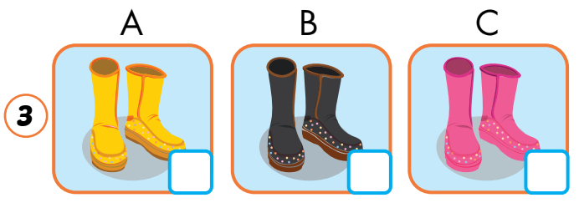
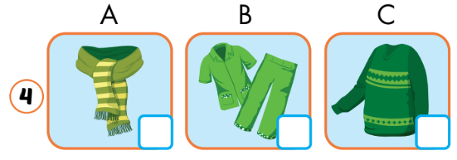
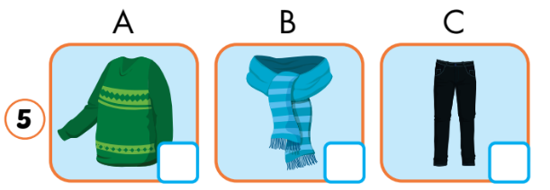
Click on the earphone to hear the sound.

Slide 15
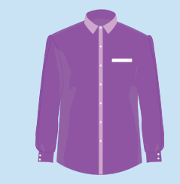

ASK YOUR FRIEND Is that/Are those yours clothes?
Student A: Asks
Student B: Answers

Slide 16


ASK YOUR FRIEND Is that/Are those yours clothes?
Student B: Asks
Student A: Answers

Slide 17

ASK YOUR FRIEND Is that/Are those yours clothes?
Student B: Asks
Student A: Answers

Slide 18
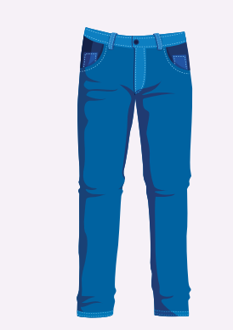
ASK YOUR FRIEND Is that/Are those yours clothes?
Student A: Asks
Student B: Answers

Slide 19

Reading

Slide 20
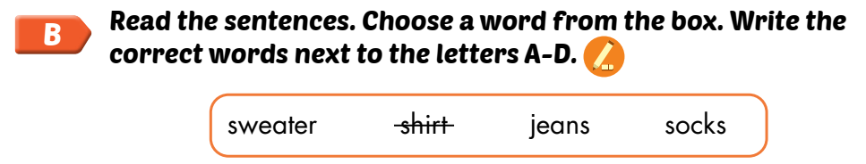
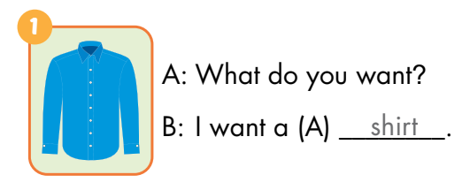
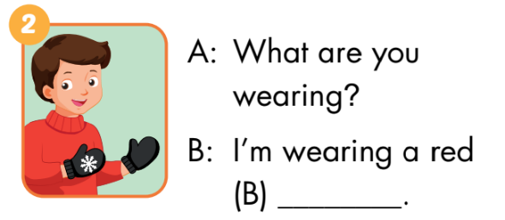
shirt
sweater

Slide 21
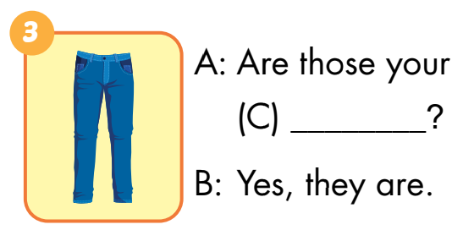
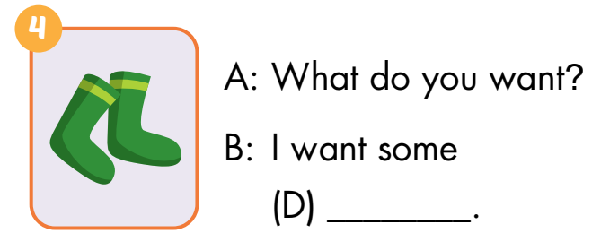
jeans
socks

Slide 22

Workbookp.66

Slide 23



boots
Pajamas

Slide 24


scarf
sweater

Slide 25


jeans
jacket

Slide 26

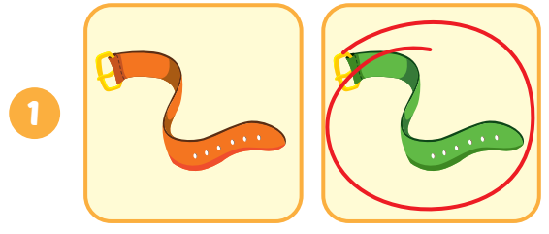
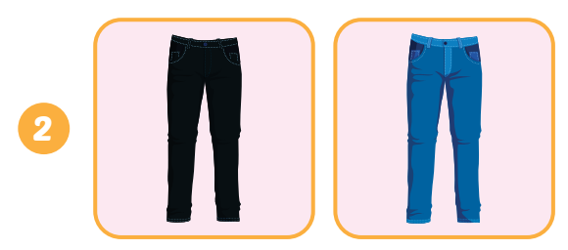
Click on the earphone to hear the sound.

Slide 27
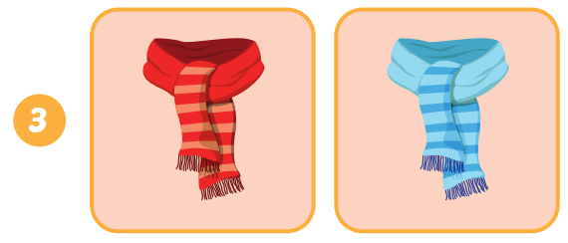
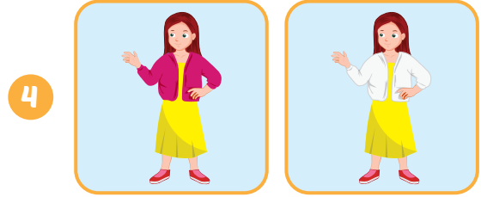
Click on the earphone to hear the sound.

Slide 28

CONSOLIDATION

Slide 29
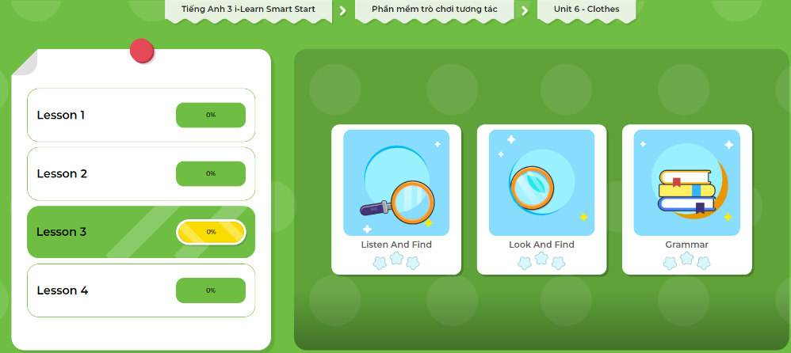
Extra Practice
DHA App
LET’S PLAY!
Click here to play the games

Slide 30

WRAP-UP

Slide 31
Lesson 3
Today’s lesson
Vocabulary
Review vocabularies about food.
Reading
Read and answer questions about food.
Listening
Listen to people ask and answer about food.

Slide 32
Lesson 3
Homework
Practice the vocabularies and structure; and make sentences using them.
Do the exercises in Tiếng Anh 3 i-Learn Smart Start WB (page 66).
Do the exercises in Tiếng Anh 3 i-Learn Smart Start Notebook (page 44).
Prepare the next lesson (page 95 SB).
Play the consolidation games in Tiếng Anh 3 i-Learn Smart Start DHA App on www.eduhome.com.vn

Slide 33
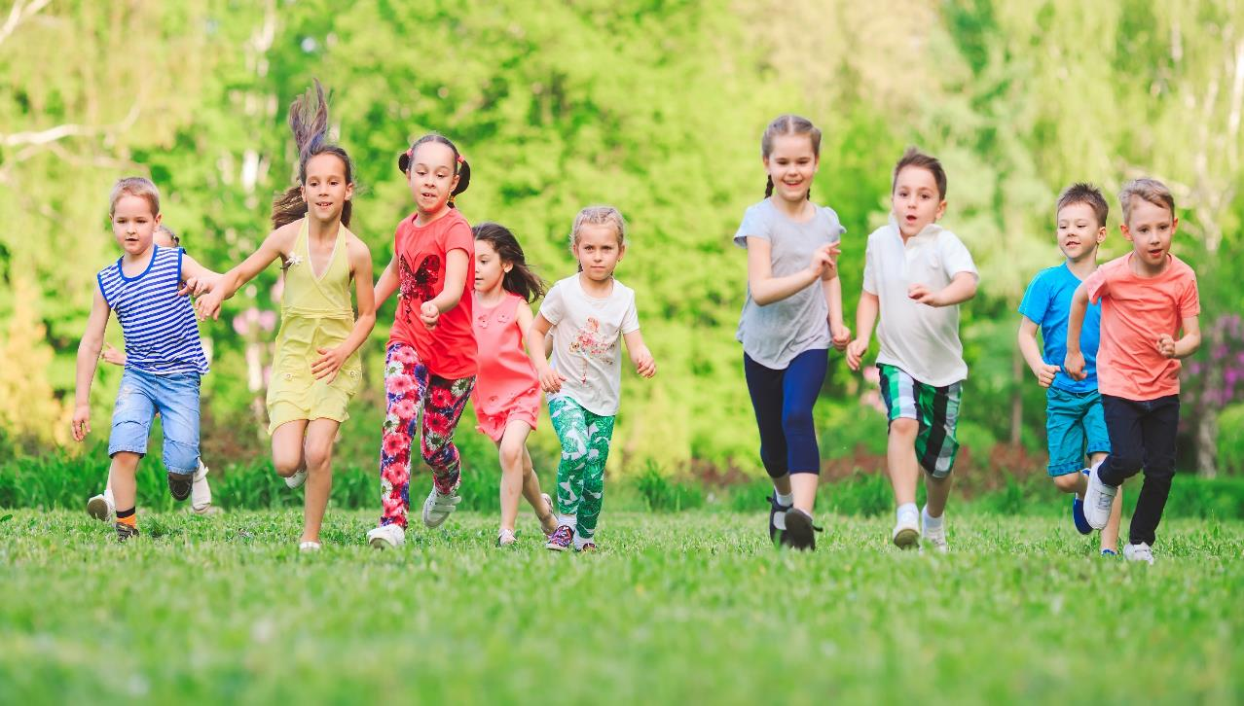
Have a nice day!

