Slide 1

Unit 6: Clothes
Lesson 4.2
Page 92

Slide 2
Lesson Outline
Warm-up
Reading
Listening
Consolidation
Wrap-up

Slide 3
Objectives
By the end of this lesson, students will be able to talk about their school uniforms and read a paragraph about them.
Vocabulary: Uniform, polo shirt, sneakers, tie.
Structure: What do you wear at school?
I wear a blue tie.
Do you like your uniform?
Yes, I do.

Slide 4

WARM UP

Slide 5
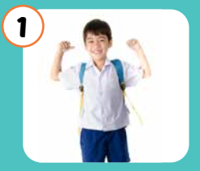
u
n f o r
m
i

Slide 6
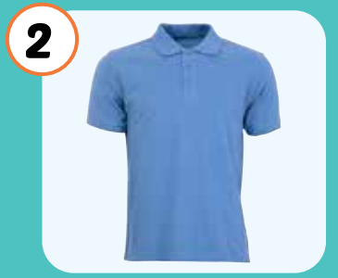
o l h i r t
p
o
s

Slide 7
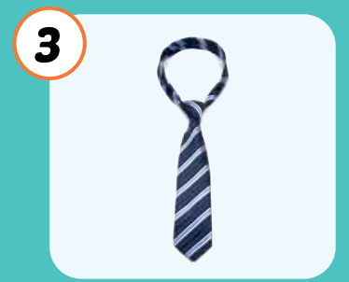
t i
e

Slide 8
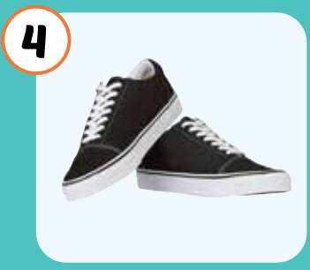
n a k e r
s
e
s

Slide 9

It’s time to learn …

Slide 10

Reading

Slide 11

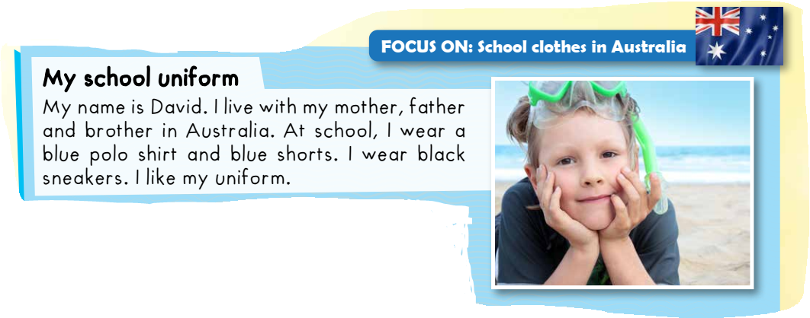


Slide 12


Slide 15

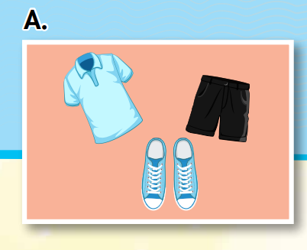
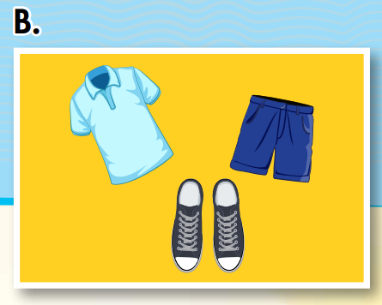
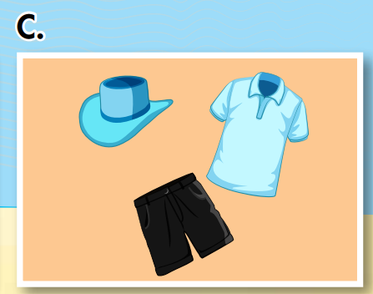
At school, I wear a blue polo shirt and black shorts. I wear blue sneakers. I like my uniform.

Slide 16

Listening

Slide 17




Slide 18

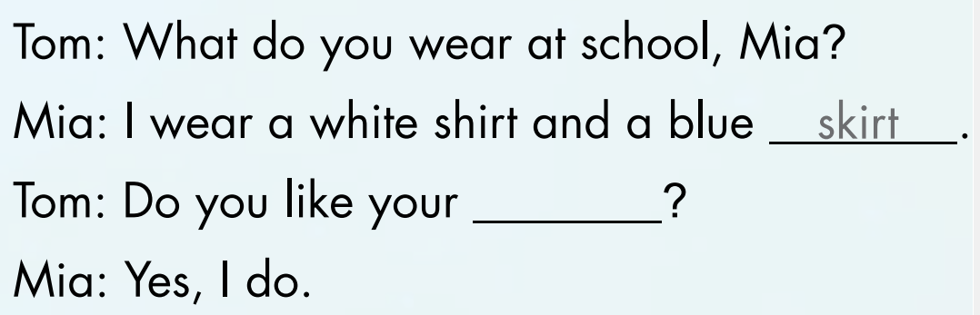
skirt
uniform

Slide 19
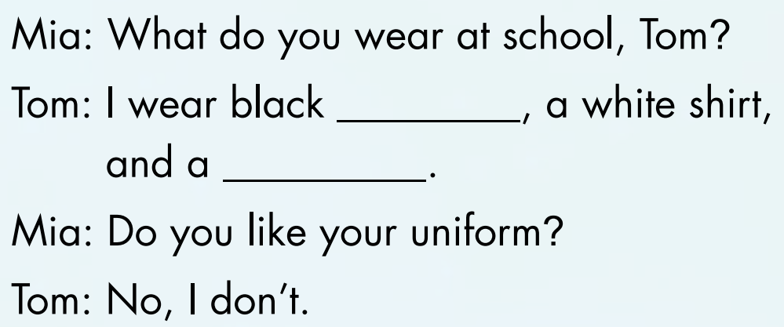
trousers
tie

Slide 20

Tom: What do you wear at school, Mia? Mia: I wear a white shirt and a blue skirt. Tom: Do you like your uniform? Mia: Yes, I do.

Slide 21
Tom: Waht do yuo wrea at scoohl, Mia? Mia: I wera a wihet shrit and a bule skrit. Tom: Do you leki your unofirm? Mia: Yes, I do.

Slide 22
Mia: What do you wear at school, Tom?
Tom: I wear black trousers, a white shirt,
and a tie.
Mia: Do you like your uniform?
Tom: No, I don’t.

Slide 23
Mia: What do you wear at school, Tom?
Tom: I wear black trousers, a white shirt,
and a tie.
Mia: Do you like your uniform?
Tom: No, I don’t.

Slide 24

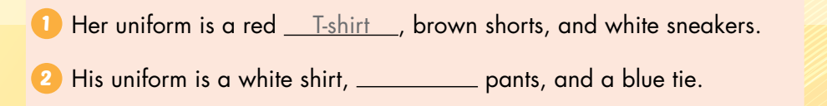
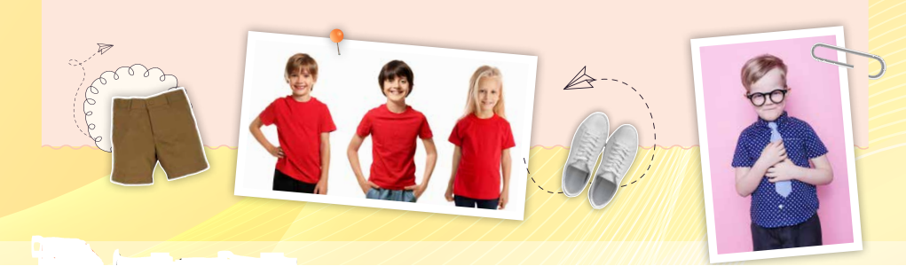
T-skirt
black

Slide 25
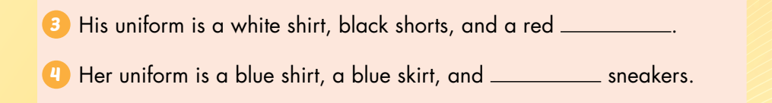
tie
red

Slide 26

CONSOLIDATION

Slide 27

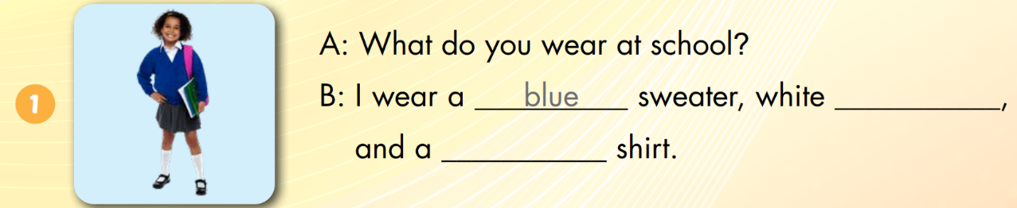
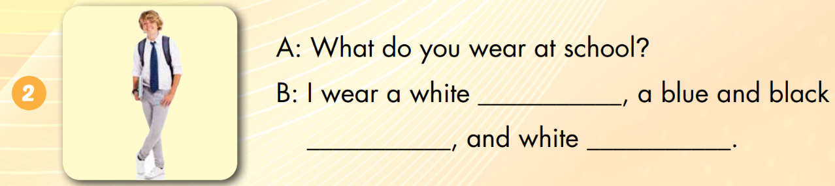
blue
socks
white
skirt
tie
sneakers

Slide 28
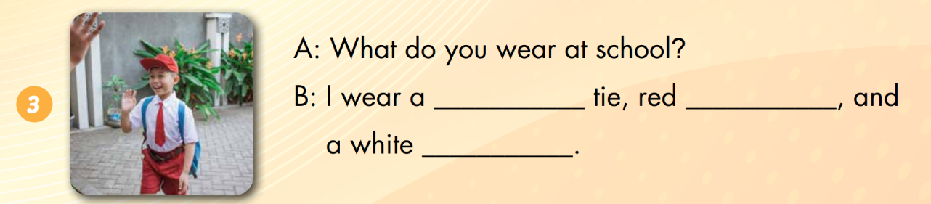
tie
socks
skirt

Slide 29

WRAP-UP

Slide 30
Lesson 3
Today’s lesson
Vocabularies
Uniform,
polo shirt,
Sneakers,
Tie.
Structures/ Sentence patterns
What do you wear at school?
I wear a blue tie.
Do you like your uniform?
Yes, I do.

Slide 31
Lesson 3
Homework
Practice the vocabularies and structure; and make sentences using them.
Do the exercises in Tiếng Anh 3 i-Learn Smart Start WB (page 65).
Prepare the next lesson (page 93 SB).
Play the consolidation games in Tiếng Anh 3 i-Learn Smart Start DHA App on www.eduhome.com.vn

Slide 32
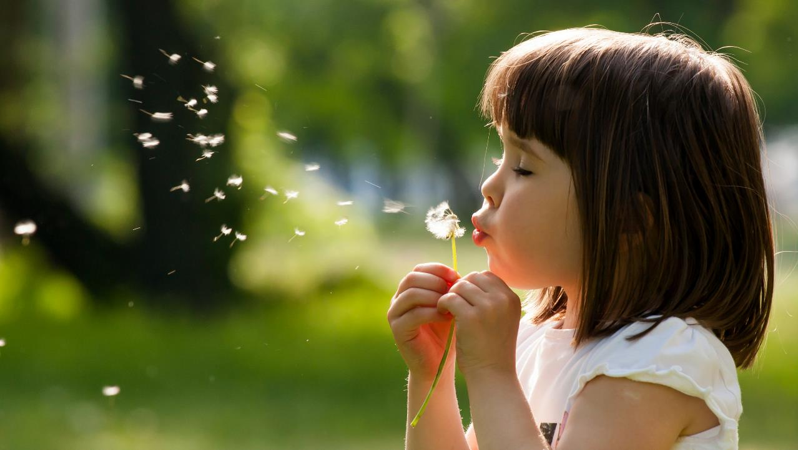
Enjoy your day!

