Slide 1

Unit 5: Sports and hobbies
Lesson 3.1
Page 74

Slide 2
Lesson Outline
Warm-up
Vocabulary
Structure
Consolidation
Wrap-up

Slide 3
Objectives
By the end of this lesson, students will be able to ask for permission, using ……….
Vocabulary: watch TV, go skateboarding, go out, go swimming
Structure: May I watch TV?
- Yes, you may./ No, you may not.

Slide 4

WARM UP

Slide 5
CROSSWORD
1
H | I | T | T | I | N | G
2
V | O | L | L | E | Y | B | A | L | L
3
B | A | D | M | I | N | T | O | N
4
B | A | S | K | E | T | B | A | L | L
5
K | I | C | K | I | N | G
6
T | E | N | N | I | S
7
S | O | C | C | E | R
KEYWORD
Click on the crossword to show the answer.
END

Slide 6
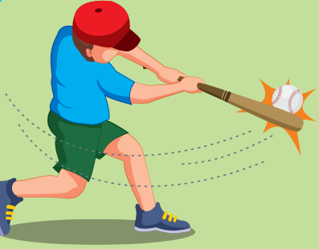
Back

Slide 7

Back

Slide 8
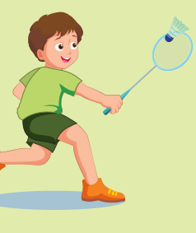
Back

Slide 9

Back

Slide 10
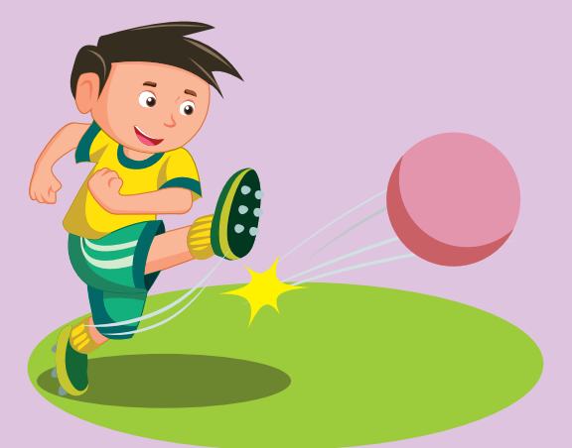
Back

Slide 11
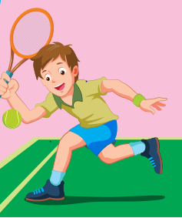
Back

Slide 12

Back

Slide 13

It’s time to learn …

Slide 14
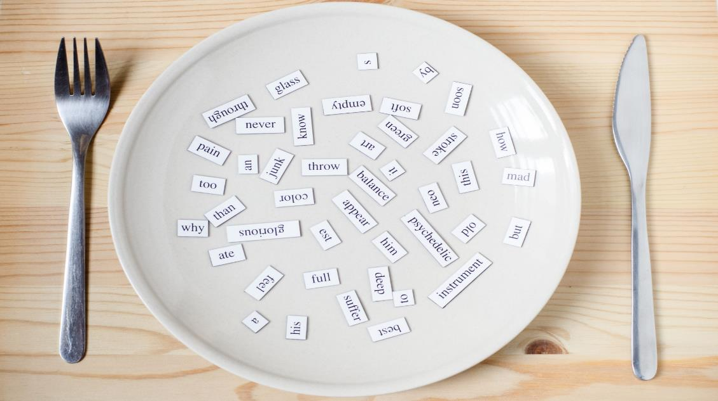
New words
watch TV
go skateboarding
go out
go swimming

Slide 15

Presentation

Slide 16

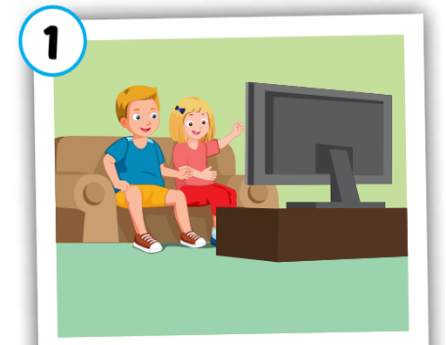

watch TV
/wɑːtʃ ˌtiː ˈviː/
Xem ti-vi
Click on each word to hear the sound.

Slide 17
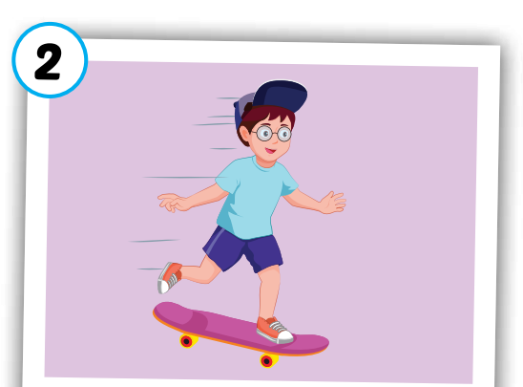
go skateboarding
/ɡəʊ ˈskeɪtˌbɔːrdɪŋ/
đi trượt ván
Click on each word to hear the sound.

Slide 18
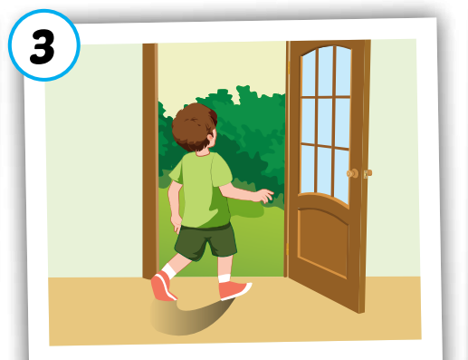
go out
/ɡəʊ aʊt/
đi ra ngoài
Click on each word to hear the sound.

Slide 19
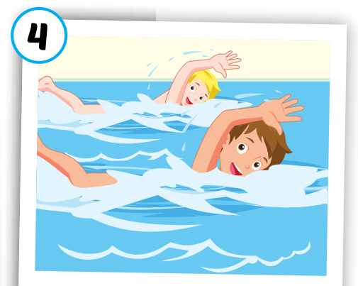
go swimming
/ɡəʊ ˈswɪmɪŋ/
đi bơi
Click on each word to hear the sound.

Slide 20




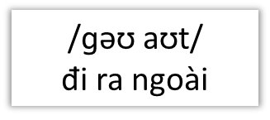
Click on each word to hear the sound.
watch TV
go swimming
go skateboarding
go out
/ɡəʊ ˈswɪmɪŋ/
đi bơi
/wɑːtʃ ˌtiː ˈviː/
Xem ti-vi
/ɡəʊ ˈskeɪtˌbɔːrdɪŋ/
đi trượt ván

Slide 21

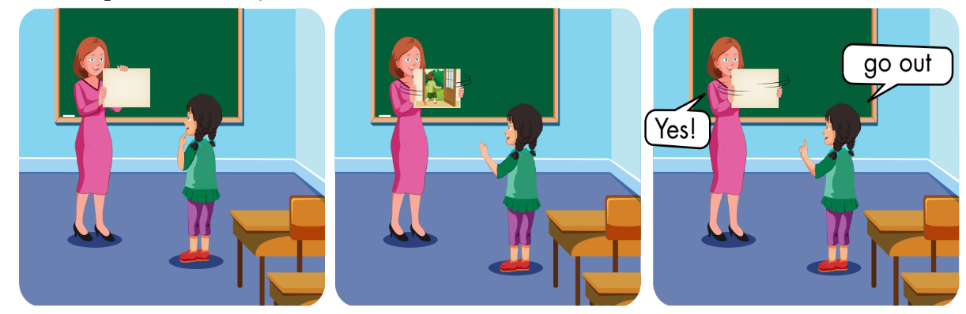

Slide 22

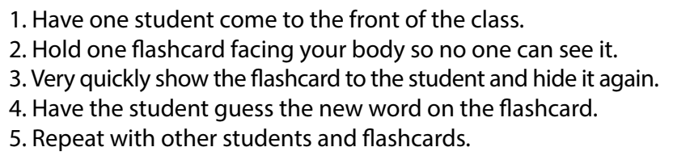

Slide 23

Practice

Slide 24



Answer 1 question correctly, you will open 1 puzzle piece.
1
2
3
4
Click here to open the task.
1
2
3
4
END

Slide 25
go o_t
U
BACK

Slide 26
go s_im_ing
W m
BACK

Slide 27
W_tc_ TV
a h
BACK

Slide 28
__ s_ate_oarding
go k b
BACK

Slide 29
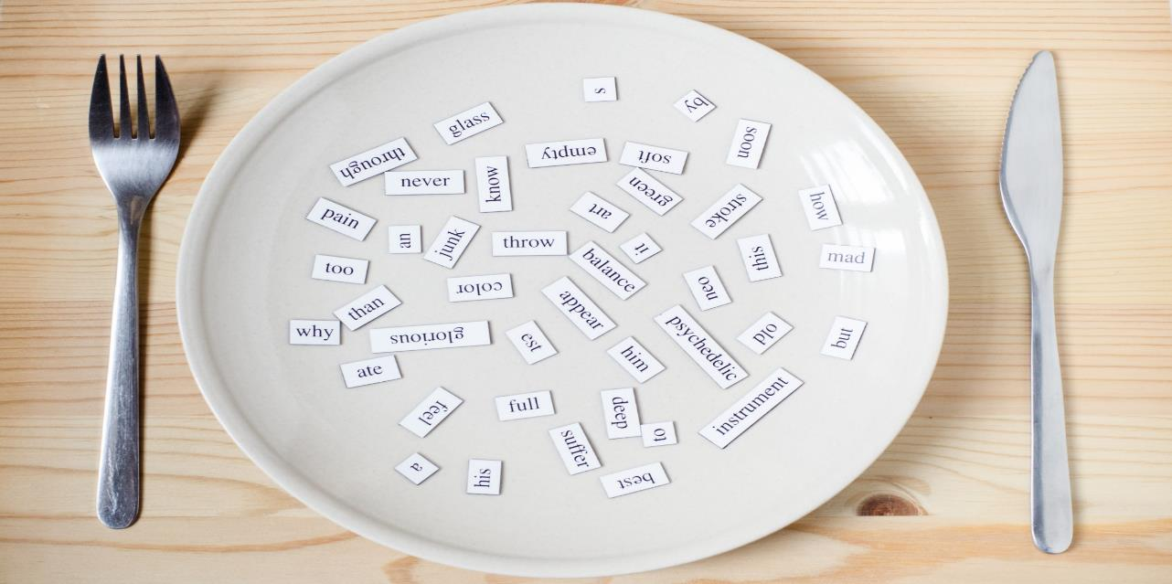
Structures
May I watch TV?
- Yes, you may./No, you may not.

Slide 30
Presentation

Slide 31



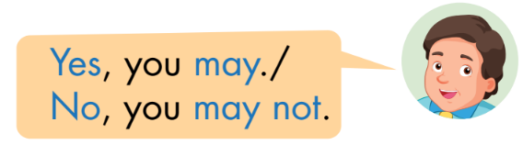

Slide 32
Practice

Slide 33

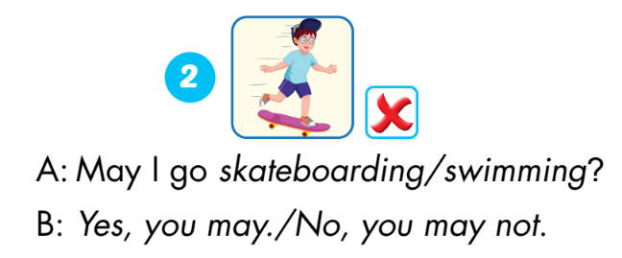
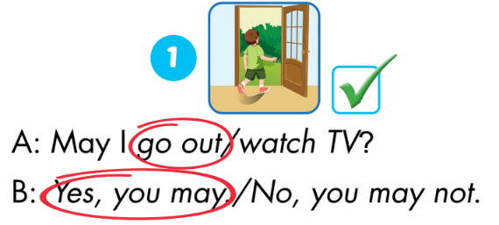
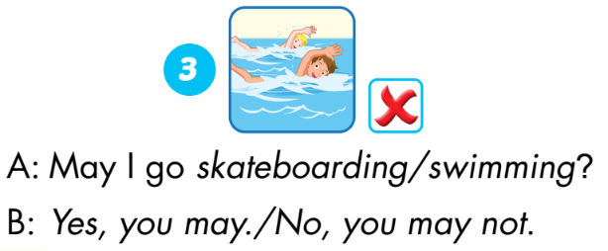
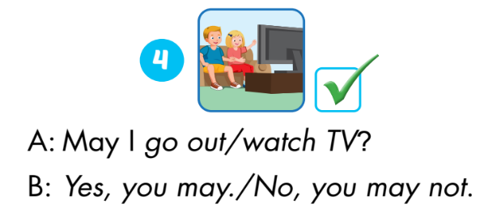

Slide 34

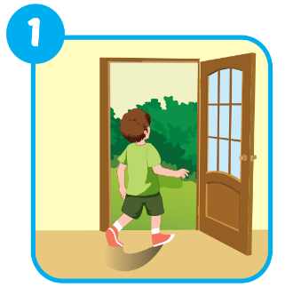
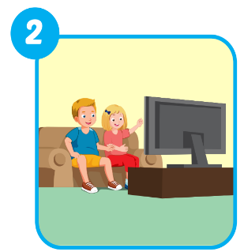
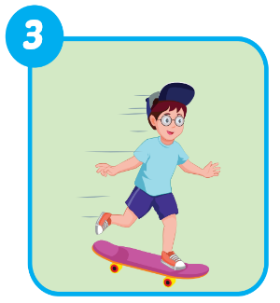
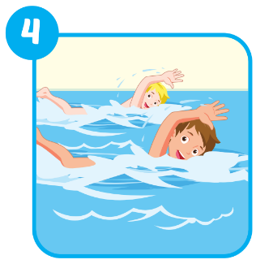
Extra Practice
WB, page 52.
go swimming
go out
go skateboarding
watch TV

Slide 35

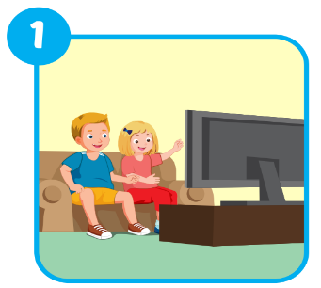
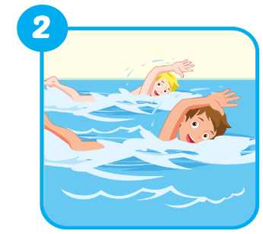


Extra Practice
WB, page 52.
✓

Slide 36
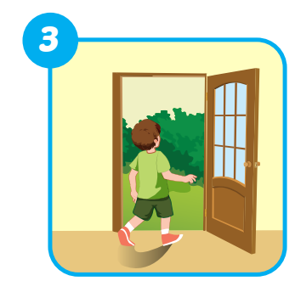
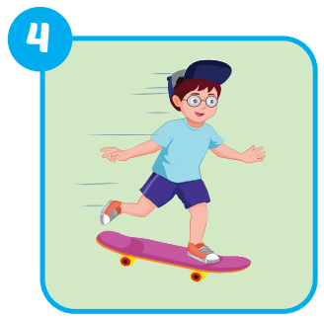

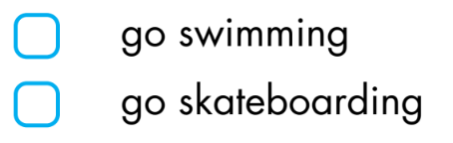
Extra Practice
WB, page 52.
✓
✓

Slide 37

CONSOLIDATION

Slide 38
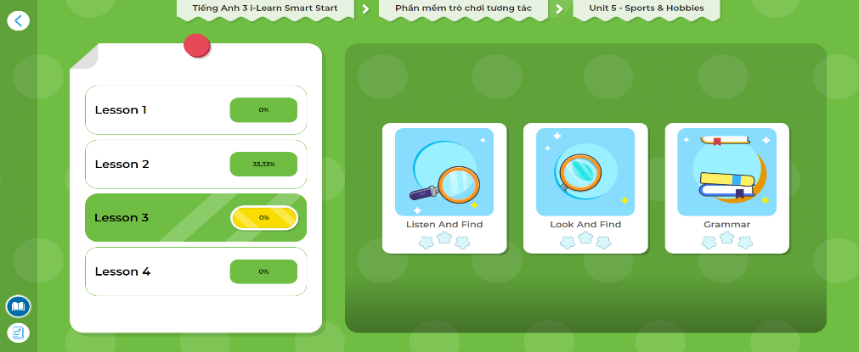
LET’S PLAY!
Click here to play the game

Slide 39
Early Production

Slide 40

WRAP-UP

Slide 41




May I…?
Lost turn
☹
1
❌
SPIN
❌
4
2
1 more turn
☺
3
✓
✓
Yes, you may./
No, you may not.
Notes:
GV dùng vòng quay để HS chọn số ngẫu nhiên. Khi chọn vào ô số nào thì sẽ làm câu cho số đó

Slide 42
Today’s lesson
Vocabularies
watch TV
go skateboarding
go out
go swimming
Structures/ Sentence patterns
May I watch TV?
- Yes, you may./No, you may not.

Slide 43
Homework
Practice vocabularies and structure. Make sentences using them.
Do the exercises in Tiếng Anh 3 i-Learn Smart Start Workbook (page 52)
Do the exercises in Tiếng Anh 3 i-Learn Smart Start Notebook (page 36)
Play the consolidation games in Tiếng Anh 3 i-Learn Smart Start DHA App on www.eduhome.com.vn
Prepare the next lesson (page 75)

Slide 44

Have a nice day!

