Slide 1

Unit 4: HOME
Lesson 4.1
Page 61

Slide 2
Lesson Outline
Warm-up
Vocabulary
Structure
Consolidation
Wrap-up

Slide 3
Objectives
By the end of this lesson, students will be able to say their address and what their house has.
Vocabulary: bed, closet, chair, desk, TV.
Structure: I live on La Thành Street in Hanoi.
My bedroom has a bed, a TV, and two chairs in it.

Slide 4

WARM UP

Slide 5



In pairs, ask and answer.
- Is the sofa in the living room?
- Yes, it is.
Sofa
- Is the picture in the living room?
- Yes, it is.
picture

Slide 6
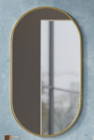
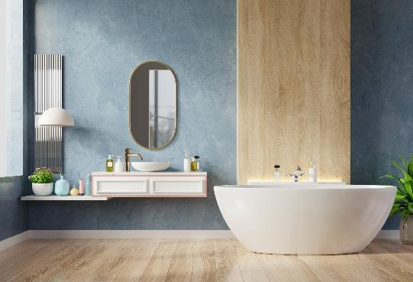
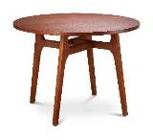
In pairs, ask and answer.
- Is the mirror in the bathroom?
- Yes, it is.
mirror
- Is the table in the bathroom?
- No, it isn’t.
table

Slide 7

It’s time to learn …

Slide 8

Vocabulary

Slide 9

New words
bed,
closet,
chair,
desk,
TV.

Slide 10



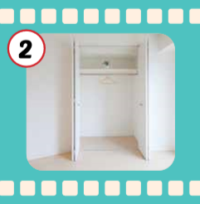
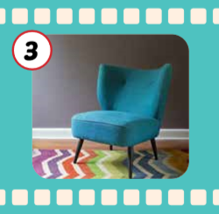

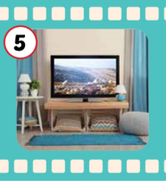
Click each English word to hear the sound.
bed
closet
chair
desk
TV
/bed/
Cái giường
/ˈklɑːzɪt/
Cái tủ quần áo
/tʃer/
Cái ghế
/desk/
Cái bàn
/ˌtiː ˈviː/
Cái ti-vi

Slide 11
Click each English word to hear the sound.
bed
/bed/
Cái giường

Slide 12
Click each English word to hear the sound.
closet
/ˈklɑːzɪt/
Cái tủ quần áo

Slide 13
Click each English word to hear the sound.
chair
/tʃer/
Cái ghế

Slide 14
Click each English word to hear the sound.
desk
/desk/
Cái bàn

Slide 15
Click each English word to hear the sound.
TV
/ˌtiː ˈviː/
Cái ti-vi

Slide 16
Decode the pictures.

Slide 17
Slap the board.

Slide 18
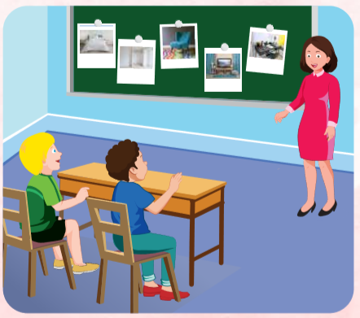
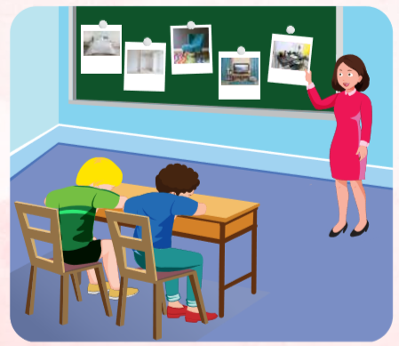
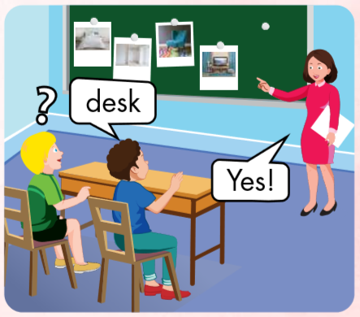

Slide 19



TV
?

Slide 20


chair

Slide 21

Structure

Slide 22

Structures
I live on La Thành Street in Hanoi.
My bedroom has a bed, a TV, and two chairs in it.

Slide 23


I live on La Thành Street in Hanoi.
My bedroom has a bed, a TV, and two chairs.

Slide 24
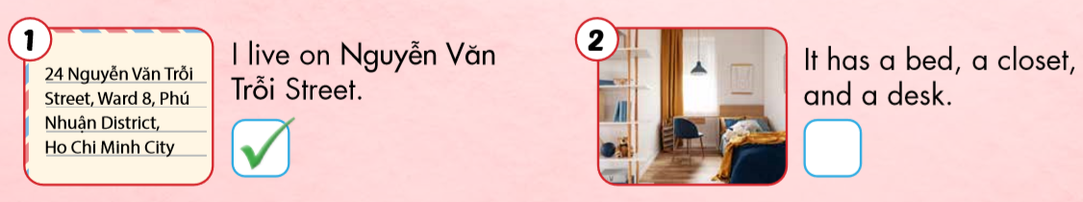

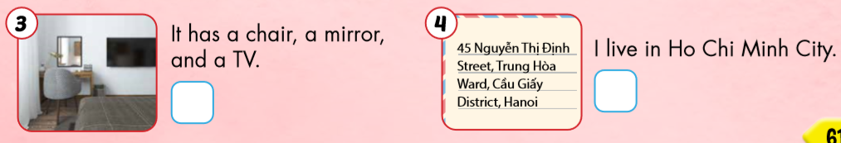


Slide 25

Workbook
p. 44

Slide 26

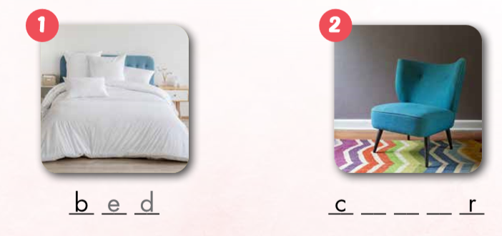
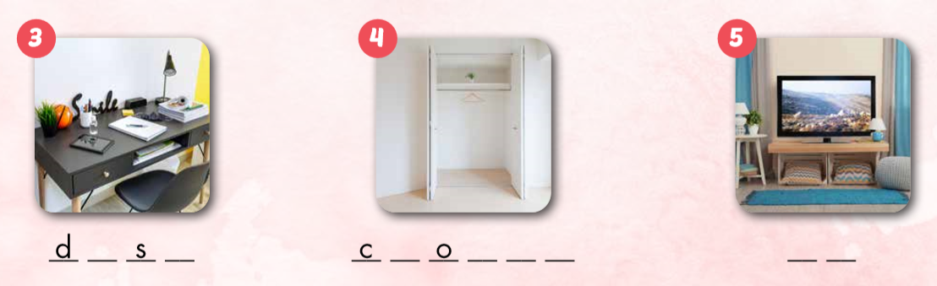
h a i
e k
l s e t
T V

Slide 27

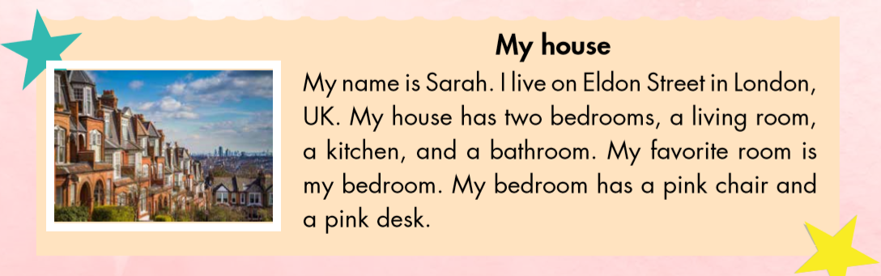
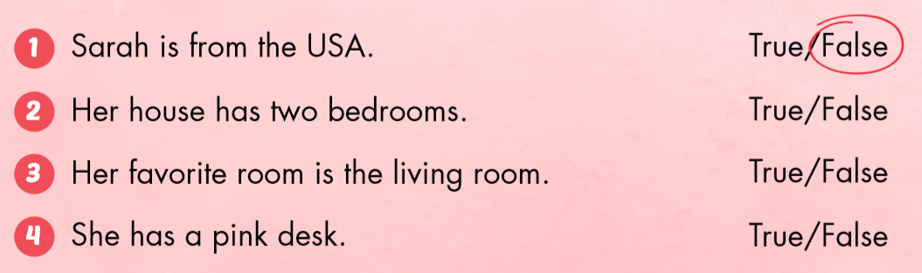

Slide 32

CONSOLIDATION

Slide 33


Say your address and what your house has.
I live on Hàng Đào Street in Hanoi.

Slide 34


Say your address and what your house has.
My living room has a sofa, a TV, and three pictures.

Slide 35
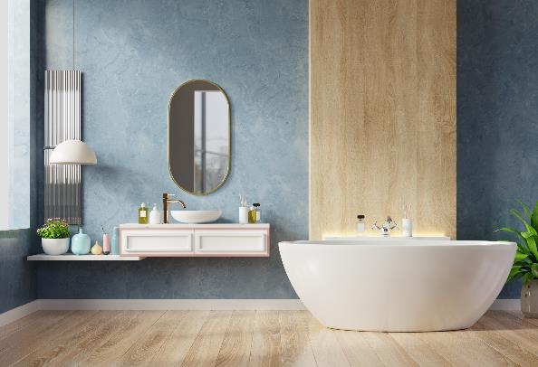
Say your address and what your house has.
My bathroom has a mirror.

Slide 36

WRAP-UP

Slide 37
Lesson 3
Today’s lesson
Structures/ Sentence patterns
I live on La Thành Street in Hanoi.
My bedroom has a bed, a TV, and two chairs in it.
Vocabularies
bed,
closet,
chair,
desk,
TV.

Slide 38
Homework
Review the vocabularies and sentence patterns. Make sentences using them.
Do the exercises on page 44 (WB)
Prepare the next lesson (page 62 SB)
Play the consolidation games in Tiếng Anh 3 i-Learn Smart Start DHA App on www.eduhome.com.vn
Do the exercise in Tiếng Anh 3 i-Learn Smart Start Notebook (page 31)

Slide 39

Enjoy your day!

Slide 40

Have a nice day!

