Slide 1

Unit 4: HOME
Lesson 2.2
Page 56

Slide 2
Lesson Outline
Warm-up
Listening
Consolidation
Wrap-up

Slide 3
Objectives
By the end of this lesson, students will be able to ask What are you doing?
Vocabulary: eating, sleeping.
Structure: What’s he doing? He’s sleeping.

Slide 4

WARM UP

Slide 5
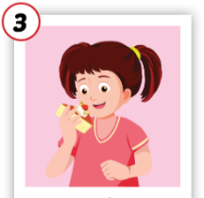
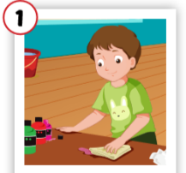
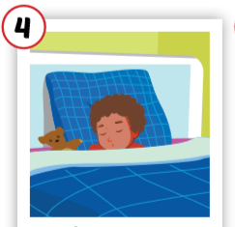
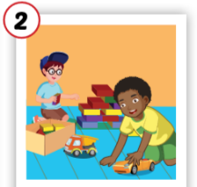
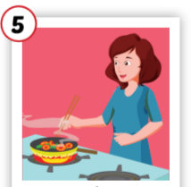
3
1
4
1
4
SPIN
3
2
2
2
5
5

Slide 6

It’s time to learn …

Slide 7


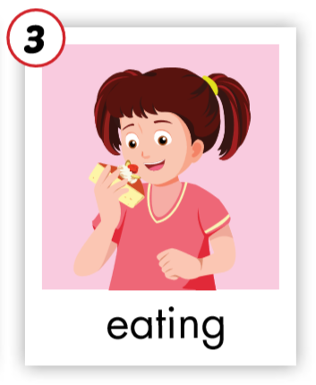
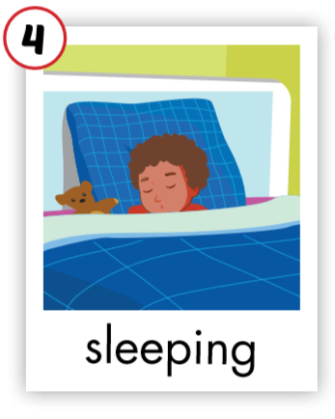
C. 1. Listen and repeat.
1
2

Slide 8
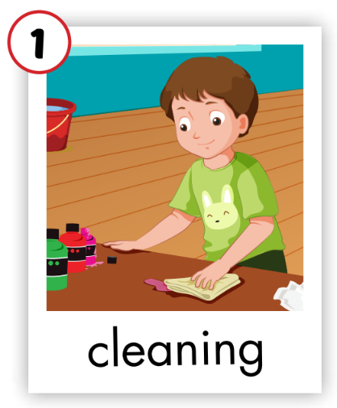
C. 1. Listen and repeat.

Slide 9


C. 2. Chant.
Click on the earphone to practice the chant.
/i:/ /i:/ /i:/
sleeping
eating
/i:/ /i:/ /i:/
/i:/ /i:/ /i:/

Slide 10

Listening

Slide 11

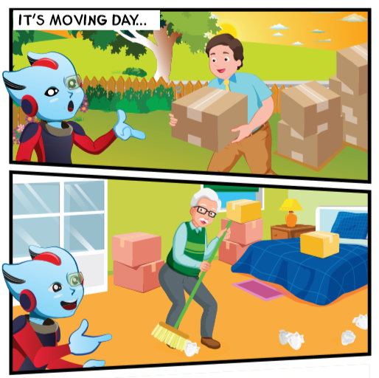
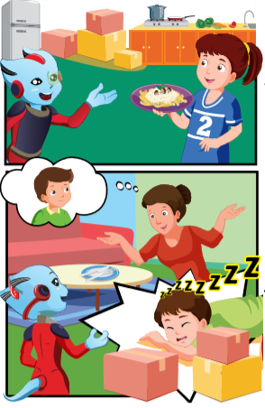

Slide 12


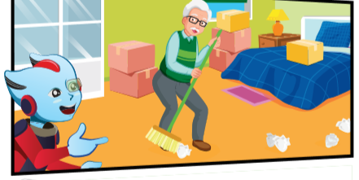

Hi, Mr. Brown. Where’s Grandpa Dan?
What’s he doing?
He’s in the bedroom.
He’s
cleaning.

Slide 13

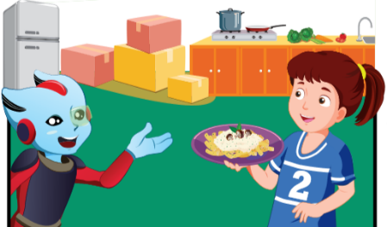
Grandpa Dan, where’s Lucy?
I think she’s in the kitchen.
What’s She doing?
She’s
cooking.

Slide 14

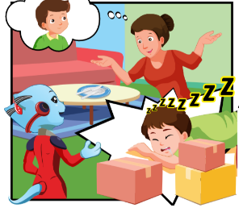
Hi, Alfie.
Hey, Lucy.
Where’s Mrs. Brown?
She’s in the living room.
What’s she doing?
She’s
eating.

Slide 15

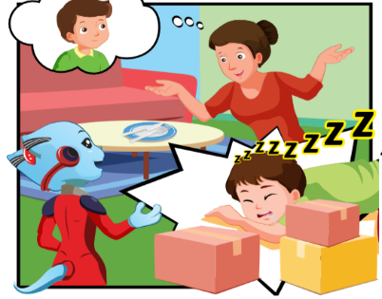
He’s in the yard.
Hi, Mrs. Brown. Where’s Ben?
She’s
playing.
What’s he doing?
I don’t know.
Oh. And where’s Tom?

Slide 16

Alfie: Hi, Mr. Brown. Where’s Grandpa Dan?
Sam: He’s in the bedroom.
Alfie: What’s he doing?
Sam: He’s cleaning.

Slide 17
Alfie: Hi, Mr. Brown. Where’s Grandpa Dan?
Sam: He’s in the bedroom.
Alfie: What’s he doing?
Sam: He’s cleaning.
Notes:
Teacher can hide the dialogue a little bit (some challenge) so that students have a chance to remember and practice.

Slide 18
Alfie: Hey, Lucy.
Lucy: Hi, Alfie.
Alfie: Where’s Mrs. Brown?
Sam: She’s in the living room.
Alfie: What’s she doing?
Sam: She’s eating.

Slide 19
Alfie: Hey, Lucy.
Lucy: Hi, Alfie.
Alfie: Where’s Mrs. Brown?
Sam: She’s in the living room.
Alfie: What’s she doing?
Sam: She’s eating.

Slide 20

Workbook
p. 41

Slide 21

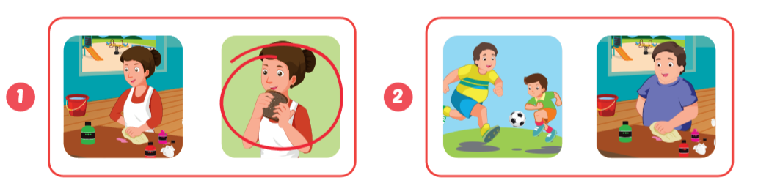
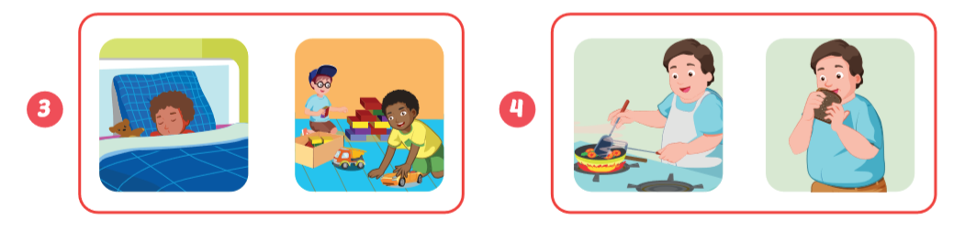

Slide 22
Point and say.
She’s eating.
He’s cleaning.

Slide 23
Point and say.
He’s sleeping.
He’s cooking.

Slide 24

CONSOLIDATION

Slide 25
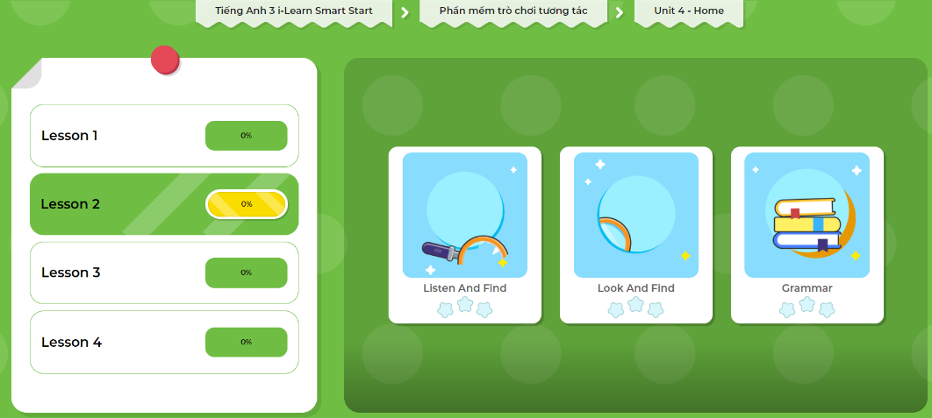
Extra Practice
DHA App
Let’s play!
Click here to play the game

Slide 26

Go around the class and ask 3 friends about what their parents are doing.
Name | cleaning | sleeping | eating
Trang’s father
Hoa’s mother
Tùng’s mother
Notes:
GV giới thiệu hoạt động HS sẽ đi vòng quanh lớp và hỏi ý kiến của 3 bạn về các loại động vật bạn yêu mến, thích, và không thích. GV chuẩn bị handout cho HS.

Slide 27

WRAP-UP

Slide 28
Lesson 3
Today’s lesson
Vocabularies
bedroom
bathroom
Structures/ Sentence patterns
What’s he doing?
He’s cleaning.
What’s she doing?
She’s cooking.

Slide 29
Homework
Review the vocabularies and sentence patterns. Make sentences using them.
Do the exercises on page 41 (WB)
Prepare the next lesson (page 57 SB)
Play consolidation games in Tiếng Anh 3 i-Learn Smart Start DHA App on www.eduhome.com.vn

Slide 30

Enjoy your day!

Slide 31
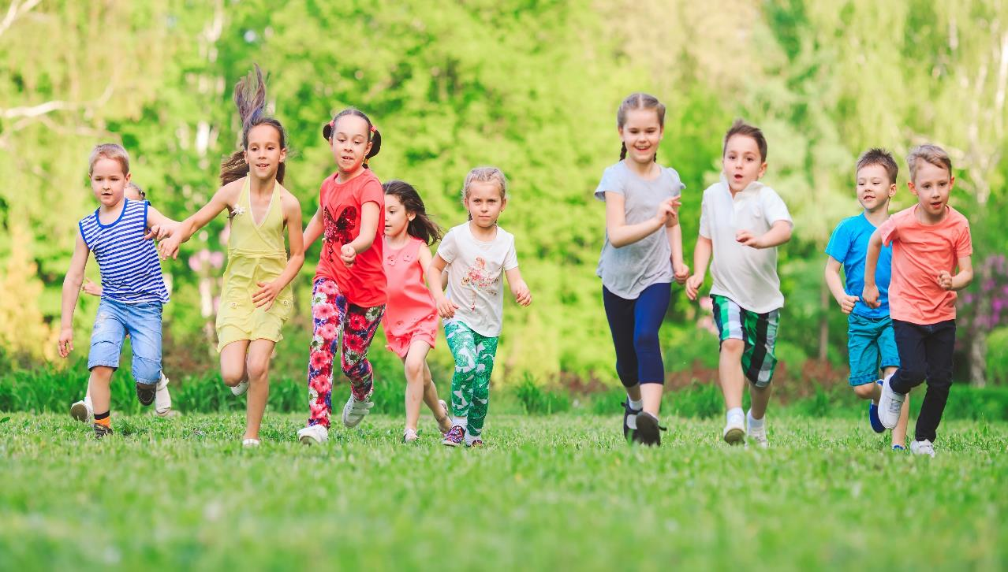
Have a nice day!

