Slide 1

Unit 4: HOME
Lesson 1.1
Page 52

Slide 2
Lesson Outline
Warm-up
Vocabulary
Structure
Consolidation
Wrap-up

Slide 3
Objectives
By the end of this lesson, students will be able to ask where people are.
Vocabulary: living room, bedroom, bathroom,
kitchen, yard.
Structure: Where’s Dad? He’s in the yard.
Where’s Grandma? She’s in the kitchen.

Slide 4

WARM UP

Slide 5




Make up sentences, using suggested pictures. pictures
Make up sentences, using pictures
I have
a green ruler.
a blue pencil.
I have

Slide 6

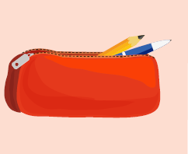
Make up sentences, using suggested pictures. pictures
I have
a yellow book.
I have
a red pencil case.

Slide 7

It’s time to learn …

Slide 8

New words
living room
bedroom
kitchen
bathroom
yard

Slide 9

Presentation

Slide 10


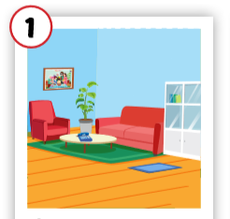
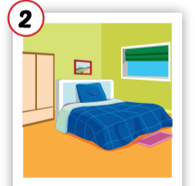
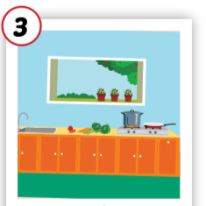
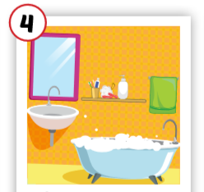
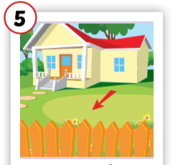
Click each English word to hear the sound.
living room
bedroom
kitchen
bathroom
yard
/ˈlɪvɪŋ ruːm/
phòng khách
/ˈbedruːm/ phòng ngủ
/ˈkɪtʃɪn/
nhà bếp
/ˈbæθruːm/ phòng tắm
/jɑːrd/
sân

Slide 11
Click each English word to hear the sound.
living room
/ˈlɪvɪŋ ruːm/
phòng khách

Slide 12
Click each English word to hear the sound.
bedroom
/ˈbedruːm/ phòng ngủ

Slide 13
Click each English word to hear the sound.
kitchen
/ˈkɪtʃɪn/
nhà bếp

Slide 14
Click each English word to hear the sound.
bathroom
/ˈbæθruːm/ phòng tắm

Slide 15
Click each English word to hear the sound.
yard
/jɑːrd/
sân

Slide 16

Practice

Slide 17
In pairs, 01 points to the picture, other says the word.
living room
bedroom
kitchen
bathroom
yard
/ˈlɪvɪŋ ruːm/
phòng khách
/ˈbedruːm/ phòng ngủ
/ˈkɪtʃɪn/
nhà bếp
/ˈbæθruːm/ phòng tắm
/jɑːrd/
sân

Slide 18
Game: Slap the board

Slide 19
Game: Decode the pictures.

Slide 20

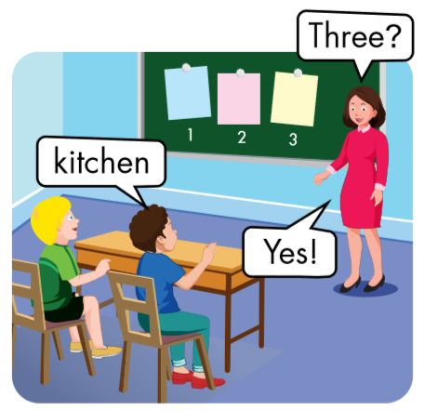
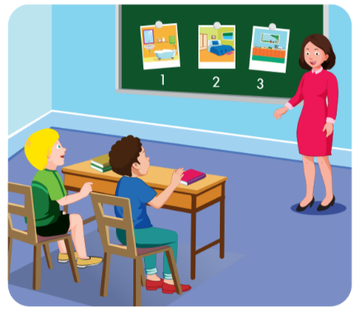
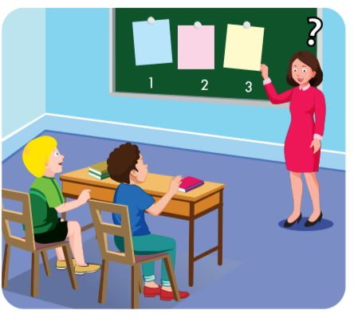


Slide 21

One?
bedroom
No

Slide 22
Two?
bedroom

Slide 23

Structures
Where’s Dad?
He’s in the yard.
Where’s Grandma?
She’s in the kitchen.

Slide 24
Presentation

Slide 25


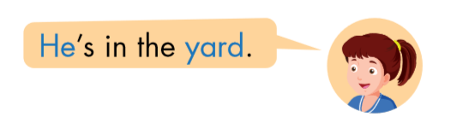

Click each English word to hear the sound.

Slide 26
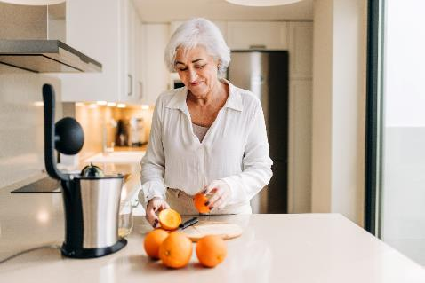


Click each English word to hear the sound.

Slide 27
Practice

Slide 28

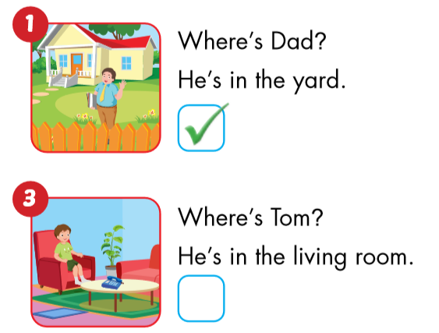
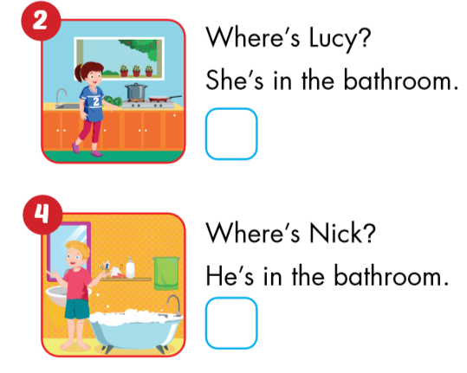

Slide 29
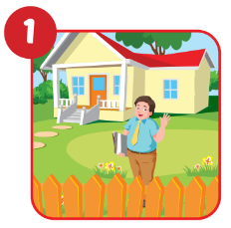
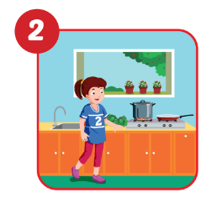
Circle the correct answers.
- Where’s Dad?
- He’s in the yard/
living room.
- Where’s Lucy?
- She’s in the kitchen/ bedroom.

Slide 30
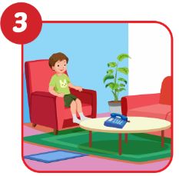
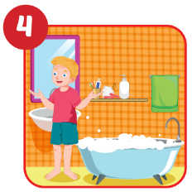
Circle the correct answers.
- Where’s Tom?
- Where’s Nick?
- He’s in the
living room/kitchen.
- He’s in the bathroom/ yard.
4

Slide 31

Workbook
p. 38

Slide 32

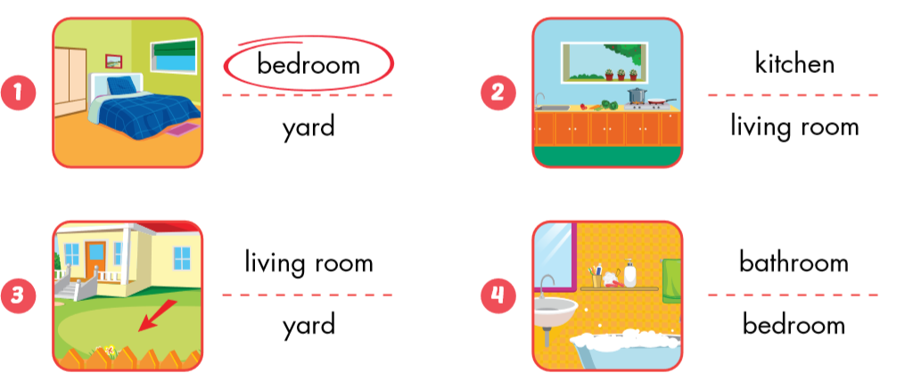

Slide 33

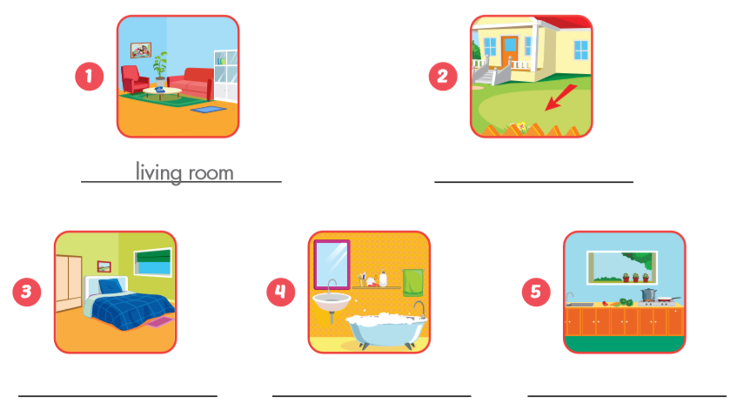
living room
yard
bedroom
bathroom
kitchen

Slide 34

Production
Production

Slide 35
3
1
Nick
4
1
4
Tom
SPIN
3
2
2
Ben
2
5
5
Lucy
Alex

Slide 36

CONSOLIDATION

Slide 37
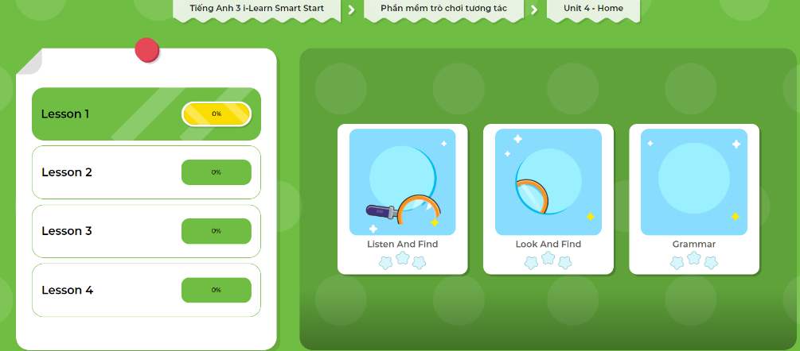
Extra Practice
DHA App
Let’s play!
Click here to play the game

Slide 38

WRAP-UP

Slide 39
Lesson 3
Today’s lesson
Vocabularies
living room
bedroom
kitchen
bathroom
yard
Structures/ Sentence patterns
Where’s Dad?
He’s in the yard.
Where’s Grandma?
She’s in the kitchen.

Slide 40
Homework
Review the vocabularies and sentence patterns. Make sentences using them.
Do the exercises on page 38 (WB)
Prepare the next lesson (page 53 SB)
Play the consolidation games in Tiếng Anh 3 i-Learn Smart Start DHA App on www.eduhome.com.vn
Do the exercises in Tiếng Anh 3 i-Learn Smart Start Notebook (page 28)

Slide 41

Enjoy your day!

Slide 42

Have a nice day!

