Slide 1


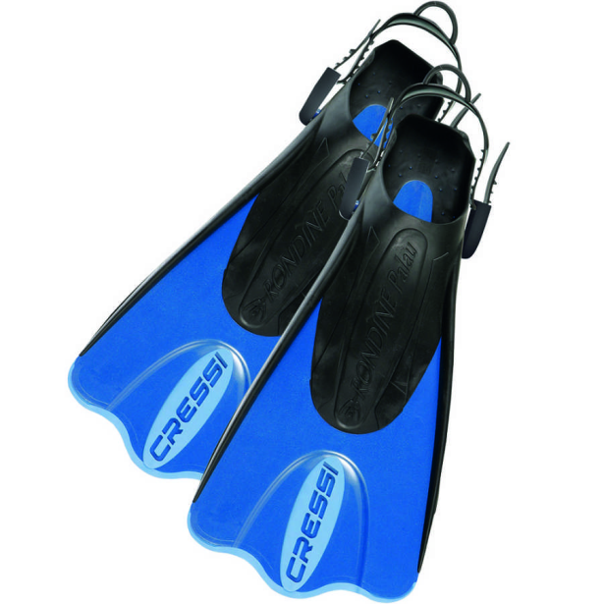
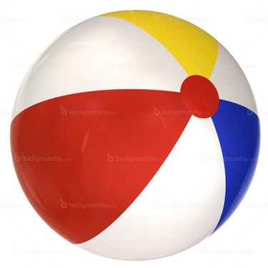
MY SUMMER HOLIDAY

Slide 2
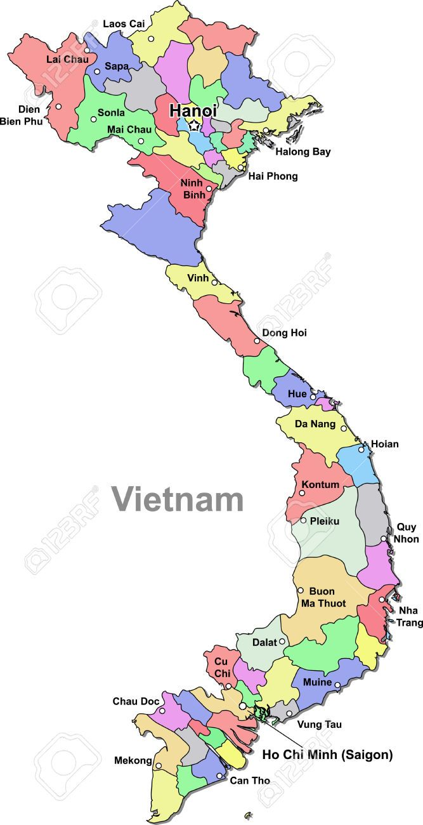
Let’s talk
This sumer
Last summer
I will go to Ha Long this summer.
I went to Da Nang but I didn’t go to Nha Trang last summer.
Go – Went- didn’t go

Slide 3
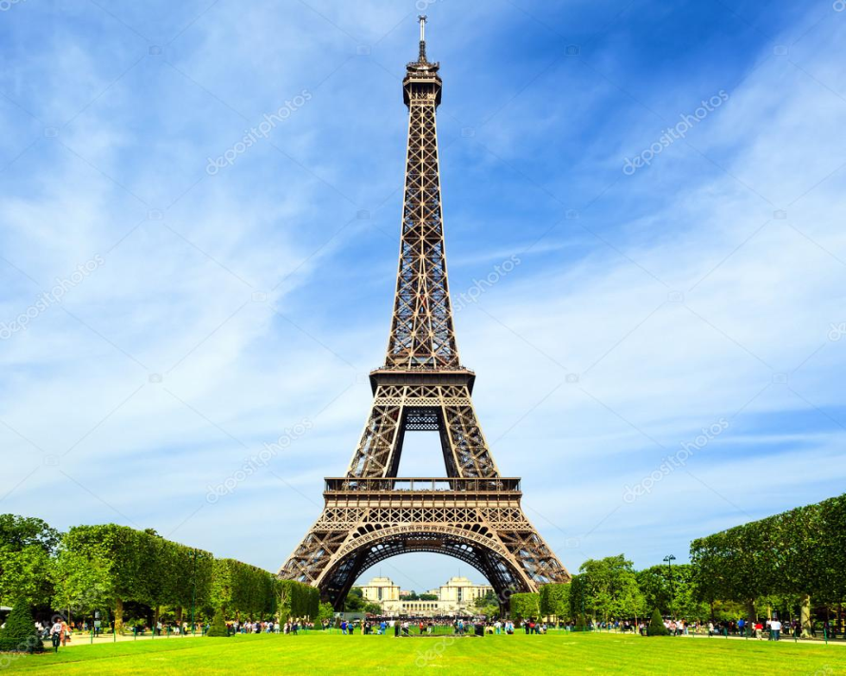
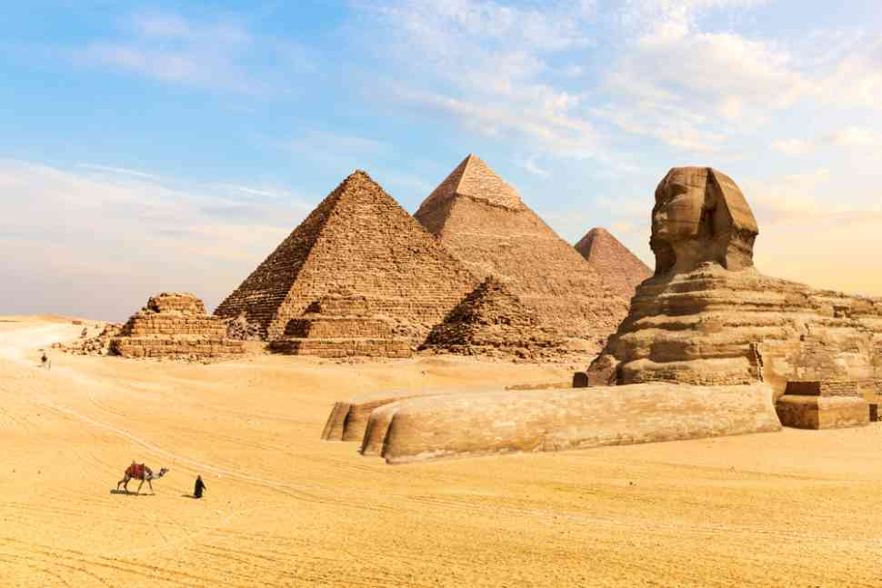
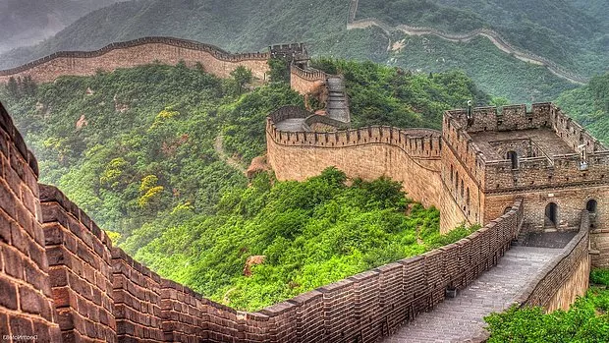
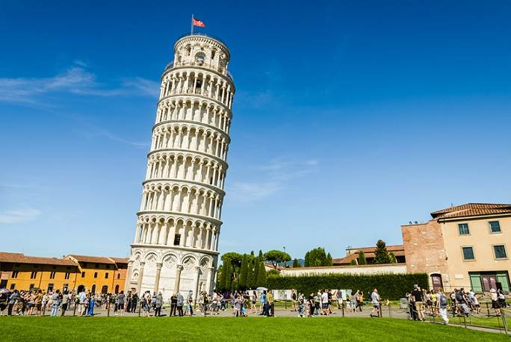
See – saw – didn’t see
Eifel Tower – Pisa Tower - Pyramids – Great Walls

Slide 4
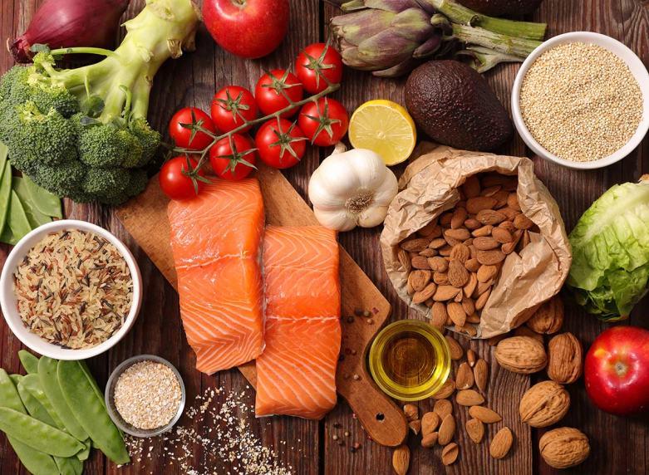
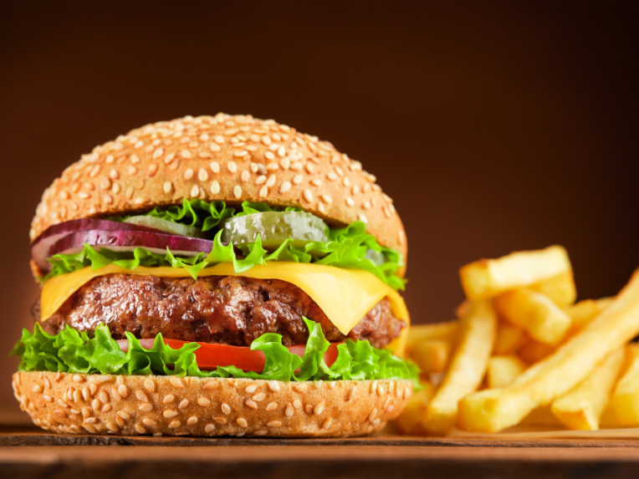
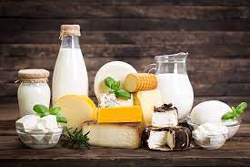
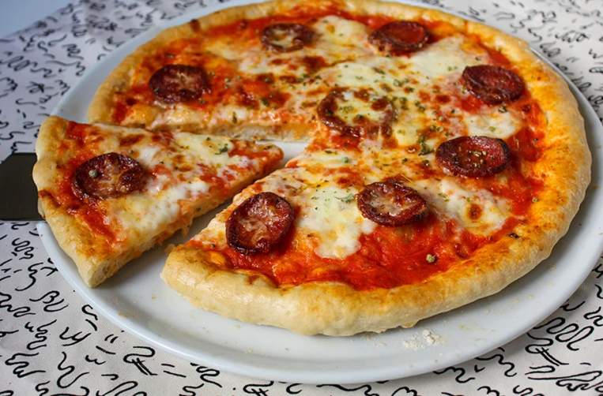
Eat – ate - didn’t eat
Healthy Food Fast Food

Slide 5
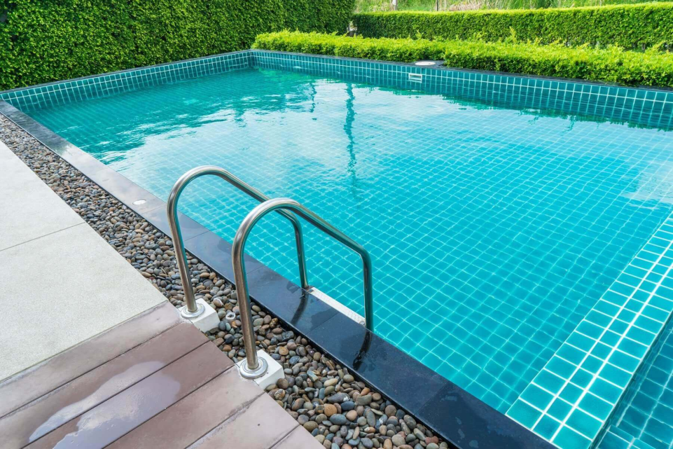
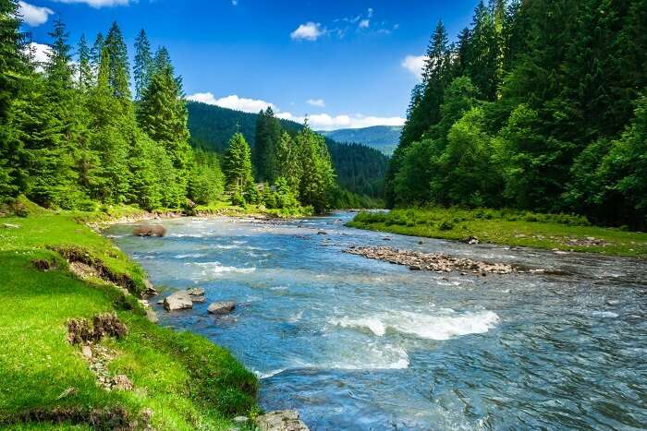
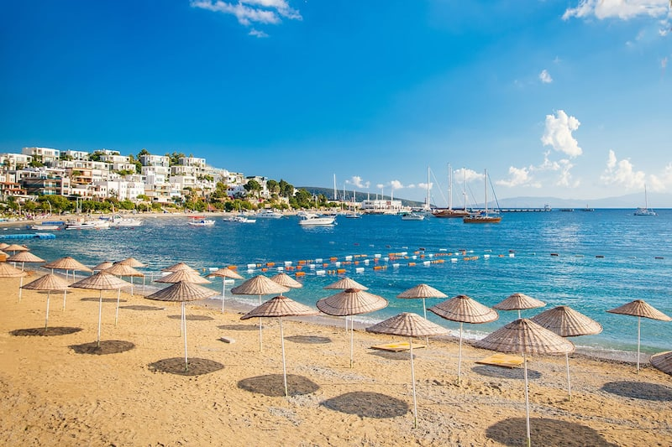
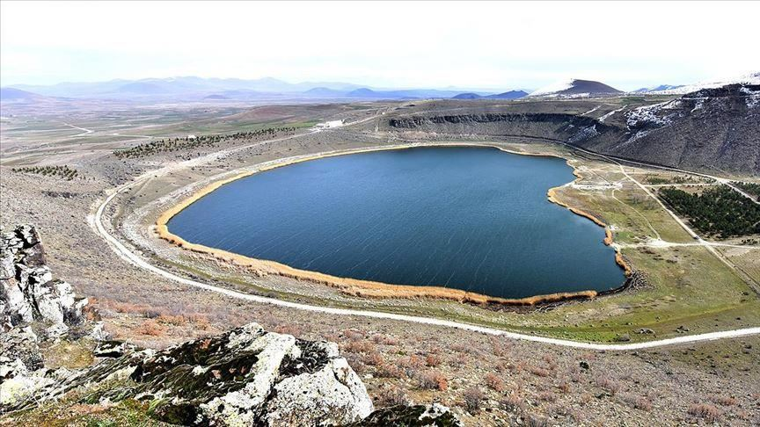
Swim – swam – didn’t swim
Swimming pool – sea – river - lake

Slide 6
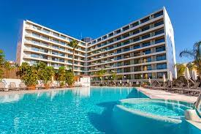
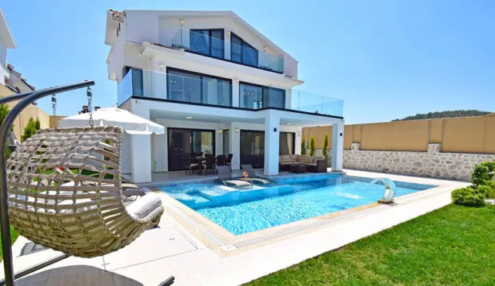
Stay – stayed – didn’t stay
Villa
Five-star hotel

Slide 7
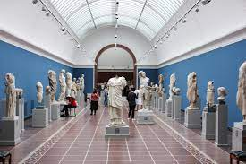
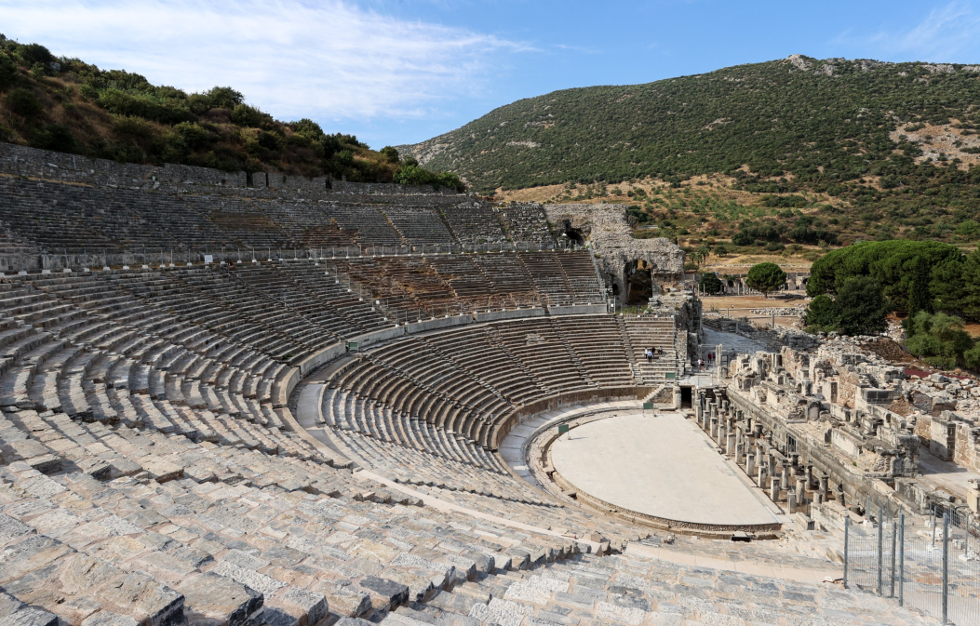
Visit – visited – didn’t visit
Ephesus theatre
Museums

Slide 8
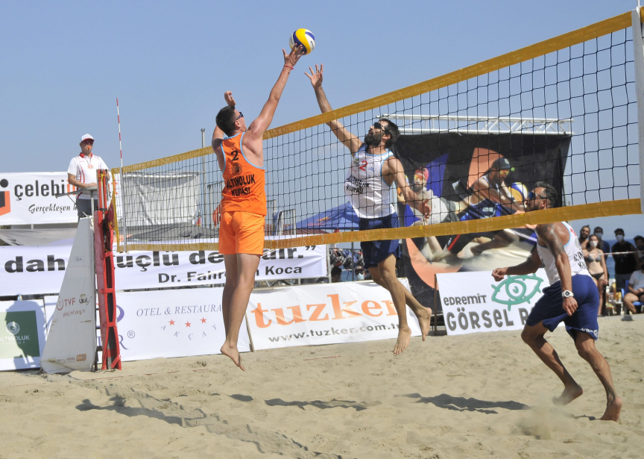
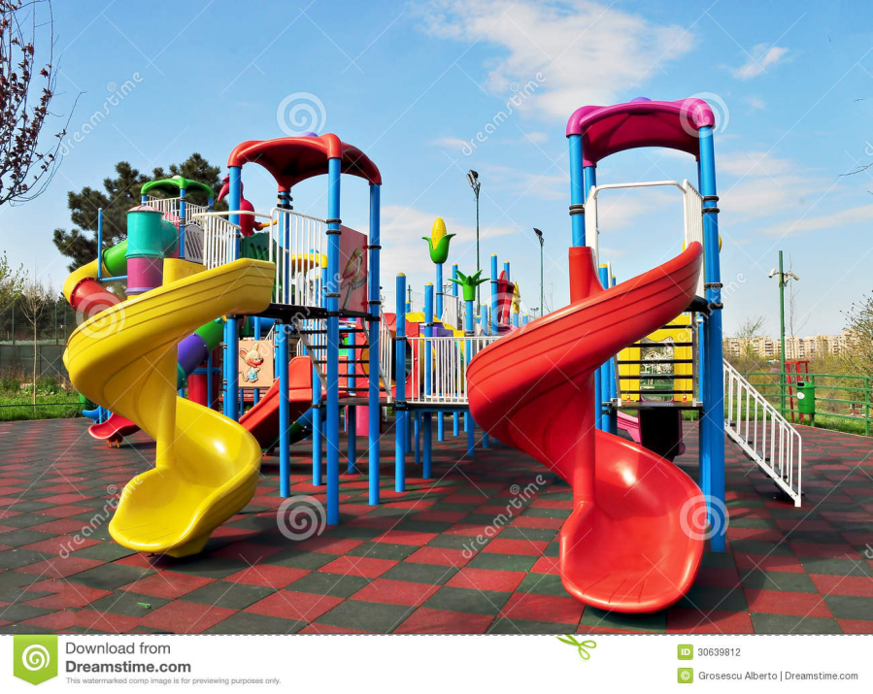
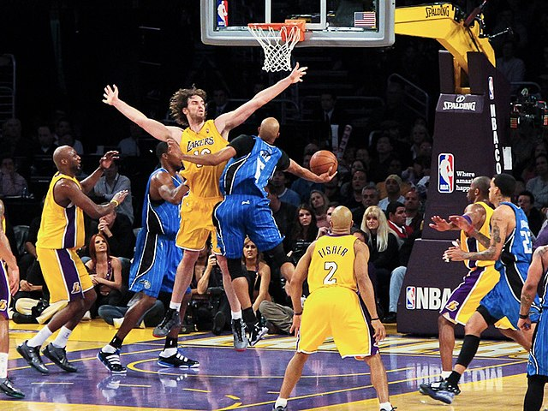
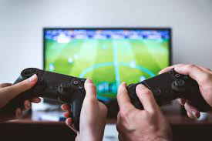
Play – played – didn’t play
Beach volleyball–basketball–video games–in the playground

Slide 9
I went to Da Nang but I didn’t go to Nha Trang.
I saw Eifel tower but I didn’t see Pisa tower.
I ate health food but I didn’t eat fast food.
I swam in the sea but I didn’t swim in the lake.
I stayed in a five-star hotel but I didn’t stay in the villa.
I visited museums but I didn’t visit The Ephesus Theatre.
I played beach volleyball but I didn’t play in the playground.

Slide 10
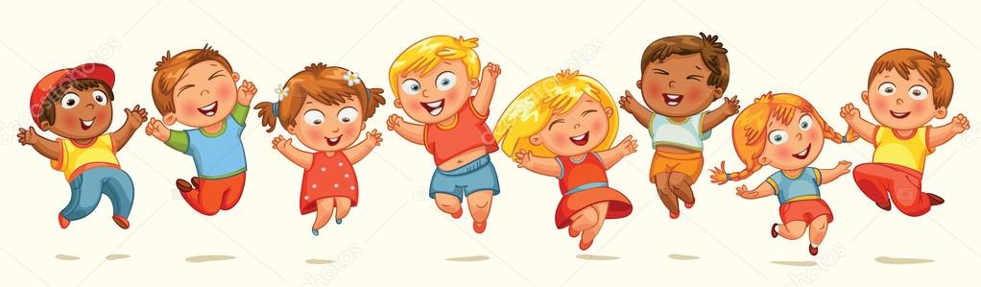
THANK YOU

