Slide 1
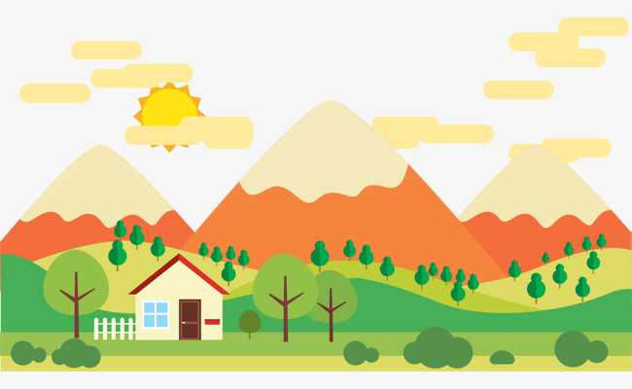

Unit 11. what time is it?
LESSON 3

Slide 2

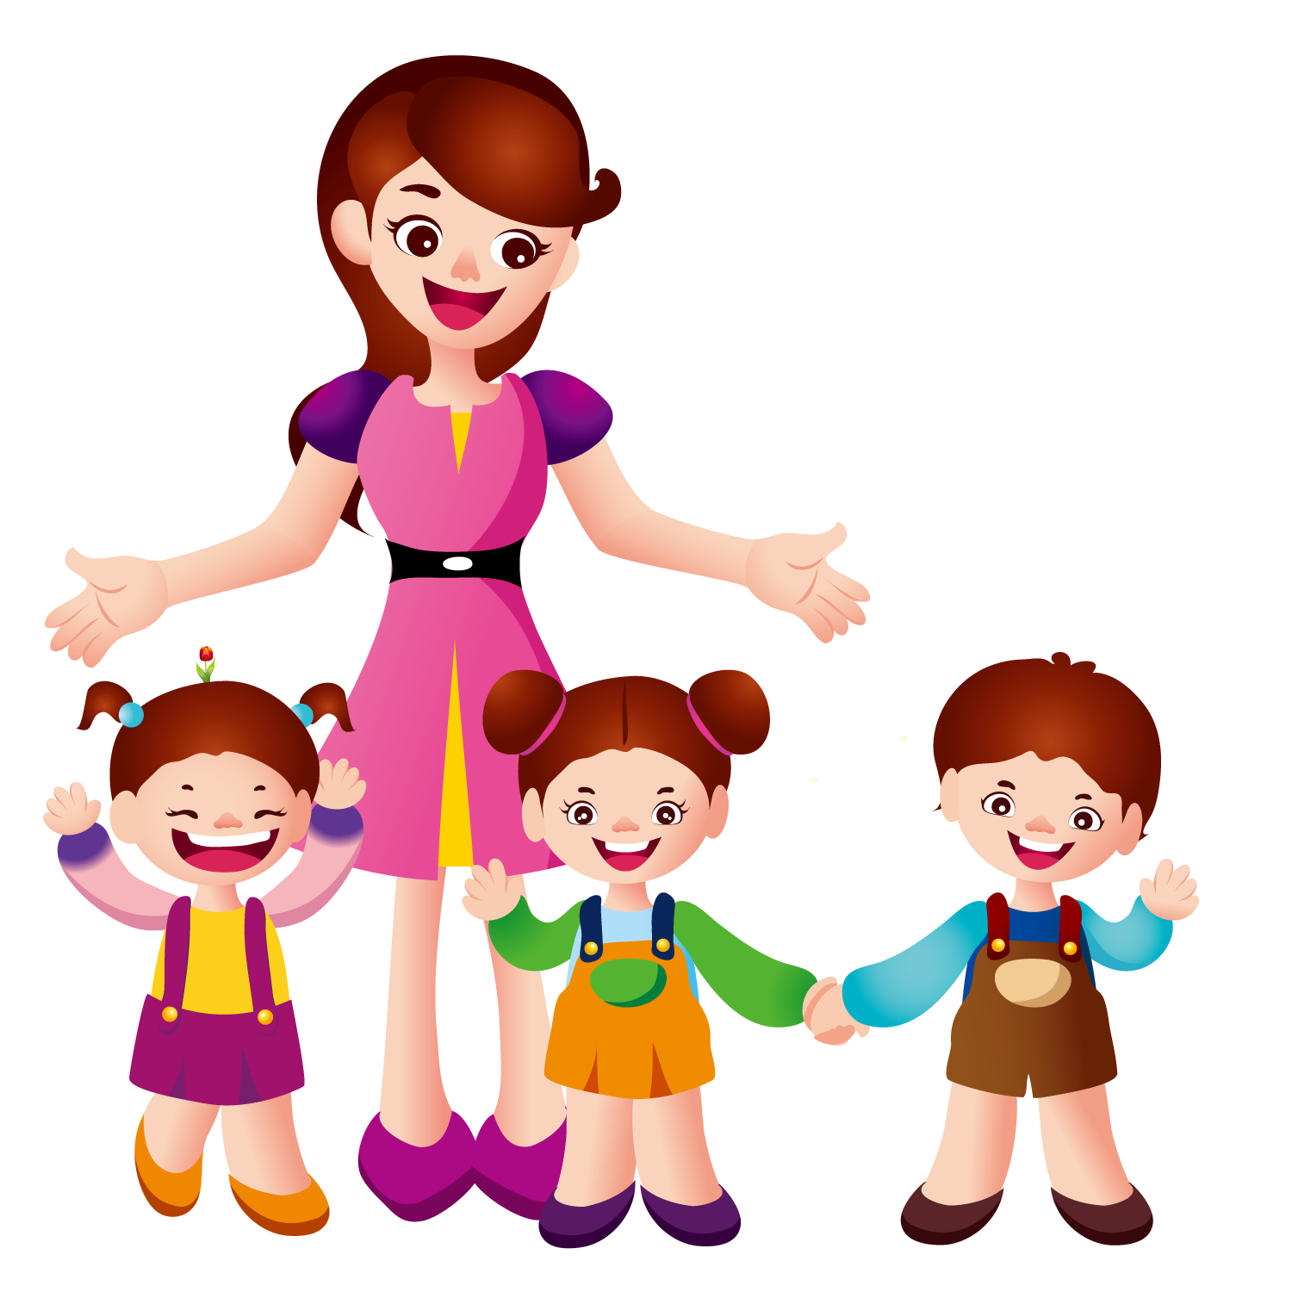

WARM UP

Slide 3
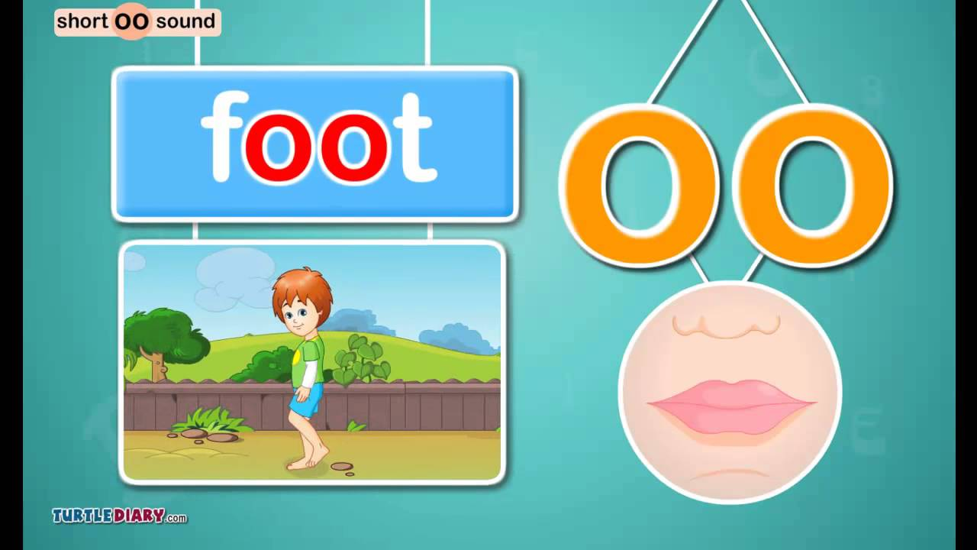

Slide 4
oo
cook
My mother cooks at six o’clock.

Slide 5
oo
book
Your book is on the table.

Slide 6
oo
noon
I play football at noon.

Slide 7
oo
school
They have lunch at school

Slide 8
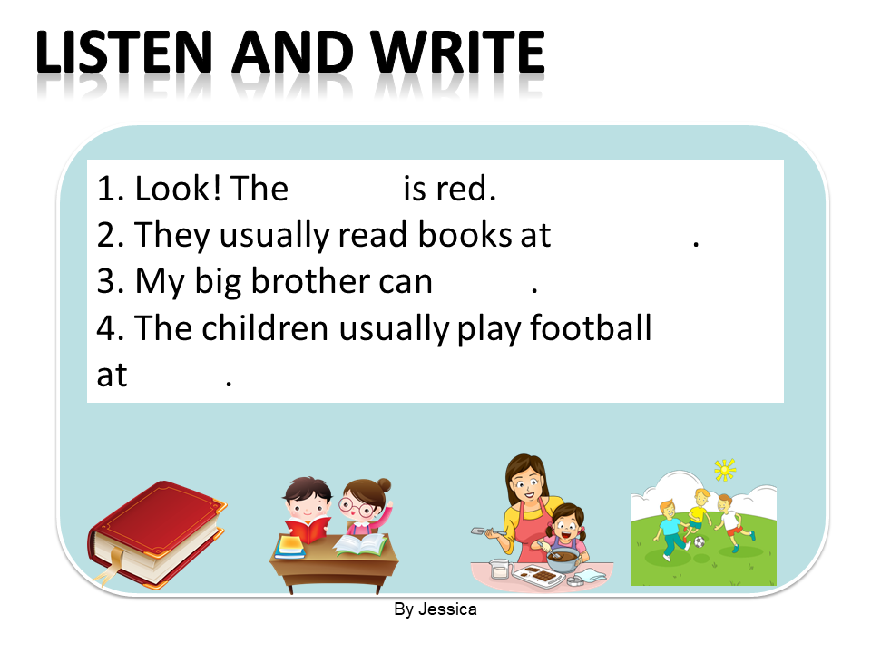
LISTEN AND WRITE
1
2
3
4
book
school
cook
noon

Slide 9
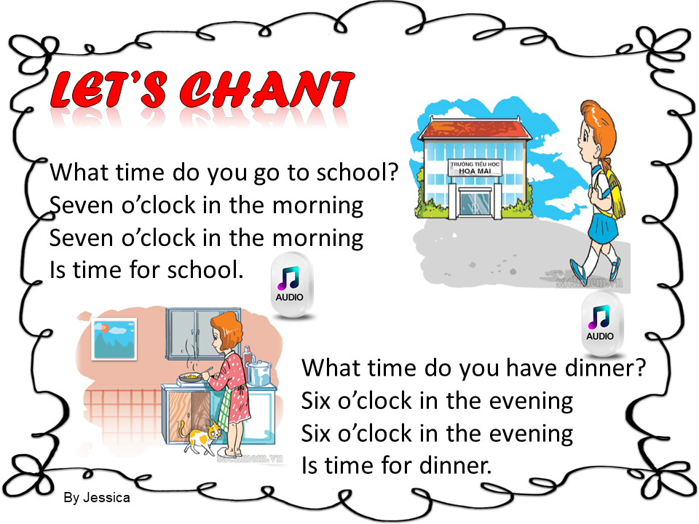

LET’S CHANT

Slide 10
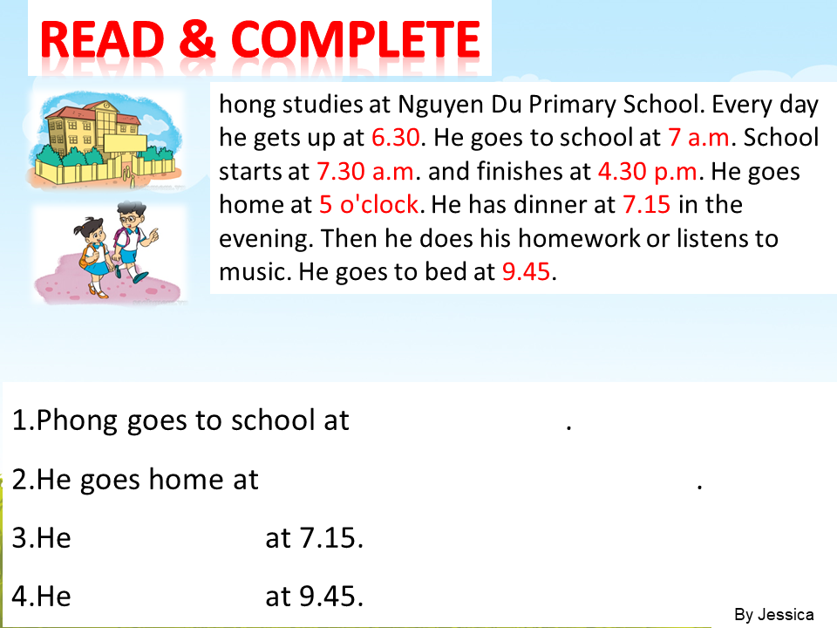
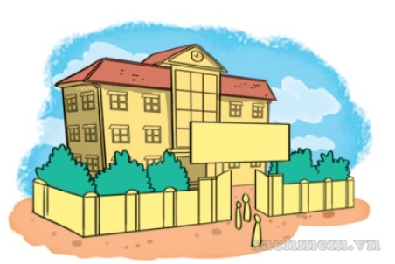
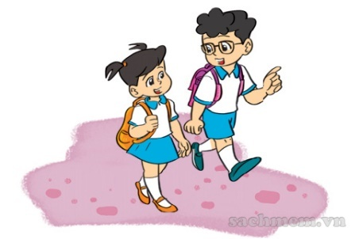
READ & COMPLETE
hong studies at Nguyen Du Primary School. Every day he gets up at 6.30. He goes to school at 7 a.m. School starts at 7.30 a.m. and finishes at 4.30 p.m. He goes home at 5 o'clock. He has dinner at 7.15 in the evening. Then he does his homework or listens to music. He goes to bed at 9.45.
7 a.m. / seven
5 o'clock / 5 / five / five o'clock
have dinner
goes to bed

Slide 11
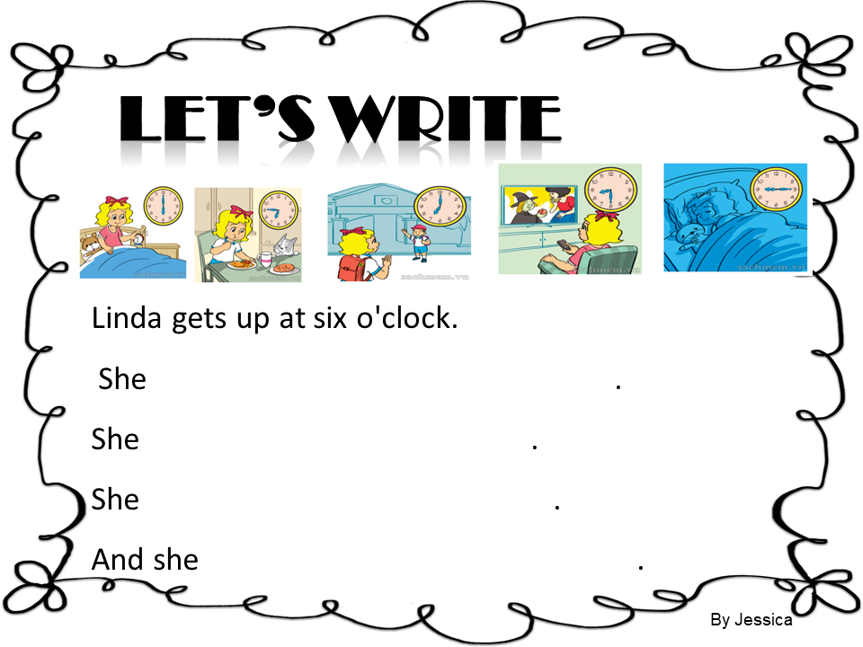
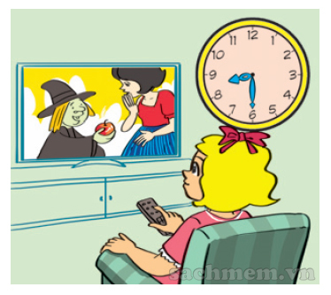
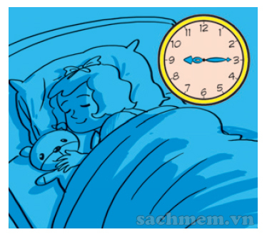
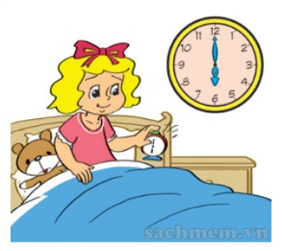
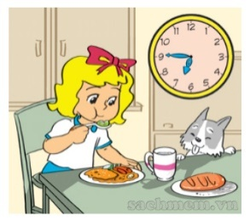
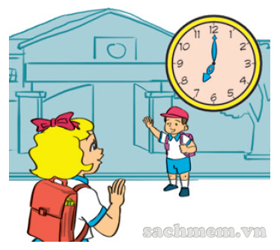
LET’S WRITE
has breakfast at six forty-five
goes to school at seven
watches TV at eight thirty
goes to bed at nine fifteen

Slide 12
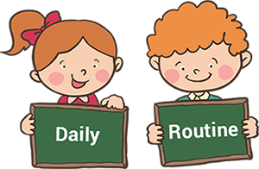

PROJECT

Slide 13
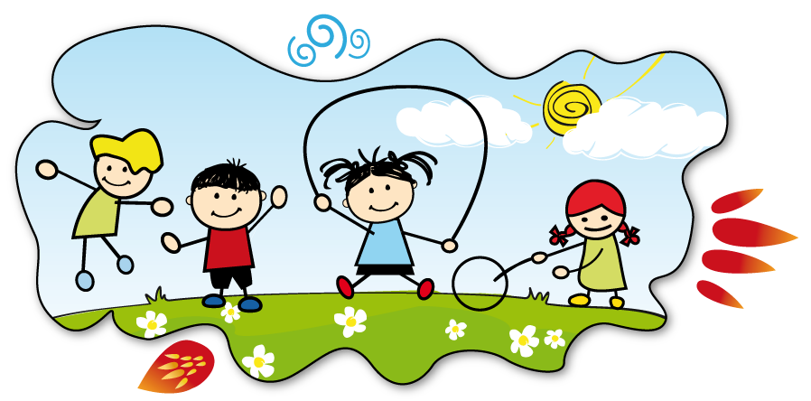
LET’S PLAY

Slide 14



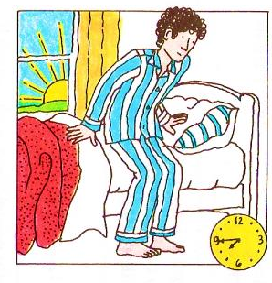
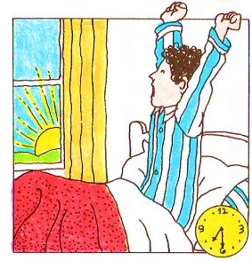


DAILY ROUTINES

Slide 15
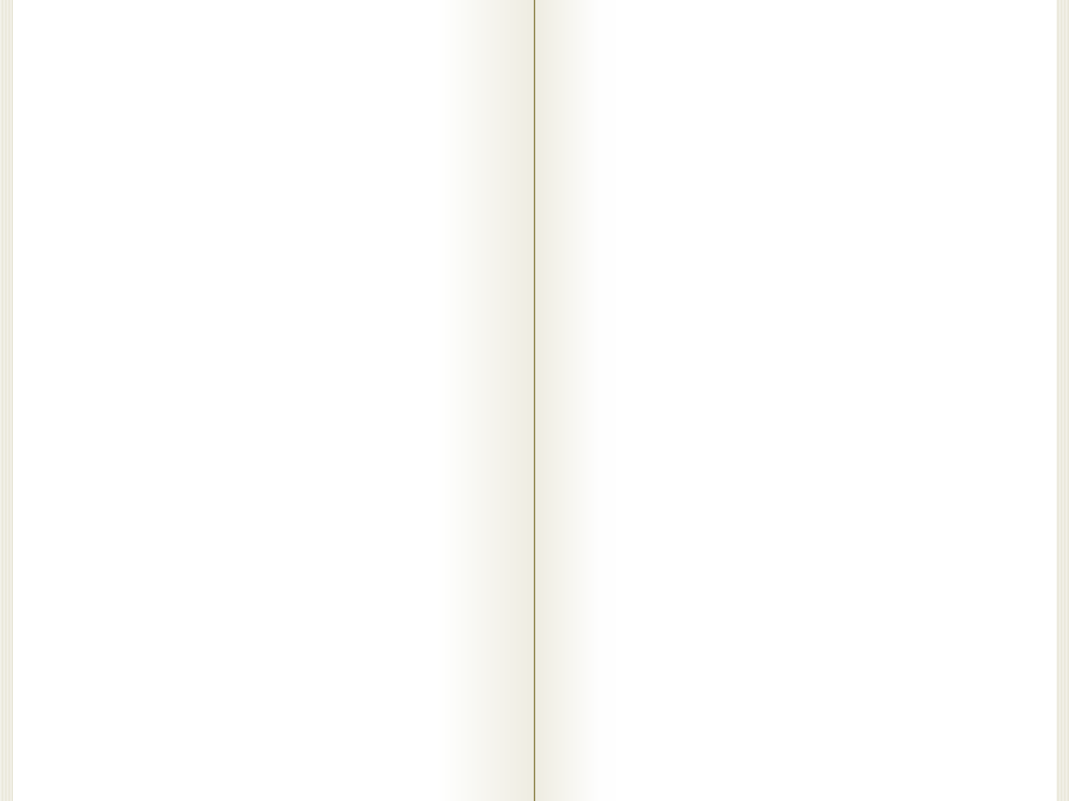

Click on the right options to complete the text.
have breakfast
go to bed
get up
seven thirty
get up
I __________
at _______________
seven forty-five
seven forty-five
seven

Slide 16
Click on the right options to complete the text.
brush my teeth
wash my face
comb my hair
eight o’clock
brush my teeth
I ______________
at _____________
eight o’clock
nine o’clock
seven forty-five

Slide 17
Click on the right options to complete the text.
wash my face
have a bath
have a shower
eight o’clock
have a shower
I ______________
at _____________
five past eight
eight five
five eight

Slide 18
Click on the right options to complete the text.
make my bed
get dressed
go to bed
eight fifteen
get dressed
I usually __________
at _______________
eight thirty
eight twenty-five
eight thirty

Slide 19
Click on the right options to complete the text.
have dinner
have lunch
have breakfast
forty eight
have breakfast
I usually ____________
with my parents
at _______________
eight forty
eight forty
eight forty-five

Slide 20
Click on the right options to complete the text.
go to school
go home
take a walk
eight thirty
go to school
I ____________
at ____________
eight fifty
eight forty
eight fifty

Slide 21
Click on the right options to complete the text.
brush my teeth
wash my face
wash my hands
twelve o’clock
I sometimes
____________
at _______________
wash my face
twelve ten
twelve fifteen
twelve fifteen

Slide 22
Click on the right options to complete the text.
get up
wake up
go to bed
twelve twenty
go to bed
I sometimes ________
at _______________
half-past twelve
twelve thirty
twelve forty
EXIT

