Slide 1

UNIT 12. DON’T RIDE YOUR BIKE TOO FAST!
LESSON 3

Slide 2
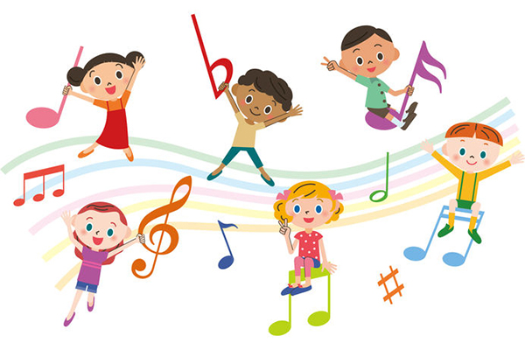


Slide 3
LISTEN AND REPEAT
Don’t play with the knife! ↷.
OK, I won’t. ↷
Don’t play with matches. ↷
OK, I won’t. ↷
Why shouldn’t I play with the knife? ↷.
Because you may cut yourself. ↷.
Why shouldn’t I play with the stove? ↷ .
Because you may get a burn. ↷.

Slide 4

Listen and circle
1
2
3
4
1.Don’t play with the ___________!
a.knife b.stove
2.Don’t climb the ___________!
a.wall b.tree
3.Why shouldn’t he ride his ___________ too fast?
a.bike b.motorbike
4.Why shouldn’t she ___________?
a.run down the stairs b.play with the stove

Slide 5
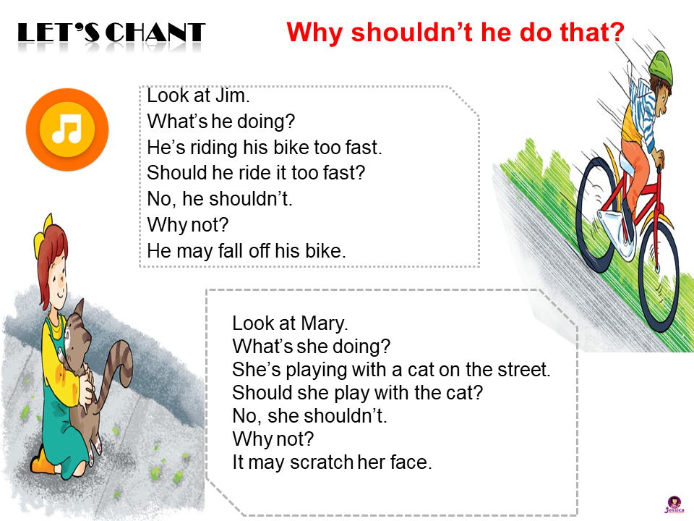

LET’S CHANT
Why shouldn’t he do that?

Slide 6

READ and circle THE BEST TITLE
a. Common accidents
b. Preventing children from falling
c. How to be safe at home
Falling is a common type of accident for young children at home. Your baby brother or sister may fall off a bed or a sofa. He or she may also fall down the stairs. The following tips can help to keep your baby brother or sister safe:
• Make sure he or she can’t roll off the bed
• Make sure he or she can’t open any windows.
• Don’t let him or her go near the stairs.
• Don’t let him or her out on the balcony.

Slide 7

READ and tick
Falling is a common type of accident for young children at home. Your baby brother or sister may fall off a bed or a sofa. He or she may also fall down the stairs. The following tips can help to keep your baby brother or sister safe:
• Make sure he or she can’t roll off the bed
• Make sure he or she can’t open any windows.
• Don’t let him or her go near the stairs.
• Don’t let him or her out on the balcony.
t
f
1.Babies may roll off a sofa.
2.You shouldn’t stop your baby brother or sister when he or she climbs the stairs.
3.You should make sure he or she can’t roll off the bed.
4.Do not open any windows at home.
5.Allow him or her to play on the balcony alone sometimes.

Slide 8

Write what may happen
1. Tony’s playing with a sharp knife.
He may
2. Linda’s playing with a neighbour’s cat.
It may
3. Quan’s riding his bike too fast.
He may
cut himself.
bit her.
fall off his bike.

Slide 9
