Slide 1


UNIT 12. DON’T RIDE YOUR BIKE TOO FAST!
LESSON 2

Slide 2
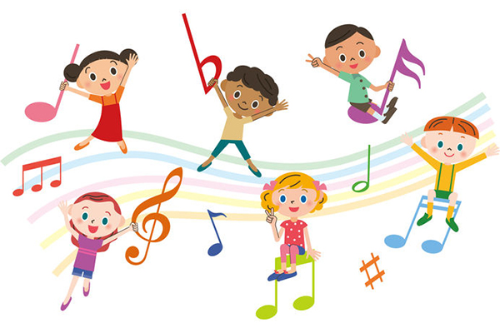


Slide 3
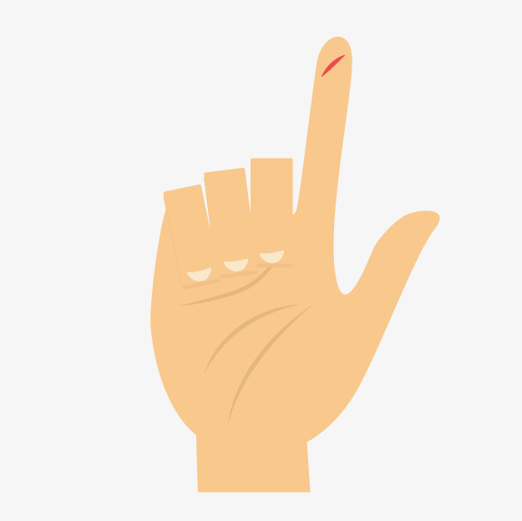
Cut yourself

Slide 4
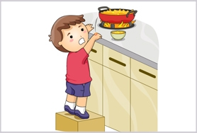
Get a burn
Play with the stove

Slide 5
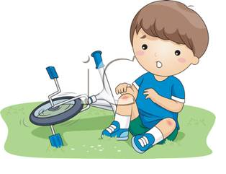
Ride your bike too fast
Fall off your bike

Slide 6
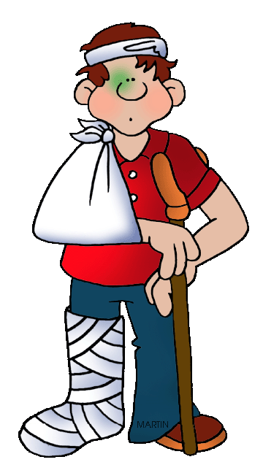
Break your arm
Break your leg

Slide 7
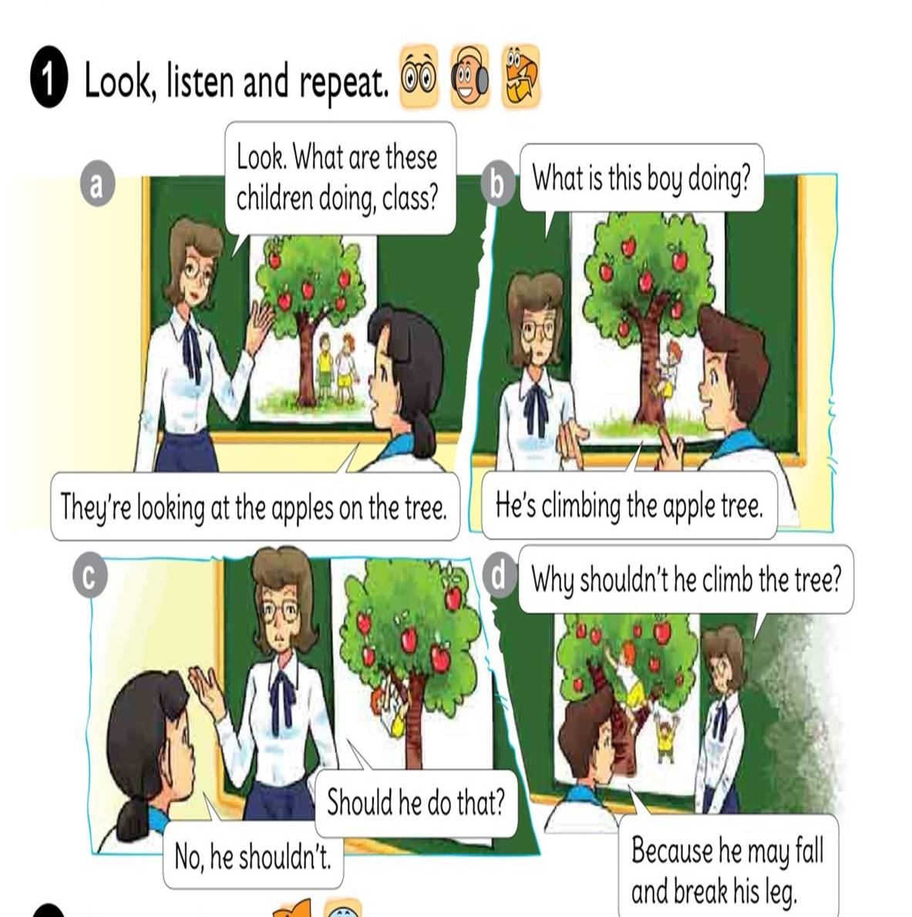




Slide 8
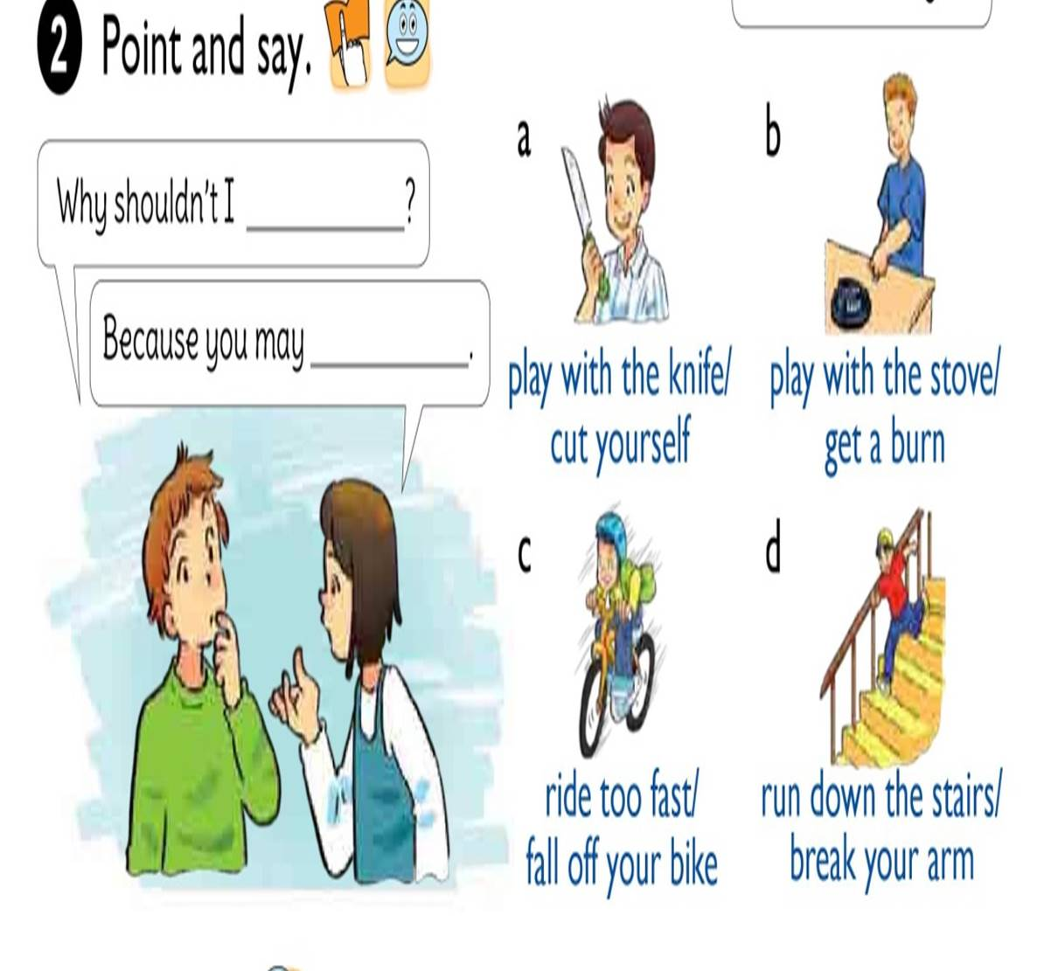

Slide 9


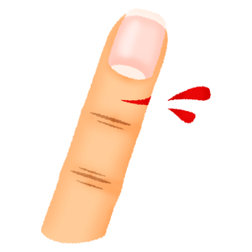
Why shouldn’t I
play with the knife?
Because you may
cut yourself.

Slide 10
Why shouldn’t I
play with the stove?
Because you may
get a burn.

Slide 11
Why shouldn’t I
ride your bike too fast?
Because you may
fall off your bike.

Slide 12
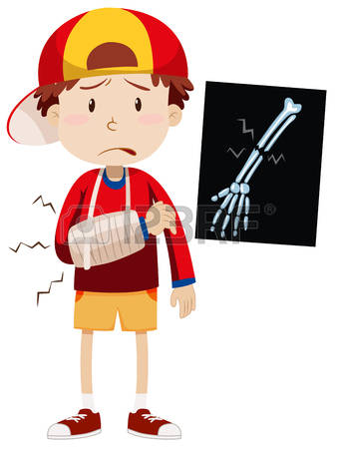
Why shouldn’t I
run down the stairs?
Because you may
break your arm.

Slide 13

LISTEN AND COMPLETE
1. Tony shouldn’t play with the knife because it’s very .
sharp
2. Nam shouldn’t climb the because he may fall and break his leg.
wall
3. Mai shouldn’t play with the stove because she may get a .
burn
4. Tom shouldn’t ride too fast because he may fall off his bike and break his .
arm

Slide 14
READ AND COMPLETE
why
see
knife
don‘t
yourself
Tom: What are you holding in your hand?
Phong: A (1) .
Tom: Oh, no. It’s dangerous. (2) play with it!
Phong: (3) shouldn’t I play with it?
Tom: Because you may cut (4) .
Phong: I can (5) that. Thank you, Tom.
knife
Don‘t
Why
yourself
see

Slide 15
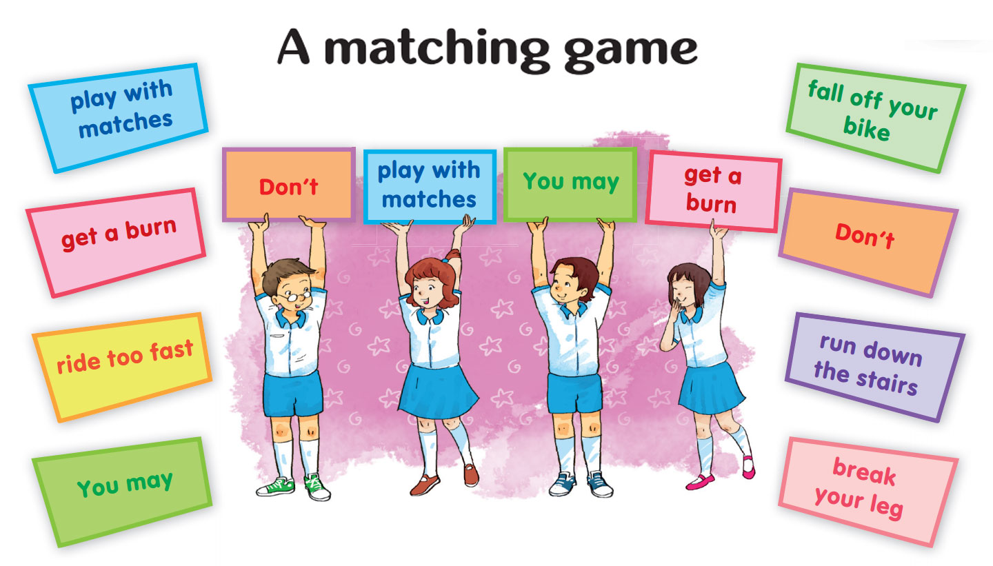
LET’S PLAY

Slide 16
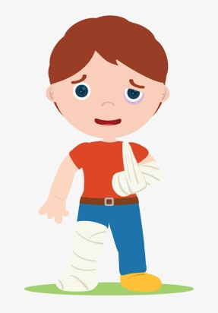
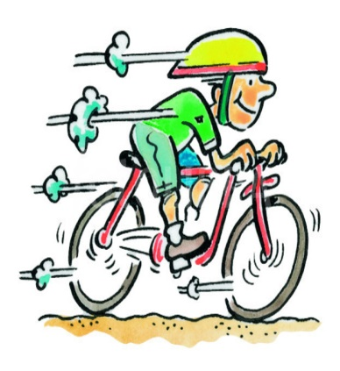
1. Vocabulary
- cut yourself
- get a burn
- fall off your bike
- break your arm
- break your leg
2. Model sentence
Why shouldn’t I ride your bike too fast.
Because you may fall off your bike.

