Slide 1
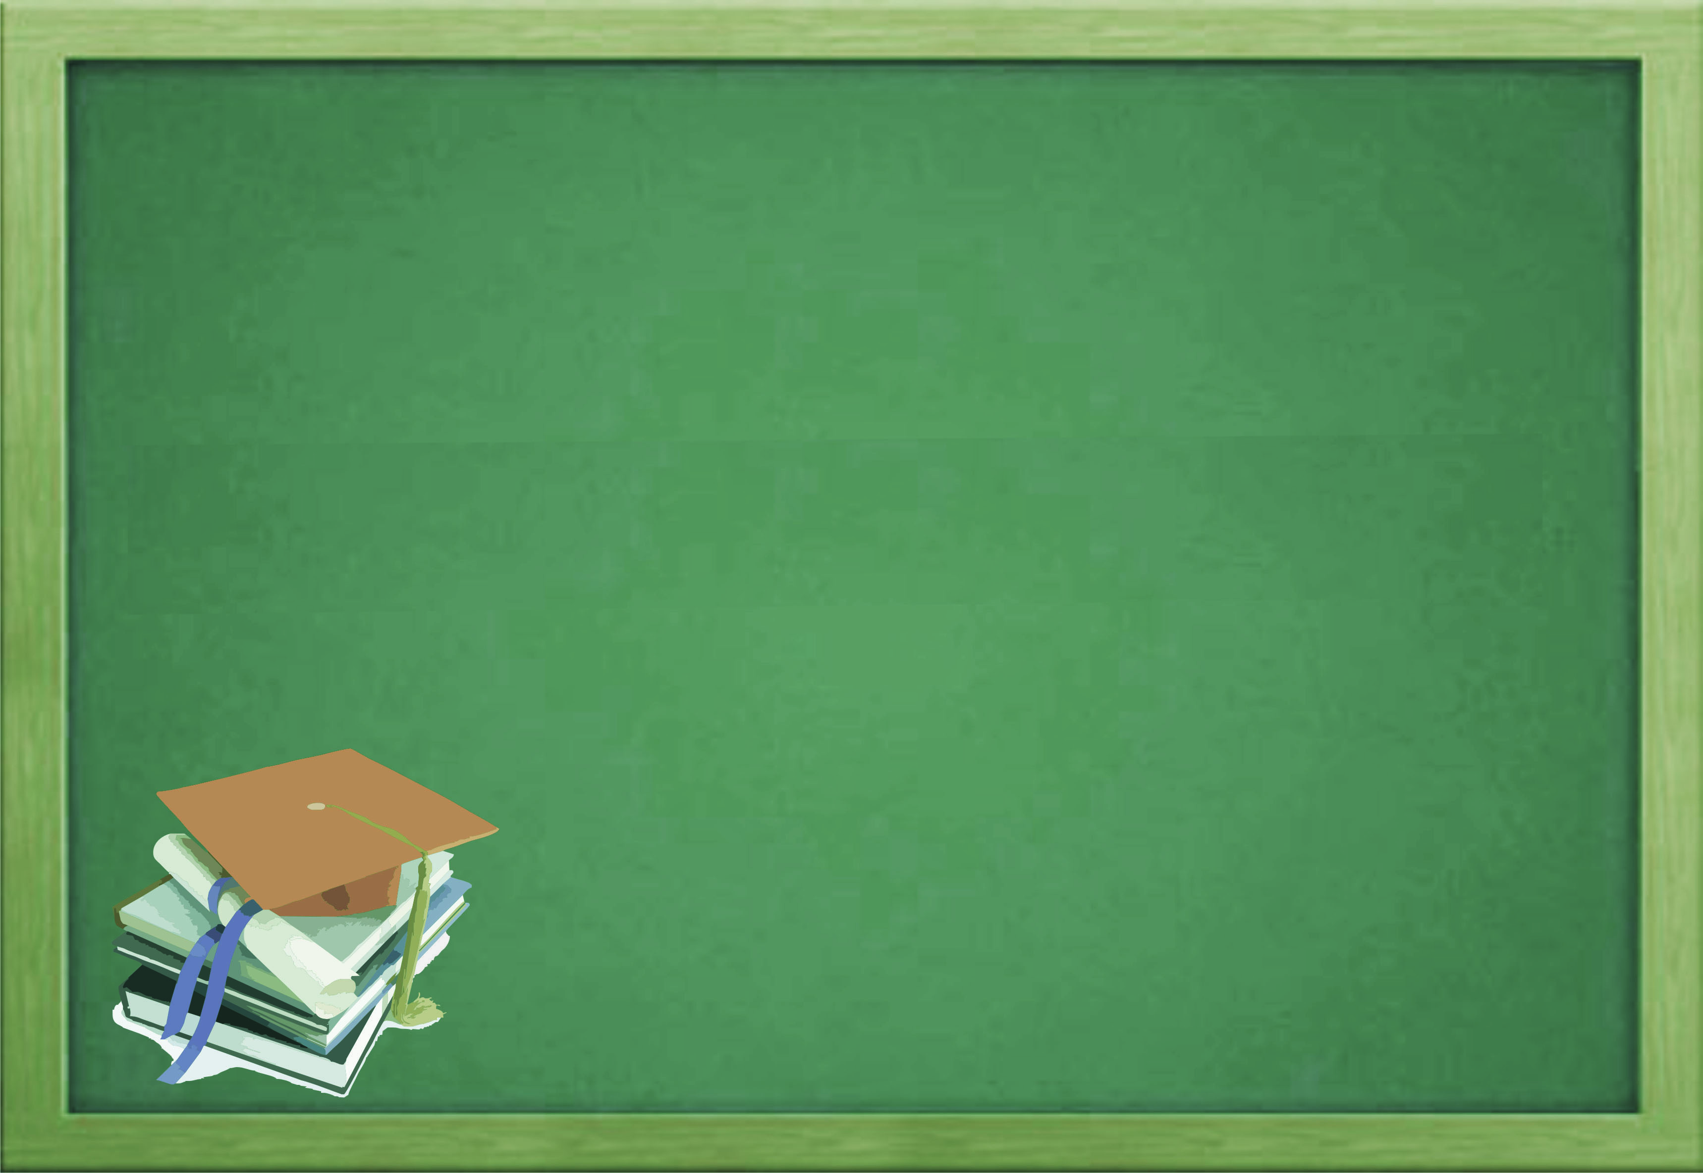
Ngoc Lam Primary School
W E L C O M E T O
O U R C L A S S

Slide 2

Wednesday, december 24th,2021
Unit 10:
WHEN WILL SPORTS
DAY BE ?
LESSON 1

Slide 3

Sports Day

Slide 4

Children’s Day

Slide 5

Teachers’ Day

Slide 6

Independence Day

Slide 7


Sports Day
Teachers’ Day
Children’s Day
Independence Day

Slide 8
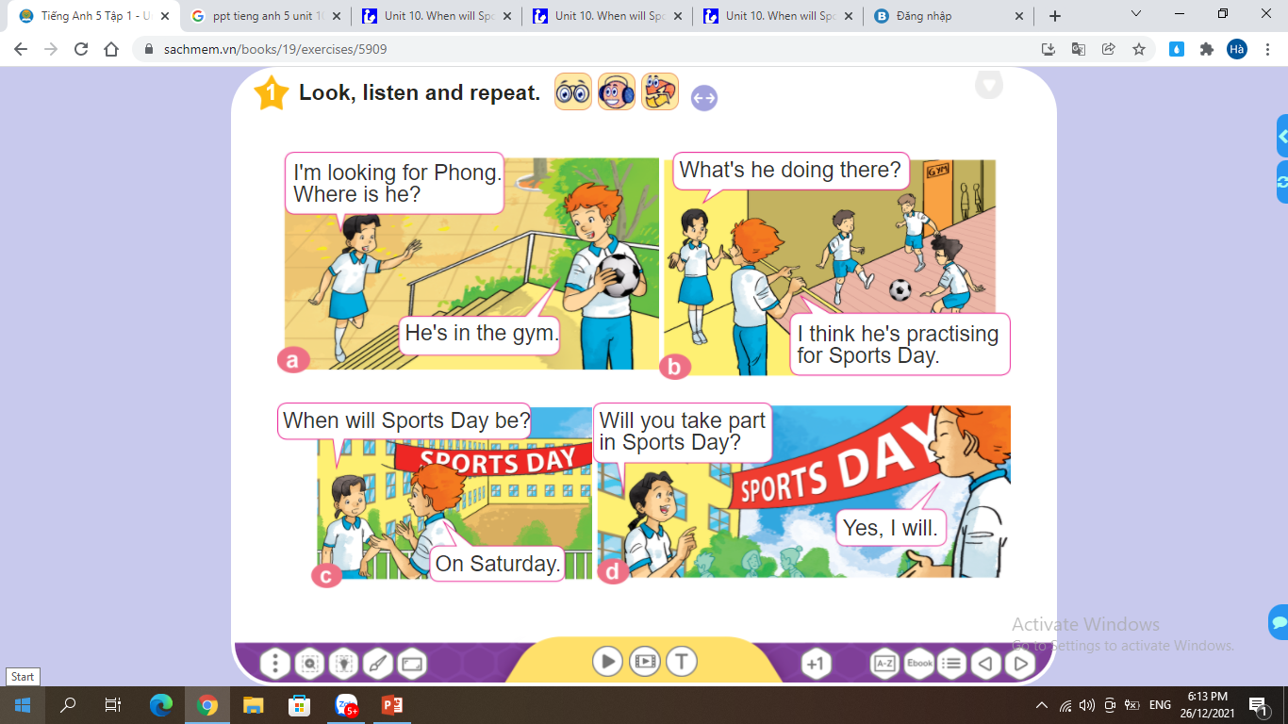


Slide 9
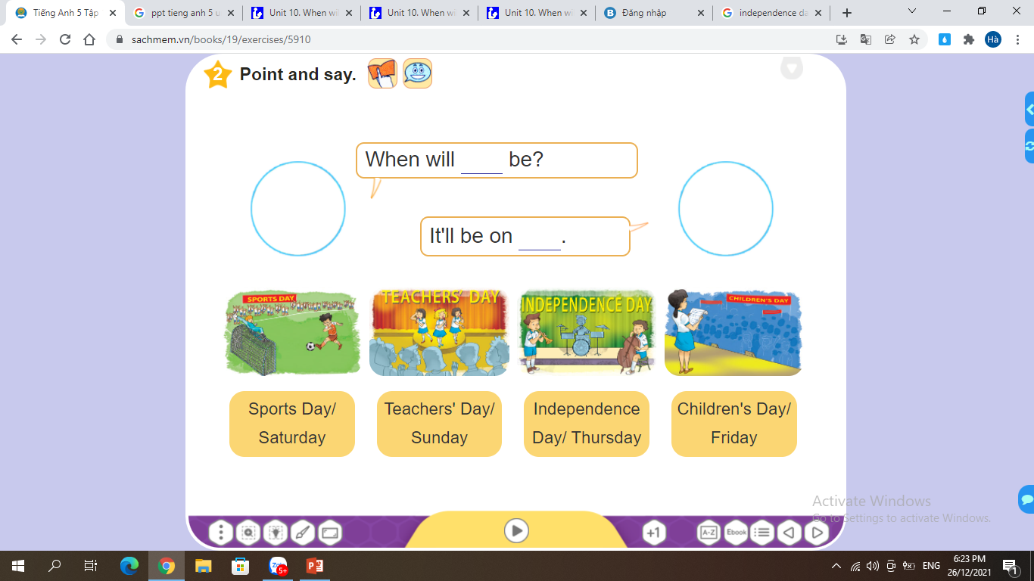


Slide 10
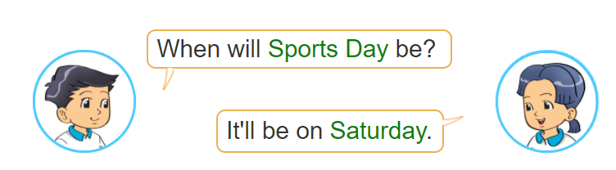
____________
_________

Slide 11
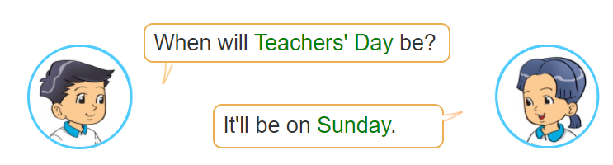
________________
_________

Slide 12
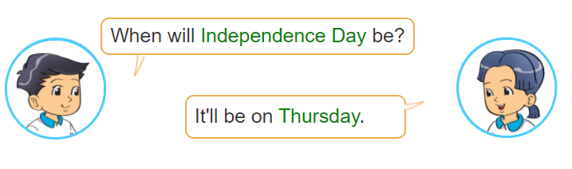
________________
_________

Slide 13
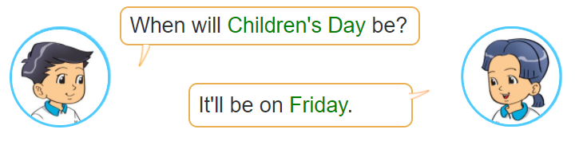
________________
_________

Slide 14
Wednesday, December 29th 2021
Unit 10: When will Sports Day be?
1. Words
- Sports Day
- Teachers’ Day
- Children’s Day
- Independence Day
2. Model
When will Sports Day be?
It’ll be on Sunday.

Slide 15
Wednesday, december 24th,2021
Unit 10:
WHEN WILL SPORTS
DAY BE ?
LESSON 2

Slide 16
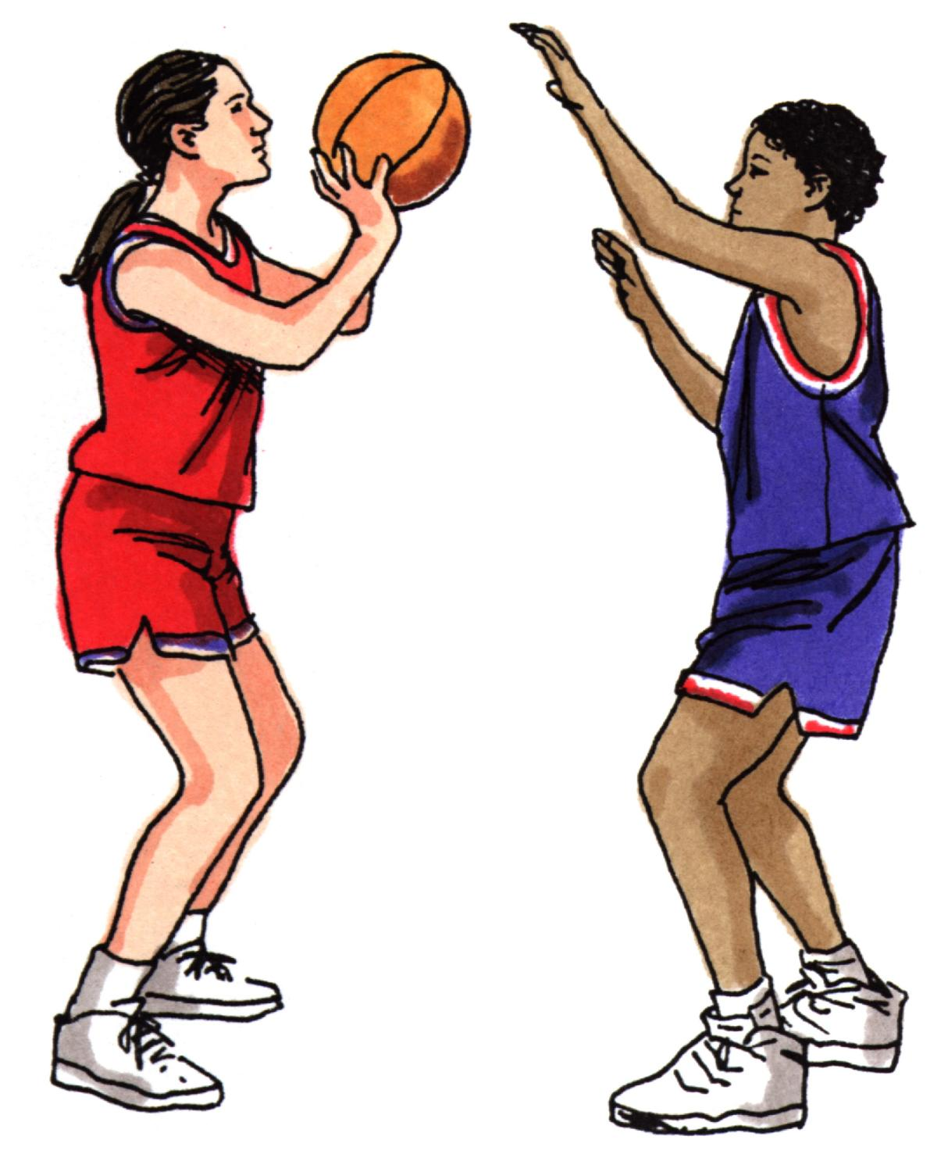
play basketball

Slide 17
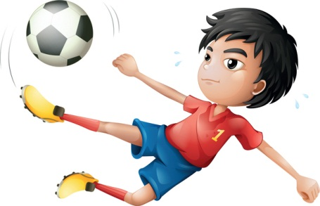
play football

Slide 18
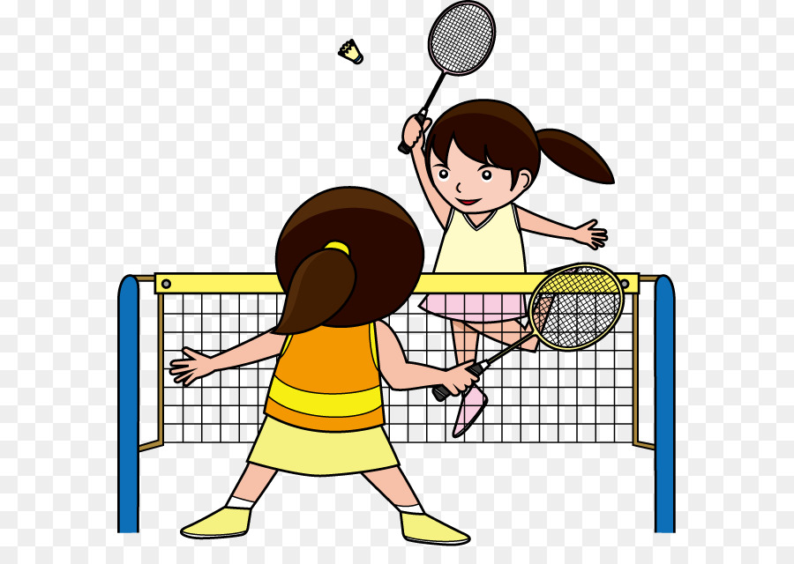
play badminton

Slide 19
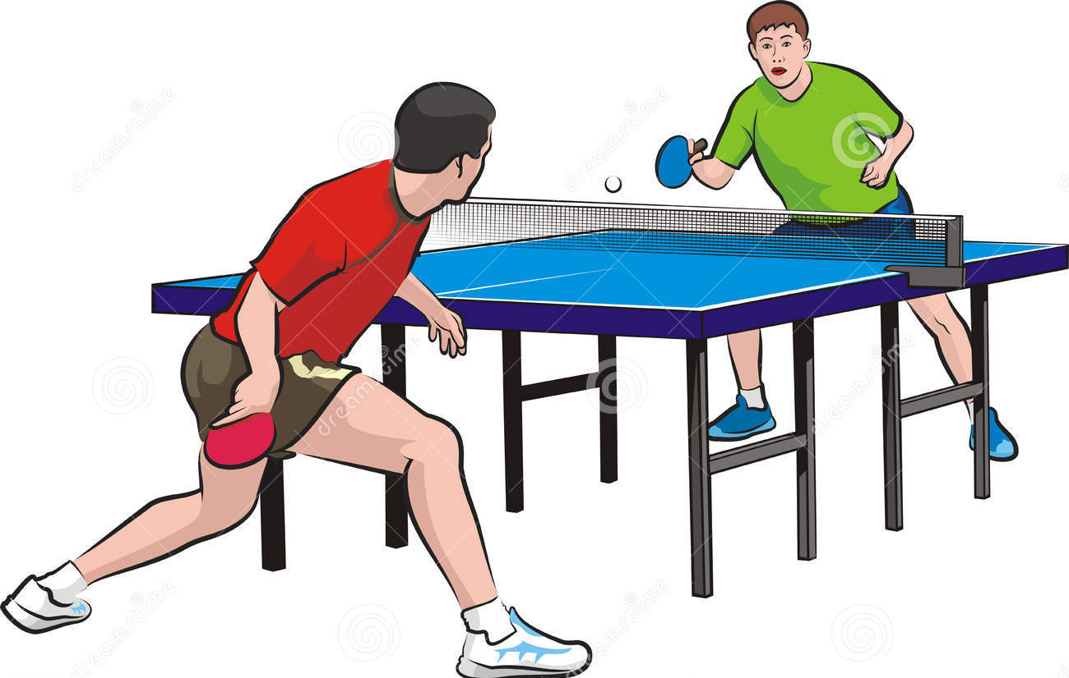
play table tennis

Slide 20



play basketball
play football
play table tennis
play badminton

Slide 21
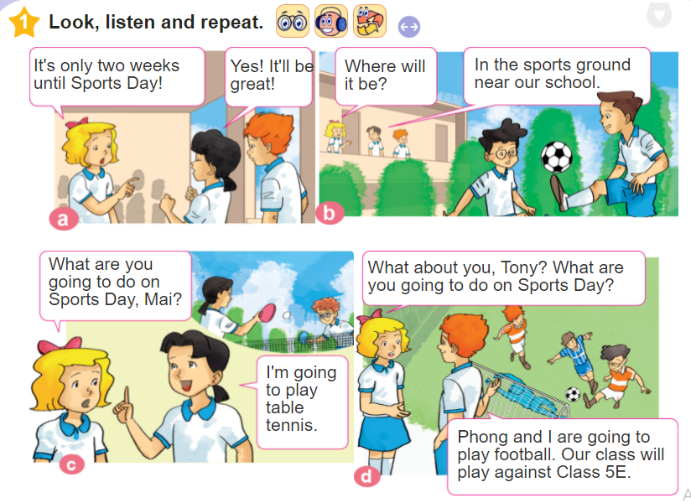

Slide 22
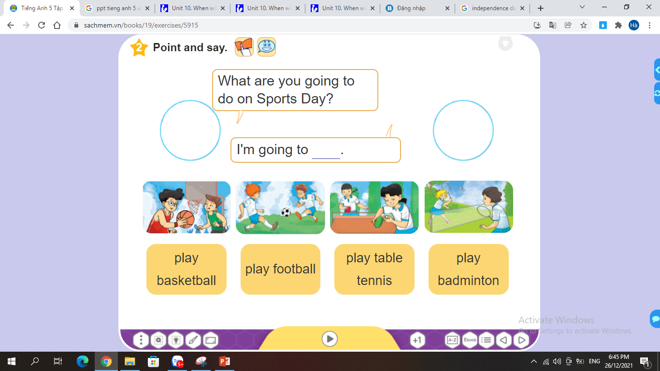


Slide 23

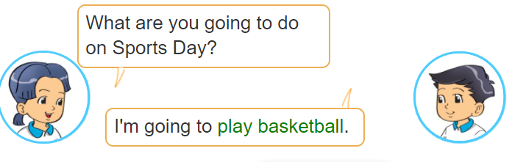
_________________

Slide 24
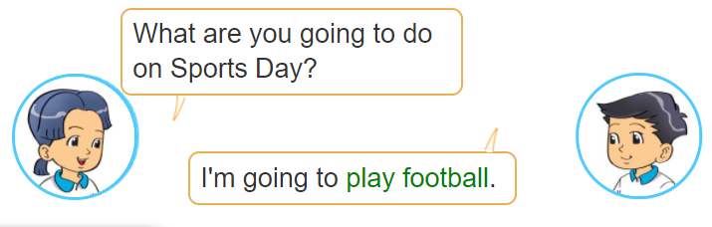
_______________

Slide 25
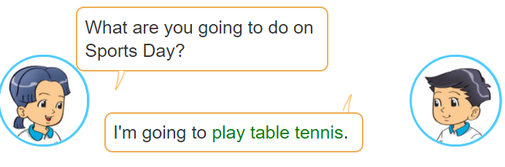
_________________

Slide 26

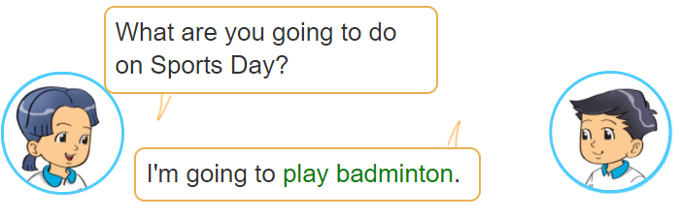
_________________

Slide 27
Wednesday, December 29th 2021
Unit 10: When will Sports Day be?
1. Words
- basketball
- football
- table tennis
- badminton
2. Model
What are you going to do on Sports Day ?
I’m going to play football.

Slide 28
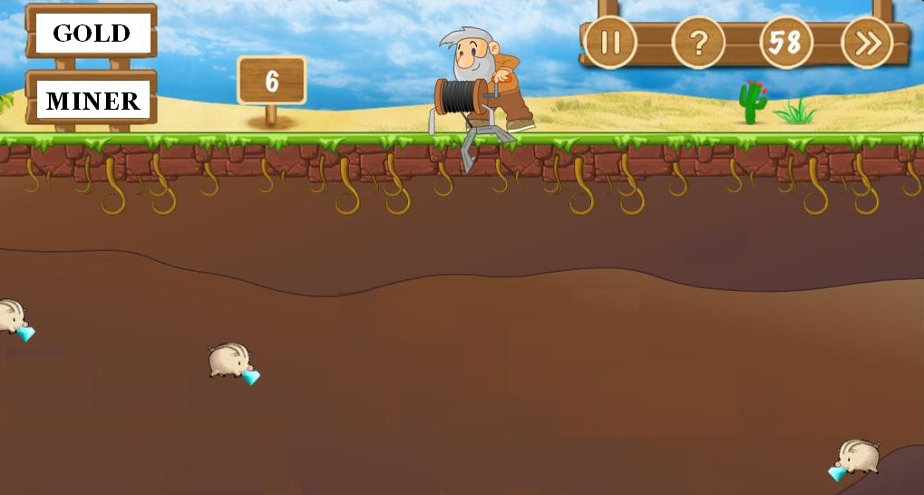


GAME : GOLD MINER
1
5
6
8
7
2
4
3

Slide 29

GOLD MINER
* THE RULE:
Each group has 4 turns to open chests and answer the questions in 10 seconds.
Answering correctly, you take 1 coin from the other group.
If you open a chest of gold, you get 1 coin without answering the question.
If you open a chest of bomb, you will lose 1 coin.

Slide 30


1. When will….. be?
6
3
8
5
2
0
10
9
7
4
1
THAT’S RIGHT !
A. Teacher’s Day
B. Sports Day
WRONG
C. Independence Day
WRONG

Slide 31
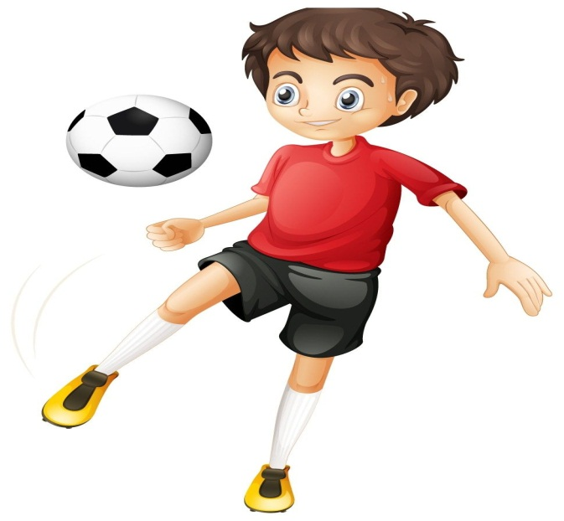
2. What are you going
to do on Sports Day?
I’m going to……………
6
3
8
5
2
0
10
9
7
4
1
A. play badminton
WRONG
B. play football
THAT’S RIGHT !
C. play volleyball
WRONG

Slide 32

3. Sports Day will be on ___________.
6
0
2
8
5
10
9
7
4
3
1
A. Saturday
WRONG
B. Sunday
THAT’S RIGHT!
C. Friday
WRONG

Slide 33
4. Reorder the words:
6
3
8
5
2
0
10
9
7
4
1
will/Sports /be/ Day/when

Slide 34
5. I’m going ___ play
badminton.
6
3
8
5
2
0
10
9
7
4
1
A. on
WRONG
B. to
THAT’S RIGHT!
C. in
WRONG

Slide 35

6
3
8
5
2
0
10
6. What are you going
to do on Sports Day?
I’m going to …………
9
7
4
1
WRONG
go swimming
THAT’S RIGHT!
B. Play badminton.
C. Play basketball.
WRONG

Slide 36
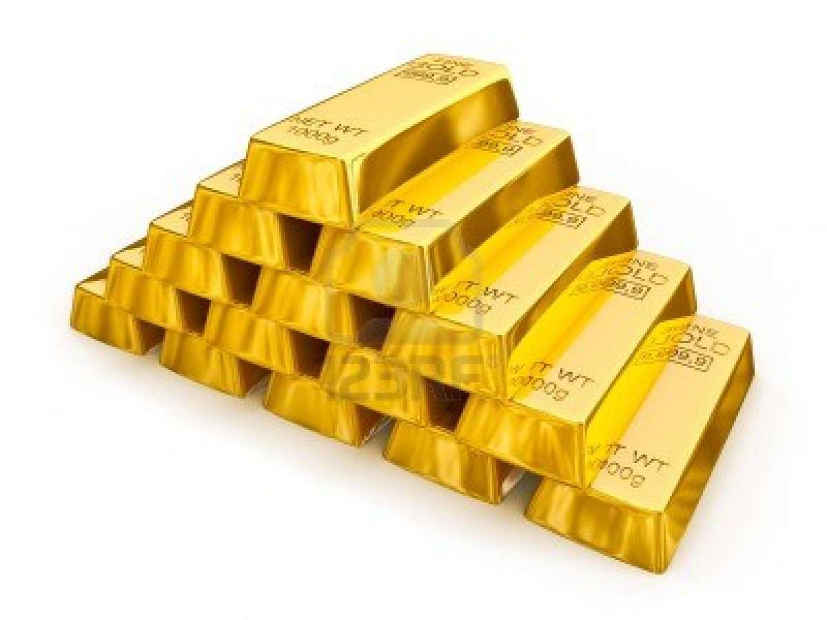

Slide 37


Slide 38
Wednesday, december 24th,2021
Unit 10:
WHEN WILL SPORTS
DAY BE ?
LESSON 3

Slide 39

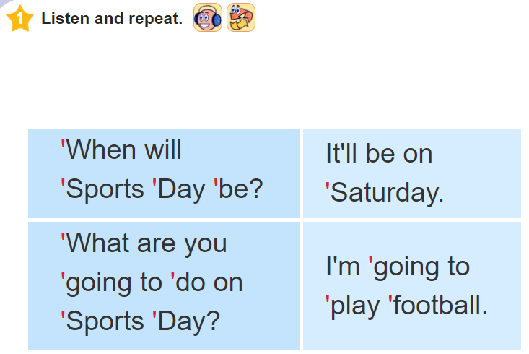

Slide 40
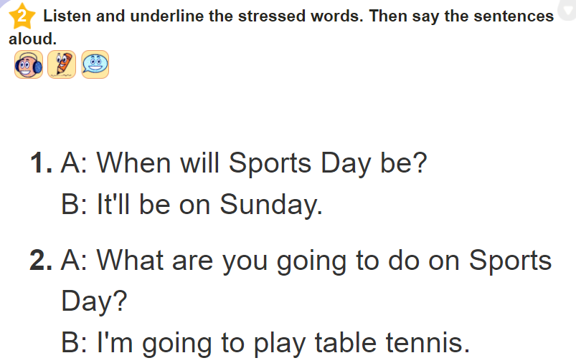

Slide 41
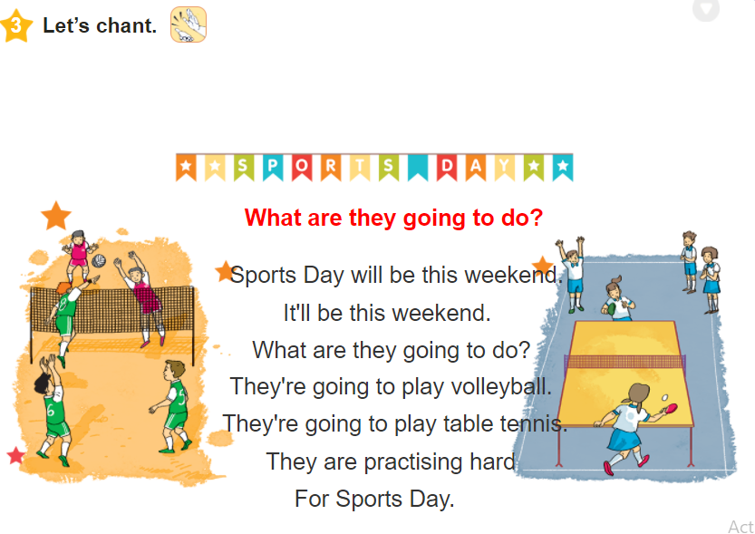

Slide 42
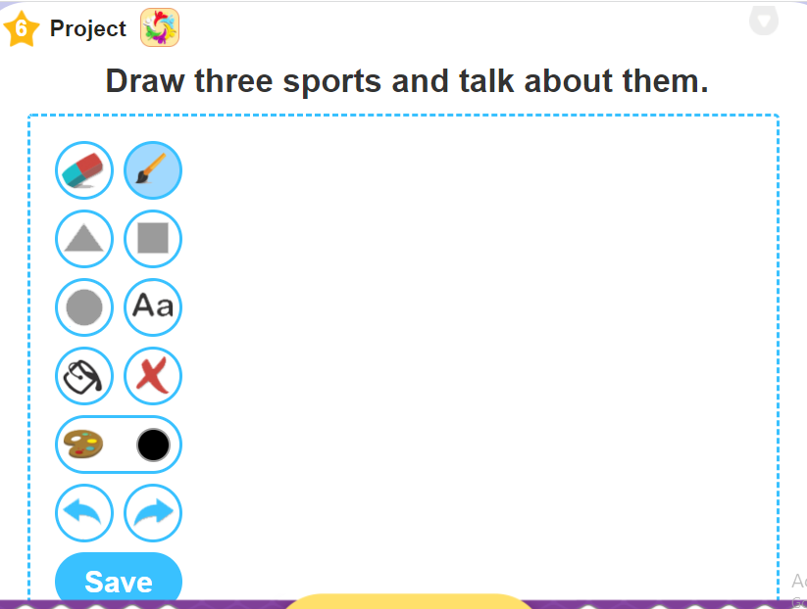

Slide 43

Homework:

Slide 44

Thank you

