Slide 1
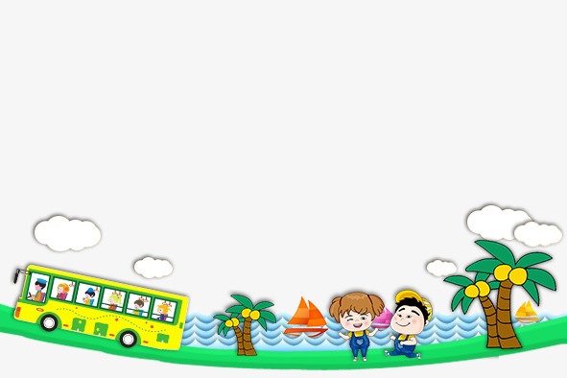

UNIT 11. WHAT’S THE MATTER WITH YOU?
LESSON 2

Slide 2
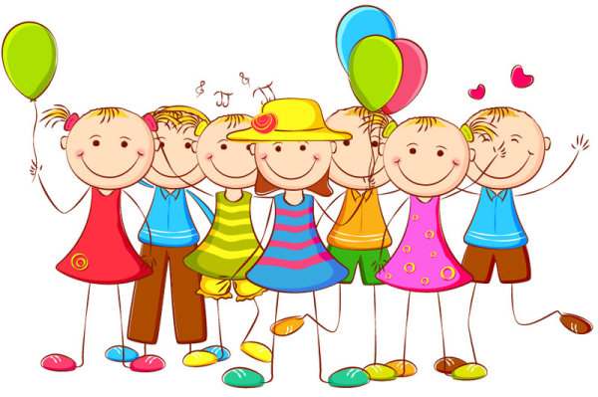

WARM UP

Slide 3
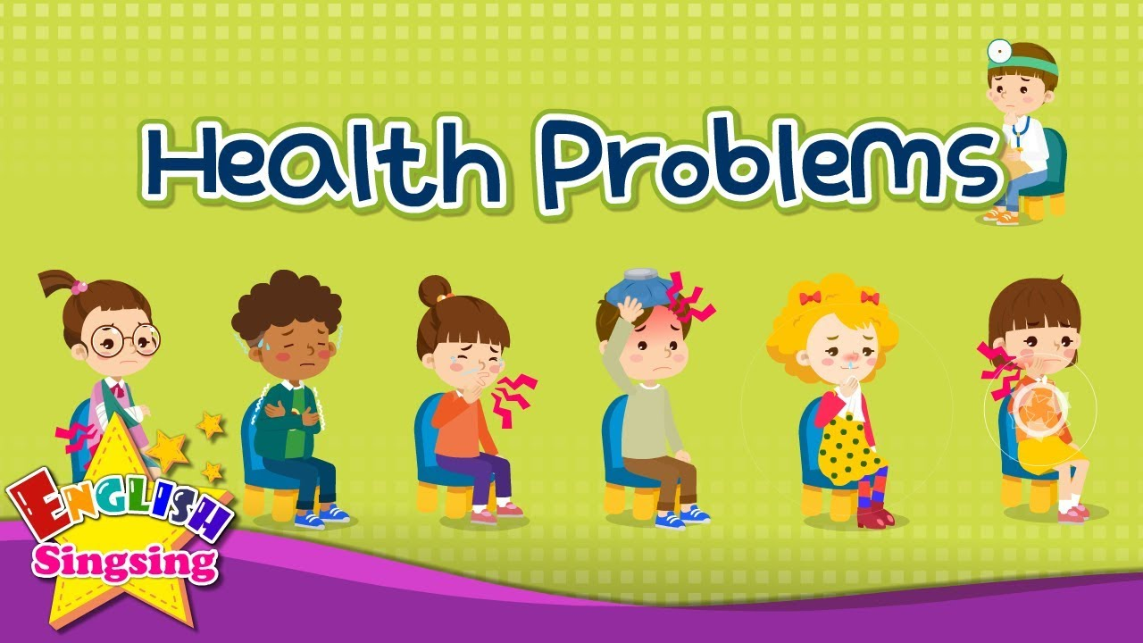

Slide 4
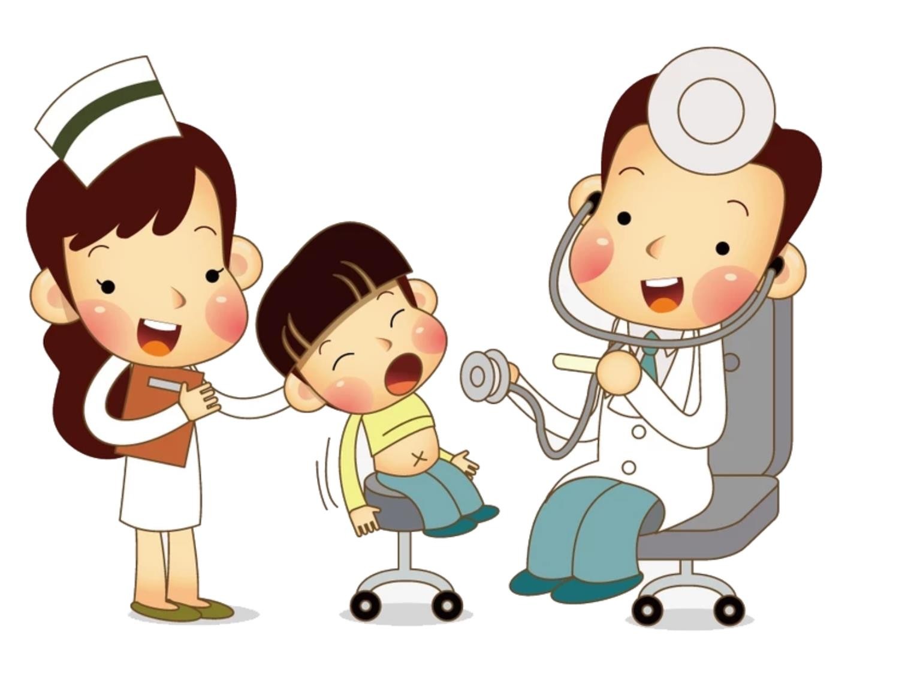
Go to the doctor

Slide 5
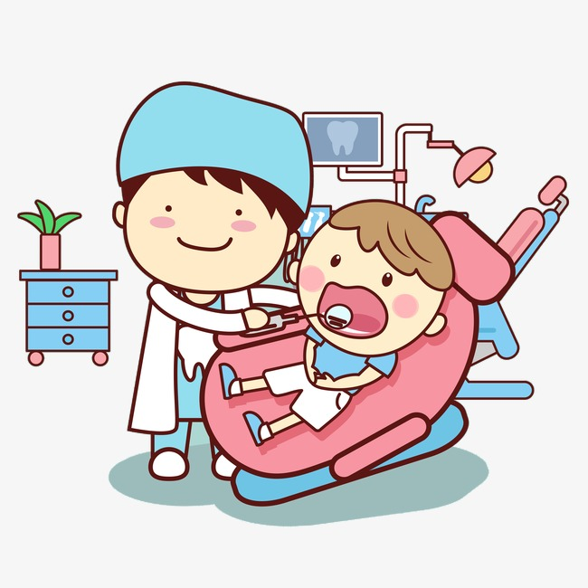
Go to the dentist

Slide 6
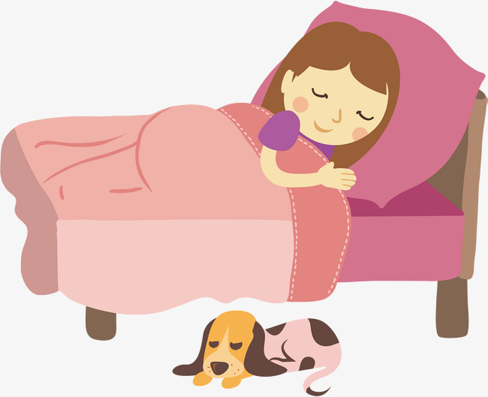
Take a rest

Slide 7
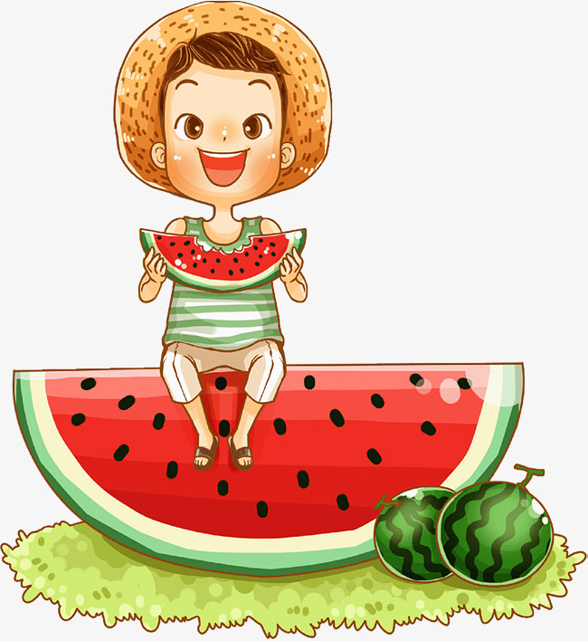
Eat a lot of fruit

Slide 8
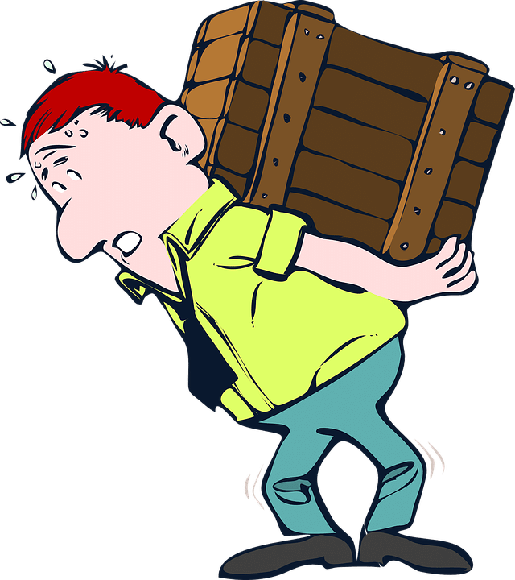
Carry heavy thing

Slide 9
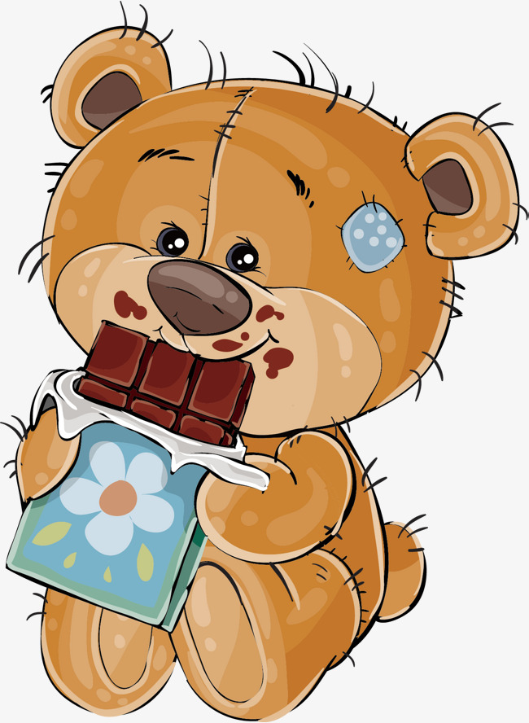
Eat a lot of sweets

Slide 10
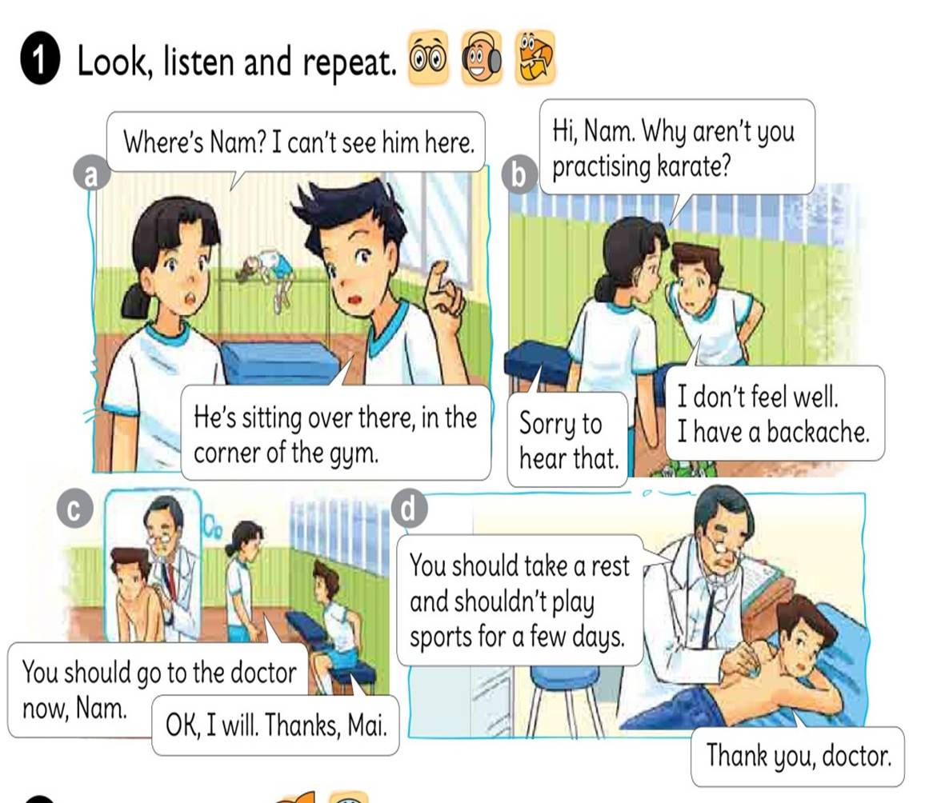


Slide 11
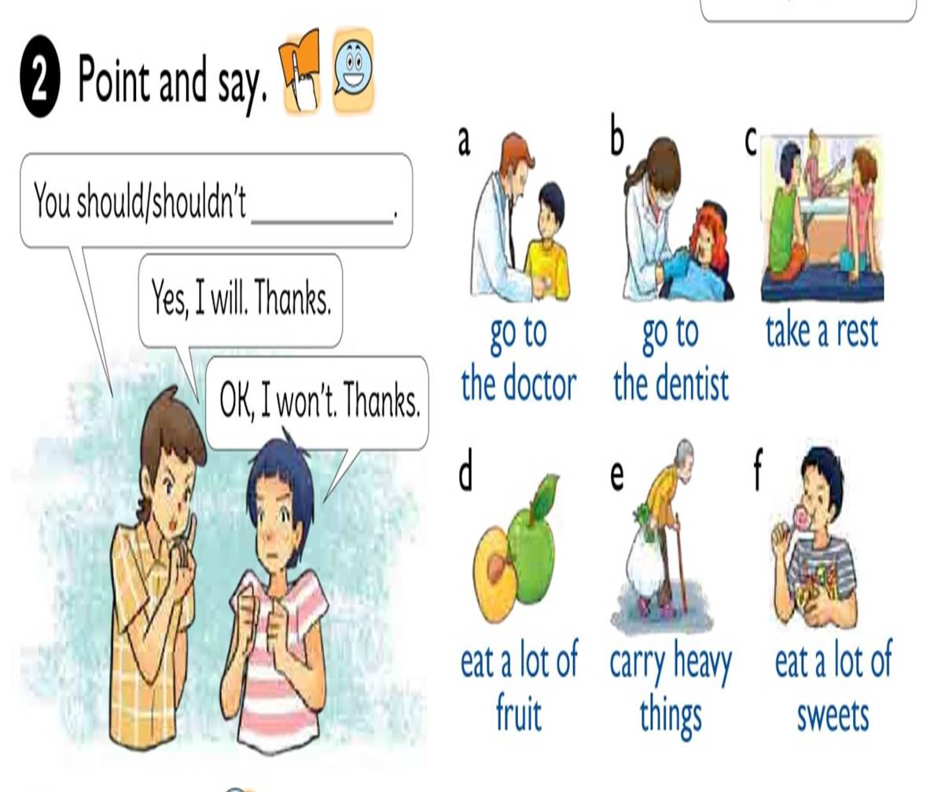

Slide 12

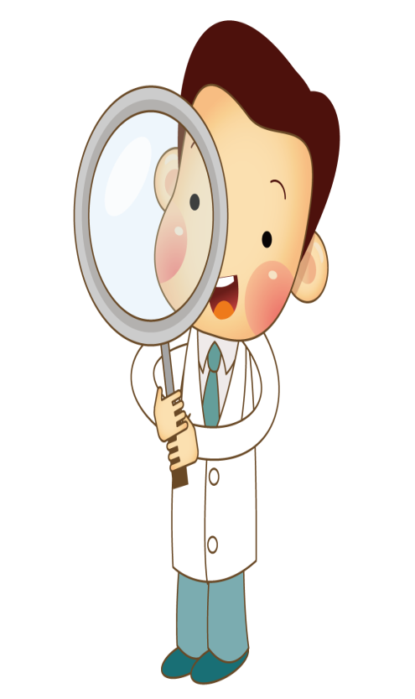
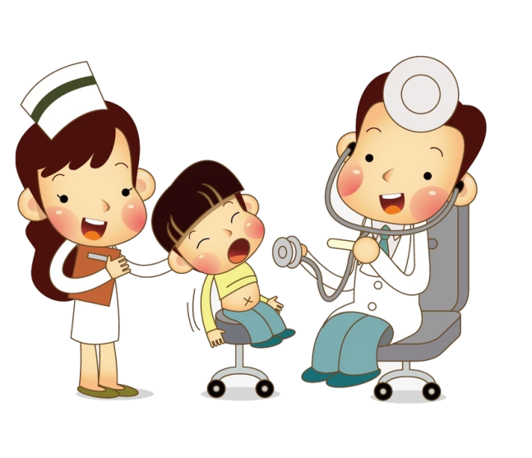
You should
go to the doctor.
Yes, I will. Thanks

Slide 13
You should
go to the dentist.
Yes, I will. Thanks

Slide 14

You should
take a rest
Yes, I will. Thanks

Slide 15

You should
eat a lot of fruit
Yes, I will. Thanks

Slide 16
You shouldn’t
carry heavy things
Yes, I won’t. Thanks.

Slide 17
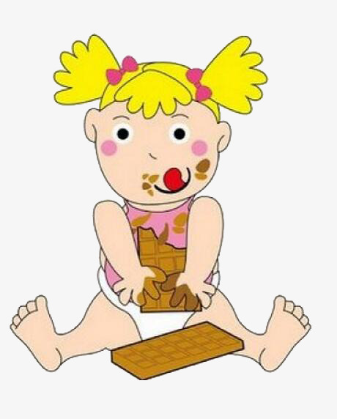
You shouldn’t
eat a lot of sweets
No, I won’t. Thanks

Slide 18

Listen and COMPLETE
Health Problem
should
shouldn’t
Quan
Stomach ache
Go to the doctor
Tony
fever
Go to school
Phong
toothache
eat ice cream
Mrs Green
backache
carry heavy things

Slide 19
READ AND COMPLETE
Quan: Where’s Phong?
Mai: He can’t go to school today.
Quan: Why not?
What’s the (1) with him?
Mai: He (2) a bad cough and is going to see the (3) this morning.
Quan: Oh, really? Poor him!
rest
matter
stomach
has
doctor
matter
Mai: What’s the matter with you, Tony?
Tony: I have a pain in my (4)
Mai: Oh, dear. You should take a (5) now and go to the doctor later.
has
stomach
doctor
rest

Slide 20
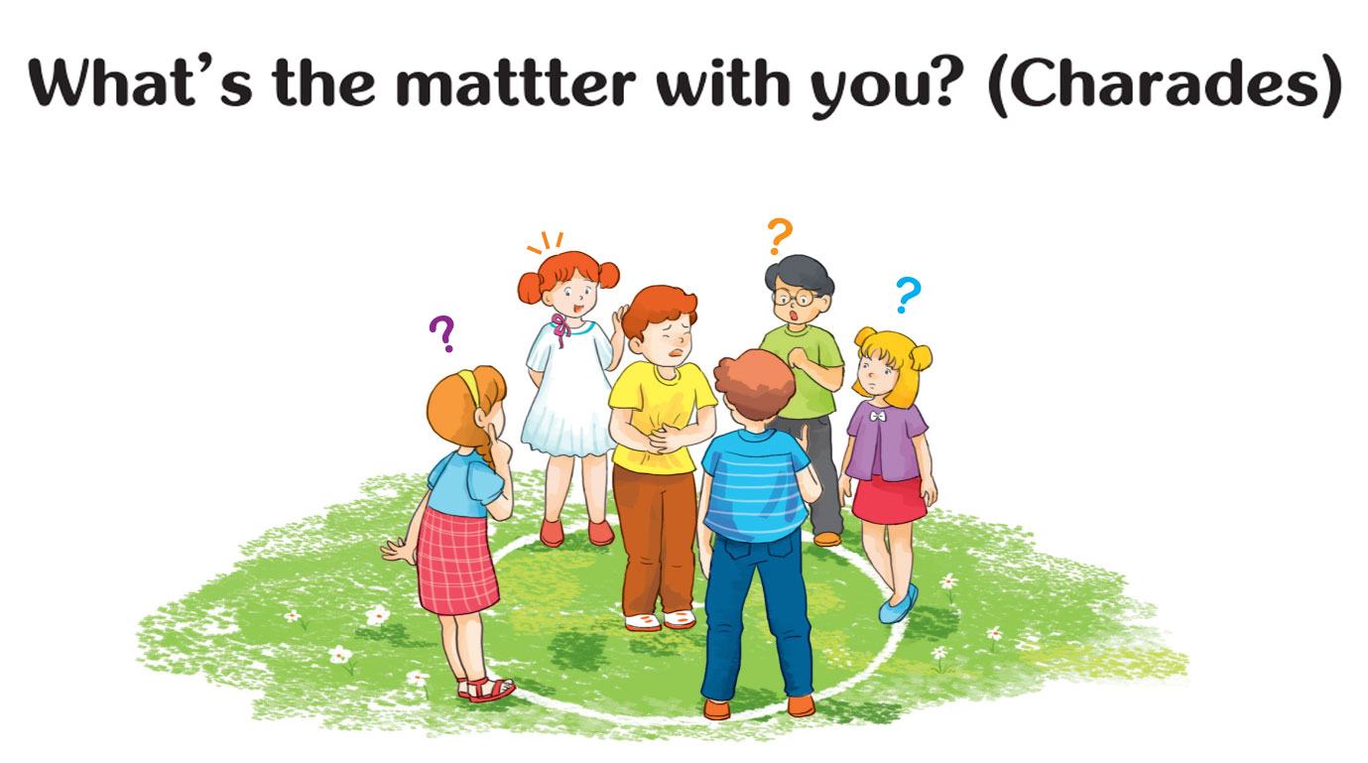
Let’s PLAY

Slide 21
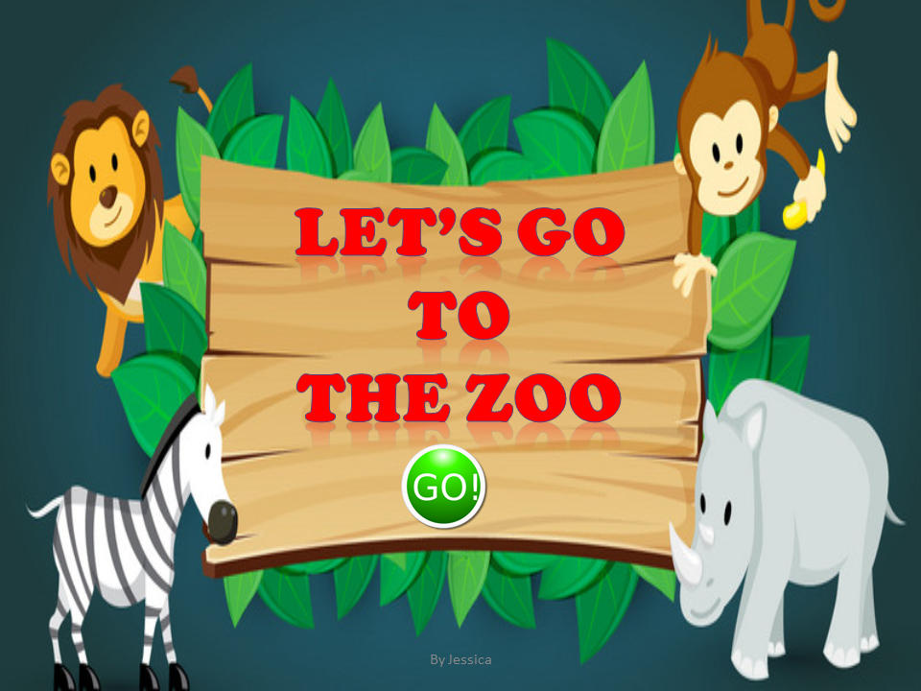

Let’s go
To
The zoo

Slide 22
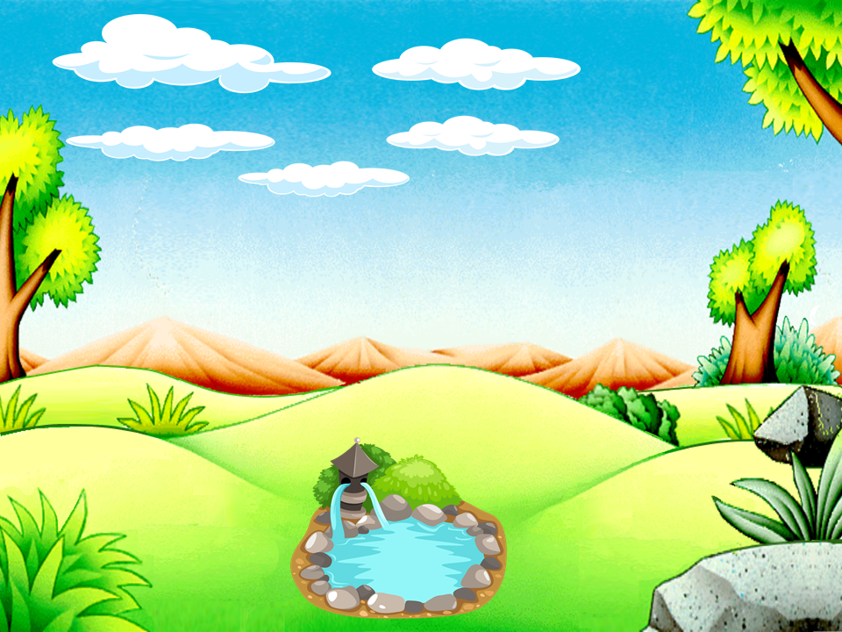

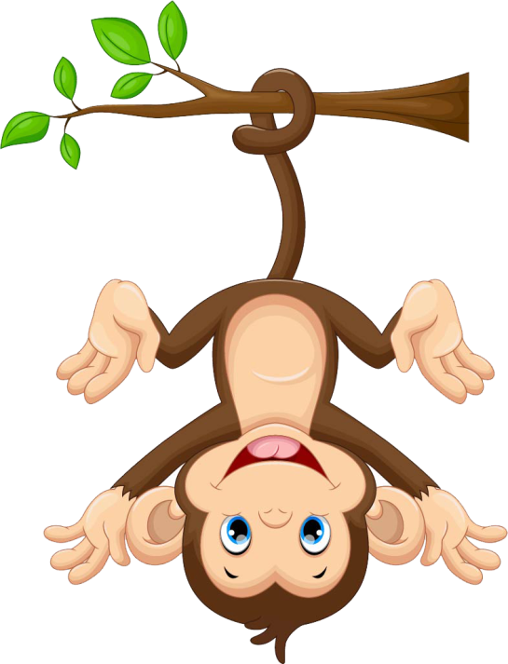
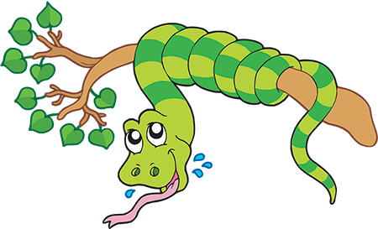
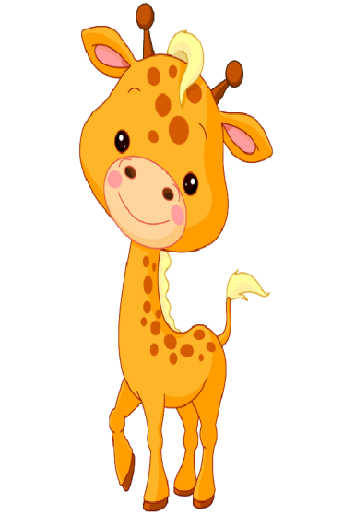
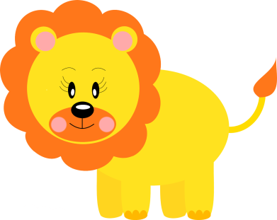
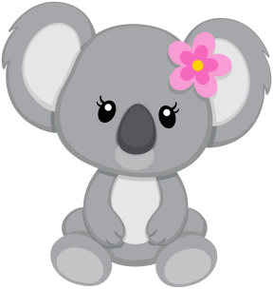
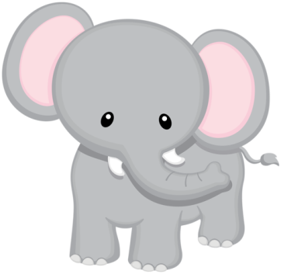
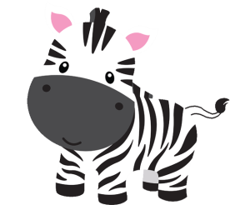
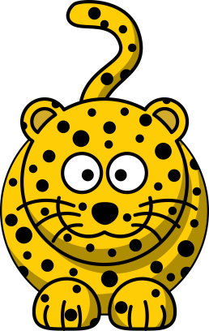
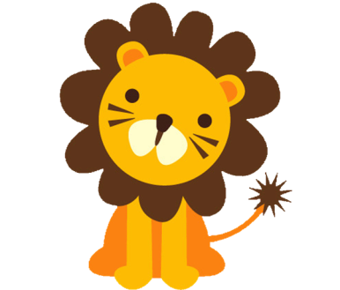
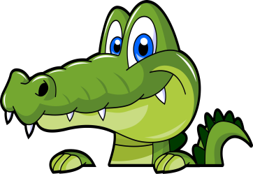


Slide 23
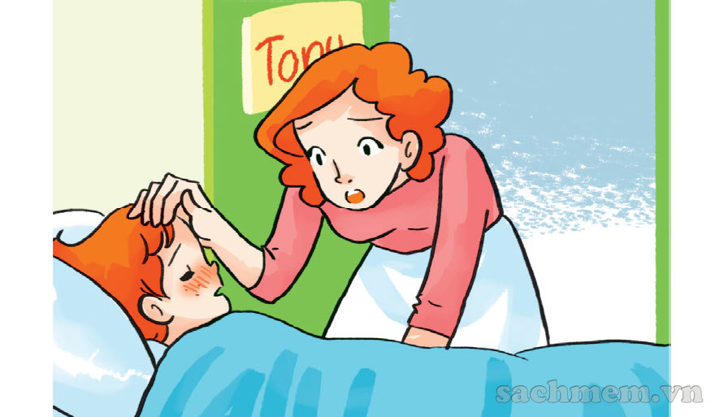
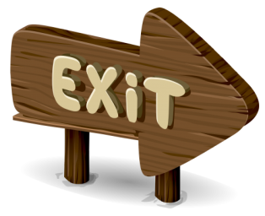
What’s the matter with you?
A toothache
A fever
An earache

Slide 24
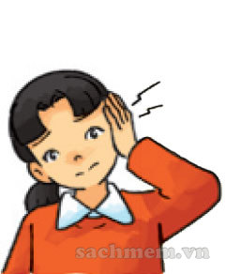
What’s the matter with you?
An earache
A stomach ache
A headache

Slide 25
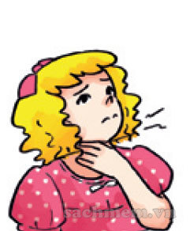
What’s the matter with you?
a backache
A toothache
A sore throat

Slide 26

You should …
Eat a lot of fruit
Take a rest
Go to the doctor

Slide 27
You should …
Carry heavy things
Take a rest
Eat a lot of sweet

Slide 28
You shuld …
Go to the dentist
Take a rest
Eat a lot of fruit

Slide 29

You should …
Eat a lot of fruit
Eat a lot of sweets
Take a rest

Slide 30
You shuldn’t …
Go to the dentist
Go to the doctor
Carry heavy things

Slide 31
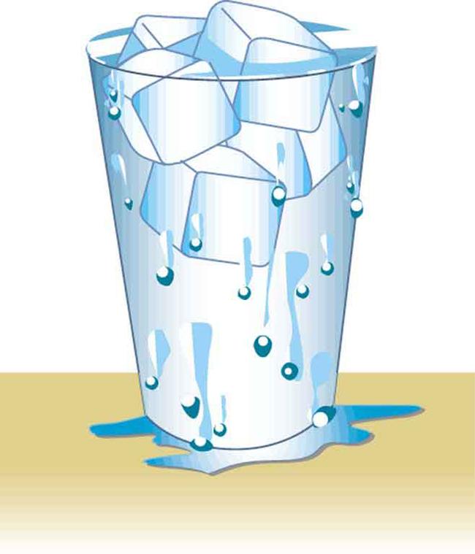
You shouldn’t …
Drink cold water
Go to the doctor
Take a rest

Slide 32
You shuldn’t …
Go to the dentist
Eat a lot of fruit
Eat a lot of sweets

Slide 33
