Slide 1

UNIT 11. WHAT TIME IS IT?
LESSON 1

Slide 2
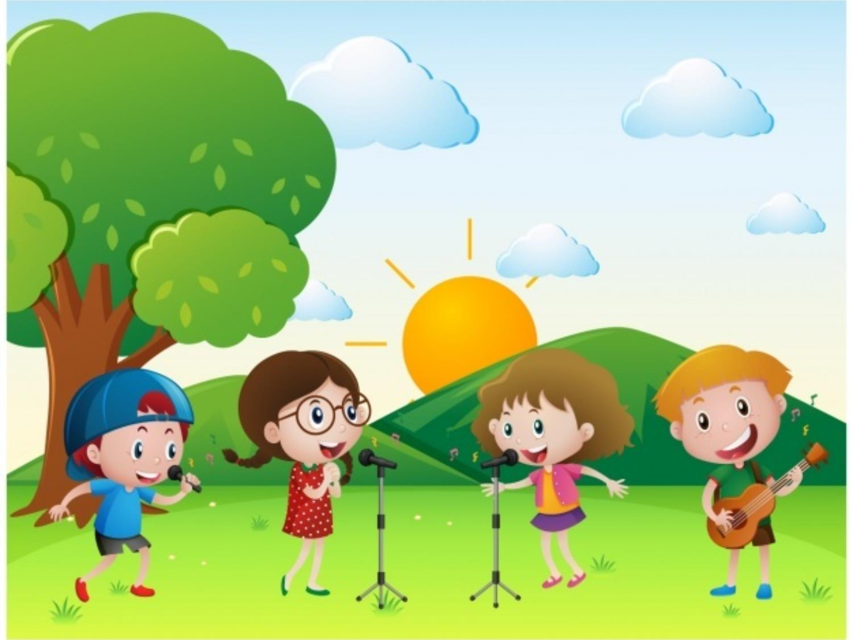

WARM UP

Slide 3
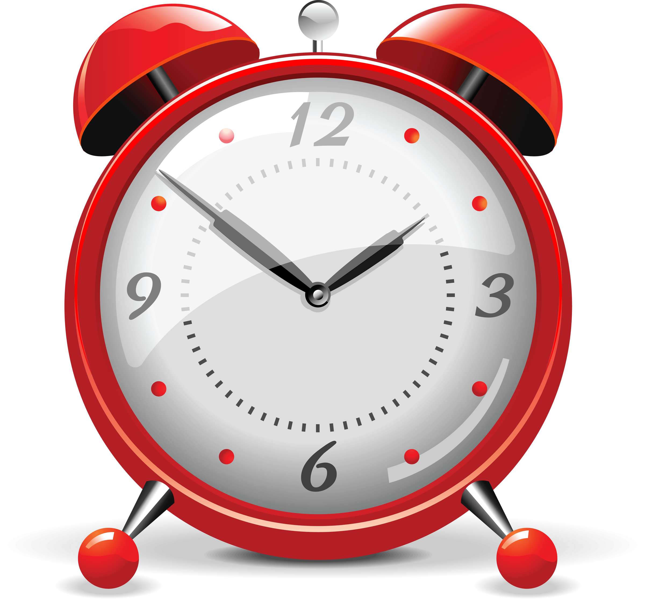
CLOCK

Slide 4
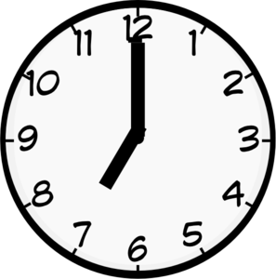
seven

Slide 5
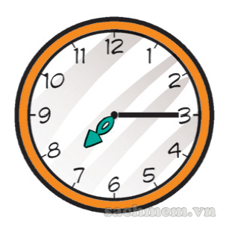
Seven fifteen

Slide 6
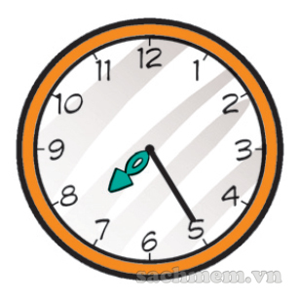
Seven twenty-five

Slide 7
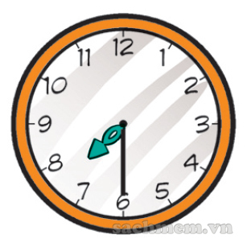
Seven thirty

Slide 8
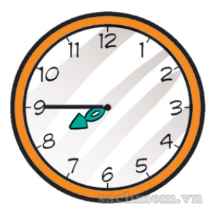
Seven forty-five

Slide 9
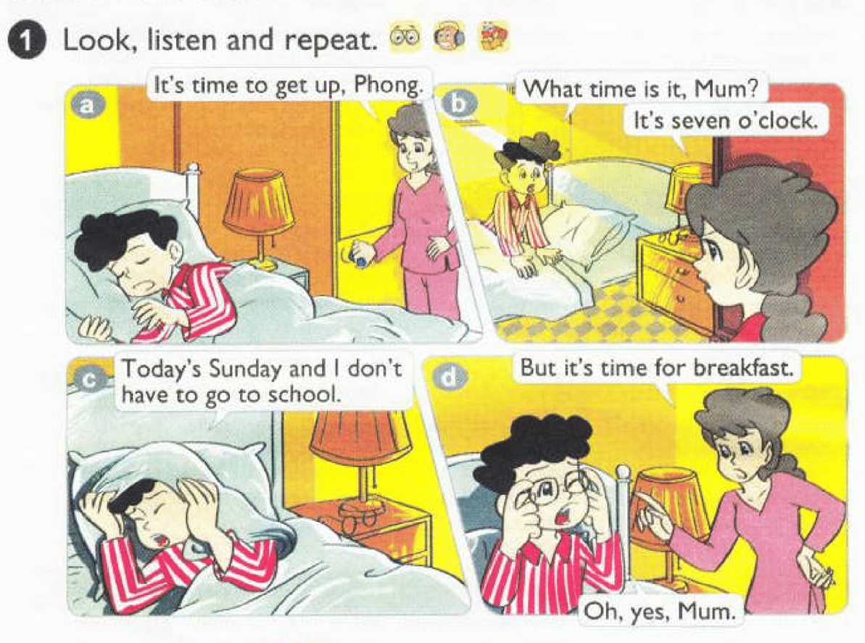



Slide 10
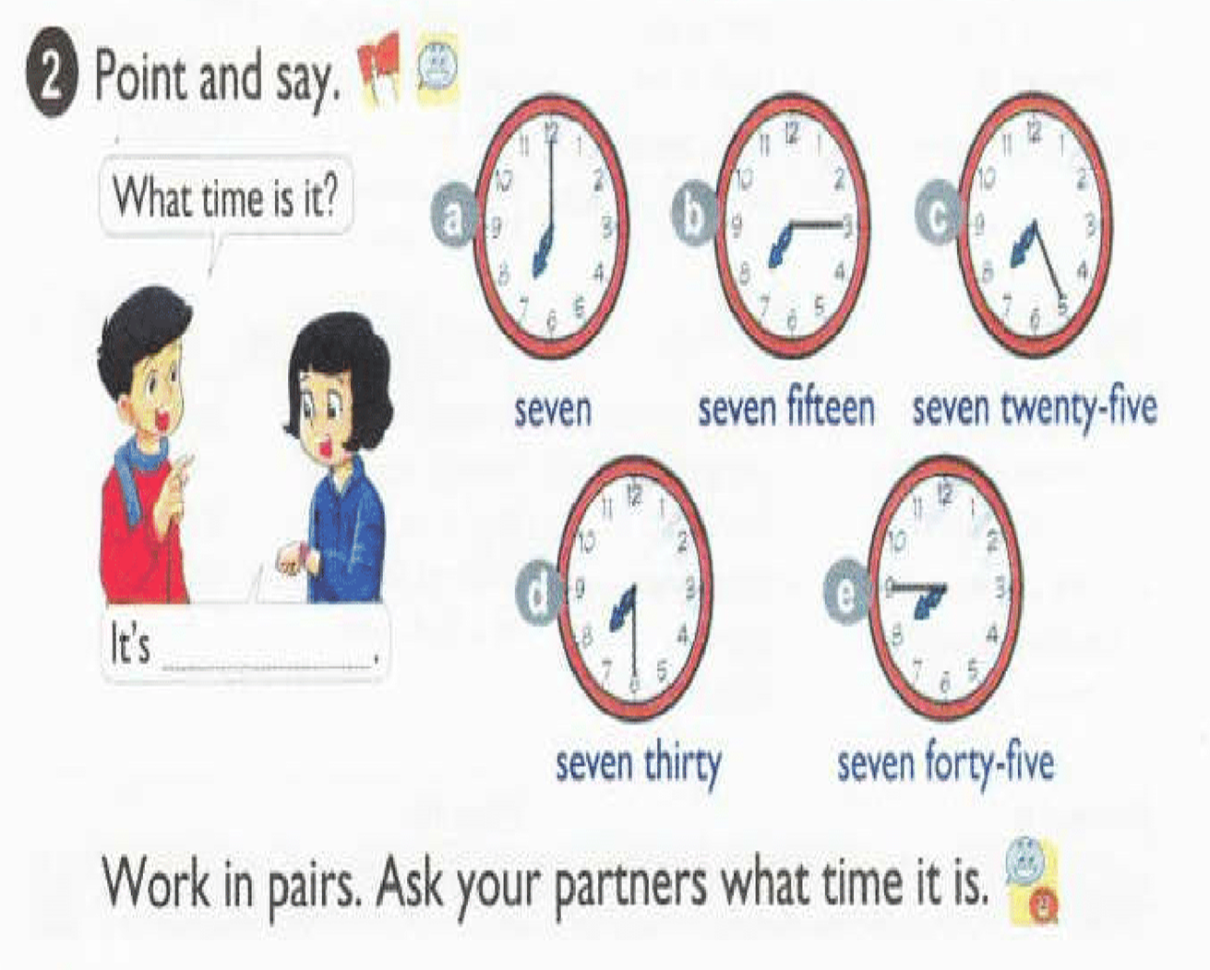

Slide 11

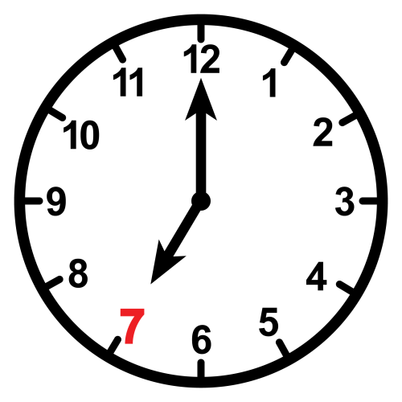

It
What time is it?
It
It’s
seven

Slide 12
It
What time is it?
It
It’s
seven fifteen

Slide 13
It
What time is it?
It
It’s
seven twenty-five

Slide 14
It
What time is it?
It
It’s
seven thirty

Slide 15
It
What time is it?
It
It’s
seven forty-five

Slide 16


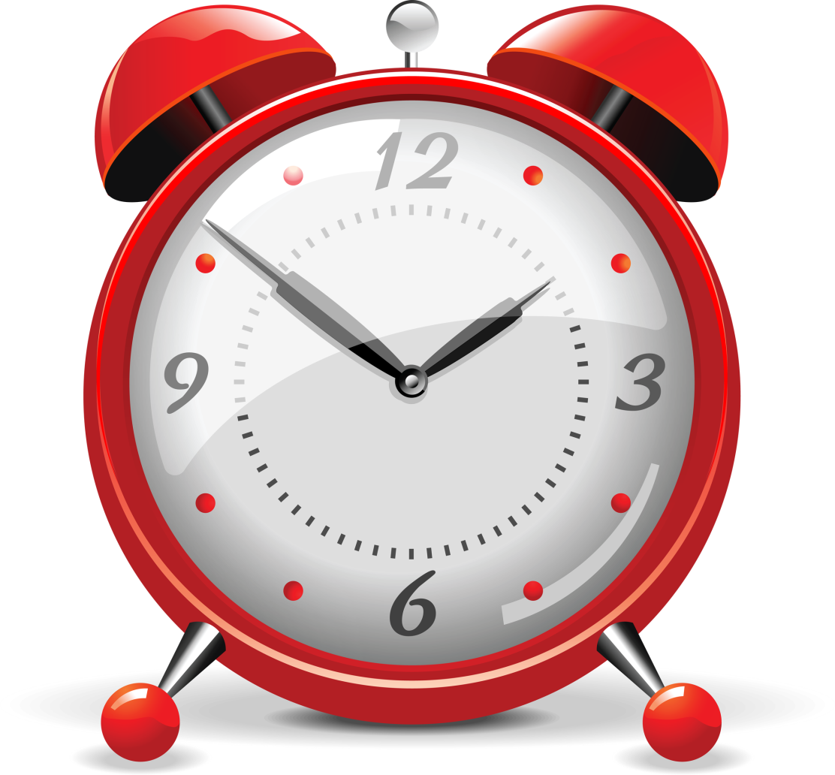
1. Vocabulary
- clock
time
2. Model sentence
What time is it?
→ It’s seven (o’clock)

Slide 17
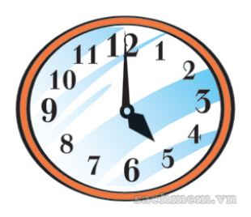
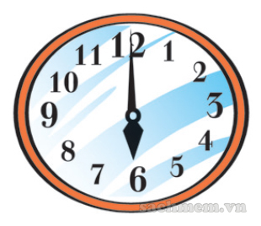
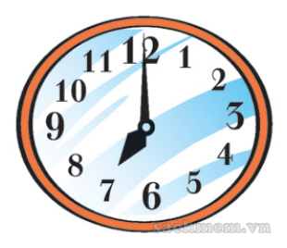
LISTEN & TICK
1
a
b
c

Slide 18
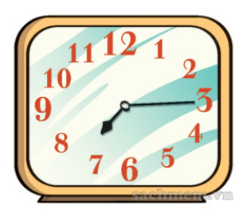
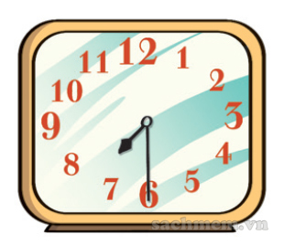
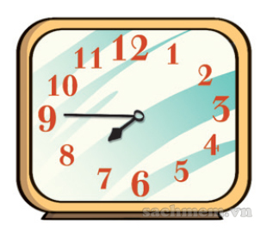
LISTEN & TICK
2
a
b
c

Slide 19
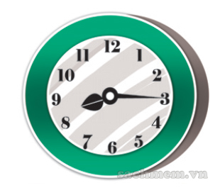
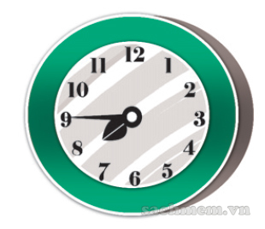
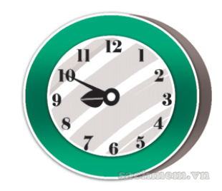
LISTEN & TICK
3
a
b
c

Slide 20
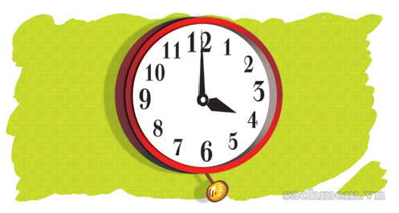
LOOK & WRITE
1
A: What time is it?
B: It’s
four o’clock

Slide 21
LOOK & WRITE
1
A: What time is it?
B: It’s
four o’clock

Slide 22
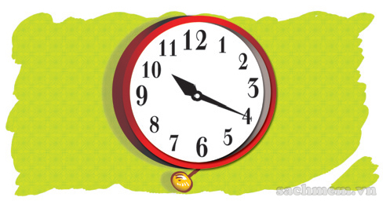
LOOK & WRITE
2
A: What time is it?
B: It’s
ten twenty

Slide 23
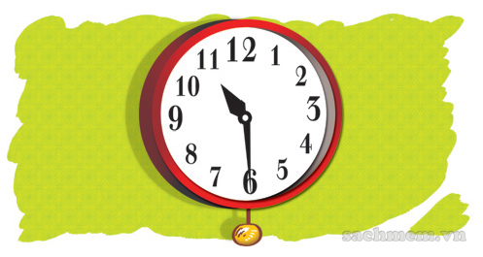
LOOK & WRITE
3
A: What time is it?
B: It’s
ten thirty

Slide 24
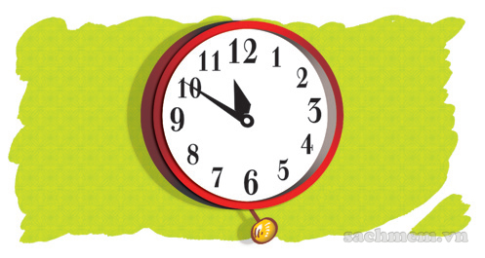
LOOK & WRITE
4
A: What time is it?
B: It’s
eleven fifty

Slide 25
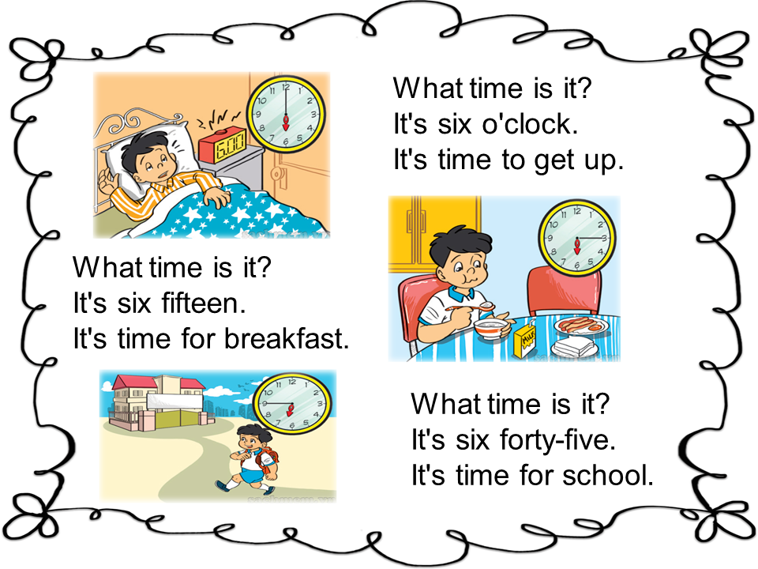



Slide 26


Slide 27



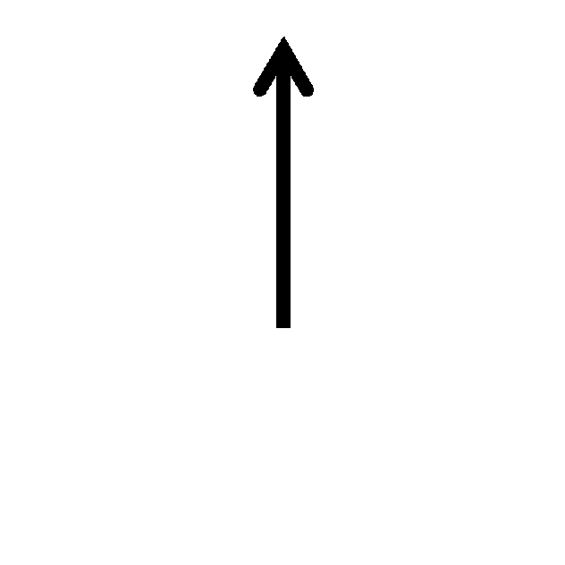

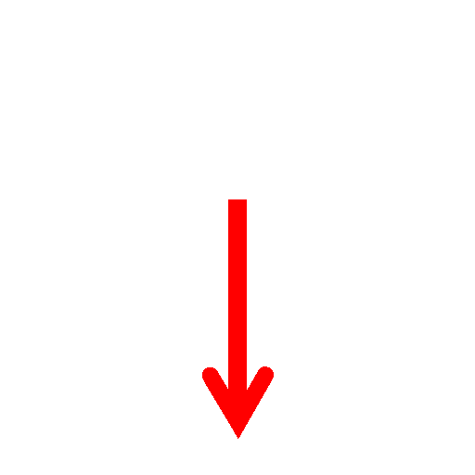









1
2
3
4
5
6
1
2
7
8
Team 1 Score
Team 2 Score
9
55
5
3
4
5
6
7
8
9
50
10
1
2
3
0
0
4
5
6
45
15
1
Team 3 Score
Team 4 Score
2
7
40
20
8
9
25
3
4
5
6
7
8
9
35
30
0
0
Notes:
Hour hand every 30 degrees per minute hand at 360 degrees. 1 to 12

