Slide 1


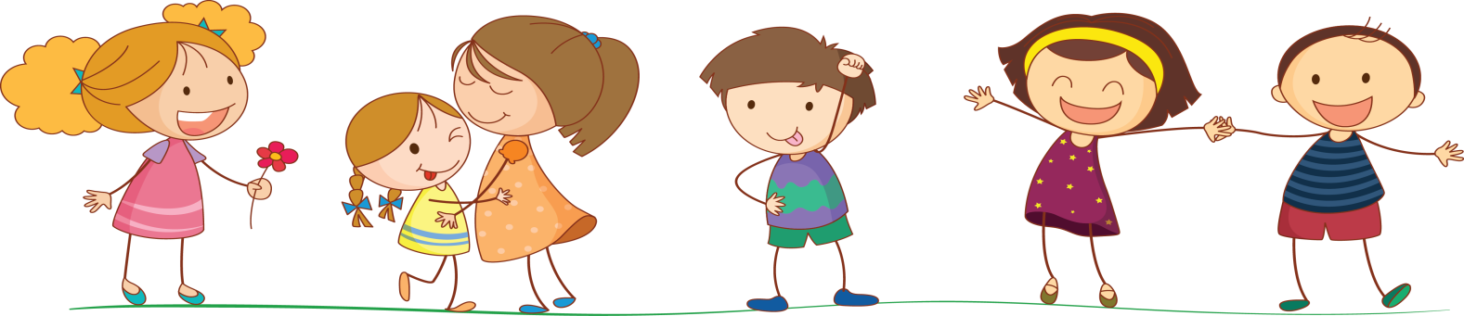
UNIT 10. WHERE WERE YOU YESTERDAY?
LESSON 1

Slide 2
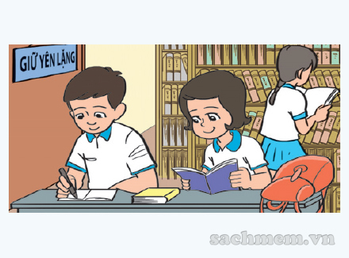
In the school library

Slide 3
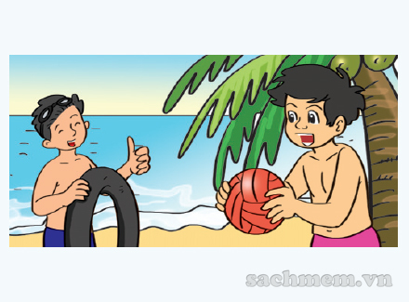
on the beach

Slide 4
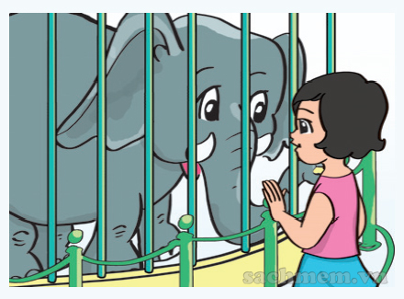
at the zoo

Slide 5
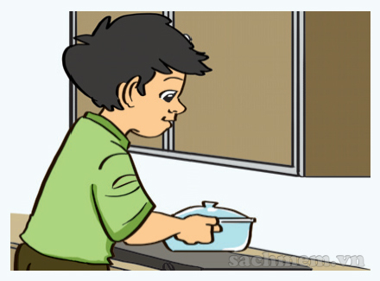
at home

Slide 6
in the school libraby
on the beach
at the zoo
at home

Slide 7
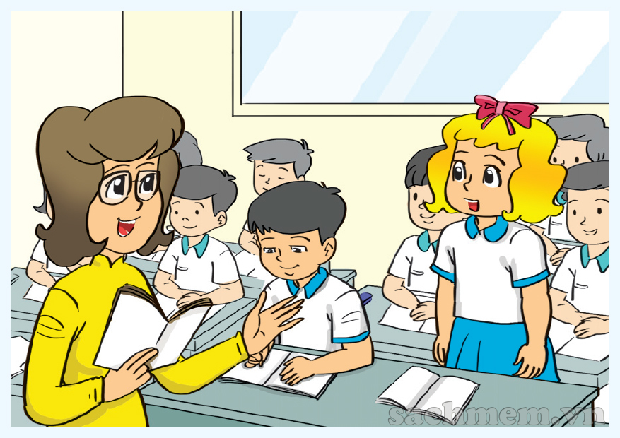
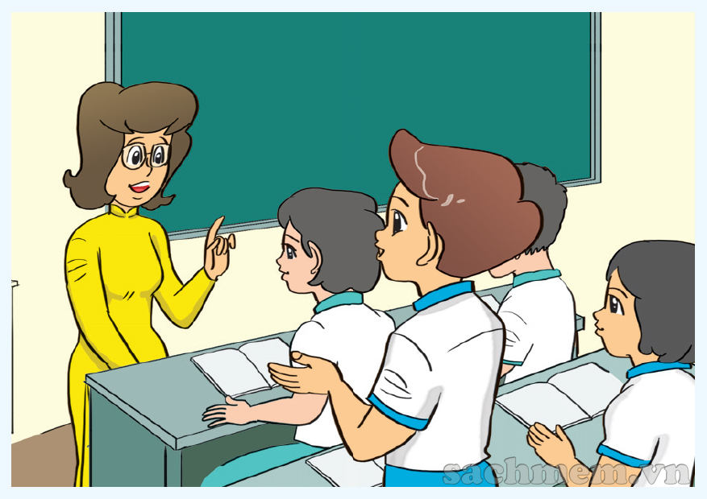
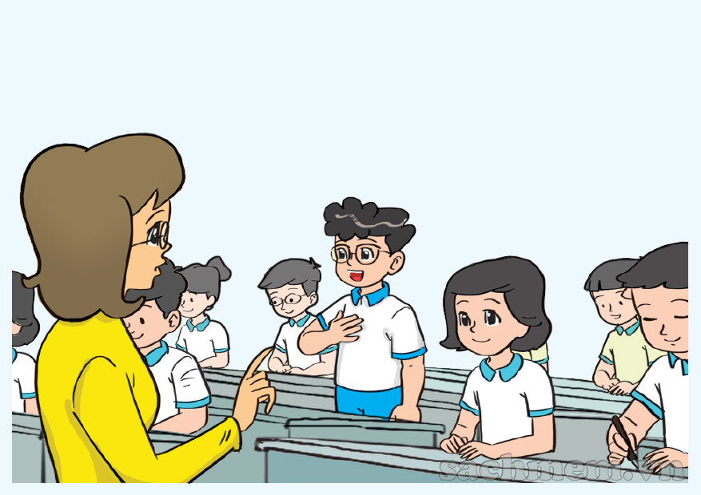
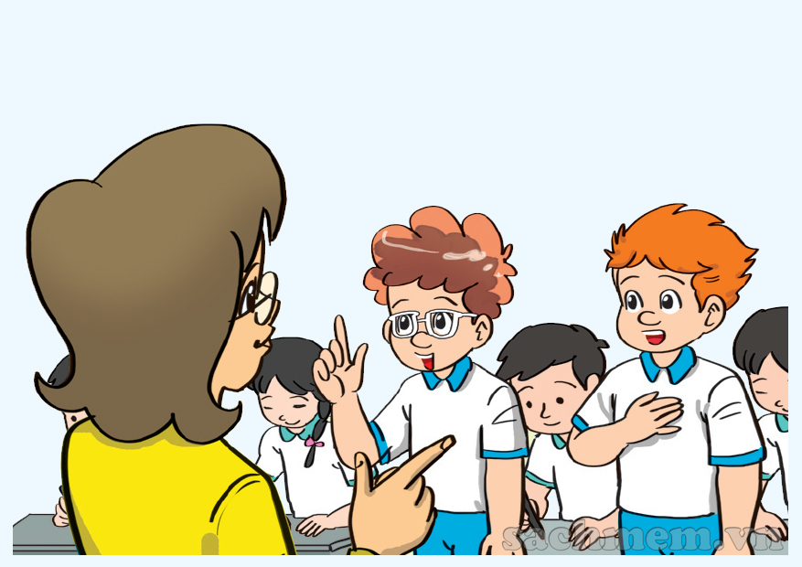
When were you yesterday, Linda?
What about you, Nam?
I was at the zoo.
I was at home.
What about you, Tom and Tony?
When were you yesterday, Phong?
I was on the beach.
We were in the school library

Slide 8
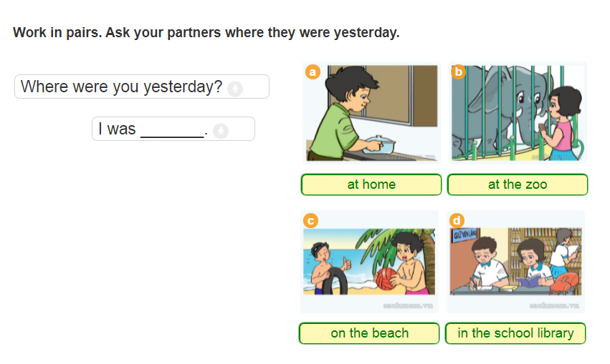

Slide 9

It
Where were you yesterday?
It
I
was at home

Slide 10
It
Where were you yesterday?
It
I
was at the zoo

Slide 11
It
Where were you yesterday?
It
was on the beach
I

Slide 12
It
Where were you yesterday?
It
We
were in the school library

Slide 13
Tuesday, January 4th 2022
Unit 10: Where were you yesterday ?
Lesson 1
New words:
At the zoo
At home
On the beach
In the school library
II. Model sentences
Where were you yesterday ?
I was on the beach.
III. Homelink

Slide 14
UNIT 10. WHERE WERE YOU YESTERDAY?
LESSON 2

Slide 15
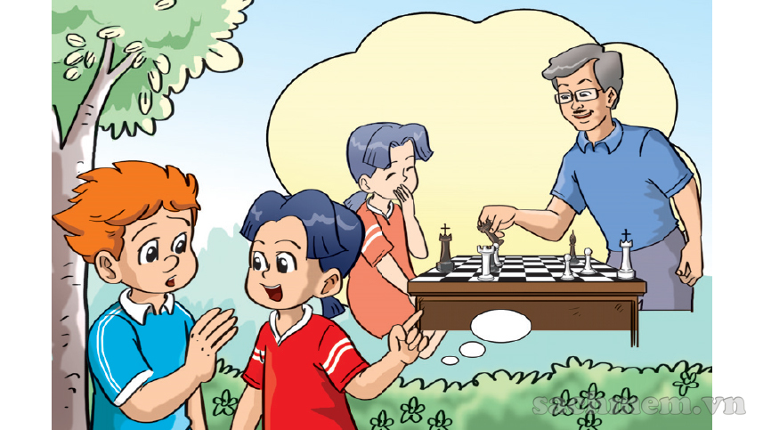
Played chess

Slide 16
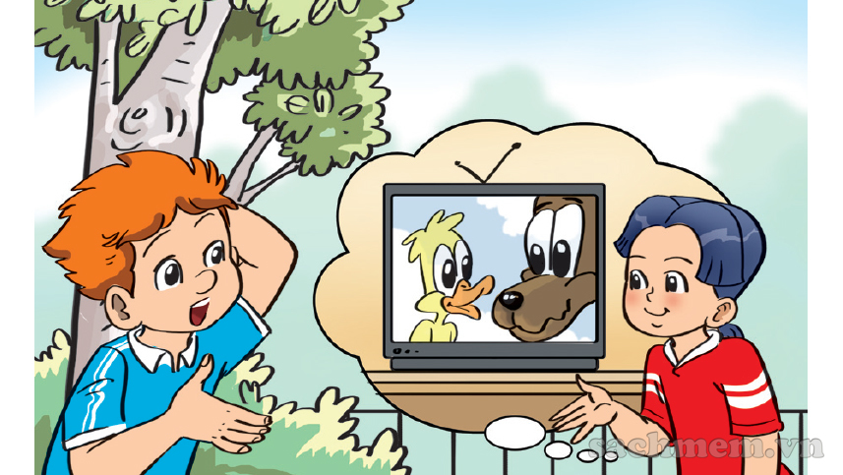
Watched TV

Slide 17
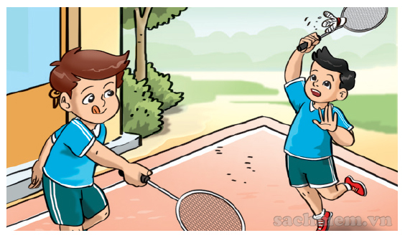
Played badminton

Slide 18
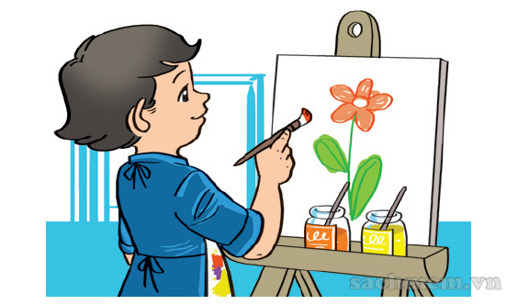
painted picture

Slide 19
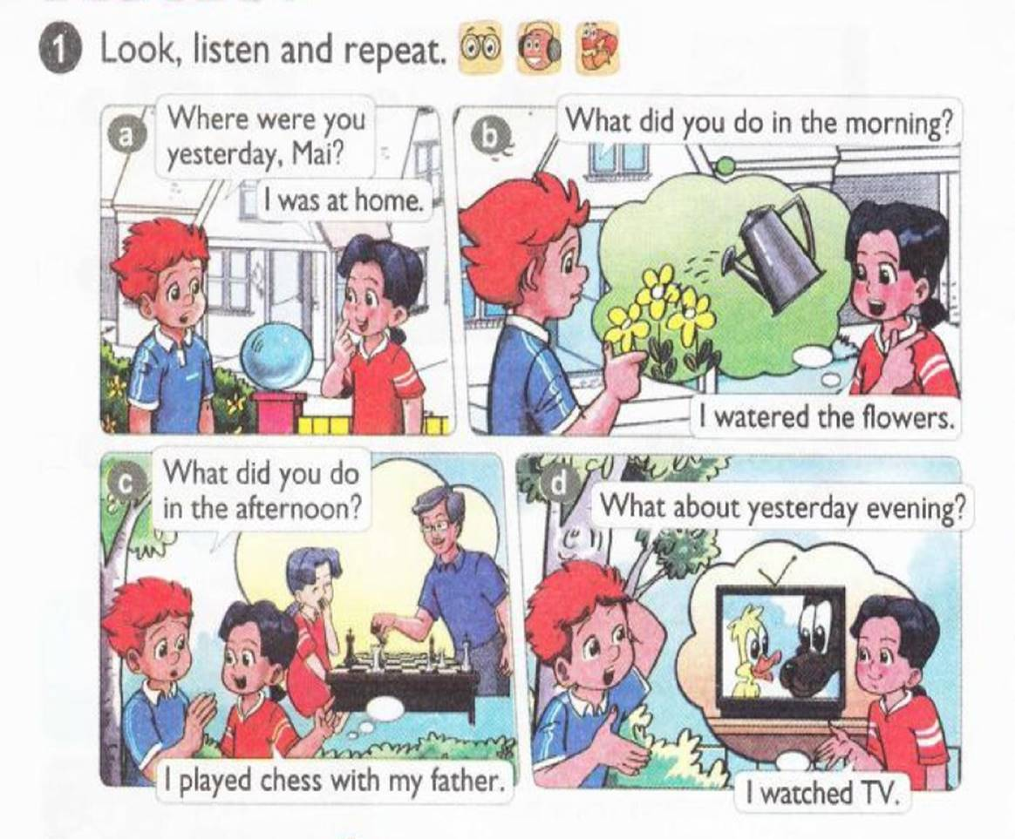




Slide 20
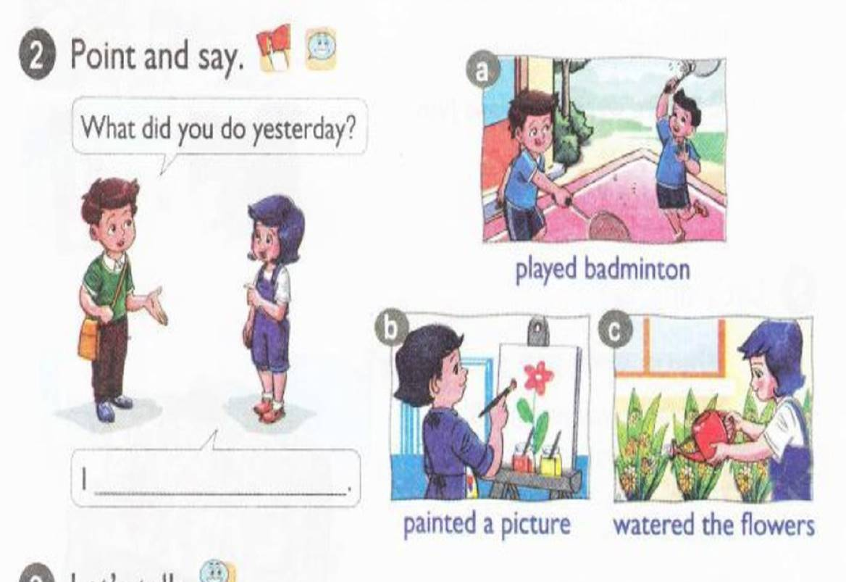

Slide 21
It
What did you do yesterday?
It
I
played badminton

Slide 22
It
What did you do yesterday?
It
painted a picture
I

Slide 23
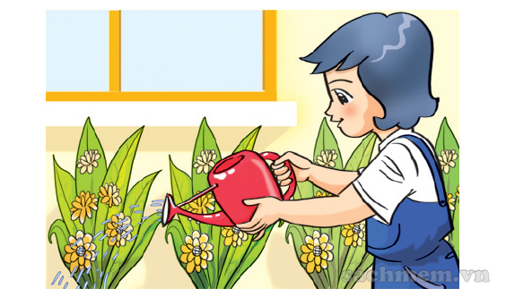
It
What did you do yesterday?
It
I
watered the flowers

Slide 24


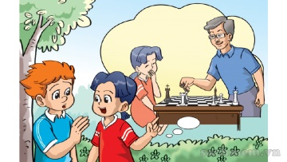
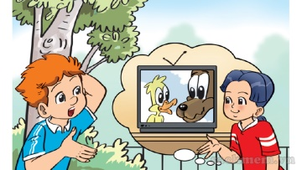
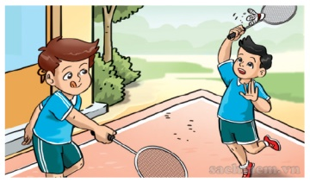

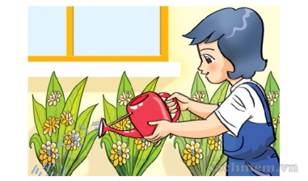
1. Vocabulary
- played chess
- watched TV
- played badminton
- painted a picture
- watered the flowers

Slide 25


Model sentence
What did you do?
I played badminton.
What did you do?
I played chess.

Slide 26

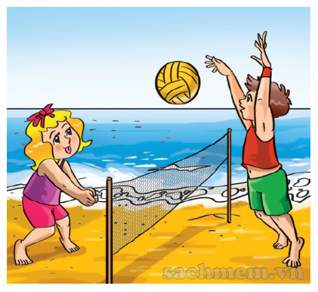
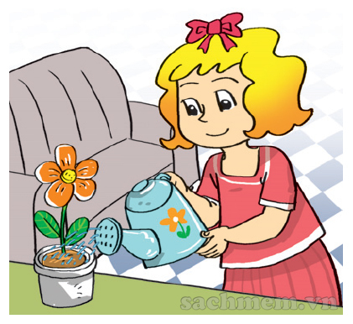
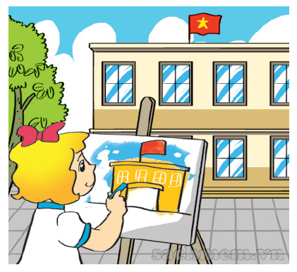
LISTEN AND NUMBER
1
3
1
2
3
2
By Jessica

Slide 27
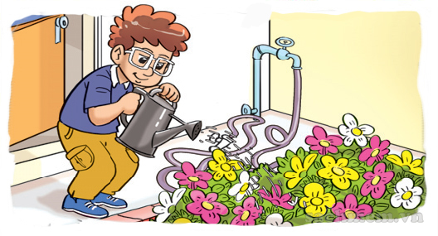
LOOK & WRITE
1
Mai: Where was Tom yesterday afternoon?
Tony: He was
Mai: What did he do?
Tony: He
in the garden.
watered the flowers

Slide 28
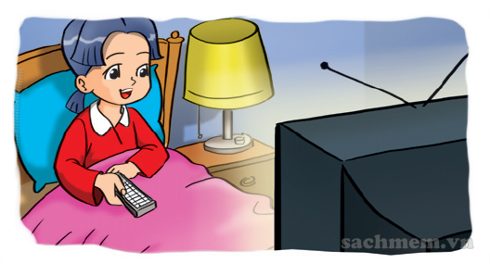
LOOK & WRITE
2
Phong: Where was Mai yesterday evening?
Akiko: She
Phong: What did he do?
Akiko: She
was at home
watched TV

Slide 29
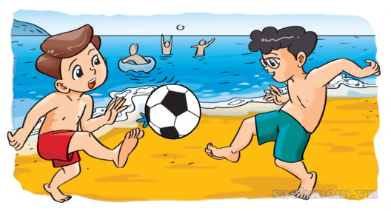
LOOK & WRITE
3
Linda: Where were Phong and Nam yesterday?
Quan: They
Linda: What did he do?
Quan: She
were on the beach
watched TV

Slide 30
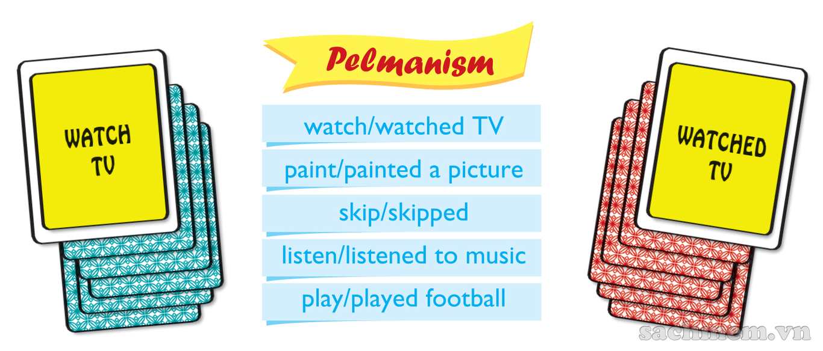

LET’S PLAY

Slide 31


Slide 32
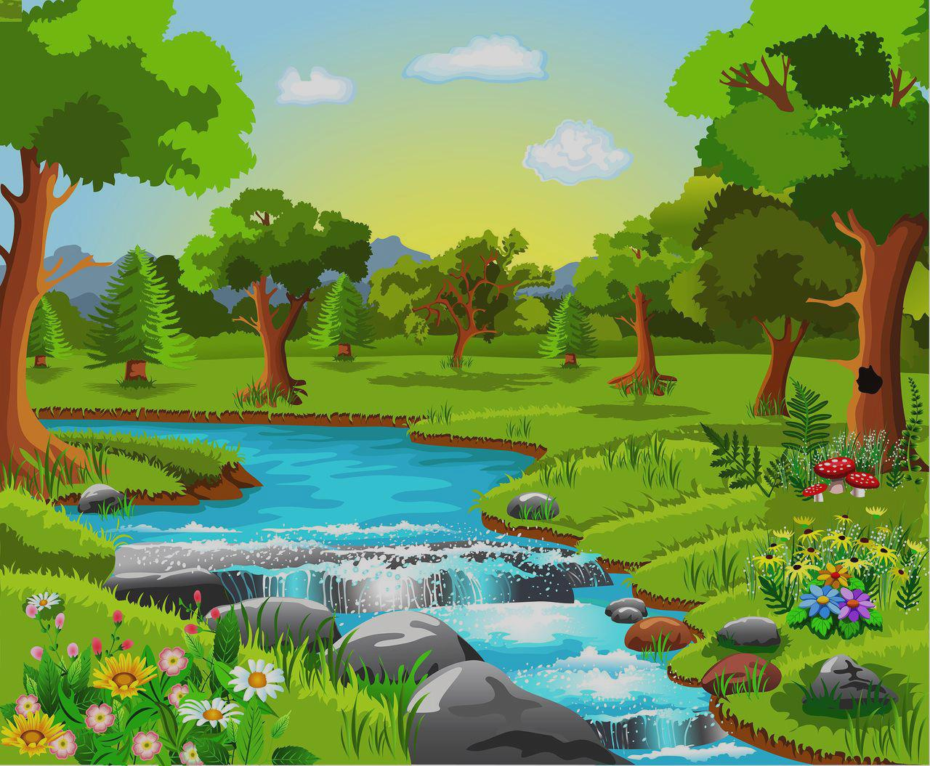



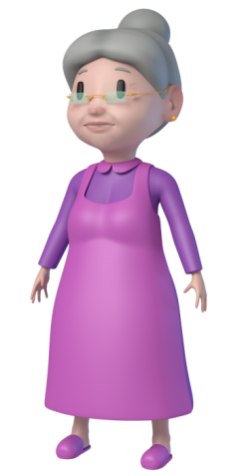
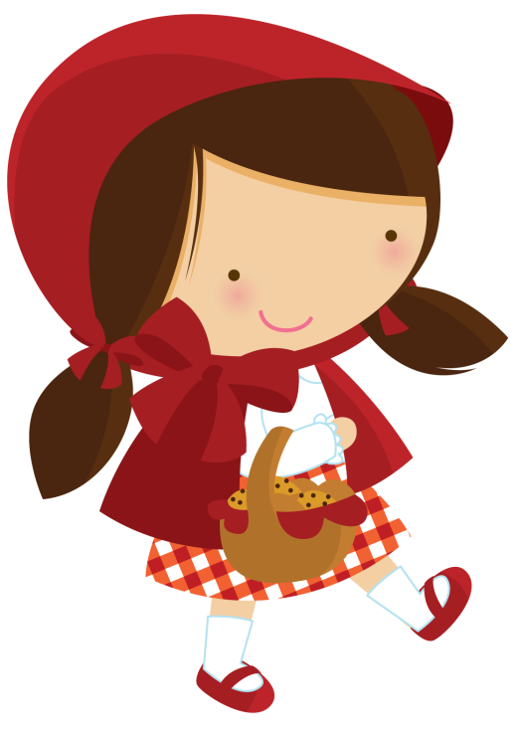

PLAY
Little
Red

Slide 33

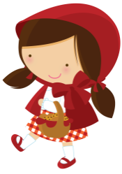

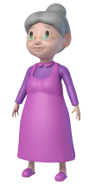
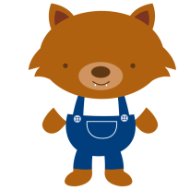





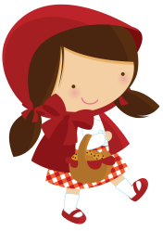

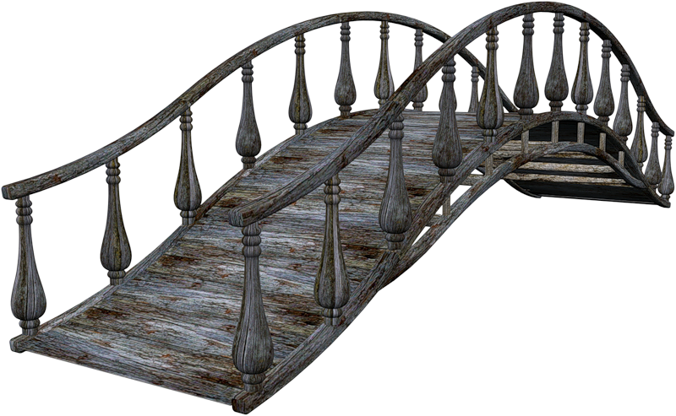



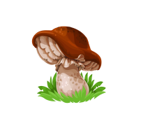


Slide 34

Where were you yesterday?
At the zoo
At home
On the beach

Slide 35


Where were you yesterday?
In the school library
On the beach
At the school

Slide 36
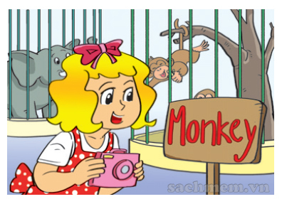
Where was Linda yesterday?
In the museum
In the cinema
At the zoo

Slide 37
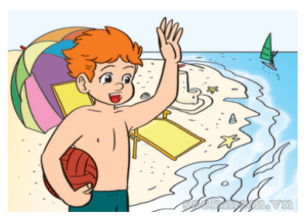
Where was Tony yesterday?
In the museum
At the zoo
On the beach

Slide 38
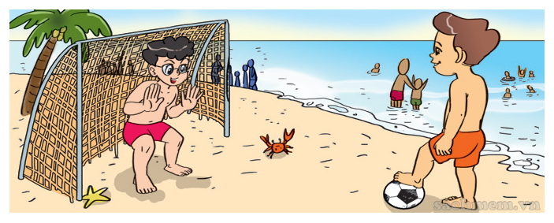
Where were Phong and Nam yesterday?
At the zoo
On the beach
At home

Slide 39
What did you do yesterday?
play chess
watched TV
painted a picture

Slide 40
What did you do yesterday?
watched TV
played badminton
watered the flowers

Slide 41
What did you do yesterday?
watered the flowers
painted a picture
watched TV

Slide 42
What did you do yesterday?
played chess
played badminton
watered the flowers

Slide 43
What did you do yesterday?
played badminton
played chess
played football

Slide 44
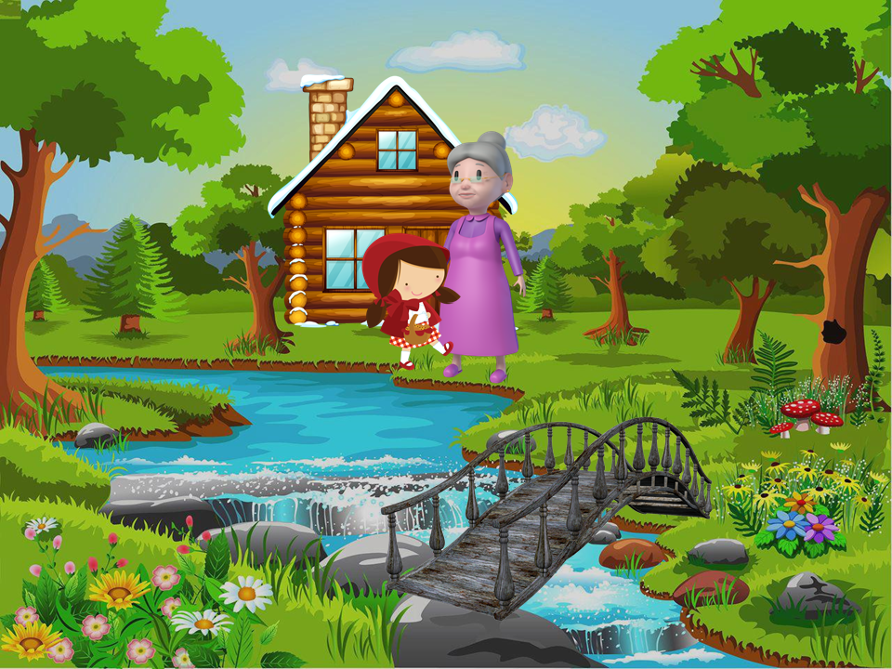


Slide 45
Tuesday, January 4th 2022
Unit 10: Where were you yesterday ?
Lesson 2
New words:
Played badminton
Painted a picture
Watered the flowers
II. Model sentences
What did you do yesterday ?
I played badminton
III. Homelink

Slide 46
UNIT 10. WHERE WERE YOU YESTERDAY?
LESSON 3

Slide 47
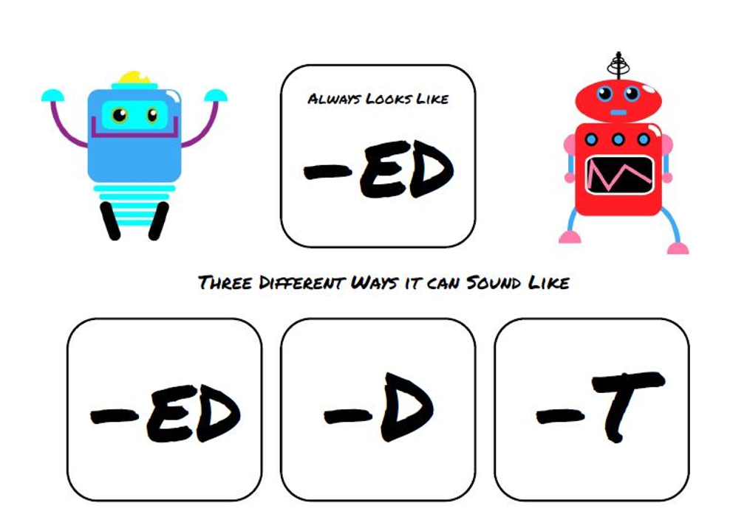

Slide 48
/d/
played
I played badminton yesterday morning

Slide 49
/t/
watched
I watched
TV yesterday morning

Slide 50
/id/
painted
Mai painted a big picture last weekend.

Slide 51

READ & COMPLETE
Hello everyone. It was Sunday yesterday and it was very cold. I was at home. In the morning, I watered the flowers in the garden. In the afternoon, I played chess with my father. After dinner, I watched TV. I was happy.
1.Linda yesterday morning.
2.She yesterday afternoon.
3.She yesterday evening.
watered the flowers in the garden
played chess with her father
watched TV

Slide 52

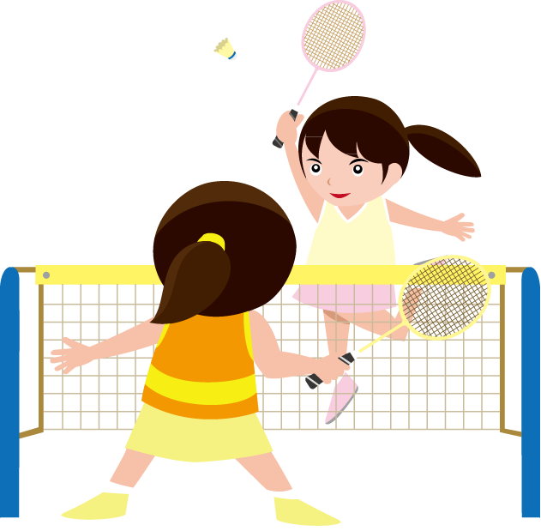

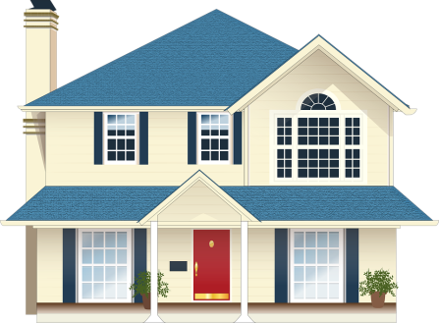
WRITE ABOUT YOU
yesterday, I was .
In the morning, I .
In the afternoon, I .
In the evening, I .
at home
watered the flowers
played badminton
watched TV

Slide 53
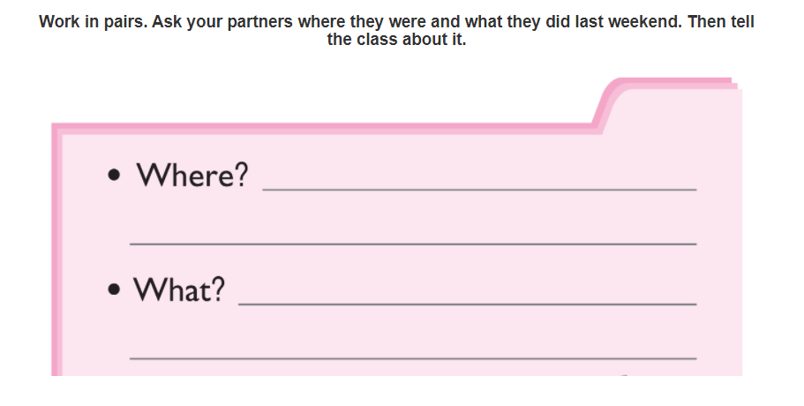

PROJECT

Slide 54
PLAY
Little
Red

Slide 56
Where ……. you yesterday?
was
were
are

Slide 57
Where … Linda yesterday?
was
were
is

Slide 58
……… was Linda yesterday?
What
Who
Where

Slide 59
Where was Tony yesterday?
In the museum
At the zoo
On the beach

Slide 60
Where were Phong and Nam yesterday?
At the zoo
On the beach
At home

Slide 61
What …….you do yesterday?
did
do
does

Slide 62
What did you ….. yesterday?
do
did
does

Slide 63
What did you do yesterday?
paint a picture
painted a picture
paints a picture

Slide 64
What did you do yesterday?
played chess
played badminton
watered the flowers

Slide 65
What did you do yesterday?
played badminton
played chess
played football

