Slide 1



Review for semester 2
grade 4

Slide 2

Circle odd one out
Have breakfast have dinner
have lunch go to bed
2. Farmer factory doctor driver
3. Bread beef pork chicken
4. Old clerk strong slim
5. Water orange juice milk fish

Slide 3
Circle odd one out
6. Nurse hospital field office
7. Taller young short big
8. Make banh chung wear new clothes
get lucky money firework
9. Buy flowers decorate the house
visit friends New Year
10. This these those thanks

Slide 4


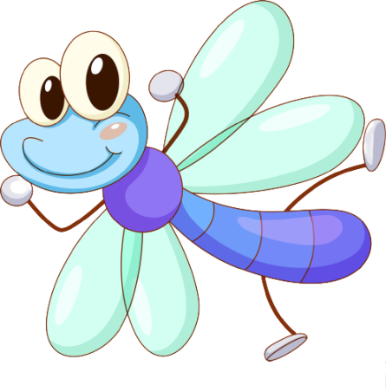
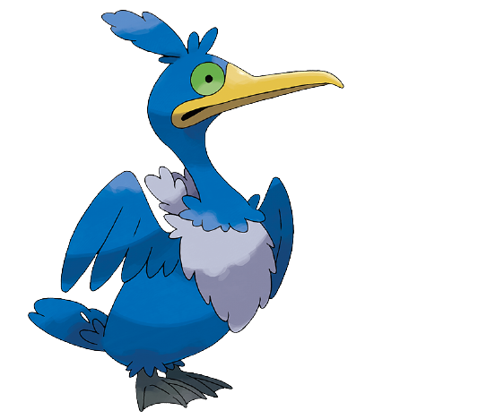
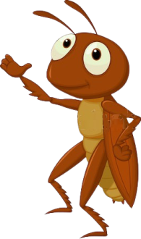

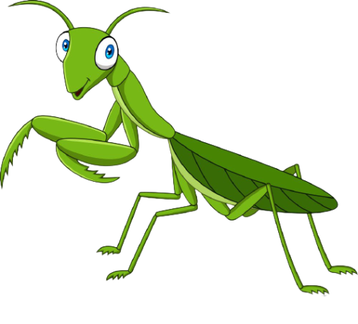
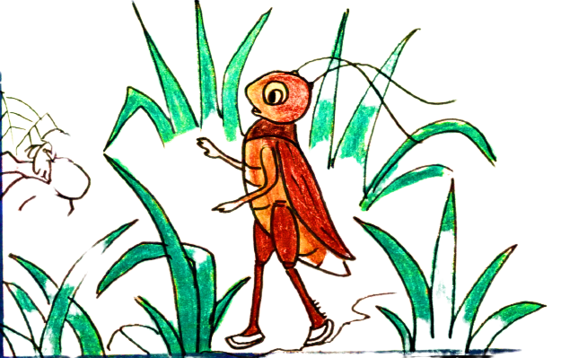
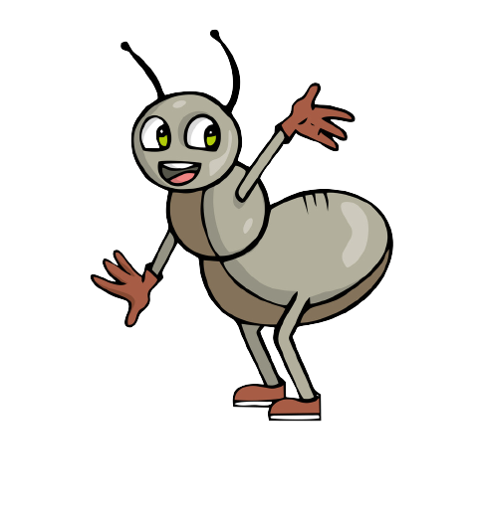
Chúng mình bắt đầu chuyến phiêu lưu thôi nào!
Notes:
Click vào các con vật để đi đên thử thách
Tại slide câu hỏi, click vào dế mèn để quay về.
Tại slide này, click vào dế mèn để đi tới bài học

Slide 5

What time is it? - …………………nine o’clock
It’s
A
Its
B
It
C
Notes:
click vào dế mèn để quay về.

Slide 6
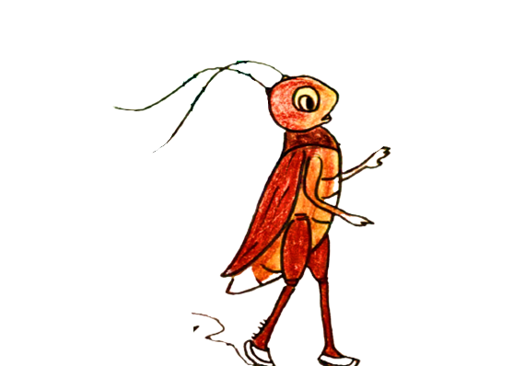
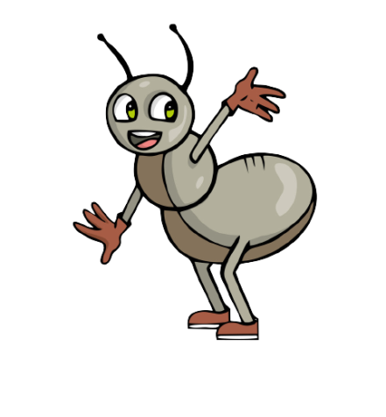
…………do you get up? - I get up at 6 o’clock
A
What
B
What time
C
What’s
Notes:
click vào dế mèn để quay về.

Slide 7
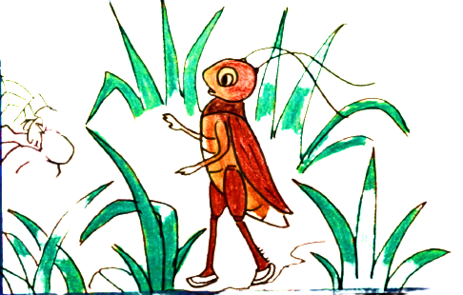
………… does your father do? - He’s a teacher
When
A
Where
B
What
C
Notes:
click vào dế mèn để quay về.

Slide 8
My uncle is a ………… - He drives a taxi.
A
farmer
B
driver
C
worker

Slide 9
………… does a worker work?
Where
A
What
B
When
C

Slide 10
A farmer………… in a …………
Work/ farmer
A
Farmer/ works
B
Works/ farmer
C

Slide 11
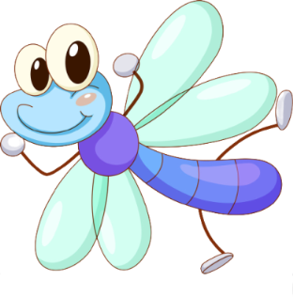
My sister is a clerk. She work in…………
An office
A
A hospital
B
A factory
C

Slide 12
Chúng mình bắt đầu chuyến phiêu lưu thôi nào!
Notes:
Click vào các con vật để đi đên thử thách
Tại slide câu hỏi, click vào dế mèn để quay về.
Tại slide này, click vào dế mèn để đi tới bài học

Slide 13
………… your favourite food?
Câu hỏi 1: Đâu là chữ a?
What
A
When
B
Where
C
Notes:
click vào dế mèn để quay về.

Slide 14
What’s your favourite drink?
A
It’s beef
B
It’s apple juice
C
It milk
Notes:
click vào dế mèn để quay về.

Slide 15
………… you like some lemonade?
What
A
Do
B
Would
C
Notes:
click vào dế mèn để quay về.

Slide 16
.What does he ………… like? – He’s tall.
A
slim
B
look
C
do

Slide 17
Trang is ………… than Hoa
younger
A
young
B
more younger
C

Slide 18
………… is smaller? – Jenny is
Who’s
A
What
B
Who
C

Slide 19
Teacher’s Day is on …………
The twentieth of November
A
The first of January
B
The twenty- fifth of December
C

Slide 20
Match
1. What time do you go to school? 2. What’s your favourite food? 3. Would you like some bread? 4. What does your brother look like? 5. What does Mai do at Tet? 6. What does your father do? 7. When’s Children’s Day? 8. Where does a doctor work | 1- 2- 3- 4- 5- 6- 7- 8- | a. He’s tall and slim b. She decorates the house. c. A doctor works in a hospital d. He is a driver. e. I go to school at six thirty f. It’s on the first of June. g. Yes, please h. It’s beef
1 - e
2 - h
3 - g
4 - a
5 - b
6 - d
7 - f
8 - c

Slide 21
Read the text
My name is Joe. I’m 10 years old. I’m in class 4B. I get up at 6 o’clock., then I go to school. I have lunch at 11: 30, and I go home at 4 o’clock in the afternoon. I like beef and orange juice. My father is a worker. He works in a factory. My mother is a nurse. She works in a hospital. My brother is a student. He is in class 6A. my brother is tall and slim. I’m shorter than him. My parents are young. We love Tet very much. We make banh chung, decorate the house and wear new clothes at Tet.
True (T) or False (F):
1. Joe is in class 6A.
- F
2. He has a brother.
- T

Slide 22
Read the text
My name is Joe. I’m 10 years old. I’m in class 4B. I get up at 6 o’clock., then I go to school. I have lunch at 11: 30, and I go home at 4 o’clock in the afternoon. I like beef and orange juice. My father is a worker. He works in a factory. My mother is a nurse. She works in a hospital. My brother is a student. He is in class 6A. my brother is tall and slim. I’m shorter than him. My parents are young. We love Tet very much. We make banh chung, decorate the house and wear new clothes at Tet.
True (T) or False (F):
3. His father is a farmer
- F
- F
4. His mother works in a school

Slide 23
Read the text
My name is Joe. I’m 10 years old. I’m in class 4B. I get up at 6 o’clock., then I go to school. I have lunch at 11: 30, and I go home at 4 o’clock in the afternoon. I like beef and orange juice. My father is a worker. He works in a factory. My mother is a nurse. She works in a hospital. My brother is a student. He is in class 6A. my brother is tall and slim. I’m shorter than him. My parents are young. We love Tet very much. We make banh chung, decorate the house and wear new clothes at Tet.
True (T) or False (F):
5. Joe is shorter than his brother
- T
6. He likes beef and orange juice
- T

Slide 24
Read the text
My name is Joe. I’m 10 years old. I’m in class 4B. I get up at 6 o’clock., then I go to school. I have lunch at 11: 30, and I go home at 4 o’clock in the afternoon. I like beef and orange juice. My father is a worker. He works in a factory. My mother is a nurse. She works in a hospital. My brother is a student. He is in class 6A. my brother is tall and slim. I’m shorter than him. My parents are young. We love Tet very much. We make banh chung, decorate the house and wear new clothes at Tet.
Answer questions:
1. How old is Joe?
- He is ten years old
2. What time does he get up?
- He gets up at 6 o’clock

Slide 25
Read the text
My name is Joe. I’m 10 years old. I’m in class 4B. I get up at 6 o’clock., then I go to school. I have lunch at 11: 30, and I go home at 4 o’clock in the afternoon. I like beef and orange juice. My father is a worker. He works in a factory. My mother is a nurse. She works in a hospital. My brother is a student. He is in class 6A. my brother is tall and slim. I’m shorter than him. My parents are young. We love Tet very much. We make banh chung, decorate the house and wear new clothes at Tet.
Answer questions:
3. Where does his father work?
- He works in a factory
4. What does his brother look like?
- He is tall and slim

Slide 26



Good bye

