Slide 1





Welcome to our class 5A1
Ngoc Lam Primary School
Teacher: HauLe

Slide 2


Unit 15: What would you like to be?
Lesson 1
Page 30,31

Slide 3

WARM UP

Slide 4

LET’S SING!
Notes:
Put three or four FLASHCARDS (family members) on the board and tell your child to look at them. Ask them to close their eyes and take one card away. When your child opens their eyes, ask them to guess what is missing.

Slide 5

SLAP
The words

Slide 6

It’s time to learn …

Slide 7

New words

Slide 8
Jobs

Slide 9


Slide 10


pi
lot
pi

Slide 11

doc
tor
doc

Slide 12
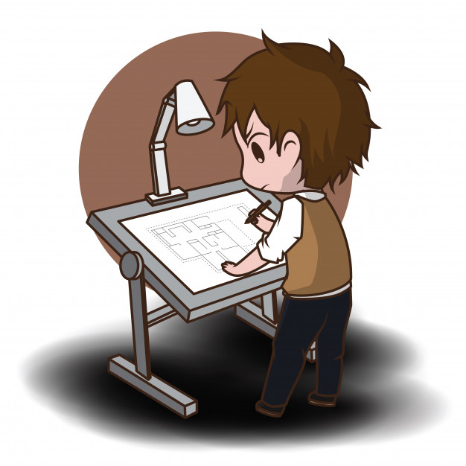
ar
chi
tect
ar
/k/
/kt/

Slide 13
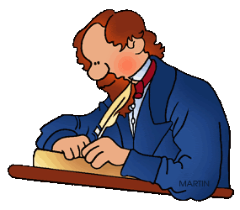
wri
wri
ter

Slide 14

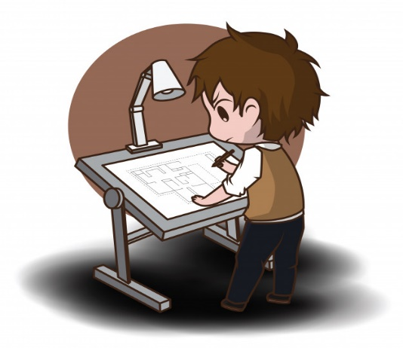
pilot
phi công
doctor
bác sĩ
pilot
phi công
doctor
bác sĩ
architect
kiến trúc sư
writer
nhà văn
architect
kiến trúc sư
writer
nhà văn

Slide 15

What’s next?

Slide 16
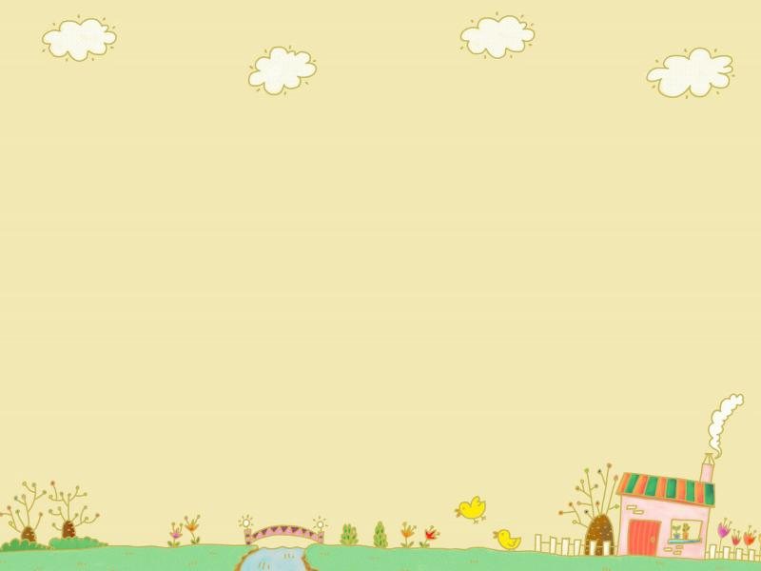




doctor

Slide 17



writer

Slide 18


architect

Slide 19




pilot

Slide 20
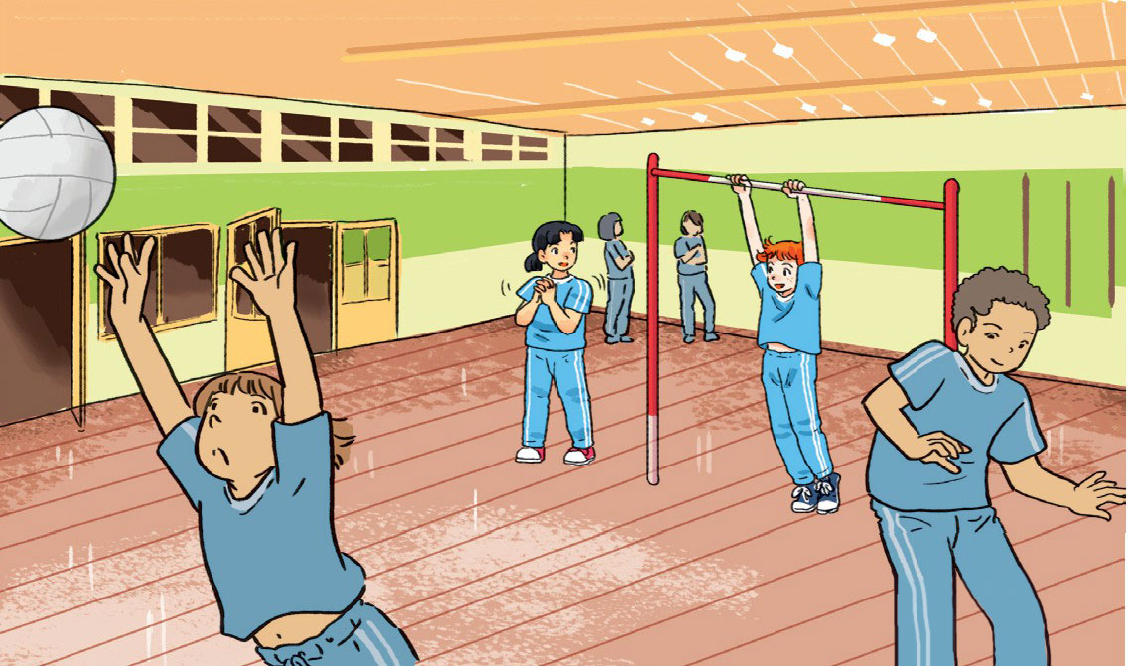
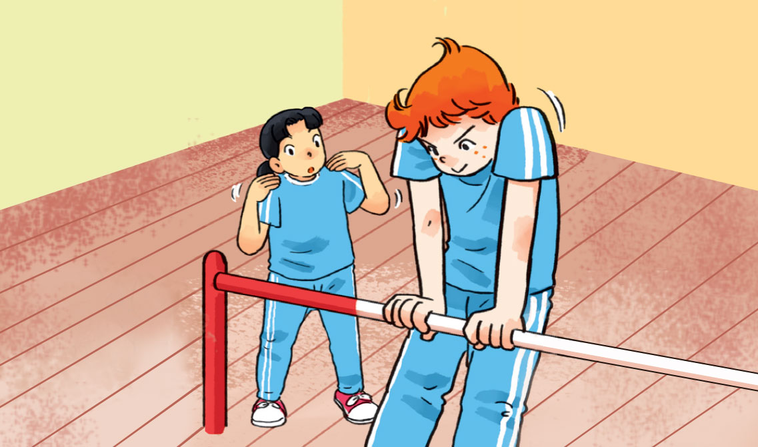
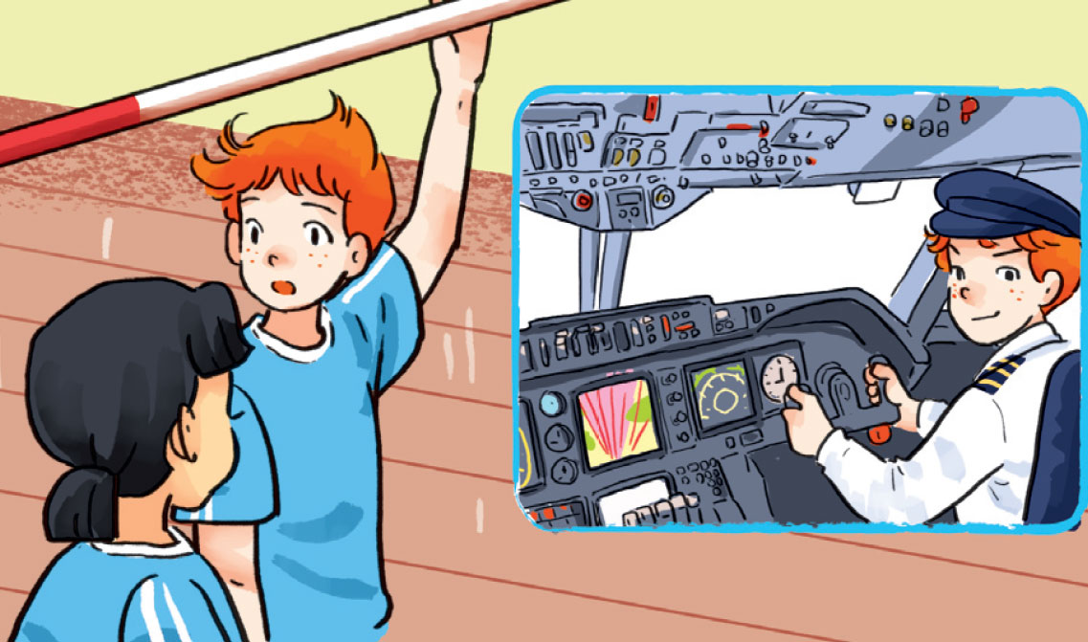
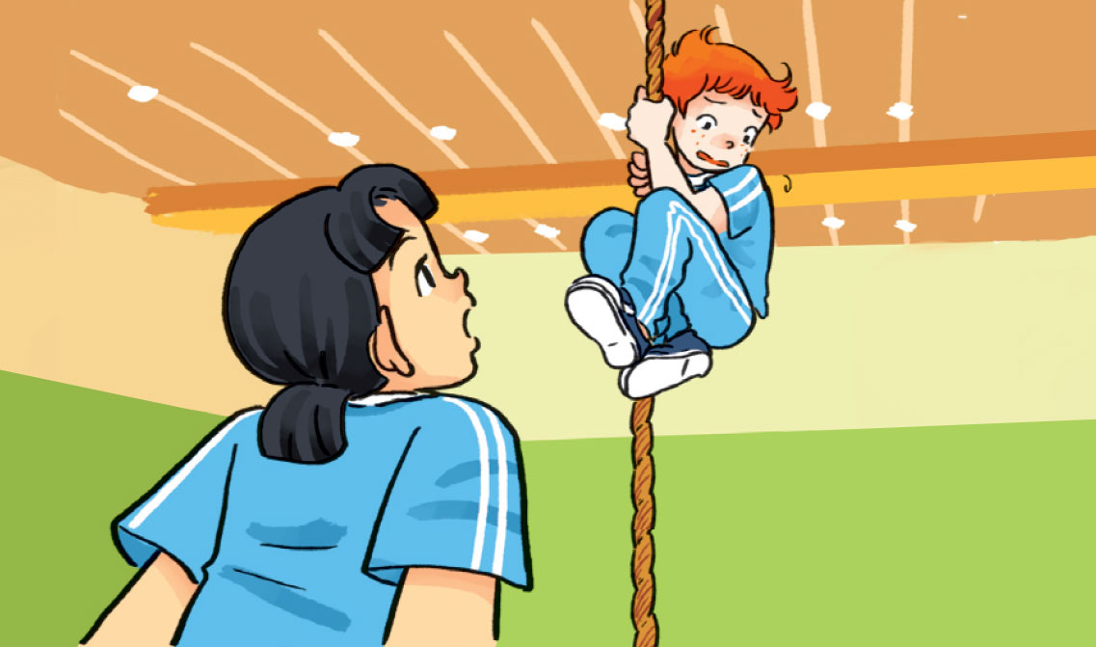
a
b
Mai
Tony
gym
c
d

Slide 21

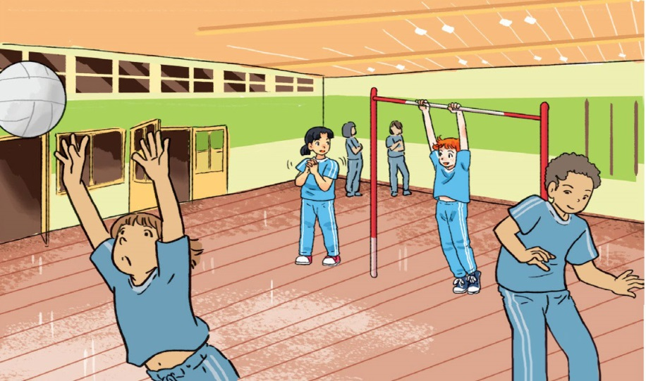

a
b
Tony
Mai
c
d

Slide 22
1. future
2. fly a plane
3. problem
4. height
tương lai
lái máy bay
vấn đề
độ cao

Slide 23








a
What would you like to be in the future, Tony?
b
Is that why you work out so much in the gym?
Yes, pilots have to be strong.
I’d like to be a pilot.
c
So would you like to fly a plane?
d
What’s that?
I’m scared of heights!
Yes, of course! There’s only one problem.

Slide 24


Model sentences
What would you like to be in the future?
What would you like
to be
in the future?
I’d like to be a/an______.
I’d like to be
pilot
a pilot.
‘d like = would like
I’d like to be a pilot. = I would like to be a pilot.

Slide 25
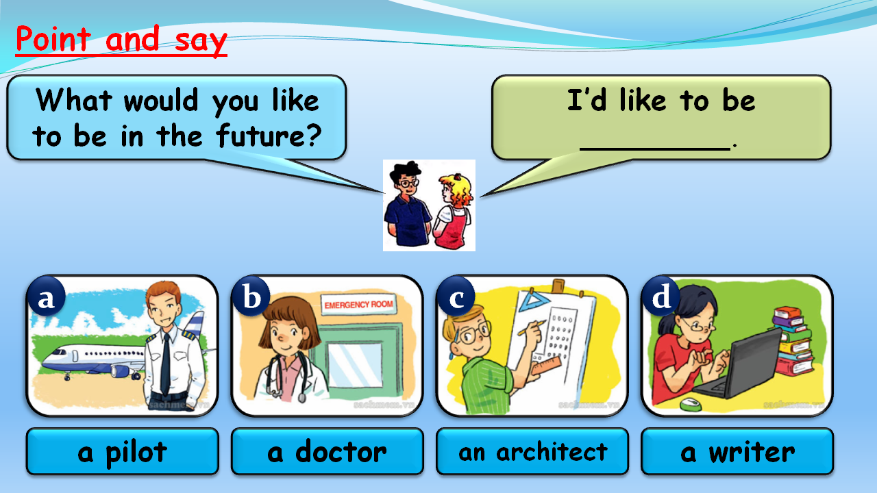

Slide 26
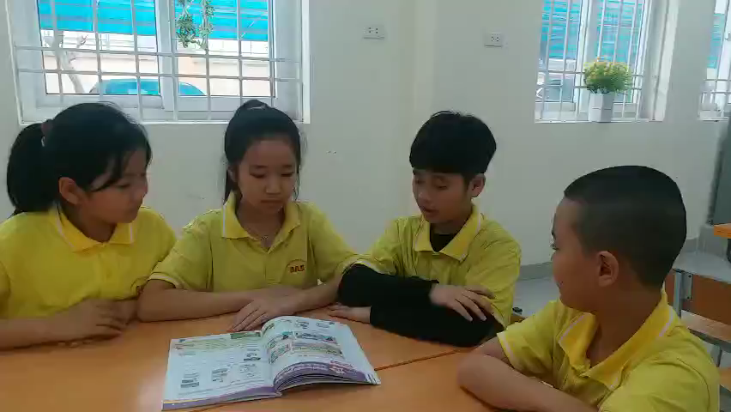

Slide 27
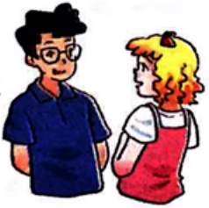

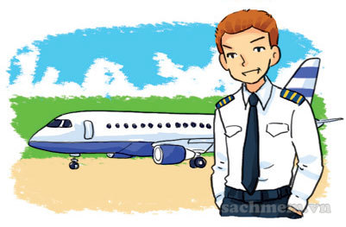

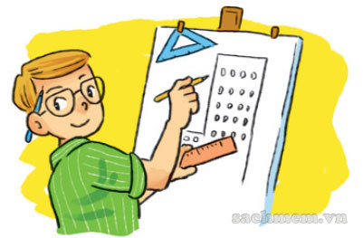

Point and say
What would you like to be in the future?
I’d like to be ________.
What would you like to be in the future?
I’d like to be ________.
a
b
c
d
a pilot
a doctor
an architect
a writer
a doctor

Slide 28
Point and say
I’d like to be ________.
What would you like to be in the future?
I’d like to be ________.
What would you like to be in the future?
a
b
c
d
a pilot
a doctor
an architect
a writer
an architect

Slide 29


Point and say
What would you like to be in the future?
I’d like to be ________.
What would you like to be in the future?
I’d like to be ________.
a
b
c
d
a pilot
a doctor
an architect
a writer
an architect
a writer

Slide 30
Point and say
What would you like to be in the future?
I’d like to be ________.
What would you like to be in the future?
I’d like to be ________.
a
b
c
d
a pilot
a doctor
an architect
a writer
an architect
a writer

Slide 31
Game 3: https://www.baamboozle.com/classic/1063961
BAMBOOZLE
GAME

Slide 32

Game 3: https://www.baamboozle.com/classic/1063961

Slide 33

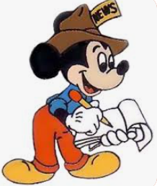

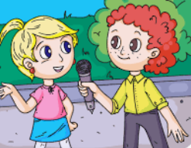


INTERVIEW
Time

Slide 34

No. | Name/Nick name | What would you like to be in the future?
1 2
3 4
5
reporter: phóng viên

Slide 35

Future Jobs
STAR
Reporter
5A1

Slide 36
DREAM JOB TREE

Slide 37
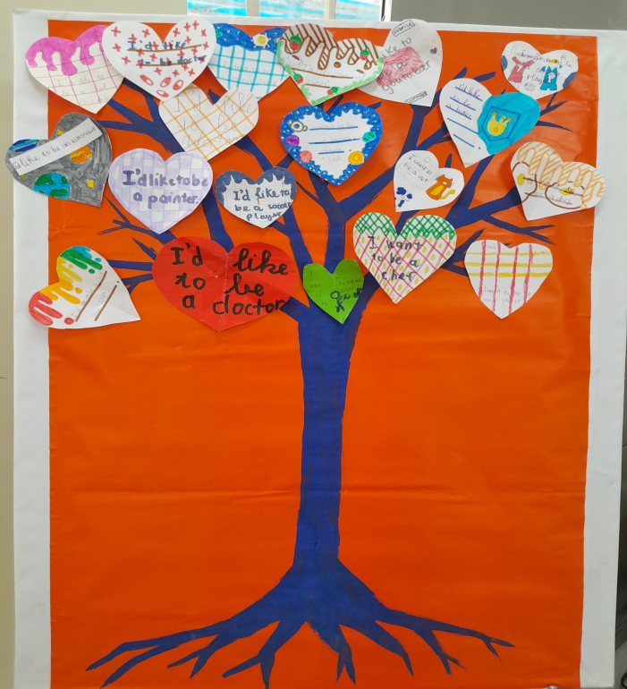
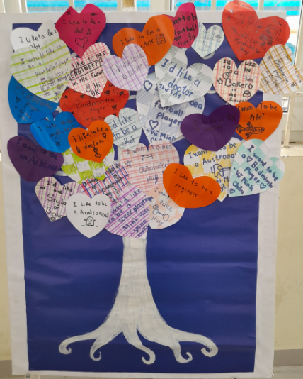
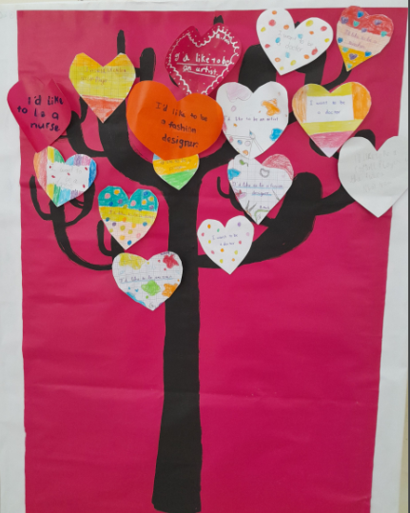
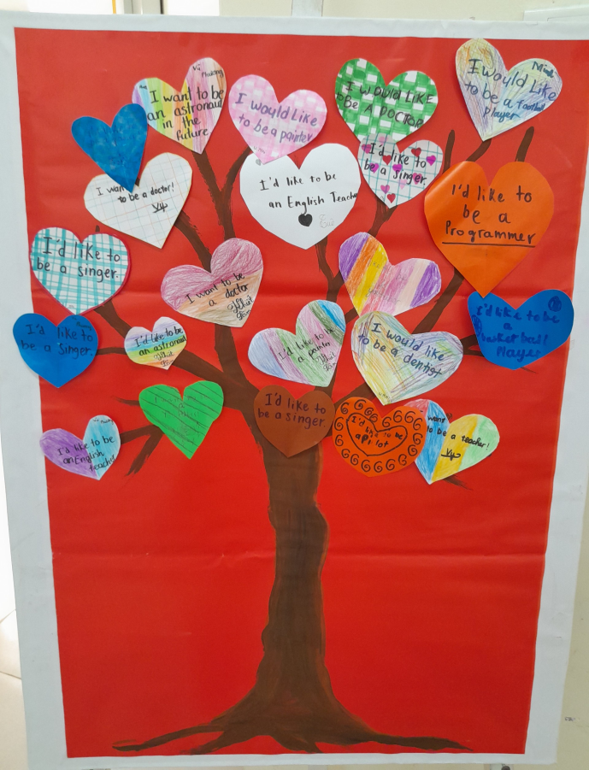

Slide 38
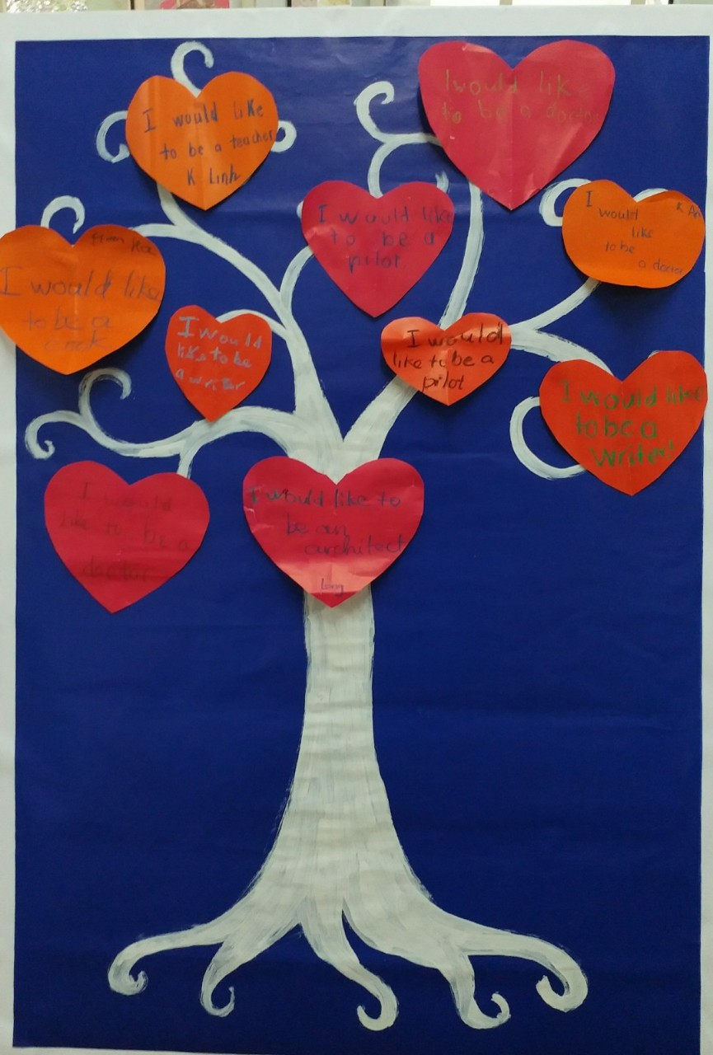
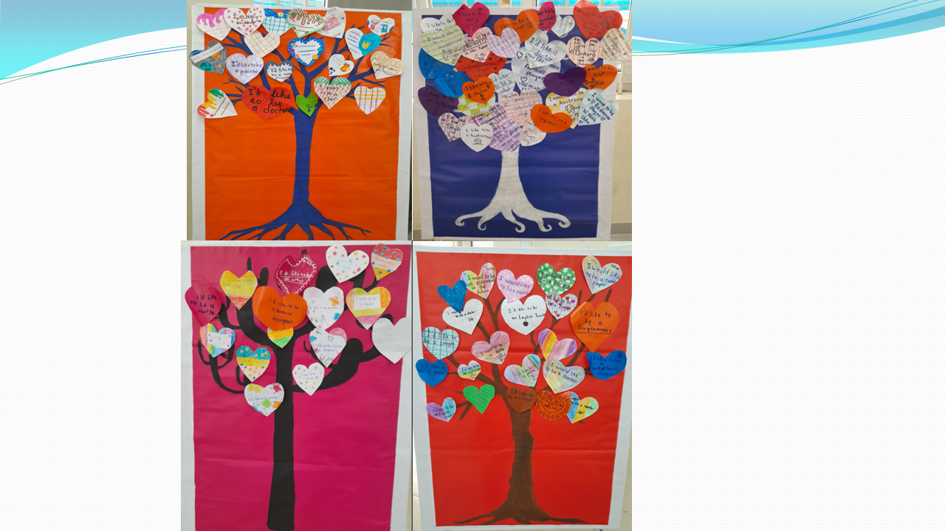

Slide 39
JOBS SHOW

Slide 40
https://www.plickers.com/classes/63f832e208ea910010b0b594
Q-CARD TEST

Slide 41

Home-link
Practice saying and writing the jobs in the lesson.
Con luyện nói và viết các từ mới về nghề nghiệp đã học trong bài.
pilot
doctor
architect
writer
Practice talking about your dream job.
Con luyện tập hỏi và trả lời về nghề nghiệp mình muốn làm trong tương lai.
What would you like to be in the future?
I’d like to be a/an________________.
Share your dream jobs with me and your friends by making a short video
Chia sẻ về nghề nghiệp mơ ước của con bằng 1 video ngắn.

Slide 42



Slide 43


Slide 44
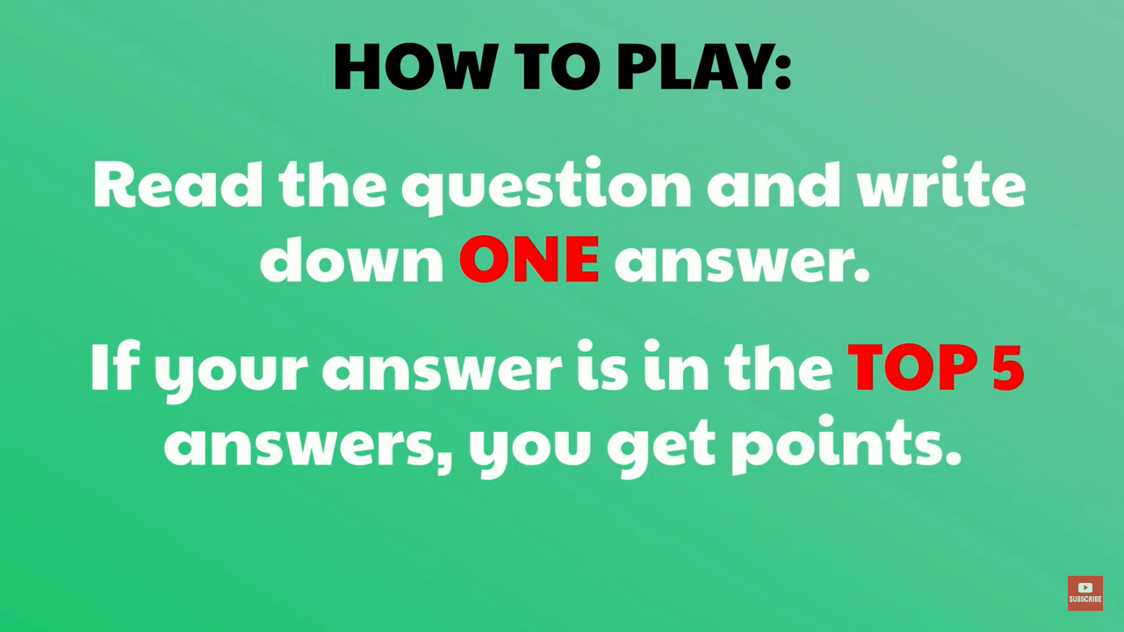

Slide 45
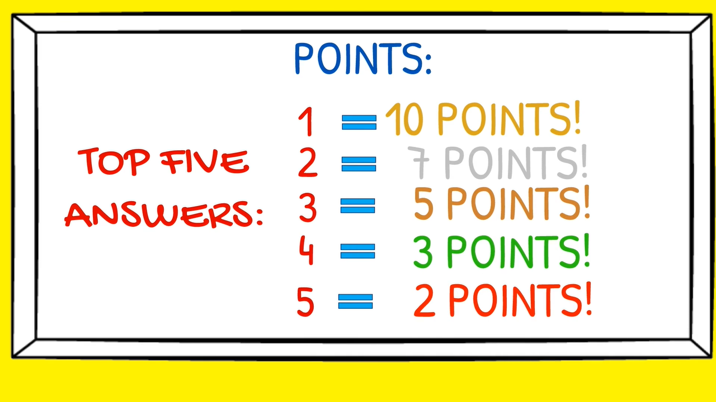

Slide 46
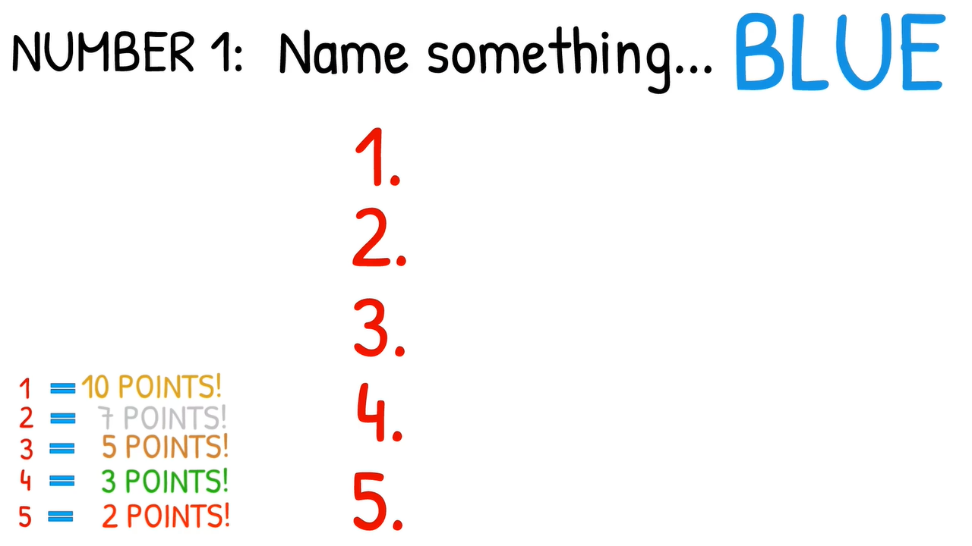

Name your dream job
youtuber
pilot
doctor
architect
writer

Slide 47
Name a job starts with letter S
singer
scientist
shopkeeper
soccer player
soldier

Slide 48
2
Name a job for WOMAN
housewife
teacher
clerk/officer
nurse
dancer

Slide 49
3
Name a job for MAN
architect
pilot
policeman
soldier
astronaut

Slide 50
4
Name a job starts with letter F
fireman/firefighter
footballer
fishman
farmer
fashion designer

Slide 51


Slide 52


Slide 53
5
Name your future job
youtuber
doctor
teacher
pilot
cook

Slide 54

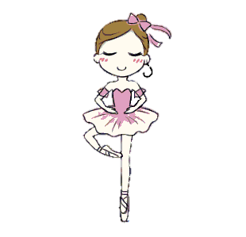

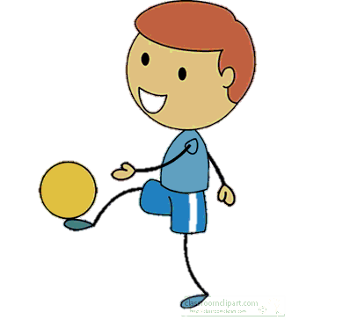
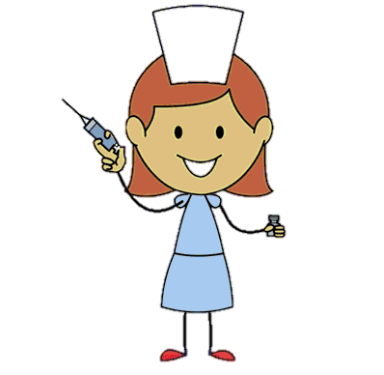
Hello. Nice to meet you.
Lily
Ben
Chi
Minh

Slide 55






















Slide 56
https://www.baamboozle.com/classic/908877
Game 2teams-What would you like to be in the future?
Why?
https://www.baamboozle.com/classic/1260624
Game 2What /Why
Game 3: https://www.baamboozle.com/classic/1063961
Chỉ What..hay duyet

Slide 57
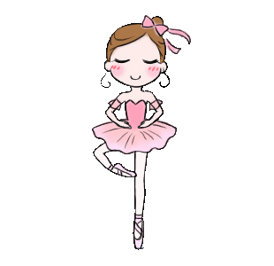
I’d like to be a ballerina.
Lily

Slide 59
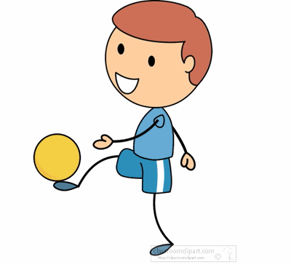
I would like to be a football player.
Ben

Slide 61

I’d like to be a nurse.
Chi

Slide 63

I would like to be a writer.
Minh

Slide 65

What would you like to be in the future?

Slide 66
I’d like to be a teacher.

Slide 67
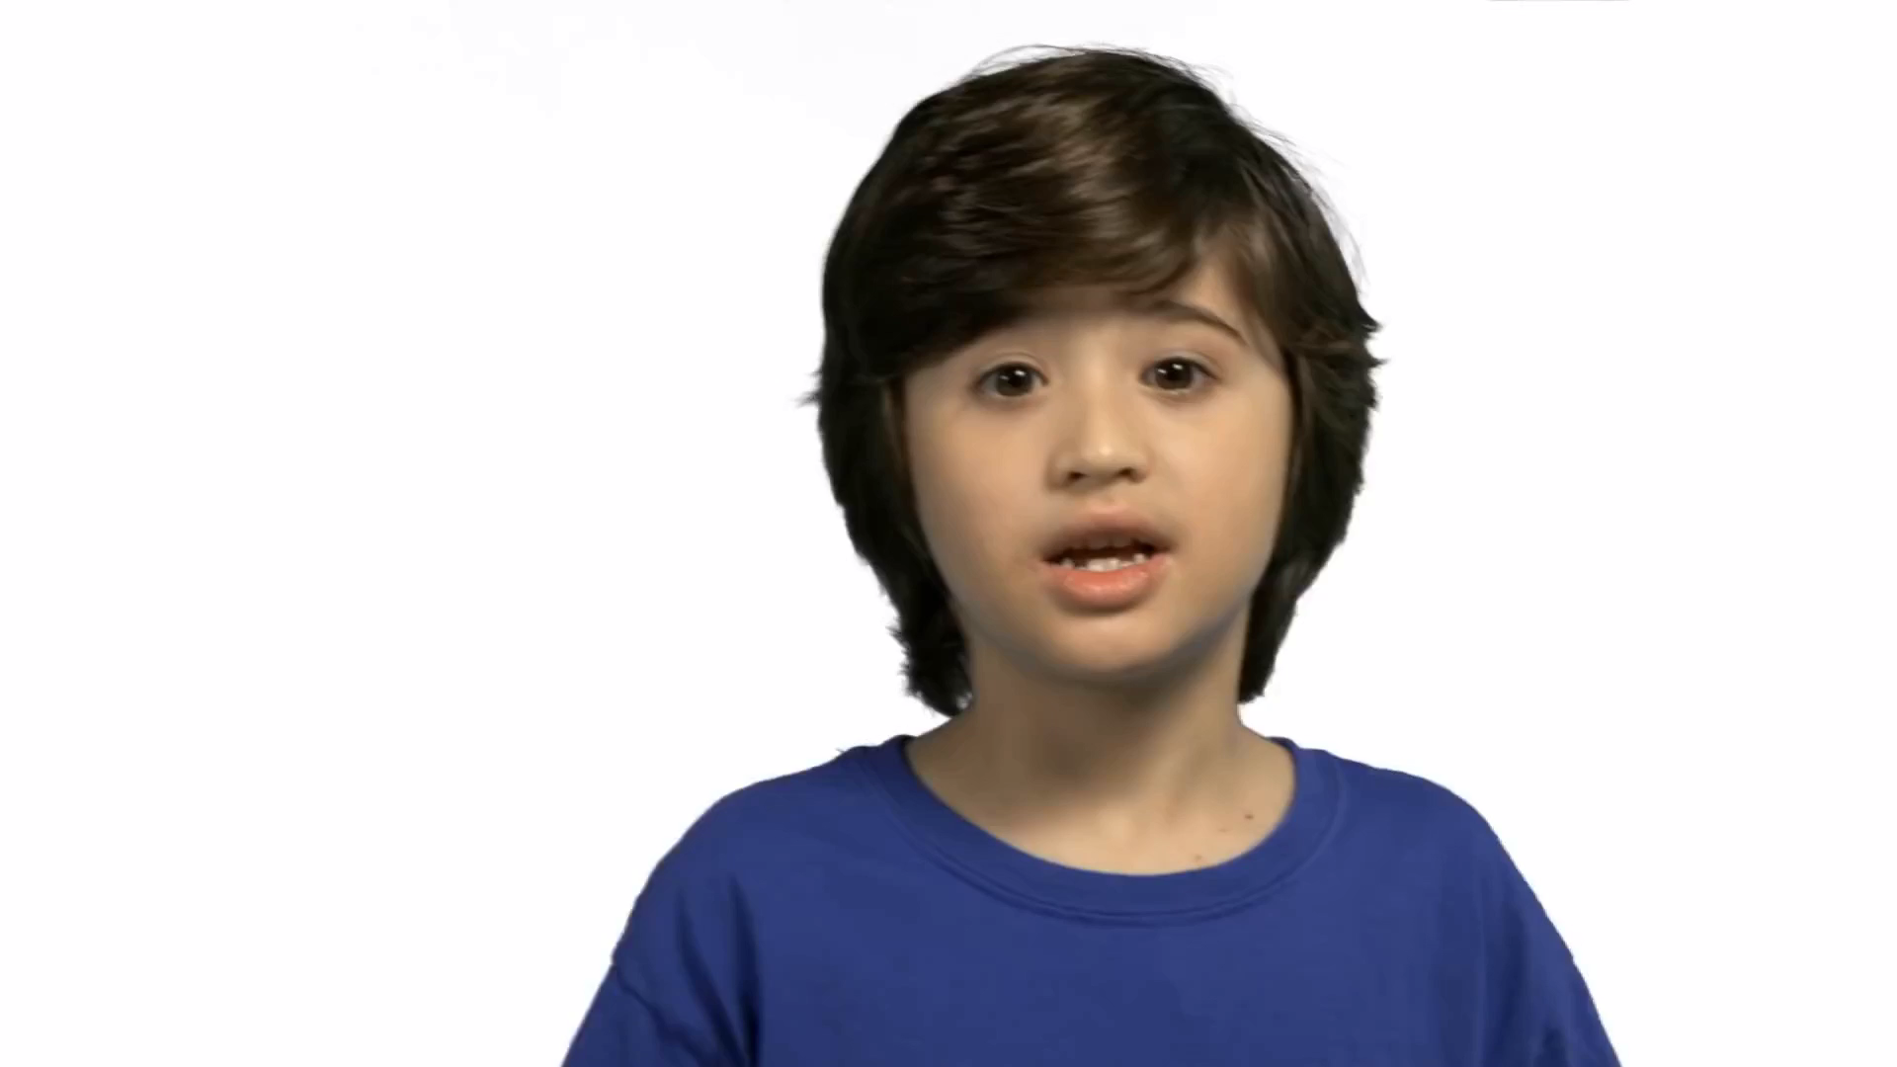

Slide 68
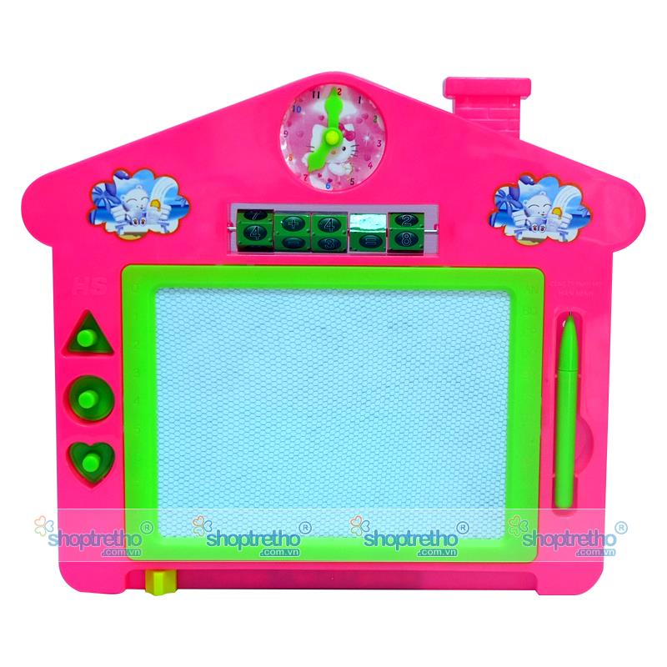


HOMEWORK
Learn by heart the vocabulary and the sentence pattern.
Prepare lesson 2 part 4-6 of the unit.(page 32)

Slide 70


Slide 71


bác sĩ
doctor
giáo viên
kiến trúc sư
teacher
architect
JOBS
phi công
pilot
nhà văn
writer
y tá
nurse

Slide 72
24/2/2023

Slide 73


Slide 74
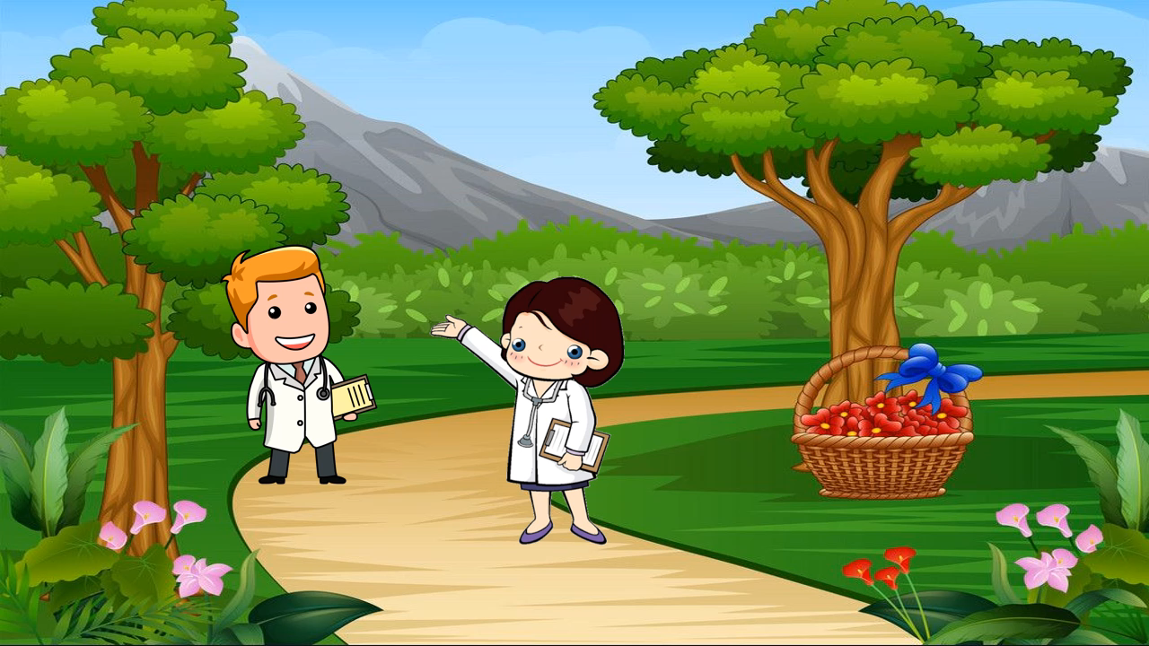
SONG ALPHABET JOBS
https://www.youtube.com/watch?v=PUhBp2AKugo

Slide 75



My survey
Topic: Free time activities.
Free time activities
How often……?
Anna
ride a bike
every day
go to the cinema
Anna’s mother
once a week
- Anna rides a bike every day.
- Anna ’s mother goes to the cinema once a week.

Slide 78


