Slide 1
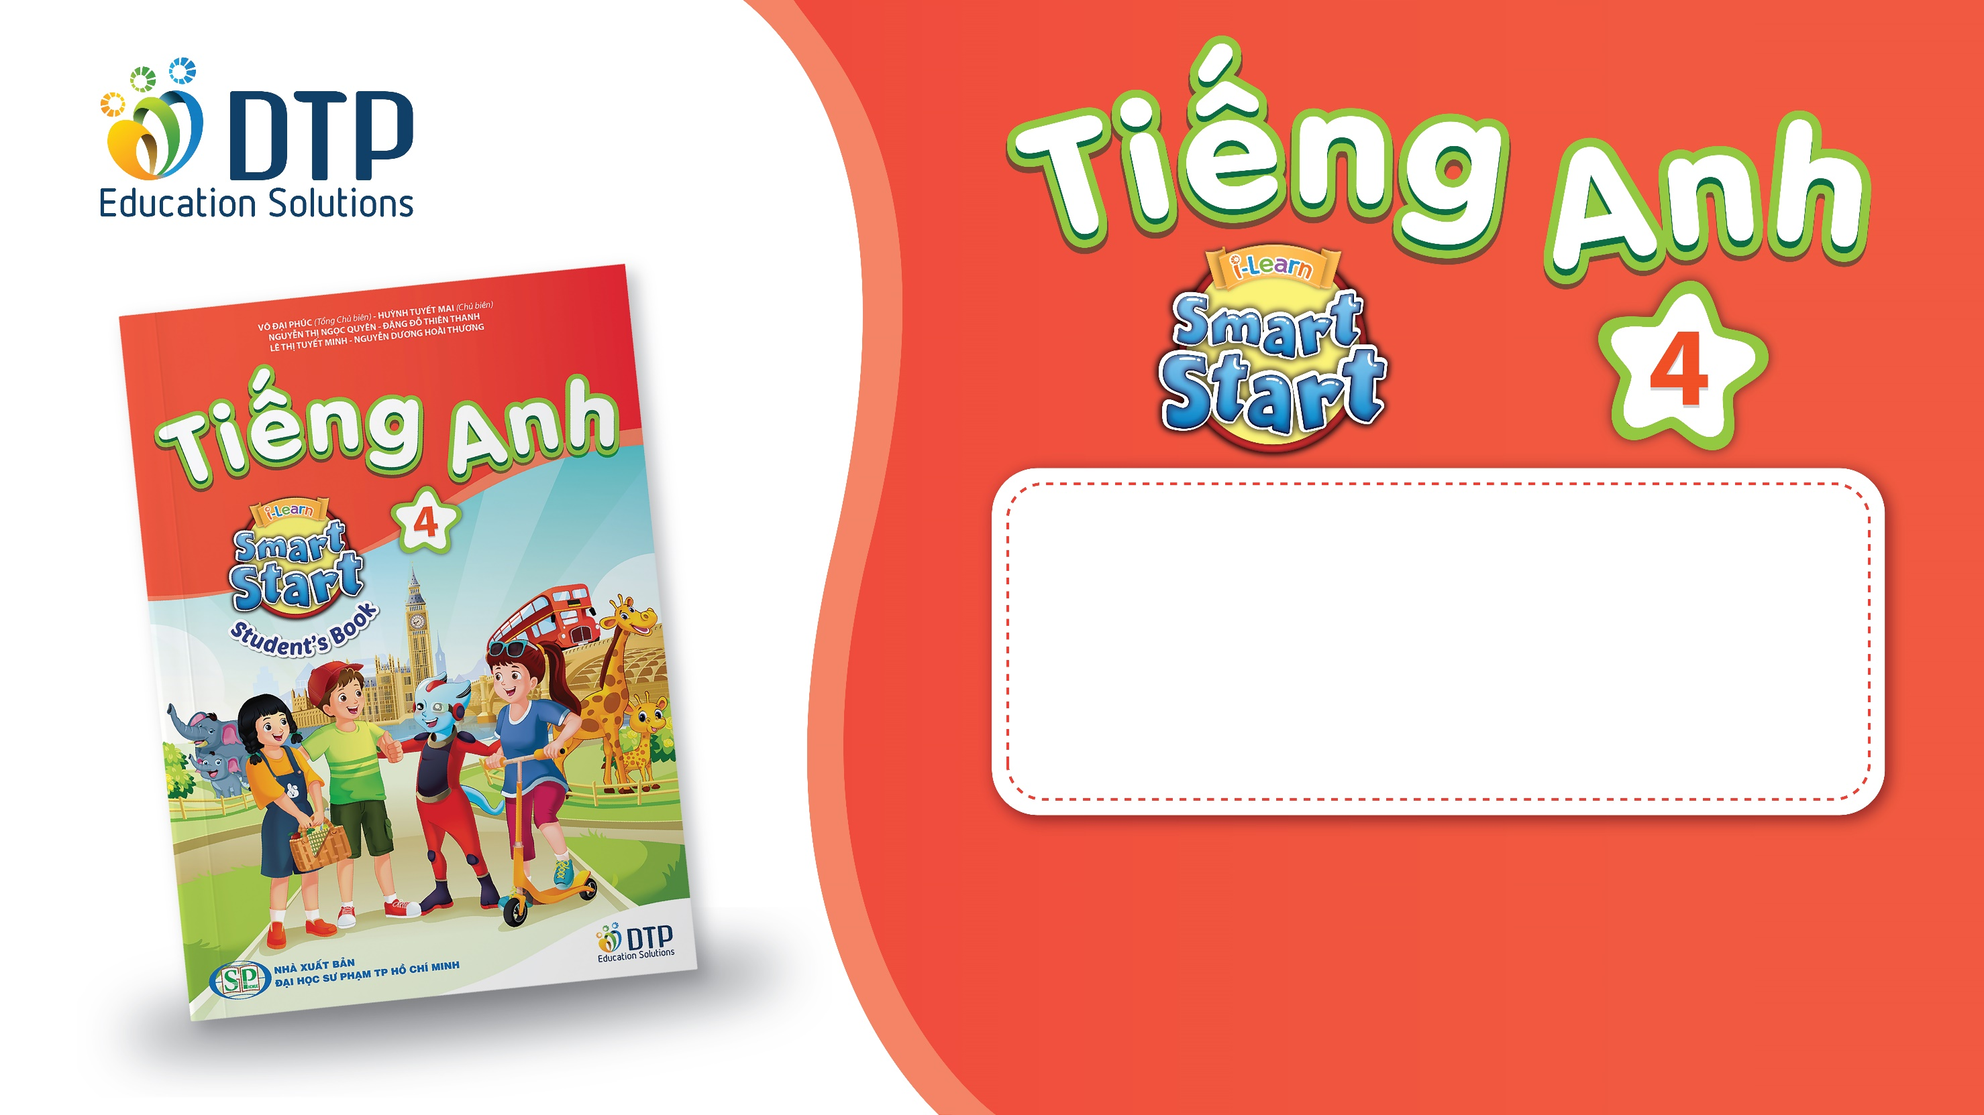
TEACHER: Le Thi Hau
Unit 4: ACTIVITIES
Lesson 2.2
Page 52

Slide 2
Lesson Outline
Warm-up
Listening
Consolidation
Wrap-up

Slide 3
Objectives
By the end of this lesson, students will be able to pronounce the sounds /w/, and /ʒ/; and practice asking and answering what they are doing.
Vocabulary: listen to music, watch television, play table tennis, do martial arts, skate, play chess.
Structure:
Is he playing chess?
– Yes, he is.
Are they doing martial arts?
- No, they aren’t. They’re skating.
Phonics: /w/, watch, walk; /ʒ/, television, Malaysia

Slide 4

WARM UP

Slide 5


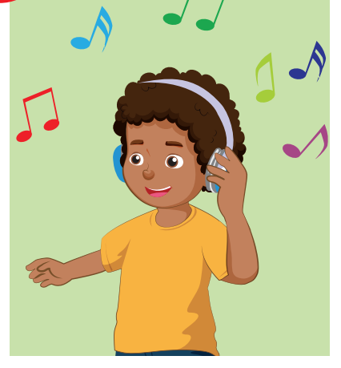

Look. Choose the correct answer.
A
play board game
B
listening to music
C
skate

Slide 6
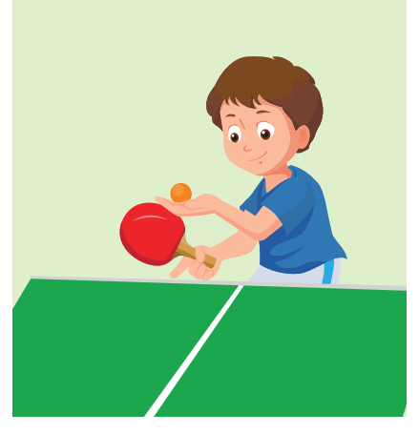
Look. Choose the correct answer.
A
skate
B
play chess
C
play table tennis

Slide 7
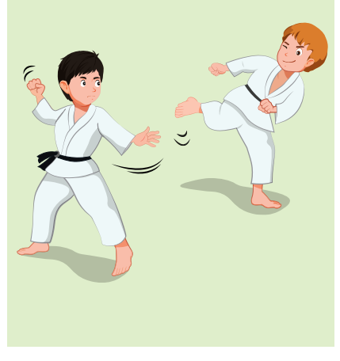

Listen. Choose the correct answer.
Click on A, B, C box to check the correct answer
A
B
C
Click on the speaker icon to hear the sound

Slide 8
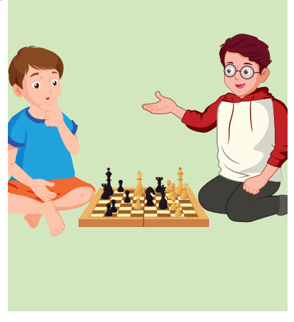
Listen. Choose the correct answer.
A
B
C
Click on the speaker icon to hear the sound

Slide 9
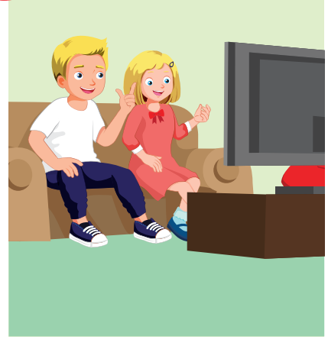
Listen. Choose the correct answer.
A
B
C
Click on the speaker icon to hear the sound

Slide 10

It’s time to learn …

Slide 11

Phonics
/w/
/ʒ/

Slide 12

Presentation

Slide 13
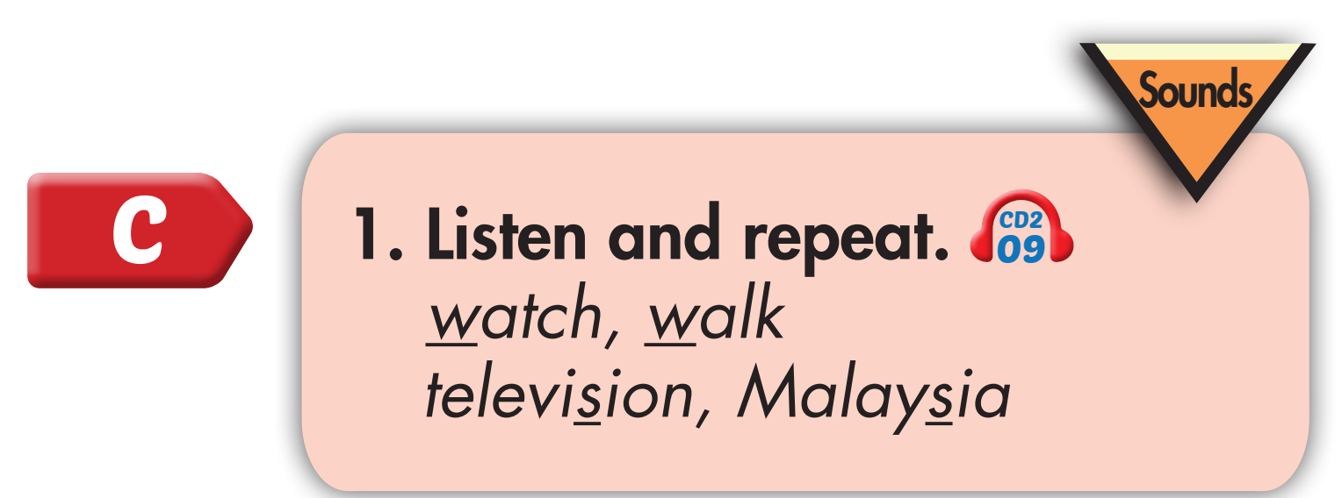
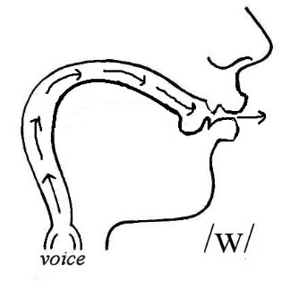
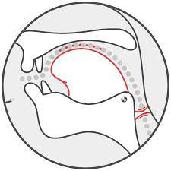
Click on the words to hear the sound
w, w, watch, walk
ʒ, ʒ, television, Malaysia
/ʒ/

Slide 14
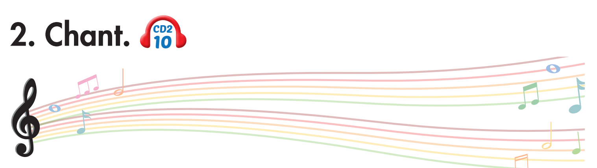
Click on the headphone icon to hear the sound
Is Alfie watching television?
Yes, he is.
Is Lucy watching television?
No, she isn't. She's walking to the store.
Notes:
1. Listen.
2. Listen and chant.

Slide 15
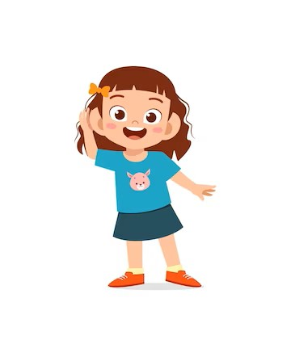
Listen. Hop and repeat when you hear /W/ sound.
Notes:
T say
Violin
Watch
Why
Volleyball
Living room
Wheel
Video games
Who
Water

Slide 16
Listen. Hop and repeat when you hear /ʒ/ sound.
Notes:
T say
Violin
television
Volleyball
Malaysia
Kitchen
usual
leisure
wash

Slide 17

Listening

Slide 18
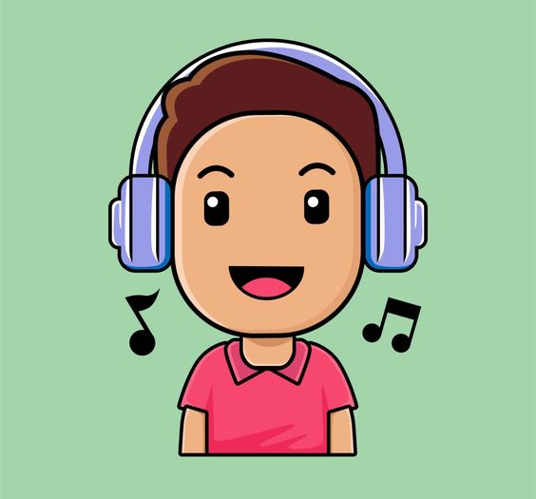
BEFORE YOU LISTEN

Slide 19
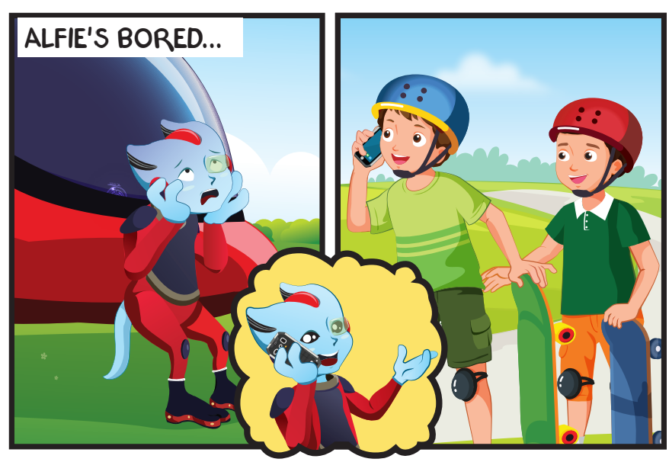
Where are Tom and Ben?
What are they doing?
Notes:
Encourage Ss to guess

Slide 20
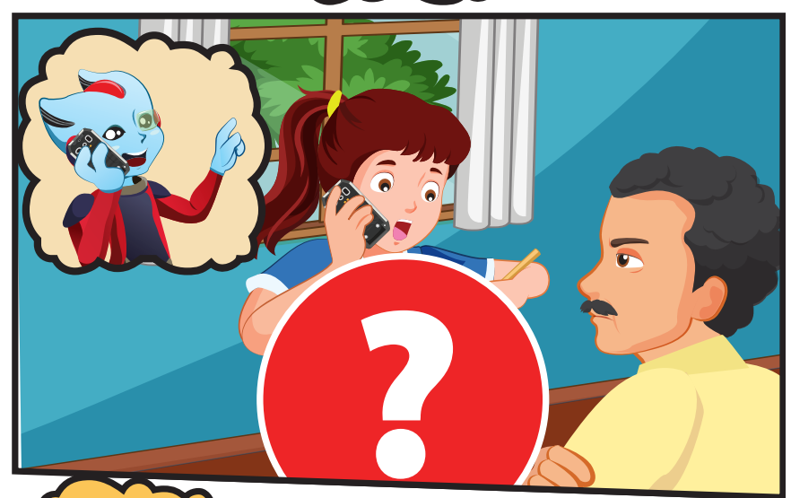
What is Lucy doing?

Slide 21
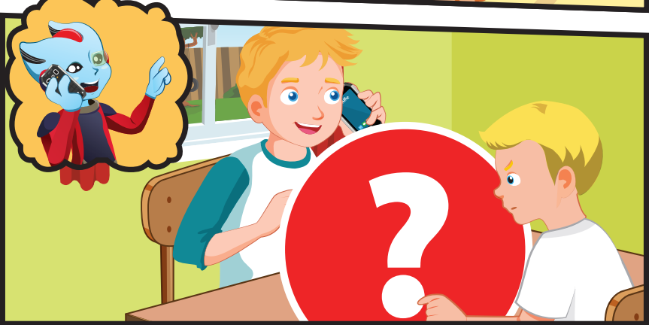
What’s Nick doing?

Slide 22
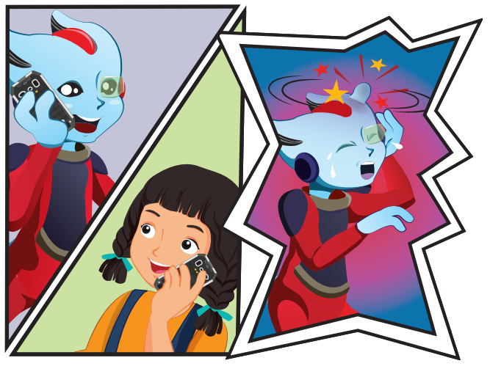
Where is Mai?
What is Mai doing?

Slide 23

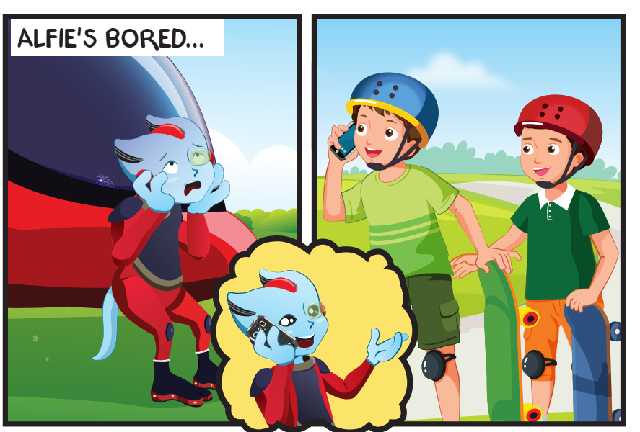
Click on the headphone icon to hear the sound

Slide 24
Click on the headphone icon to hear the sound

Slide 25
What’s Nick doing?

Slide 26
Where is Mai?
What is Mai doing?

Slide 27

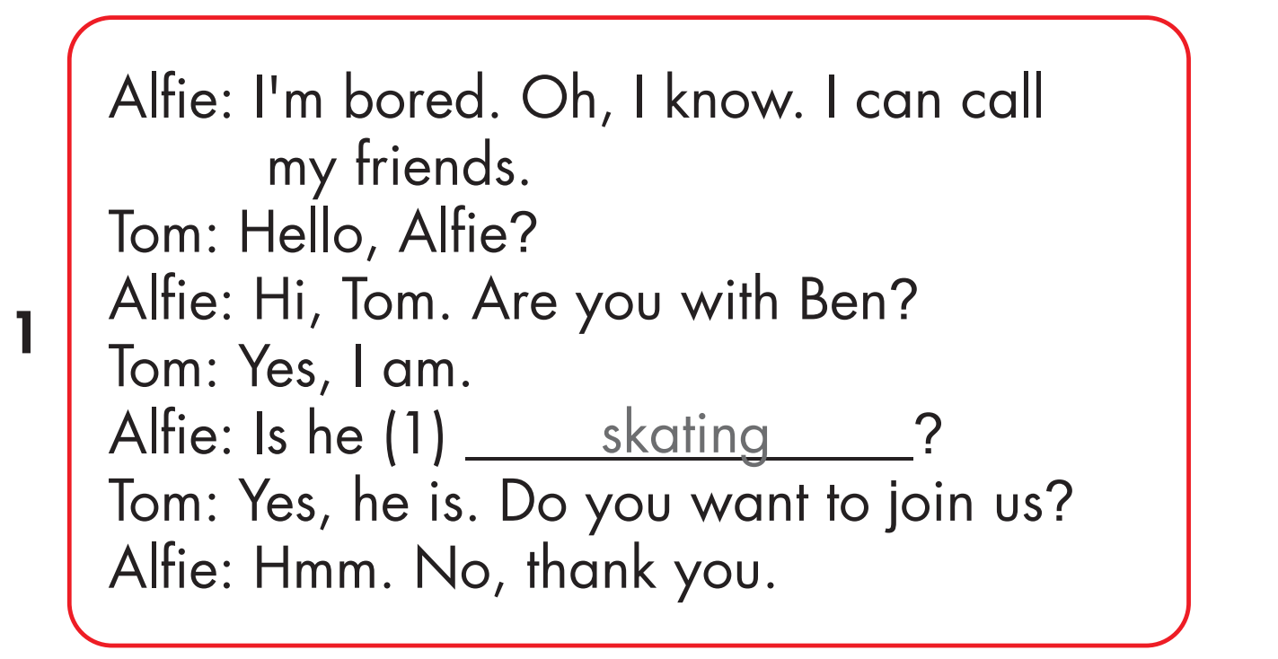
Click on the headphone icon to hear the sound.
Click on number 1
to show the answer.

Slide 28
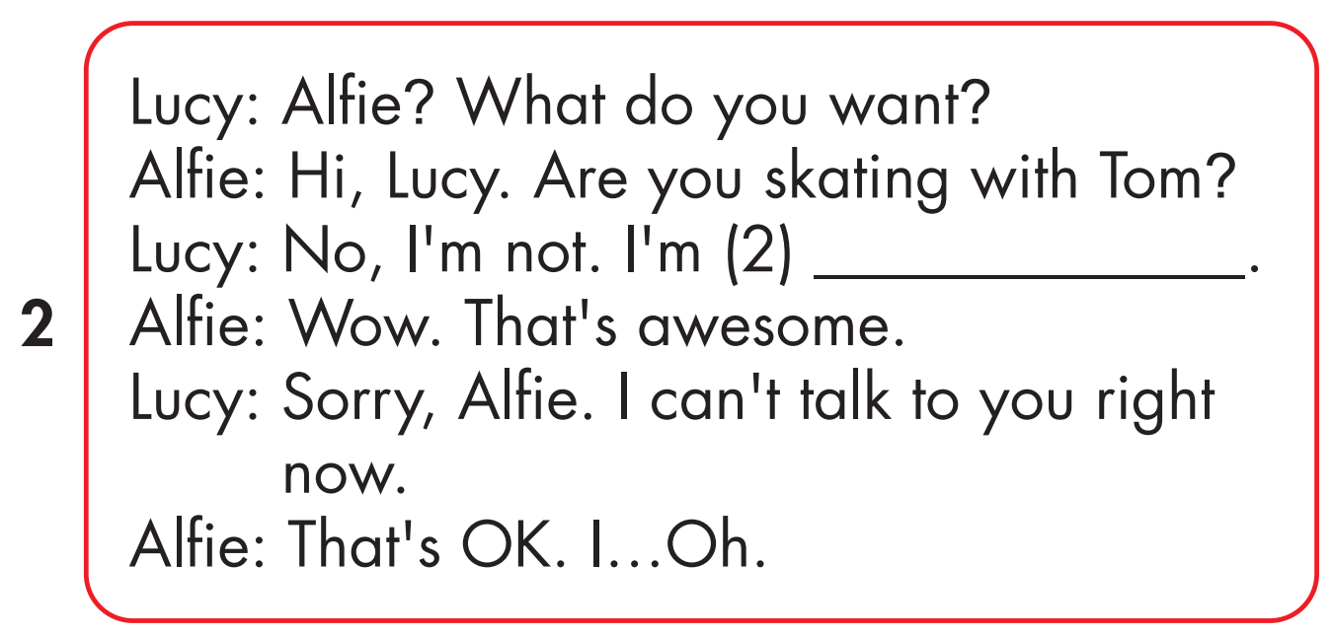
Click on the headphone icon to hear the sound.
playing drums
Click on number 2
to show the answer.

Slide 29
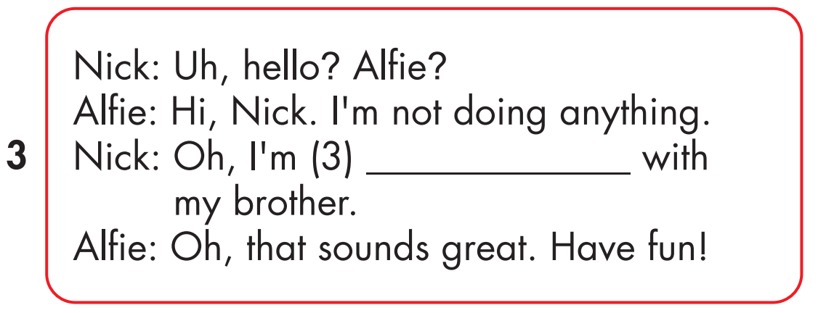
Click on the headphone icon to hear the sound.
playing chess
Click on number 3
to show the answer.

Slide 30
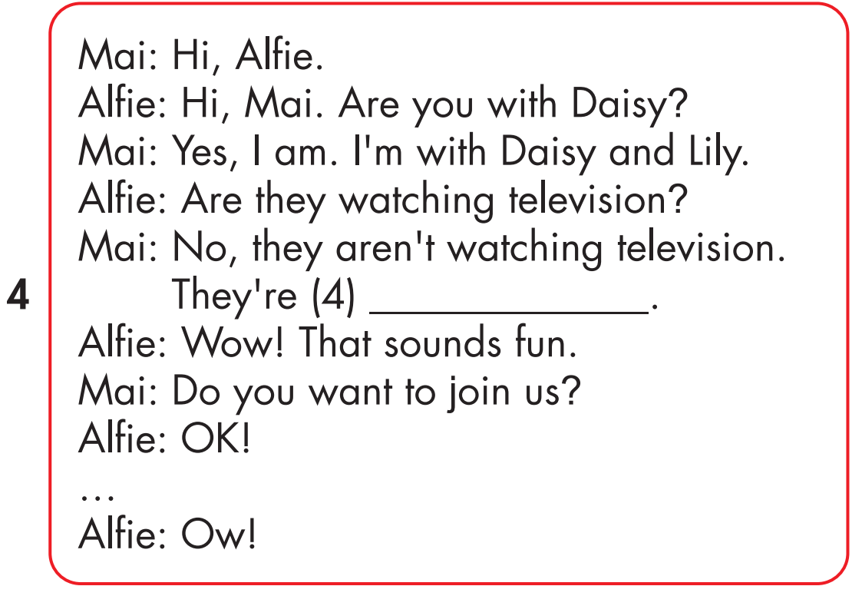
Click on the headphone icon to hear the sound.
doing martial arts
Click on number 4
to show the answer.

Slide 31

Practice

Slide 32


Slide 33

playing drums

Slide 34

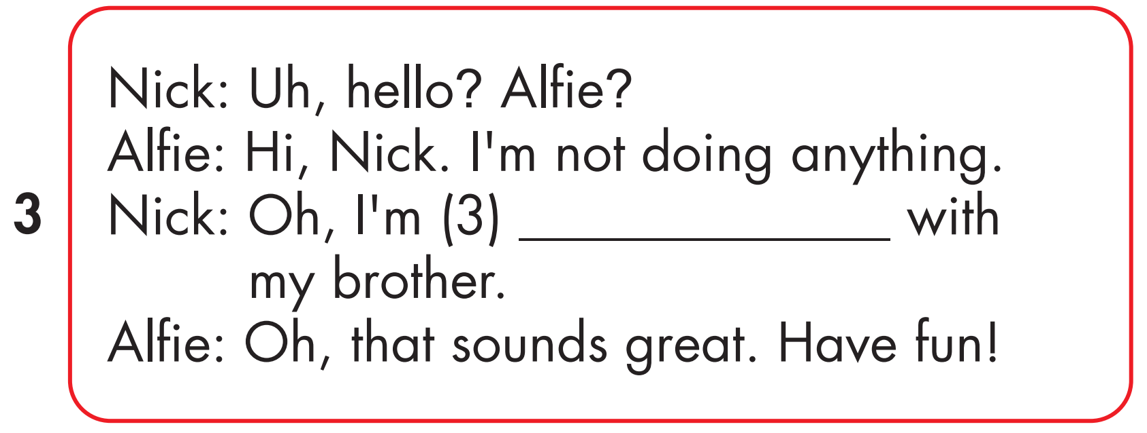
playing chess

Slide 35

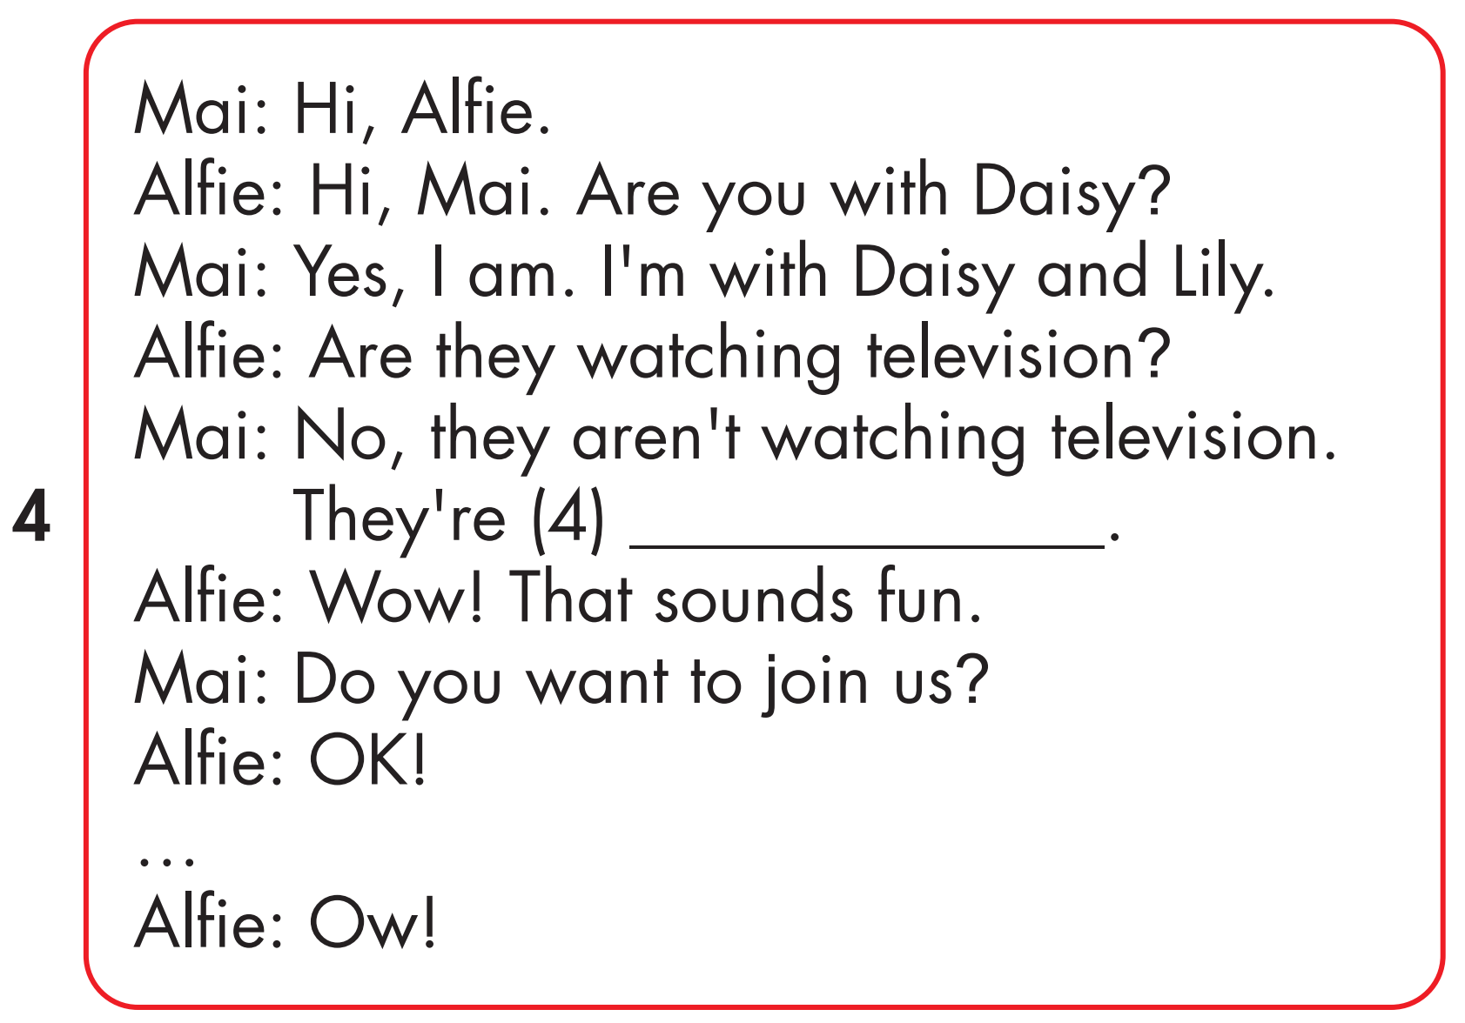
doing martial art

Slide 36

Production

Slide 37
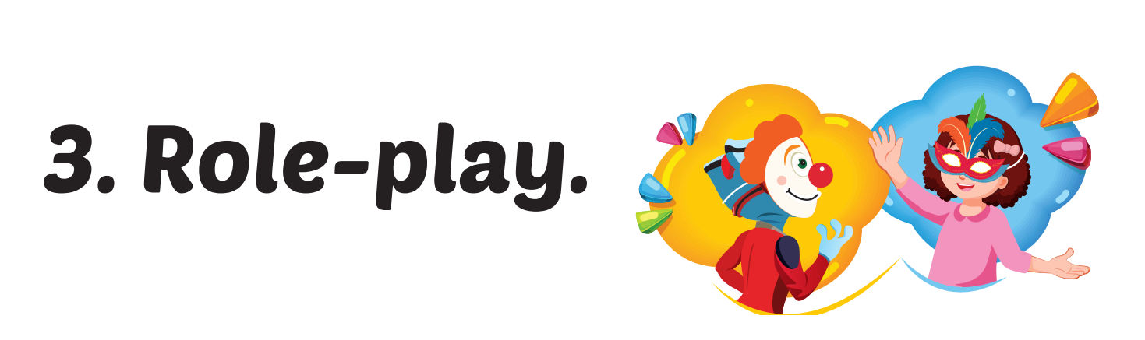

Slide 38

CONSOLIDATION

Slide 39

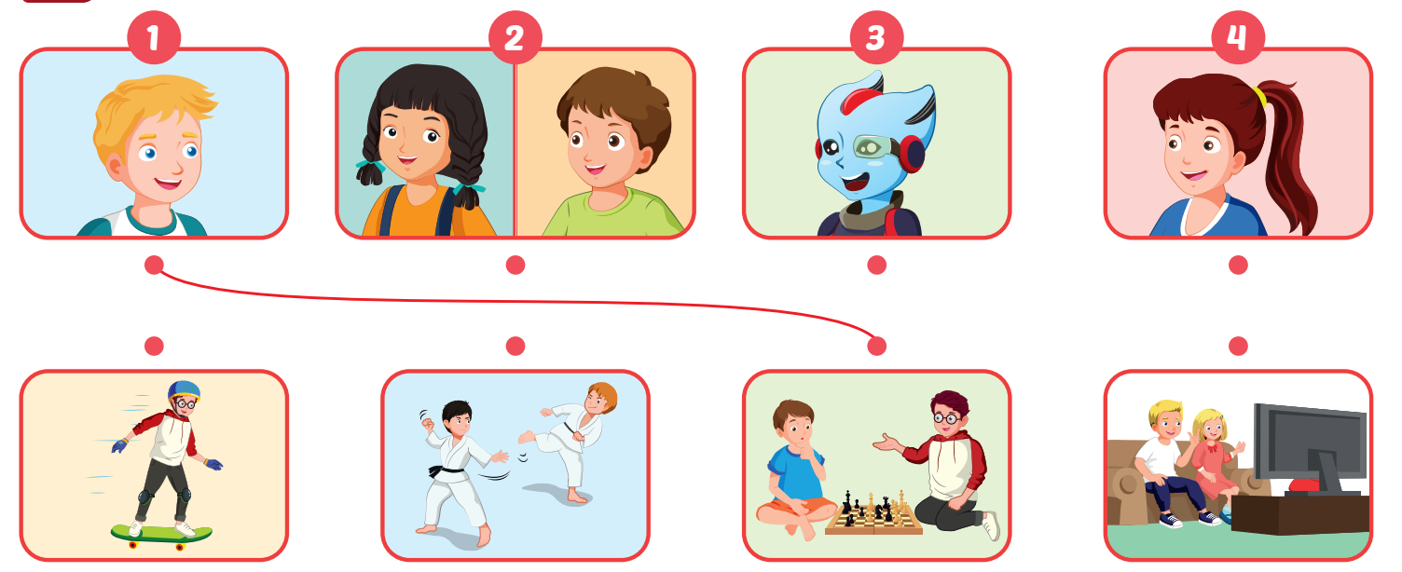
Click on the headphone icon to hear the sound.

Slide 40

WRAP-UP

Slide 41
Today’s lesson
Vocabularies
play a board game, do a puzzle, read a comic book, eat snacks, play video games.
Structures/ Sentence patterns
Are you reading a comic book?
– Yes, I am.
Are you read a comic book?
- No, we aren’t. We’re playing a board game.

Slide 42
Homework
Practice the vocabularies and structure, and make sentences using them.
Do the exercises in Tiếng Anh 4 i-Learn Smart Start WB (page 35)
Do the exercises in Tiếng Anh 4 i-Learn Smart Start Notebook (page 23).
Prepare the next lesson (page 53 SB).
Play the consolidation games in Tiếng Anh 4 i-Learn Smart Start DHA App on www.eduhome.com.vn

Slide 43

Lesson 3
Stay positive and have a nice day!

