Slide 1
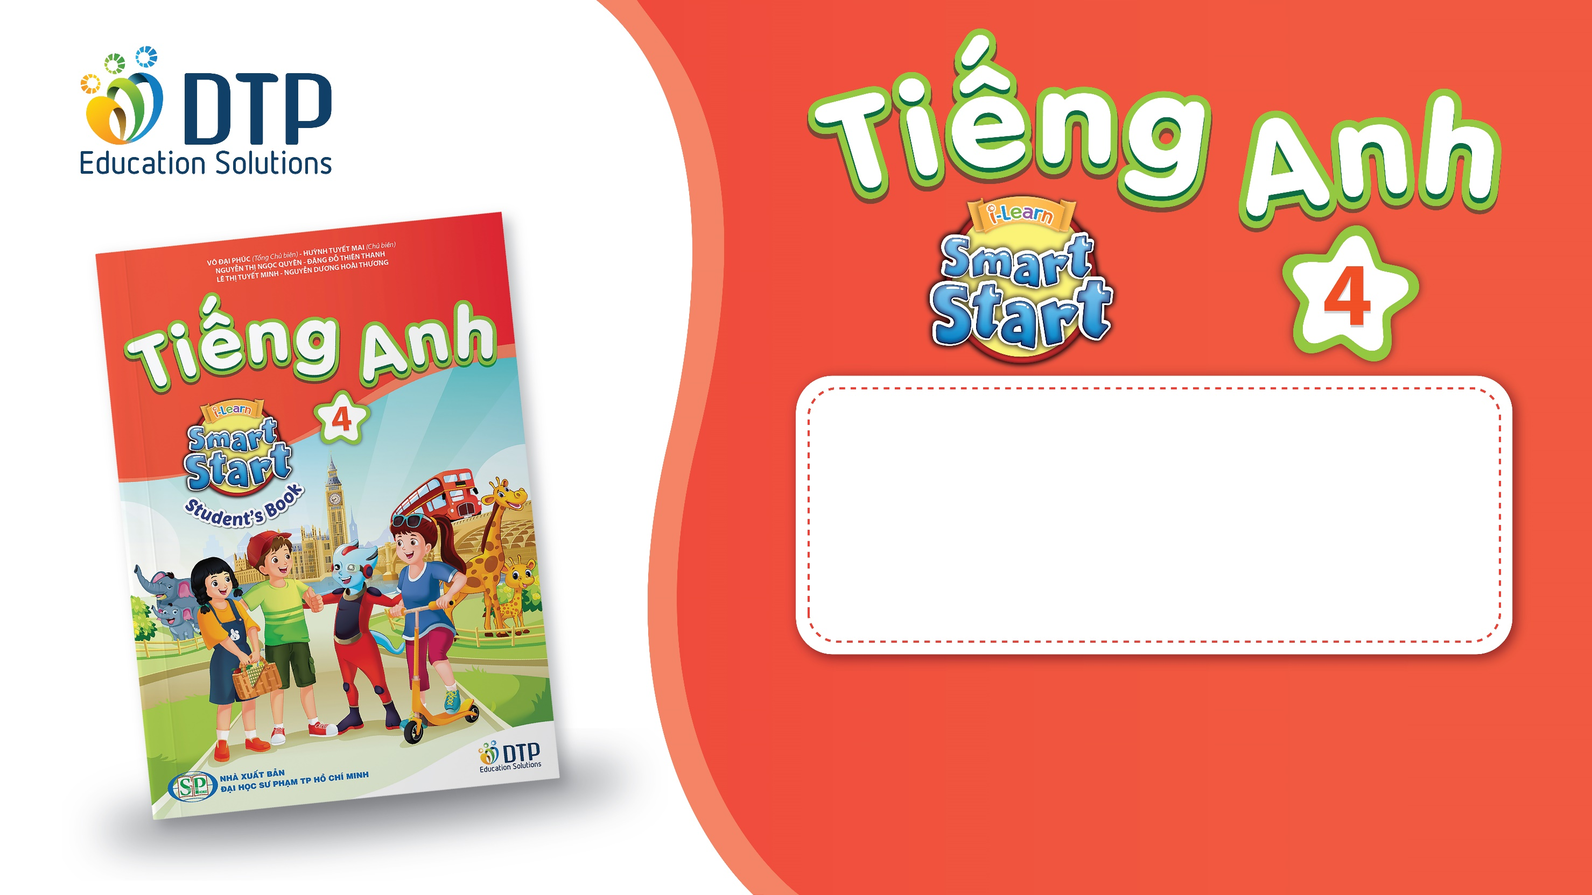
TEACHER: Le Thi Hau
Unit 4: ACTIVITIES
Lesson 1.1
Page 48

Slide 2
Lesson Outline
Warm-up
Vocabulary
Structure
Consolidation
Wrap-up

Slide 3
Objectives
By the end of this lesson, students will be able to learn and use ….
Vocabulary: play a board game, do a puzzle, read a comic book, eat snacks, and play video games.
Structure:
Are you reading a comic book?
– Yes, I am.
Are you read a comic book?
- No, we aren’t. We’re playing a board game.

Slide 4

WARM UP

Slide 5





REVIEW 1
Look and say.
What’s the weather like today?
It’s …….

Slide 6


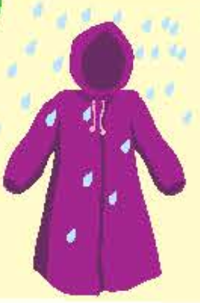
Bring your…
when it’s…
sunglasses
sunny
gloves
snowy
raincoat
rainy

Slide 7

It’s time to learn …

Slide 8

New words
play a board game
do a puzzle
read a comic book
eat snacks
take photos

Slide 9

Presentation

Slide 10

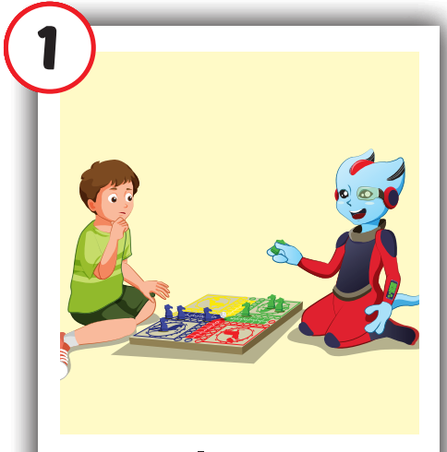
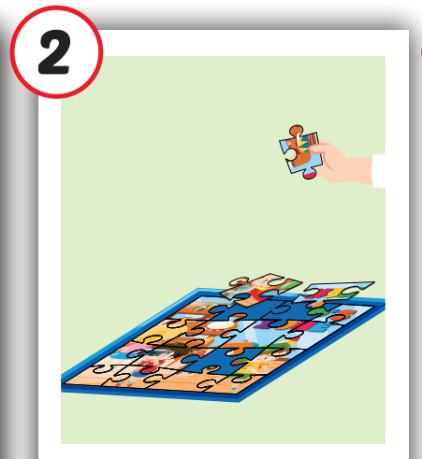
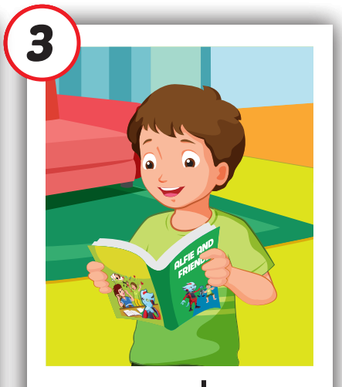

Click each English word to hear the sound.
play a board
game
do
a puzzle
read a comic book
/pleɪ ə ˈbɔːrd ˌɡeɪm/
chơi trò chơi có bàn cờ
/duː ə ˈpʌzl /
trò chơi xếp hình
/riːd ə ˈkɑːmɪk bʊk/
đọc truyện tranh

Slide 11
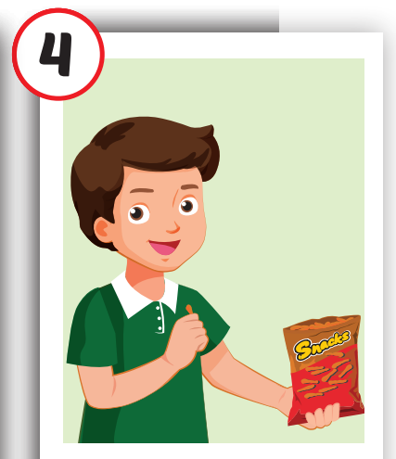
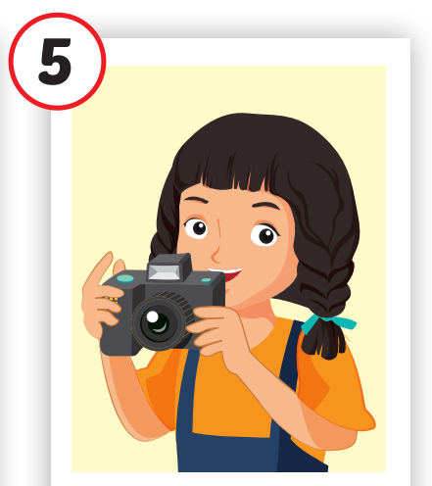
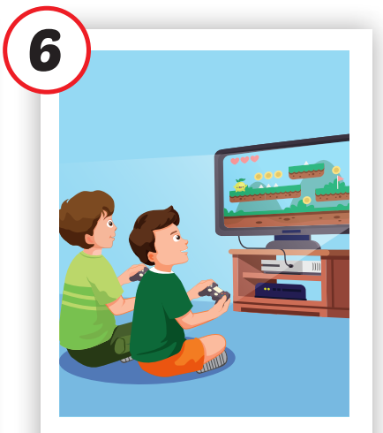
play
video games
eat snacks
take photos
/iːt snæk/
ăn vặt
/teɪk ˈfoʊtoʊz /
chụp ảnh
/ˈplei ˈvɪdioʊ ɡeɪmz/
chơi trò chơi điện tử

Slide 12

Practice

Slide 13
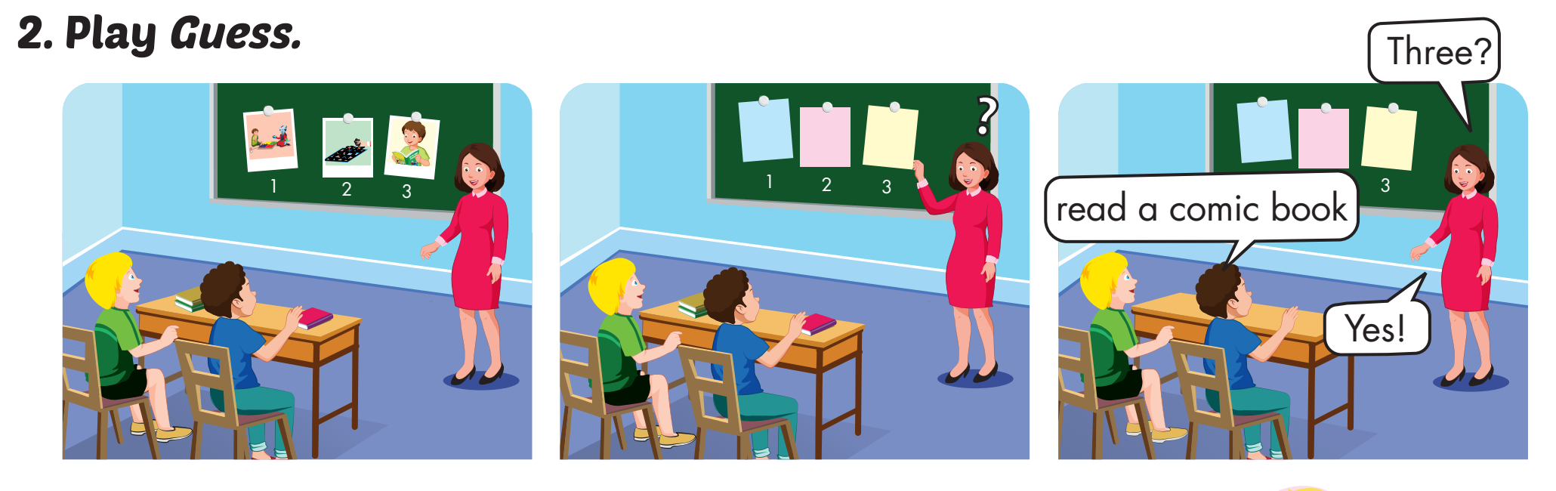

Slide 14

WHAT IS IN THE CLOCK?
HOW TO PLAY
Press START to play.
Click CHECK to show the answer.

Slide 15

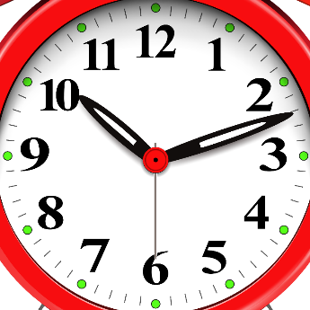
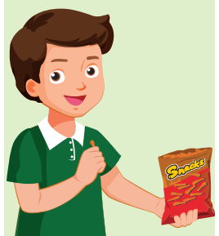
START
CHECK

Slide 16

START
CHECK

Slide 17
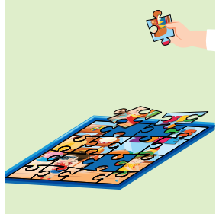
START
CHECK

Slide 18
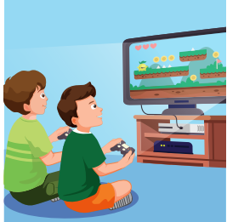
START
CHECK

Slide 19
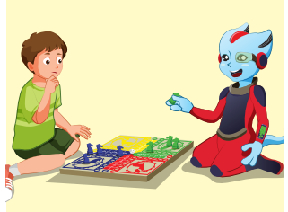
START
CHECK

Slide 20
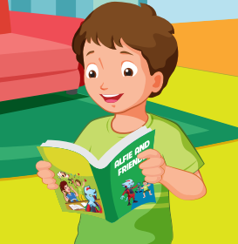
START
CHECK

Slide 21
WHAT’S MISSING?
play a board game
eat snacks
read a comic book
take photos
take photos
Do a puzzle
Do a puzzle
Do a puzzle
eat snacks
take photos
read a comic book
read a comic book
play a board game
Do a puzzle
eat snacks
Do a puzzle
eat snacks
take photos
play a board game
take photos
read a comic book
play a board game
read a comic book

Slide 22
Structures
Are you reading a comic book? - Yes, I am.
Are you reading a comic book?
No, we aren’t. We are playing a board game.

Slide 23
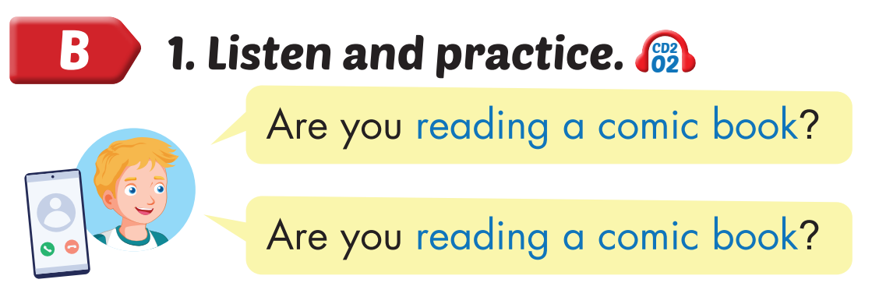
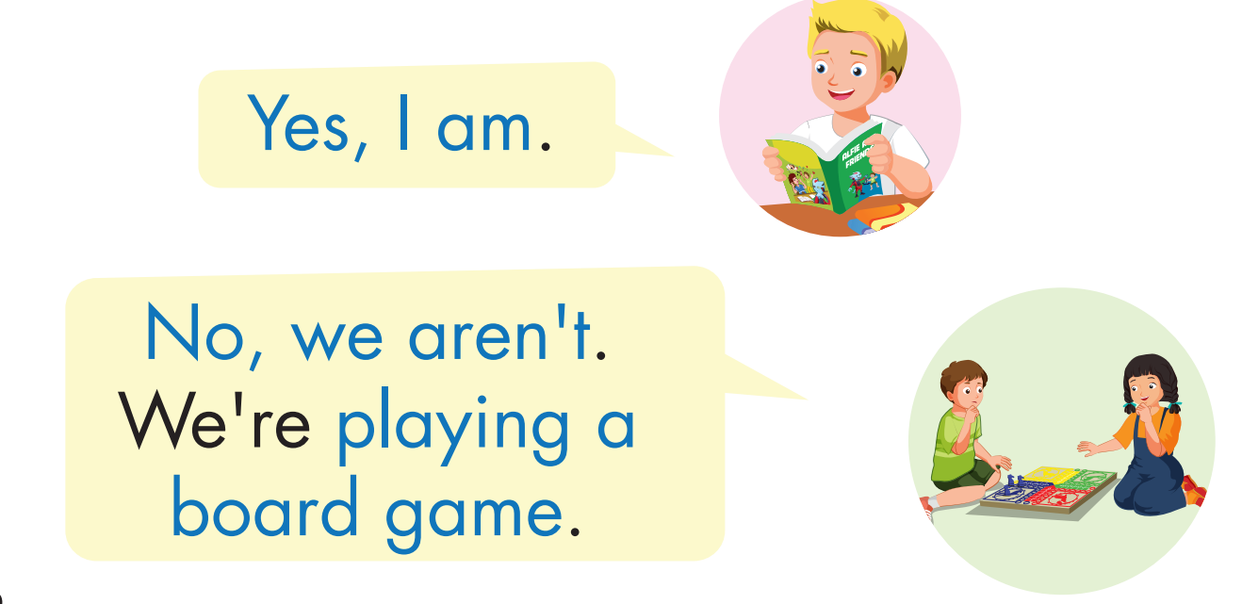
Click on the headphone icon to hear the sound.

Slide 24

Practice

Slide 25
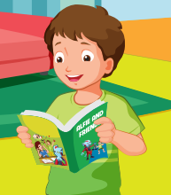
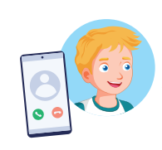


Are you reading a comic book?
Yes, I am.

Slide 26

Are you ……..?
Yes, I am.

Slide 27
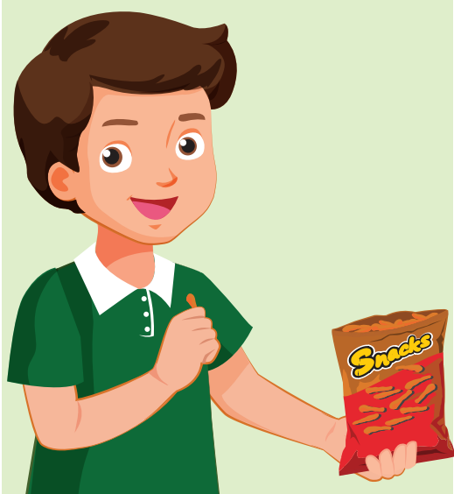
Are you ……..?
Yes, I am.

Slide 28
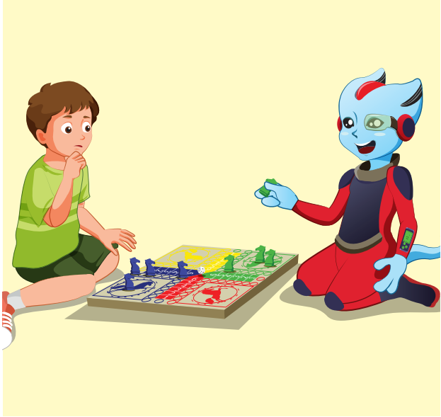

Are you ……..?
No, we aren’t. We …

Slide 29
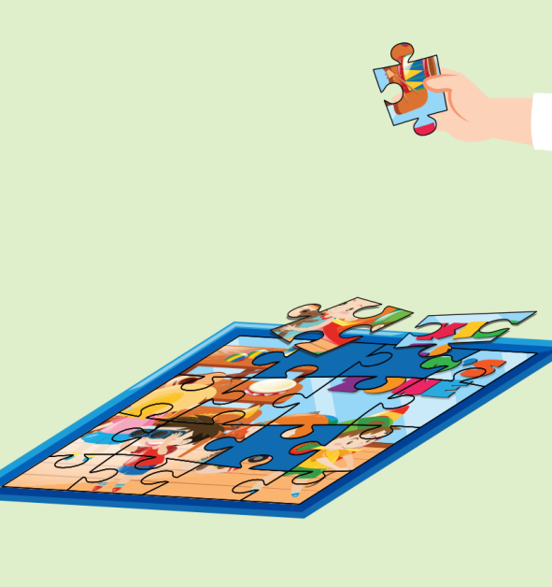
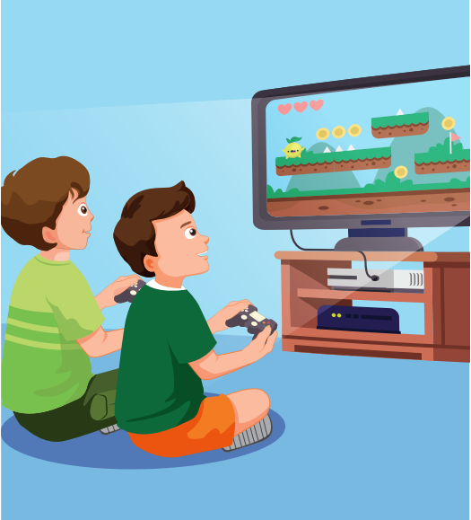
Are you ……..?
No, we aren’t. We …

Slide 30
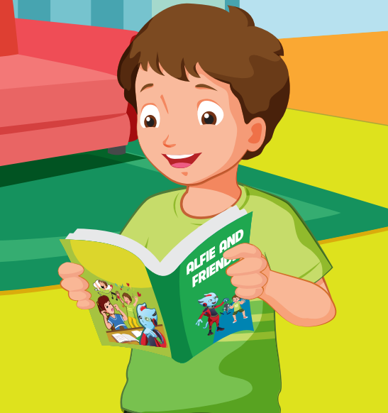
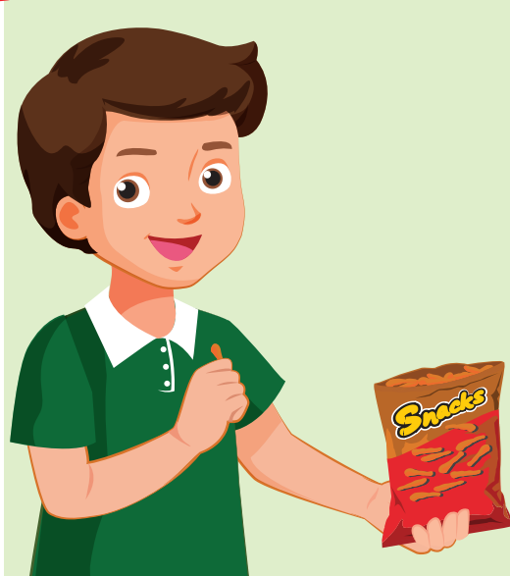
Are you ……..?
No, we aren’t. We …

Slide 31

CONSOLIDATION

Slide 32
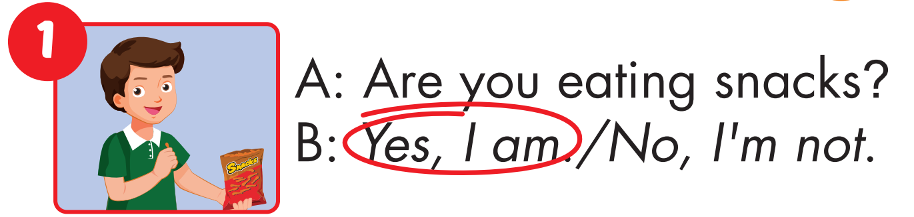
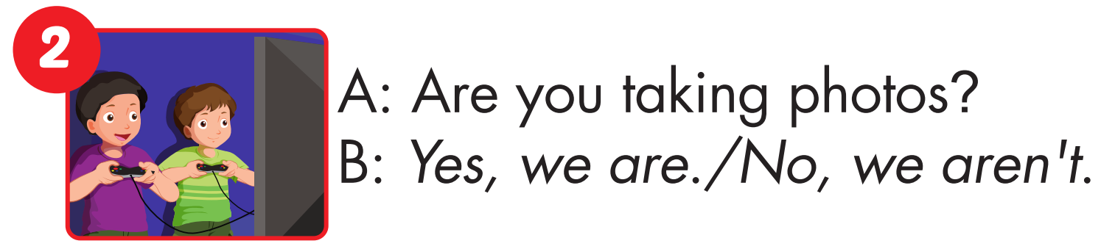

Slide 33
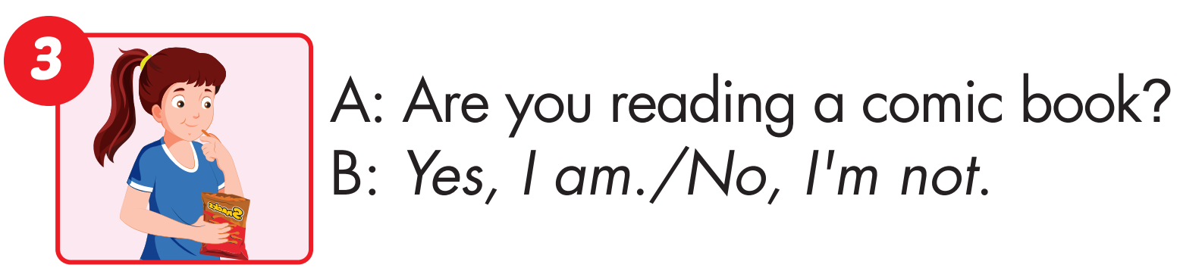
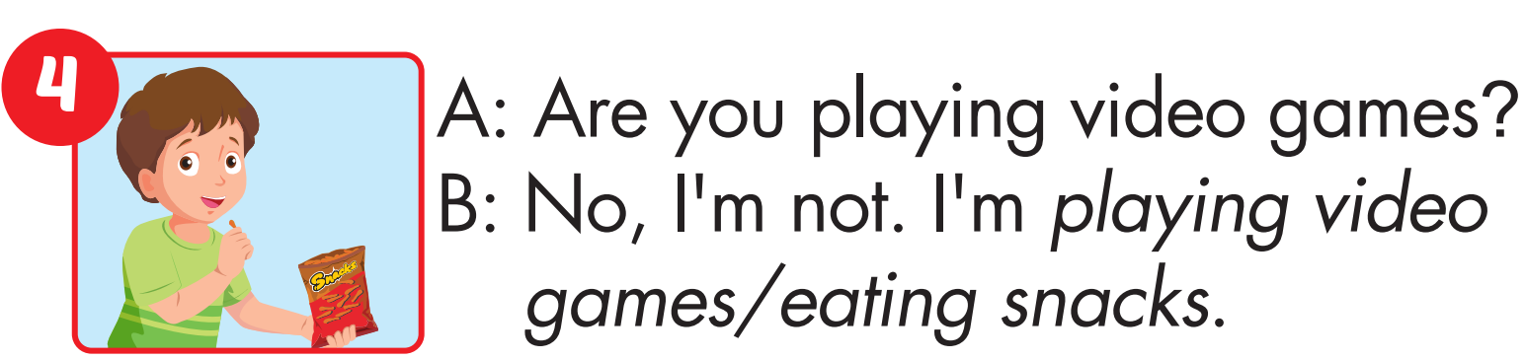

Slide 34
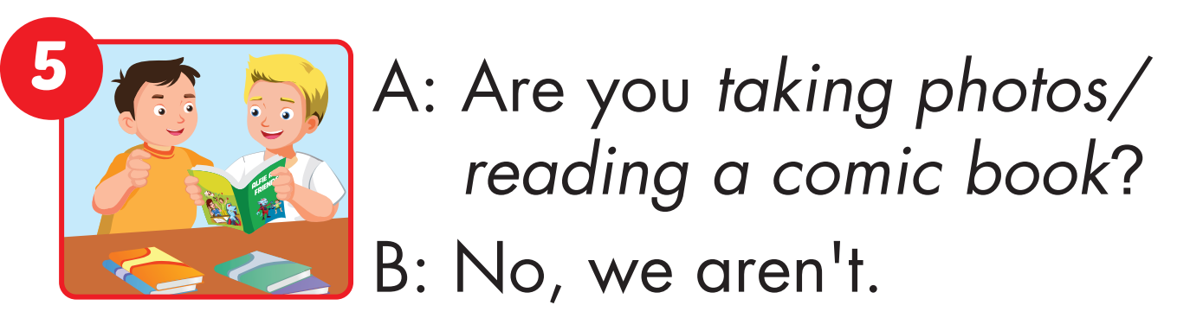
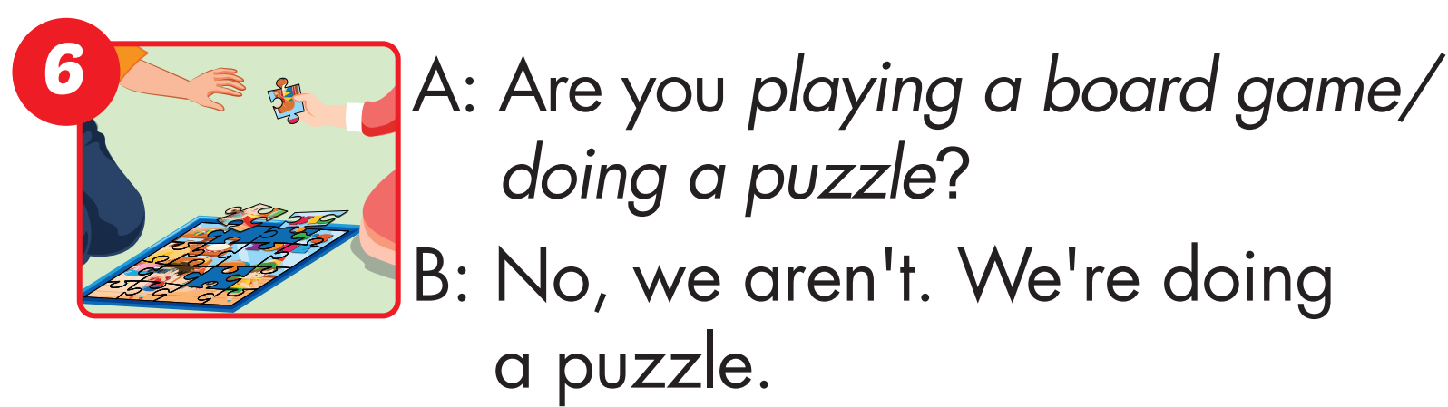

Slide 35

WRAP-UP

Slide 36
Today’s lesson
Vocabularies
play a board game, do a puzzle, read a comic book, eat snacks, play video games.
Structures/ Sentence patterns
Are you reading a comic book?
– Yes, I am.
Are you read a comic book?
- No, we aren’t. We’re playing a board game.

Slide 37
Homework
Practice the vocabularies and structure, and make sentences using them.
Do the exercises in Tiếng Anh 4 i-Learn Smart Start WB (page 32).
Do the exercises in Tiếng Anh 4 i-Learn Smart Start Notebook (page 22).
Prepare the next lesson (page 49 SB).
Play the consolidation games in Tiếng Anh 4 i-Learn Smart Start DHA App on www.eduhome.com.vn

Slide 38
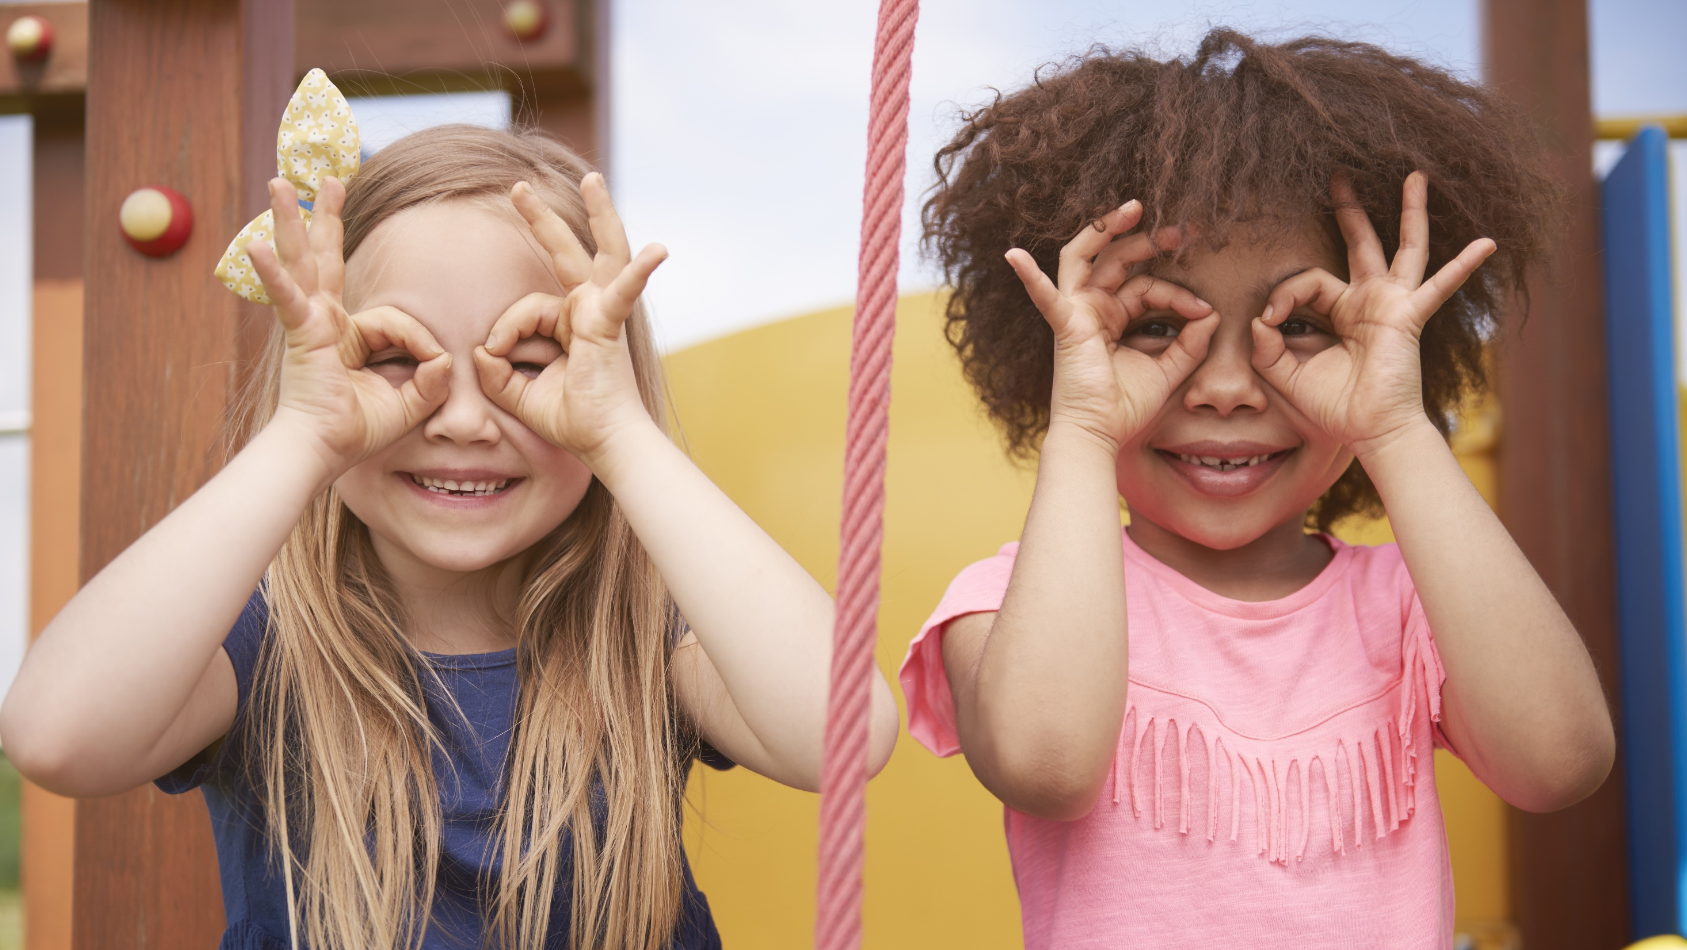
Enjoy your day!

