Slide 1

Unit 2: Family
Lesson 2.1
Page 27

Slide 2
Lesson Outline
Warm-up
Vocabulary
Structure
Consolidation
Wrap-up

Slide 3
Objectives
By the end of this lesson, students will be able to learn, practice and use …..
Vocabulary: grandfather, grandmother, uncle, aunt, cousin
Structure:
Who’s she? – She’s my aunt.
What’s her name? – Her name’s May.

Slide 4

WARM UP

Slide 5
Guessing game ☺☺

Slide 6

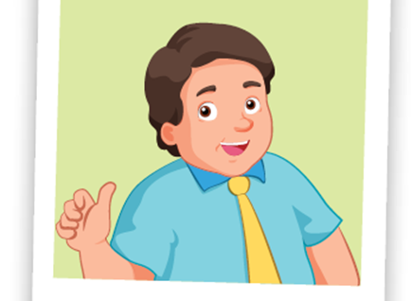
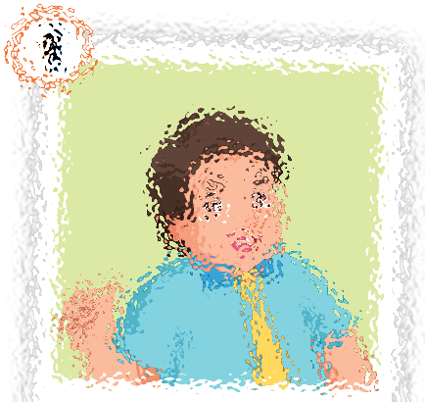
father

Slide 7
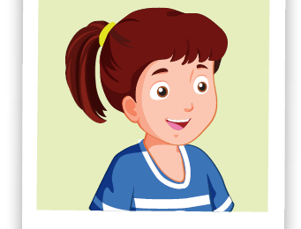
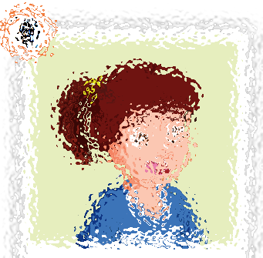
sister

Slide 8
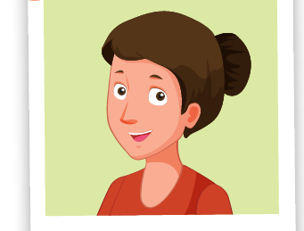
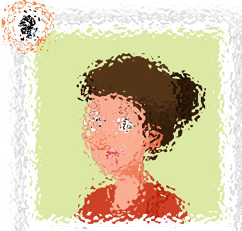
mother

Slide 9
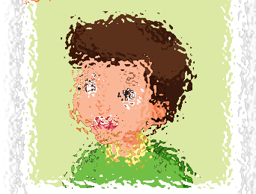
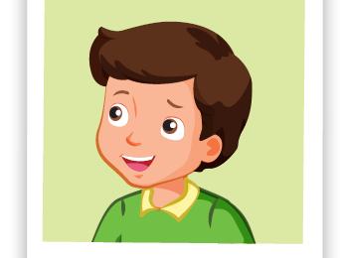
brother

Slide 10

It’s time to learn …

Slide 11
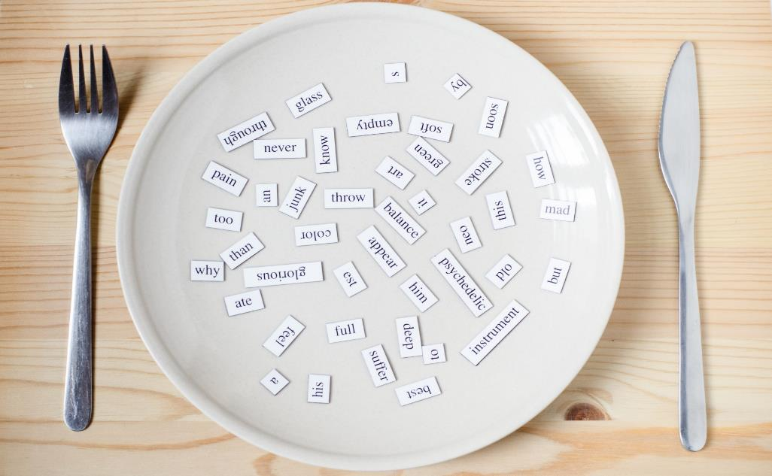
New words
grandfather
grandmother
uncle
aunt
cousin

Slide 12

Presentation

Slide 13




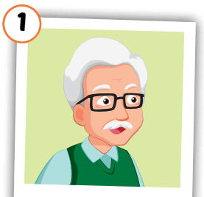
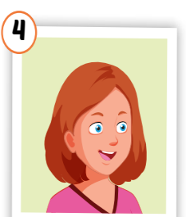
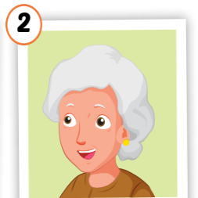
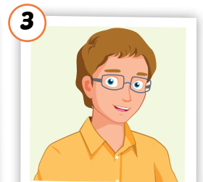
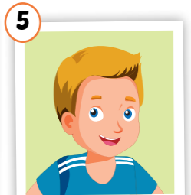
Click on each word to hear the sound.
grandfather
grandmother
uncle
aunt
cousin
/ˈɡrænfɑːðər/
ông nội,
ông ngoại
/ˈɡrænmʌðər/
bà nội,
bà ngoại
/ˈʌŋkl/
chú, bác, cậu
/ænt/
cô, dì, mợ
/ˈkʌzn/
anh/chị/em họ

Slide 14

Practice

Slide 15

Choose a number and fill in the blank.
au_t
gr_nd_athe_
1
a
2
n
f
r
c _us_n
uncl_
Click on each word to hear the sound.
3
4
o i
e
g_an_mo_her
5
r d t
Click here to show answers.
1
2
3
4
5

Slide 16
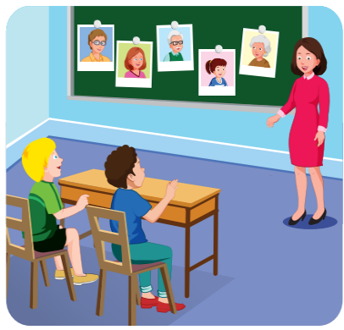
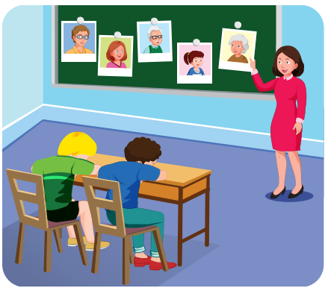
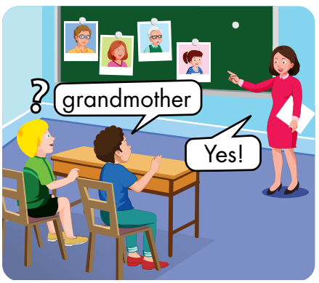

Slide 17
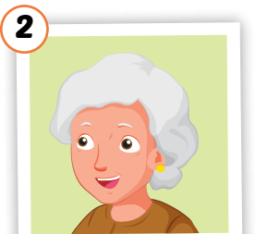





Slide 18
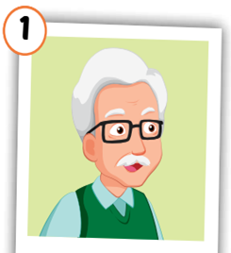
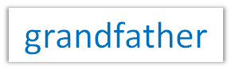
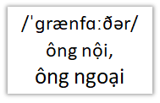

Slide 20

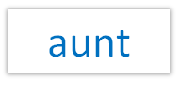


Slide 22


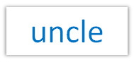
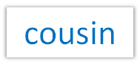



Slide 23

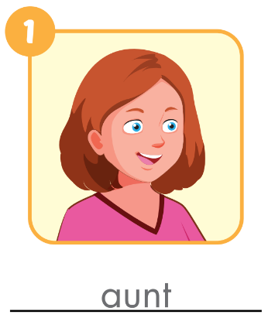
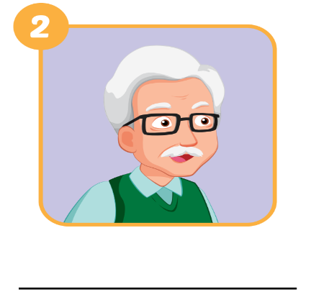
Extra Practice
WB, page 20.
grandfather

Slide 24
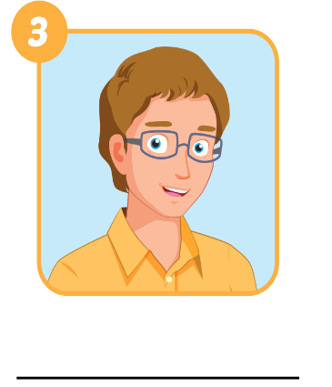
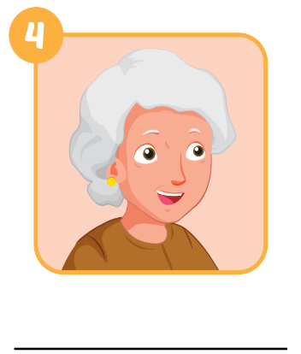
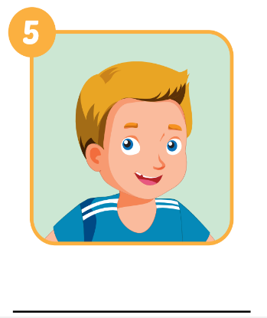
Extra Practice
WB, page 20.
uncle
grandmother
cousin

Slide 25

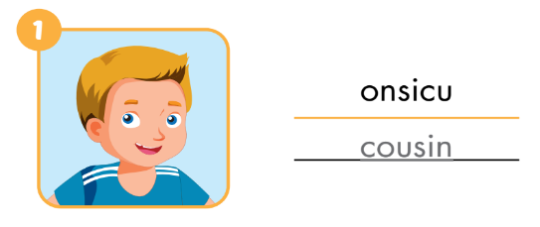
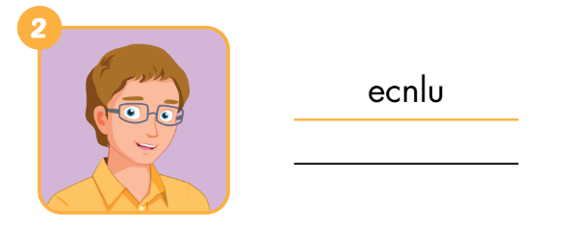
Extra Practice
WB, page 20
uncle

Slide 26
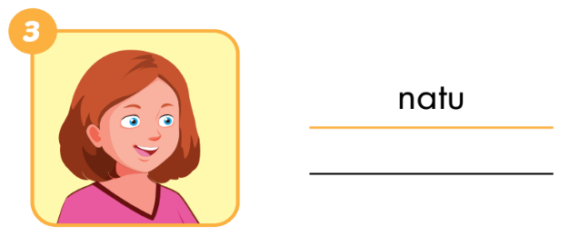

Extra Practice
WB, page 20
aunt
grandmother

Slide 27
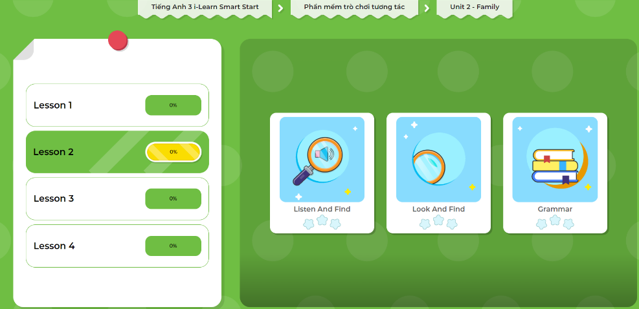
LET’S PLAY!
Click here to play the game.

Slide 28
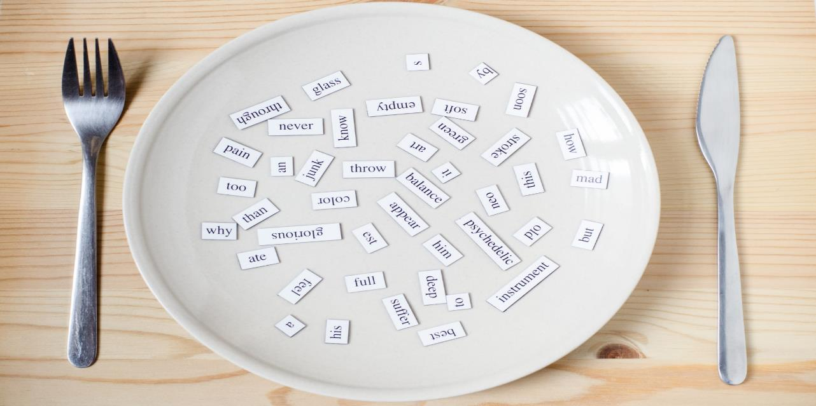
Structures
Who's he/she? - He’s/ She's my….
What's his/her name? - His/her name's ...

Slide 29
Presentation

Slide 30





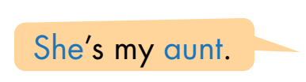



Slide 31
Practice

Slide 32

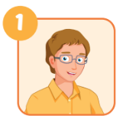
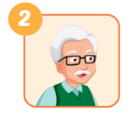
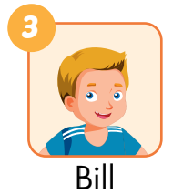
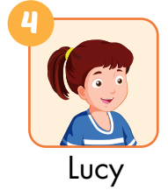
he
A: Who’s he?
B: He’s my________.
A: Who’s ___________?
B: He’s _____________.
uncle
my grandfather
A: What’s his name?
B: His name’s ______.
her name
A: What’s___________?
B: Her___________.
Bill
name’s Lucy

Slide 33

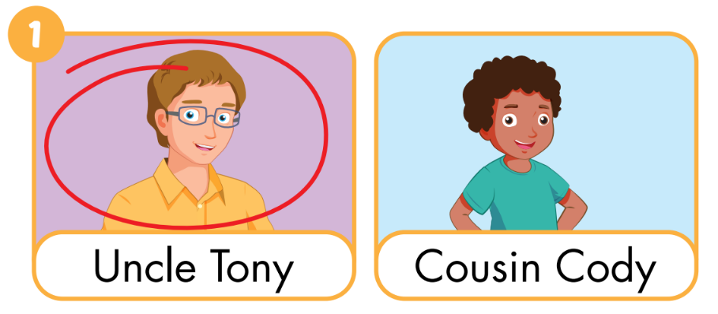
Extra Practice
WB, page 20

Slide 34
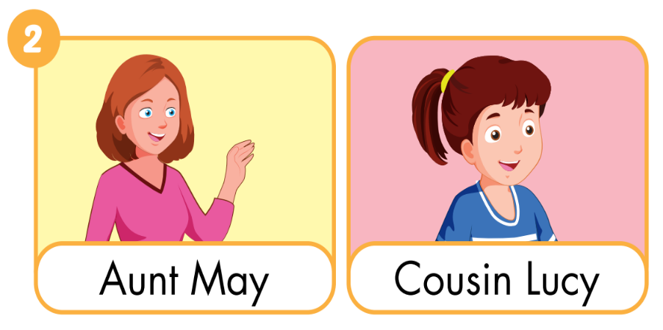

Slide 35
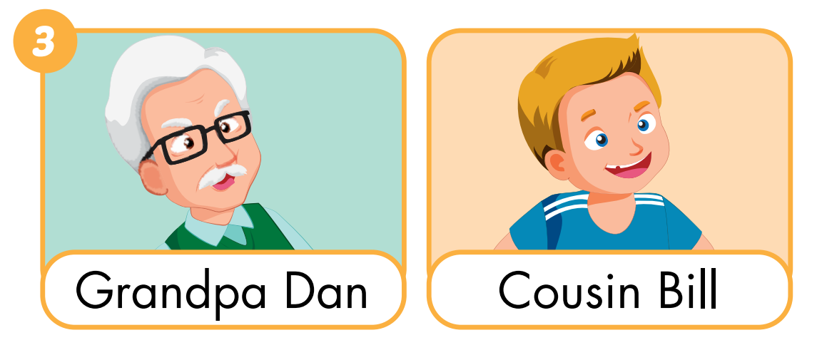

Slide 36
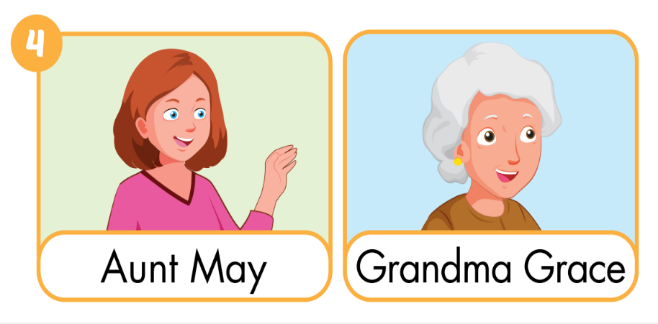

Slide 37
LET’S PLAY!
Click here to play the game.

Slide 38

CONSOLIDATION

Slide 39

Early
Production

Slide 40


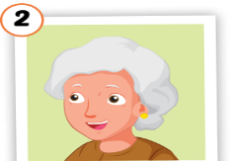


Lost turn
☹
1
SPIN
5
2
4
3
Notes:
GV dùng vòng quay để HS chọn số ngẫu nhiên. Khi chọn vào ô số nào thì sẽ làm câu cho số đó

Slide 41

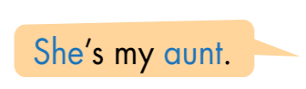


Draw your family members and talk with your partner.
👨
STUDENT B
👩
STUDENT A

Slide 42

WRAP-UP

Slide 43
Today’s lesson
Vocabularies
grandfather
grandmother
uncle
aunt
cousin
Structures/ Sentence patterns
Who's he/she?
-> He’s/ She's my….
What's his/her name?
-> His/her name's ...

Slide 44
Lesson 3
Homework
Practice vocabularies and structure. Make sentences using them.
Do the exercises in Tiếng Anh 3 i-Learn Smart Start Workbook (page 20)
Play the consolidation games in Tiếng Anh 3 i-Learn Smart Start DHA App on www.eduhome.com.vn
Prepare the next lesson (page 28)
Do the exercises in Tiếng Anh 3 i-Learn Smart Start Notebook (page 17)

Slide 45

Have a nice day!

