Slide 1

Unit 1: My Friends
Lesson 3.2
Page 17

Slide 2
Lesson Outline
Warm-up
Phonics
Structure
Consolidation
Wrap-up

Slide 3
Objectives
By the end of this lesson, students will be able to improve their listening skills and ask what their friends like doing.
Vocabulary: dancing, singing, drawing, reading, painting
Structure: Do your friends like dancing?
Yes, they do./No, they don't.

Slide 4

WARM UP

Slide 5
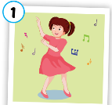
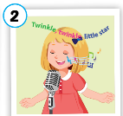
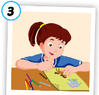

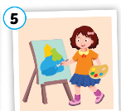
Lucky numbers!
A
1
2
3
4
5
$20
$30
$50
$30
$20
B
1
2
3
4
5
$30
$20
$30
$0
$50
C
1
2
3
4
5
$50
-$30
$20
-$10
$20
Notes:
Students say : 1A, 1B or 1C to open a picture.
After the picture is shown, ask students to say it and make sentences with “ Do your friends like…?” and answer.
Click the pictures to show the money behind.

Slide 6

It’s time to learn …

Slide 7

Phonics
/ŋ/ sound
singing
drawing
painting
reading
dancing

Slide 8

Presentation

Slide 9

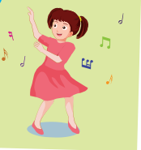





C
1. Listen and repeat.
singing
dancing
Notes:
Click the speakers to listen.
Click the light bulb to show the words.
Get student to pay attention to highlighted “ing” which is /ŋ/ sound . Pronounce it correctly.

Slide 10












C
2. Listen and chant.
/ŋ/, /ŋ, /ŋ/,
/ŋ/, /ŋ, /ŋ/
singing, dancing,
/ŋ/, /ŋ, /ŋ/.
(x2)
Notes:
Click the mic to listen.
Get student to listen and repeat carefully.
Click to show the lyrics.

Slide 11

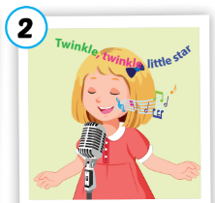



Activity 1
Look, complete and say.
danc___
sing___
draw___
read___
paint___
ing
ing
ing
ing
ing

Slide 12
Activity 2
Listen and repeat. Then draw lines.
1
singing
2
dancing
3
drawing
reading
4
painting
5
Notes:
Click the hearts to listen. Ask students to read along.
Click the hearts again to show answers.

Slide 13

Listening
Do your friends like dancing?
Yes, they do.
Do your friends like singing?
No, they don’t.

Slide 14
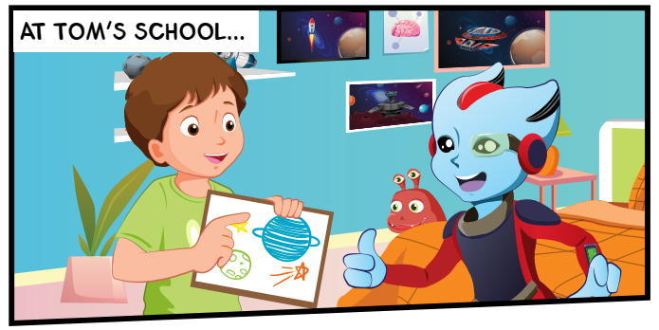
D
1. Look and listen.
drawing
Notes:
Ask:
Look at the picture and ask: What is in Tom’s hand? A picture.
What can you do with the picture? I can draw a picture.
Guess the word: Is it reading? Is it singing? Is it drawing?
The get students to listen and check. Do the same for the rest.
Click on the picture to listen.

Slide 15
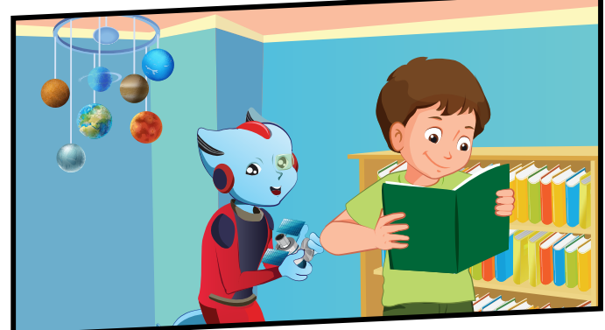
D
1. Look and listen.
Reading.
Notes:
Ask:
Look at the picture and ask: What is in Tom’s hand? A book.
What can you do with the picture? I can read.
Guess the word: Is it reading? Is it singing? Is it drawing?
The get students to listen and check. Do the same for the rest.
Click on the picture to listen.

Slide 16
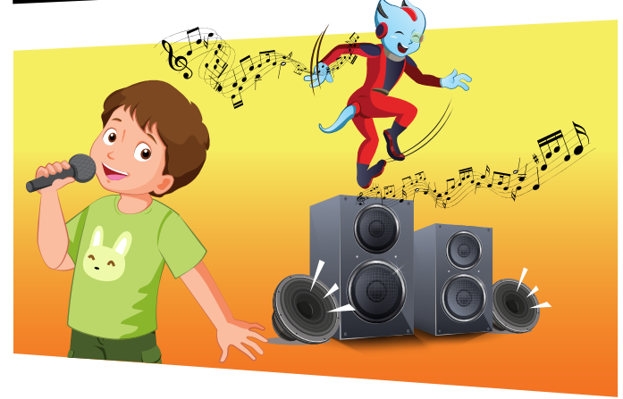
D
1. Look and listen.
singing
Notes:
What’s Tom doing?

Slide 17
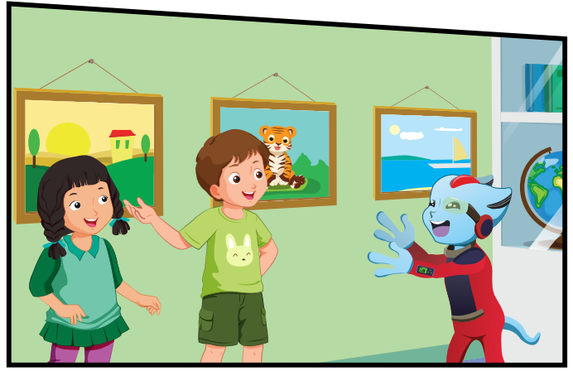
D
1. Look and listen.
Mai
Notes:
Who is the girl? Mai.
What can you see on the wall? Pictures.
What’s Alfie saying? Student’s own answers,

Slide 18

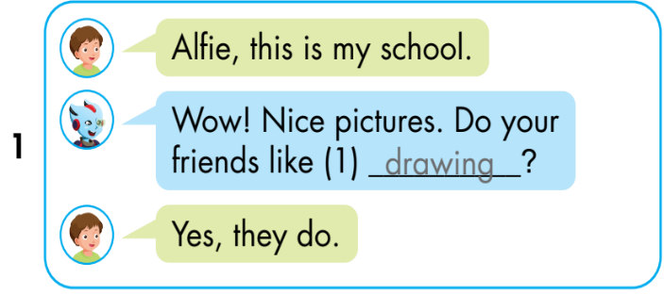
D
2. Listen and write.
Notes:
Ask:
Look at the picture and ask: What is in Tom’s hand? A picture.
What can you do with the picture? I can draw a picture.
Guess the word: Is it reading? Is it singing? Is it drawing?
The get students to listen and check. Do the same for the rest.
Click on the picture to listen.

Slide 19

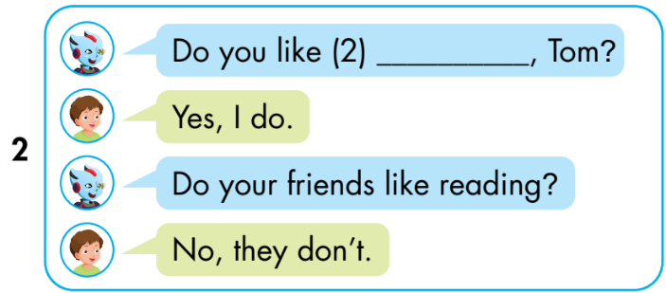
D
2. Listen and write.
reading
Notes:
Ask:
Look at the picture and ask: What is in Tom’s hand? A book.
What can you do with the picture? I can read.
Guess the word: Is it reading? Is it singing? Is it drawing?
The get students to listen and check. Do the same for the rest.
Click on the picture to listen.

Slide 20

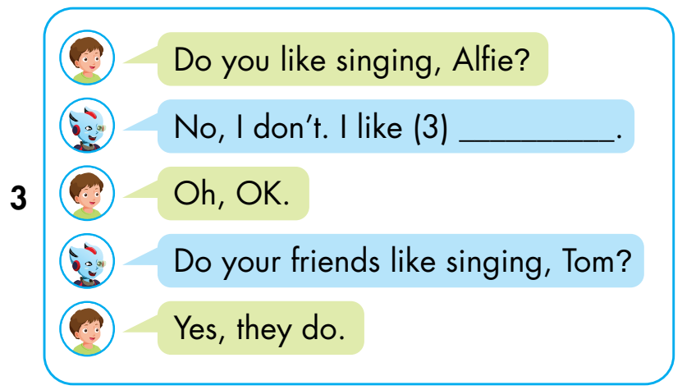
D
2. Listen and write.
dancing
Notes:
What’s Tom doing?

Slide 21

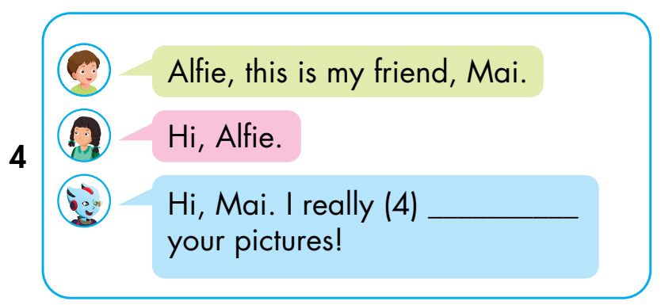
D
2. Listen and write.
like
Notes:
Who is the girl? Mai.
What can you see on the wall? Pictures.
What’s Alfie saying? Student’s own answers,

Slide 22

Practice

Slide 23
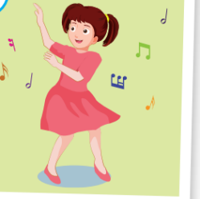
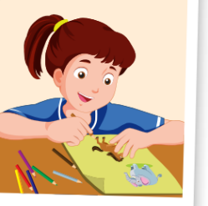
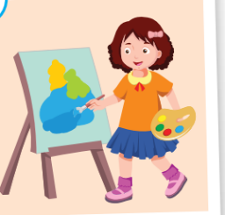
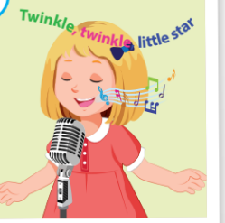

Activity 1
Can you catch it?
1
2
3
Do your friends like……………?
4
5
Yes, they do./ No, they don’t.
Notes:
Click the stars to show pictures quickly. Get students to pay attention and fill in the blank to ask question about the picture.

Slide 24
Activity 2
Look, read and choose the best answer.
Red: Do your friends like_ _ _ _ _ _ _?
Blue: Yes, they do.
a. singing b. dancing

Slide 25
Activity 2
Look, read and choose the best answer.
Red: Do your friends like _ _ _ _ _?
Blue: No, they don’t
a. painting b. drawing

Slide 26
Activity 2
Look, read and choose the best answer.
Red: Do your friends like _ _ _ _ _?
Blue: No, they don’t.
a. painting b. drawing

Slide 27
Activity 2
Look, read and choose the best answer.
Red: Do your friends like _ _ _ _ _?
Blue: Yes, they do.
a. singing b. reading

Slide 28
Activity 2
Look, read and choose the best answer.
Red: Do your friends like dacing?
Blue: _ _ _, they do.
a. Yes b. No

Slide 29
Activity 2
Look, read and choose the best answer.
Red: Do your friends like drawing?
Blue: _ _ , they don’t
a. Yes b. No

Slide 30
Activity 2
Look, read and choose the best answer.
Red: Do you friends like painting?
Blue: No,_ _ _ _ _.
a. they don’t b. they do

Slide 31
Activity 2
Look, read and choose the best answer.
Red: Do your friends like singing?
Blue: _ _ _ _ _ _ _ .
a. Yes, they do b. Yes, they don’t

Slide 32

Activity 2
Look, read and choose the best answer.
Red: Do your friends like reading ?
Blue: _ _ _ _ _ _ .
a. No, they do b. No, they don’t

Slide 33

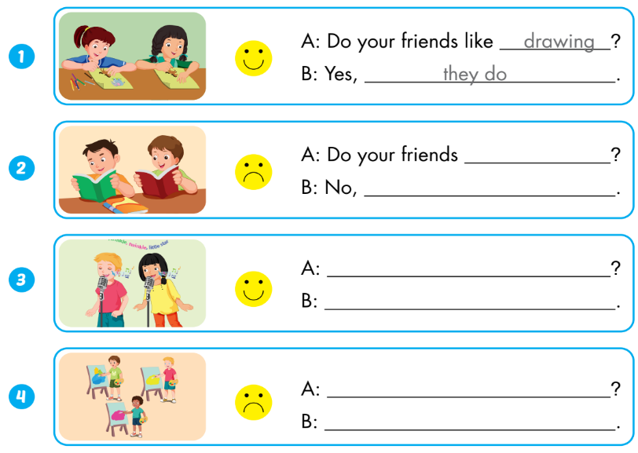
Extra Activity
WB p.13
like reading
they don’t
Do your friends like singing
Yes, they do.
Do your friends like painting
No, they don’t

Slide 34
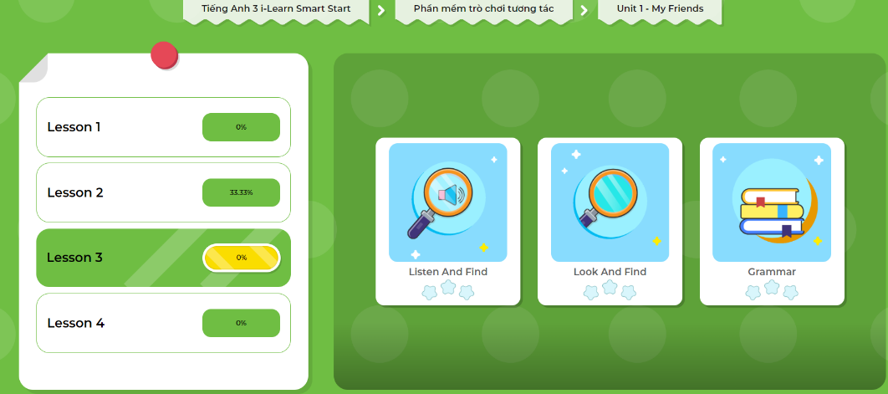
Extra- DHA app.
Click here to play the games

Slide 35
Consolidation

Slide 36
What your friends like doing?
Hi, class. My name’s……. I’m here to tell you about my friends.
They are Alfie and Tom. They don’t like singing, but they like painting.
They are Sam and Nick. They like reading, but they don’t like drawing.
Notes:
Interview some friends and talk about them.

Slide 37

WRAP-UP

Slide 38
Today’s lesson
Vocabulary
Dancing
Singing
Drawing
Reading
Painting
Structures/ Sentence patterns
Do your friends like dancing?
Yes, they do.
No, they don’t.

Slide 39
Lesson 3
Homework
Practice vocabularies and structure. Make sentences using them.
Do the exercises in Tiếng Anh 3 i-Learn Smart Start Workbook (page 13)
Practice the structure in Tiếng Anh 3 i-Learn Smart Start Notebook (page 13)
Play the consolidation games in Tiếng Anh 3 i-Learn Smart Start DHA App on www.eduhome.com.vn
Prepare the next lesson (page 18)

Slide 40
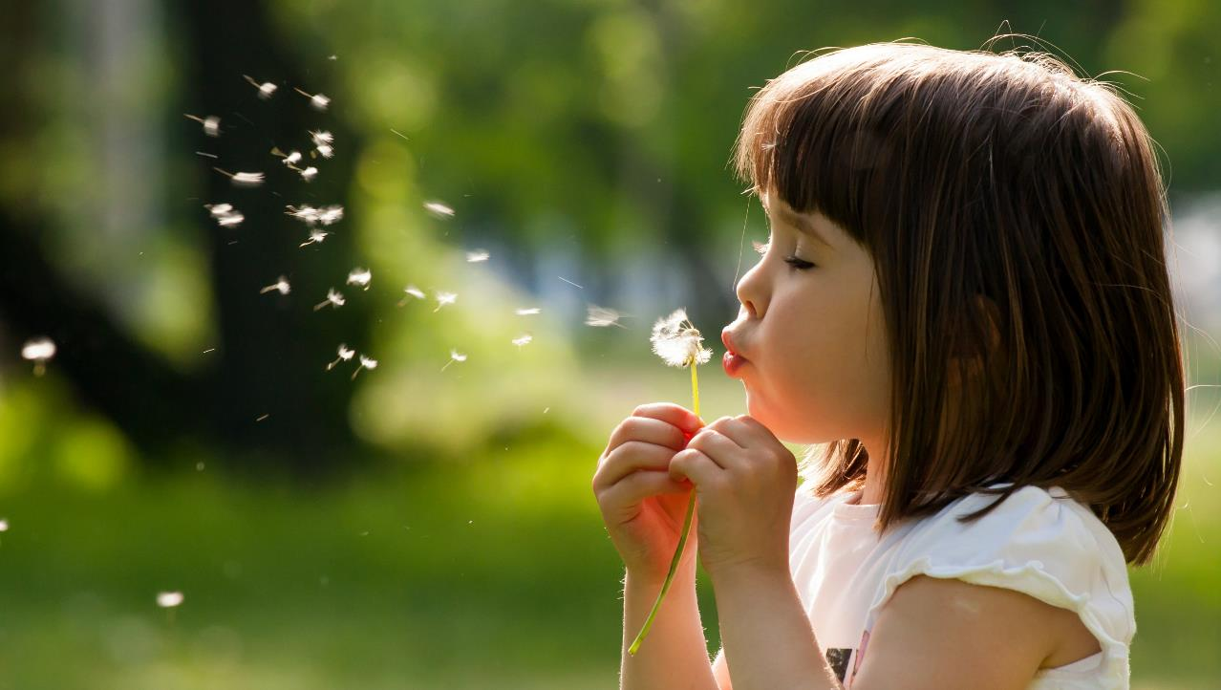
Enjoy your day!

