Slide 1

Teacher: Le Thi Hau
Unit 2
WHAT I CAN DO?
LESSON 2. 2 - PAGE 24

Slide 2
Lesson Outline
Warm-up
Listening
Consolidation
Wrap-up

Slide 3
Objectives
By the end of this lesson, students will be able toidentify the /p/ and /b/ sounds and practice the conversations.
Vocabulary: hop, fly, rope, Ben, keyboard
Structure: Can Lucy hop?
- Yes, she can./ No, she can't.
Phonics: /p/ and /b/

Slide 4

WARM UP

Slide 5
Look, ask and answer!

Slide 6
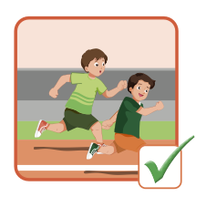
Can you run?
Yes, we can.

Slide 7
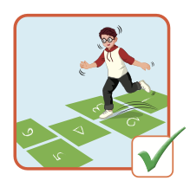
Can Charlie hop?
Yes, he can.
Charlie

Slide 8
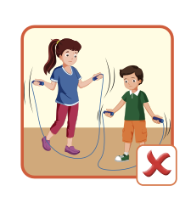
Can Lucy and Ben jump rope?
No, they can’t.
Lucy and Ben

Slide 9

It’s time to learn …

Slide 10

Phonics /p/ and /b/

Slide 11

Presentation

Slide 12
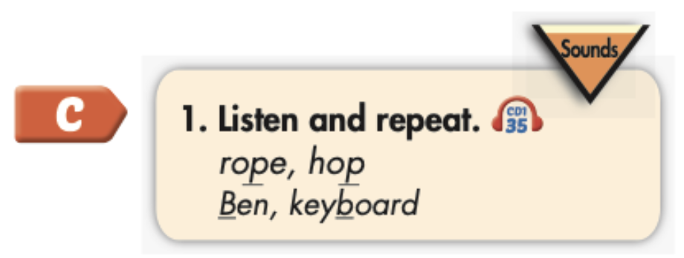

Click the icon to hear the sound.
rope
hop
Ben
keyboard
/roʊp/
/hɑːp/
/ben/
/ˈkiːbɔːrd /

Slide 13

Practice

Slide 14



Slide 15
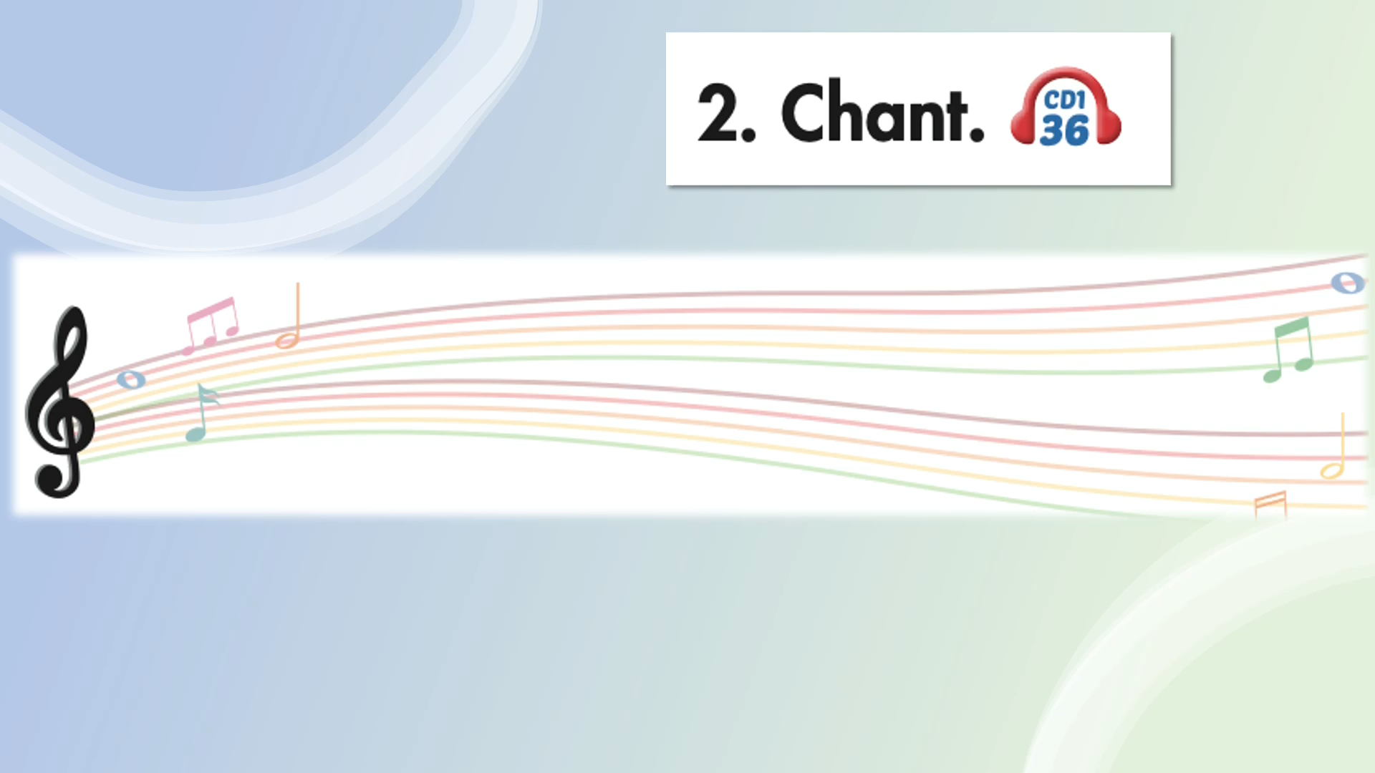

Slide 16

Speaking

Slide 17
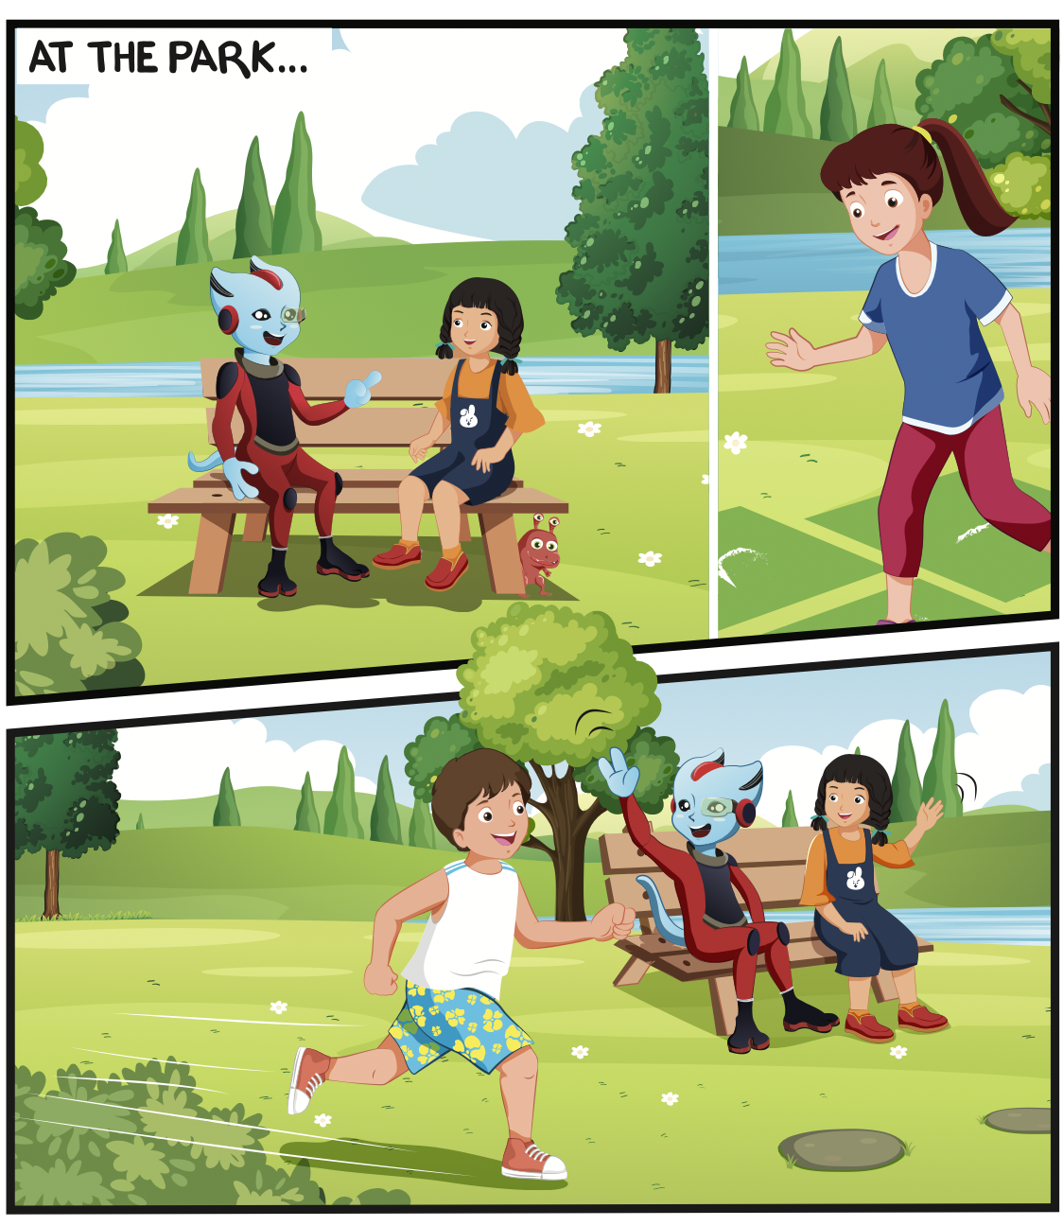
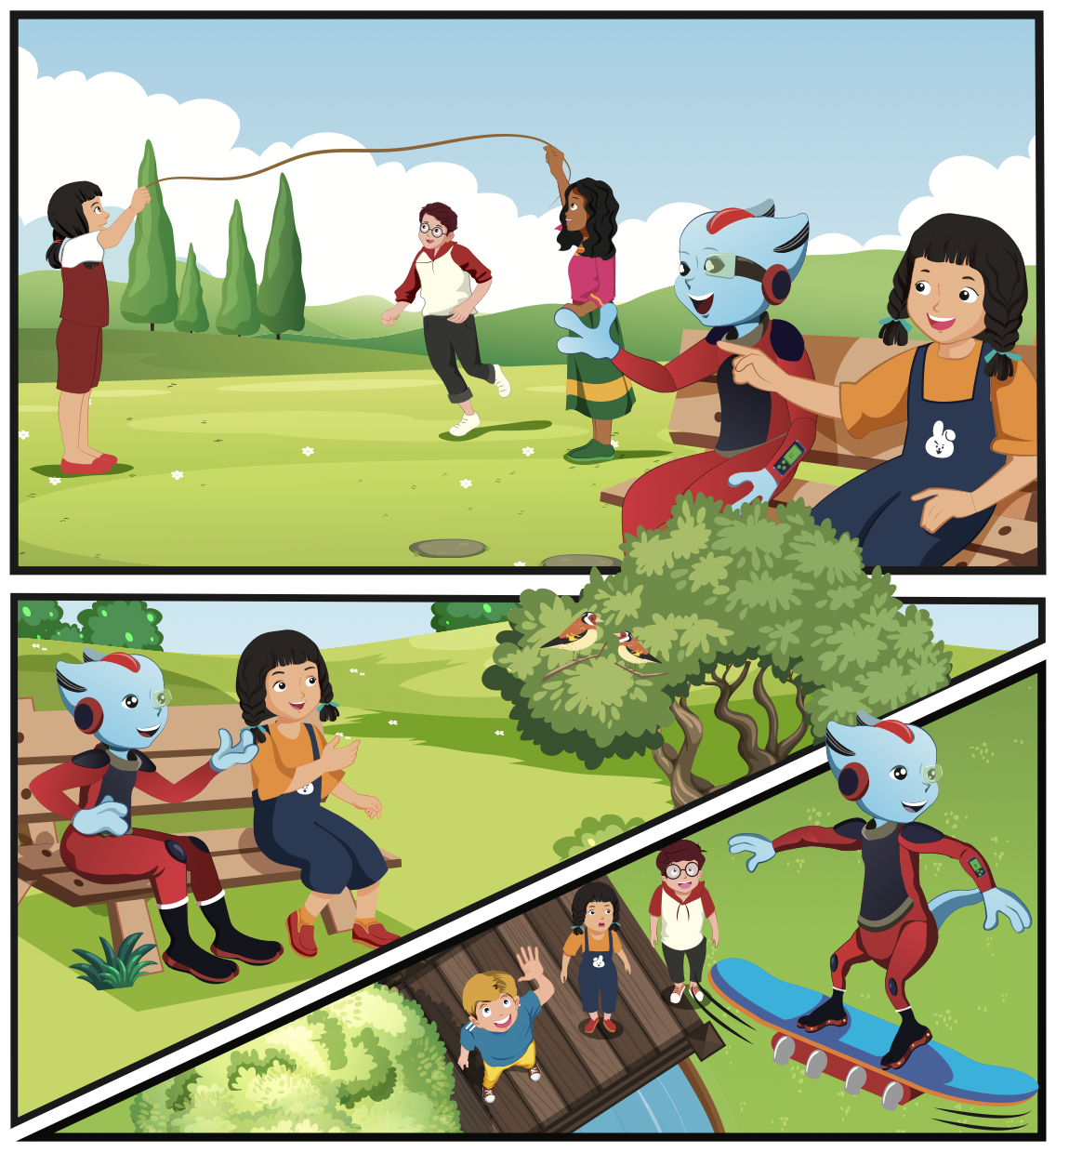
What are the children doing?
Who can you see?
What is Lucy doing?

Slide 18

Listening

Slide 19


Slide 20

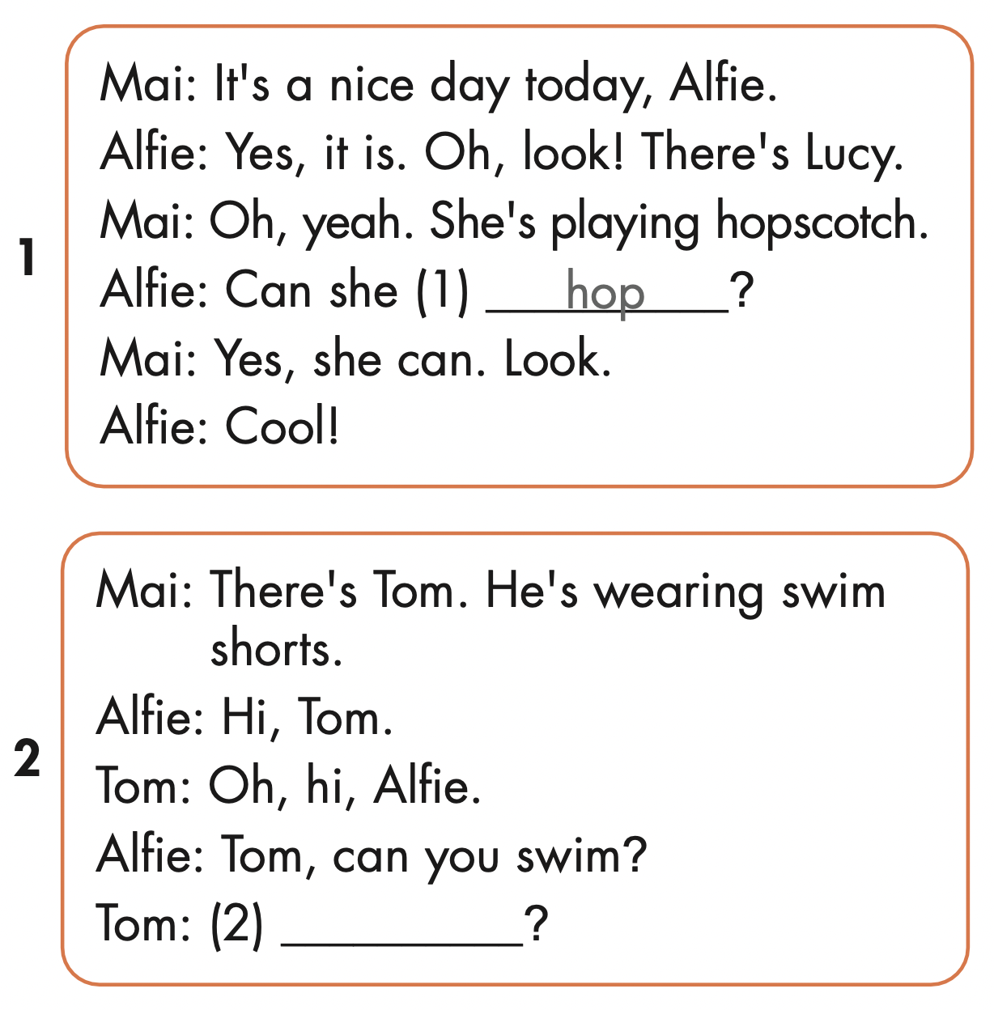
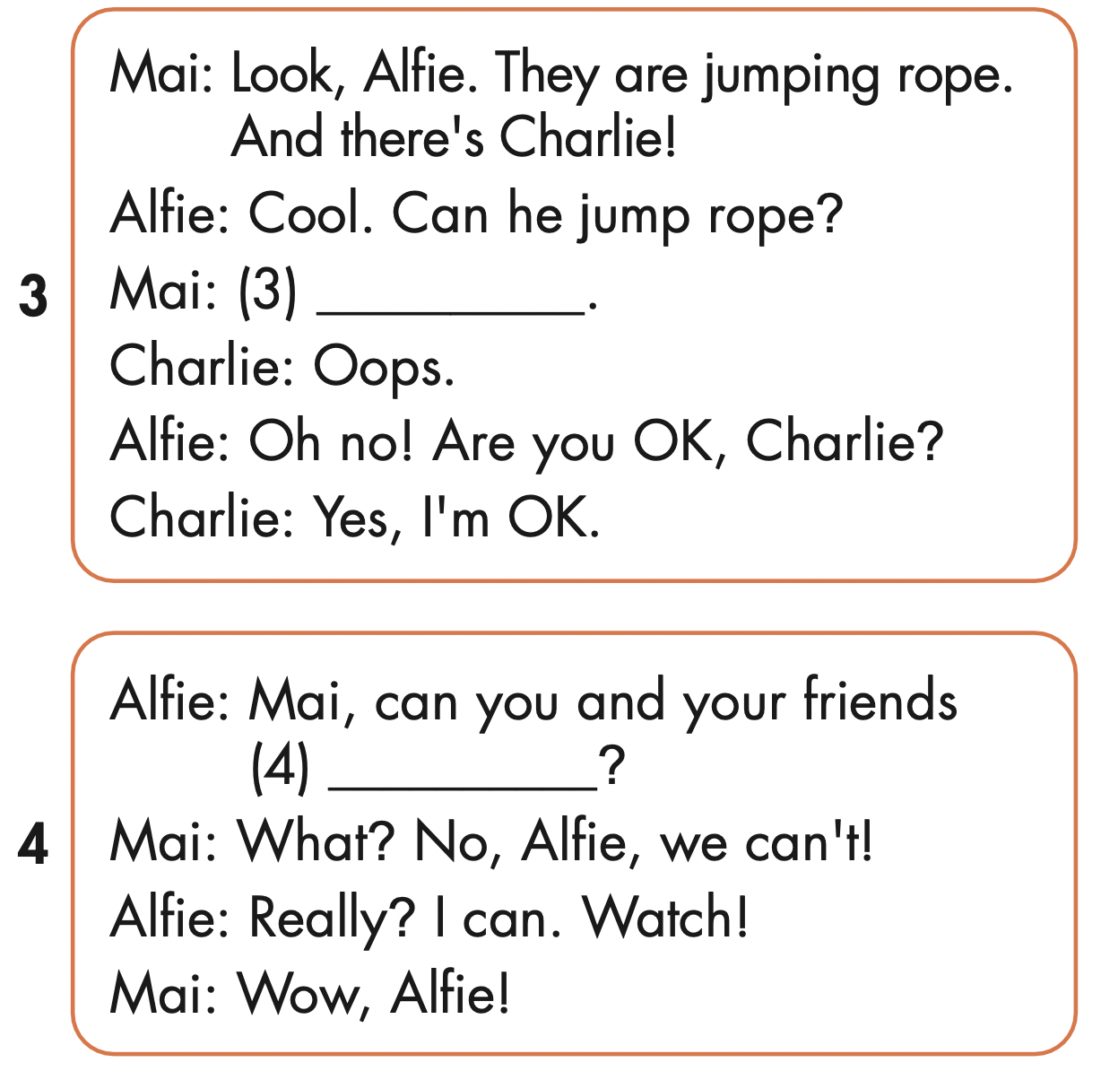
No, he can’t.
fly
Yes, I can.

Slide 21

Production

Slide 22



Slide 23

Writing

Slide 24
MAKE YOUR OWN STORY

Slide 25

CONSOLIDATION

Slide 26

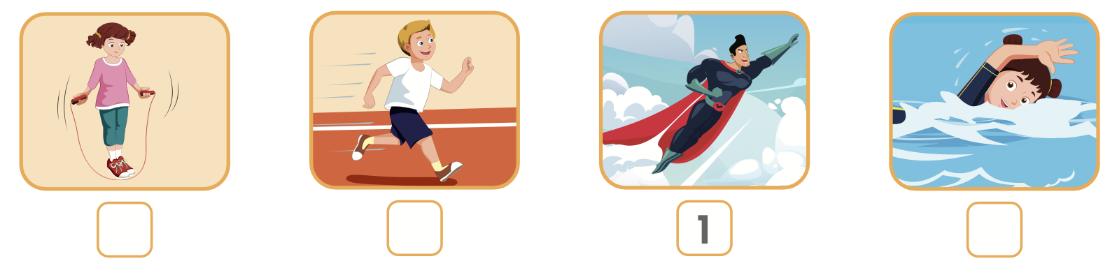
Extra Practice
WB, page 15
3
4
2

Slide 27

WRAP-UP

Slide 28
Today’s lesson
Phonics
/p/
/b/
Structures/ Sentence patterns
Can Lucy hop?
- Yes, she can./ No, she can't.

Slide 29
Homework
Practice the vocabularies and structure; and make sentences using them.
Do the exercises in Tiếng Anh 4 i-Learn Smart Start WB (page 15)
Do the exercises in Tiếng Anh 4 i-Learn Smart Start Notebook (Page 11)
Prepare the next lesson (page 25 SB)
Play the consolidation games in Tiếng Anh 4 i-Learn Smart Start DHA App on www.eduhome.com.vn

Slide 30

Enjoy your day!

