Slide 1
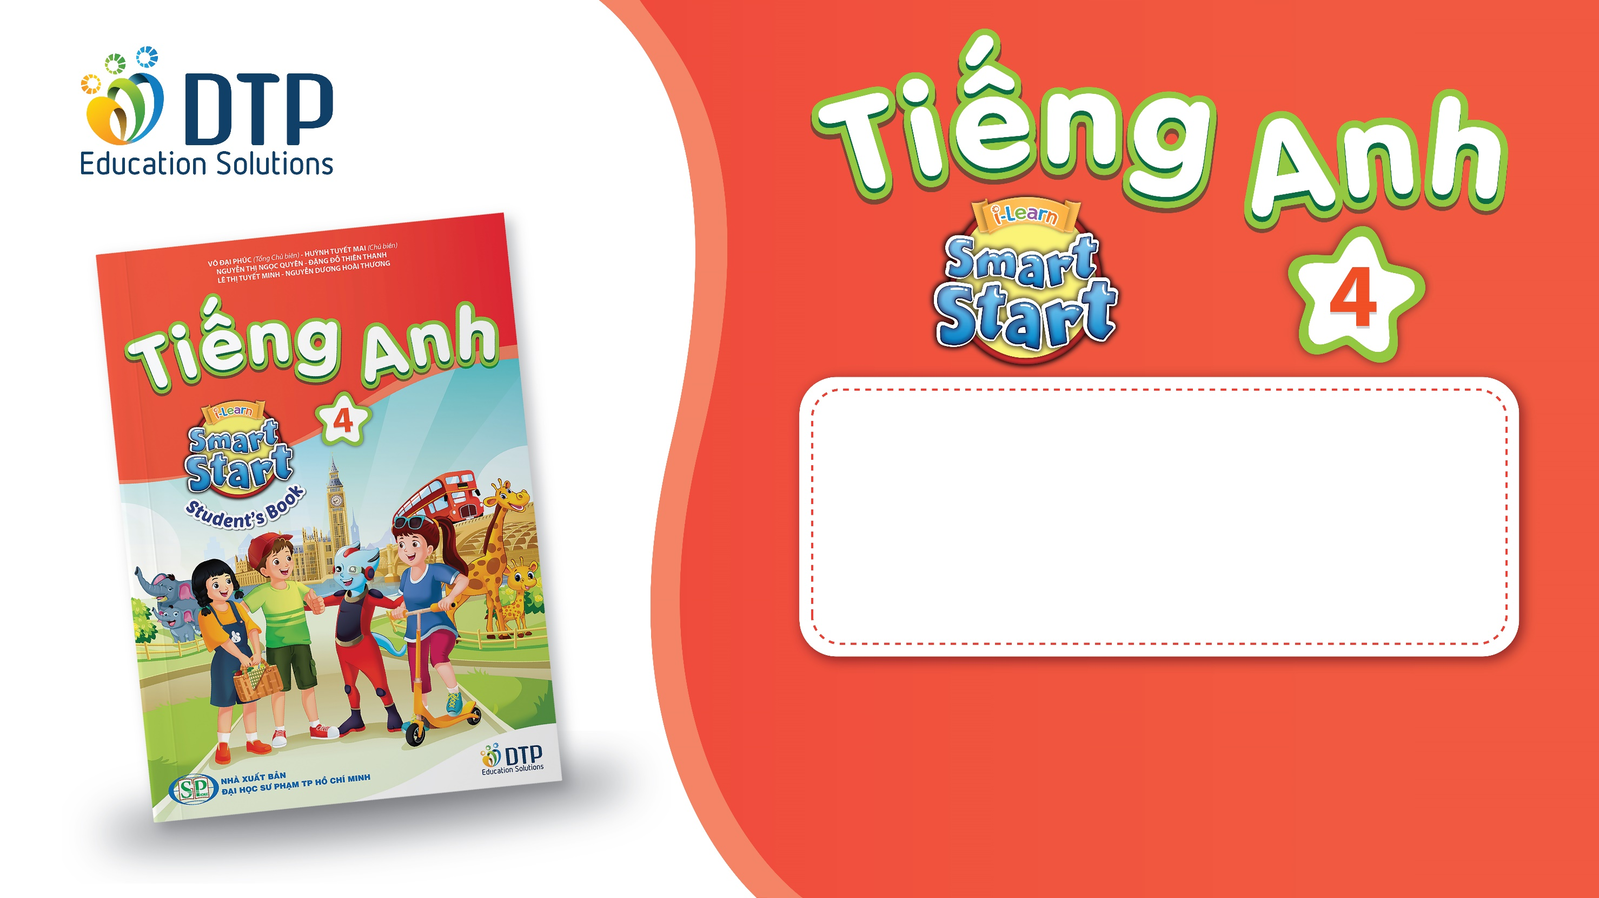
Teacher: Le Thi Hau
Unit 1: Animals
Lesson 1.1
Page 6

Slide 2
Lesson Outline
Warm-up
Vocabulary
Structure
Consolidation
Wrap-up

Slide 3
Objectives
By the end of this lesson, students will be able to…
Vocabulary: Pronounce and use the words related to the topic properly: snake, monkey, horse, camel, hippo, rhino.
Structure: This is a monkey. - These are monkeys.
That's a snake. - Those are snakes

Slide 4

WARM UP

Slide 5



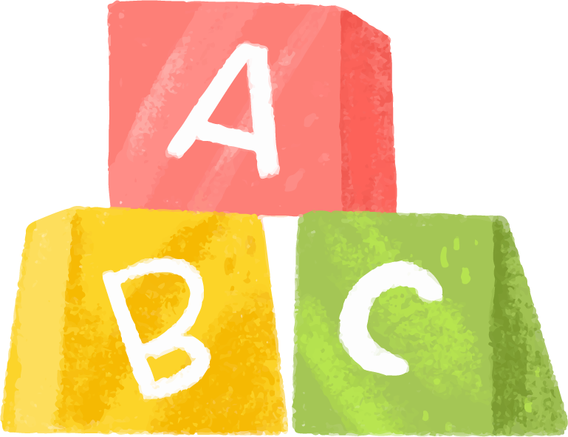

Game: Finding the way home.

Slide 6







1
3
4
2
5
7
6
8

Slide 7

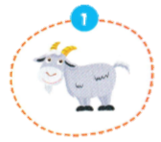
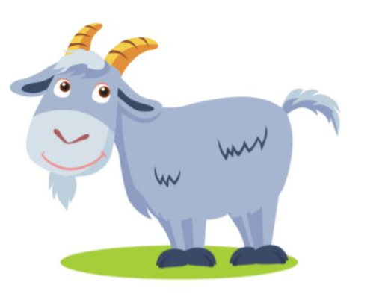

It’s a …..
It’s a goat.

Slide 8

It’s a …..
It’s a bird.

Slide 9
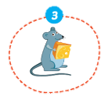
It’s a ….
It’s a mouse.

Slide 10
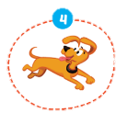
It’s a ….
It’s a dog.

Slide 11
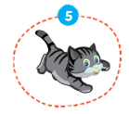
It’s a ….
It’s a cat.

Slide 12
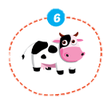
It’s a …..
It’s a cow.

Slide 13
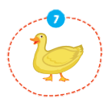
It’s a …..
It’s a duck.

Slide 14
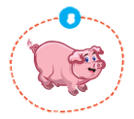
It’s a …..
It’s a pig.

Slide 15

It’s time to learn …

Slide 16

New words
snake, monkey, horse,
camel, hippo, rhino

Slide 17

Presentation

Slide 18

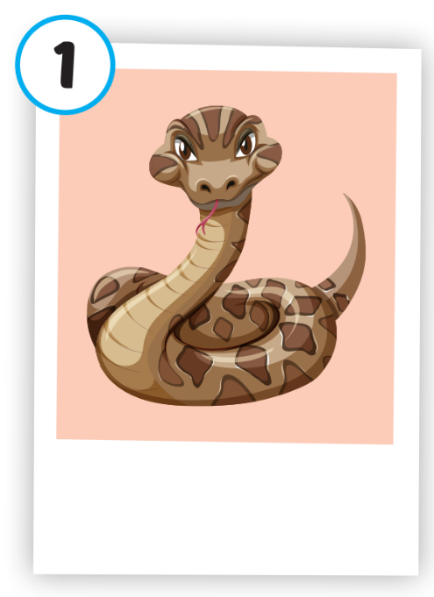
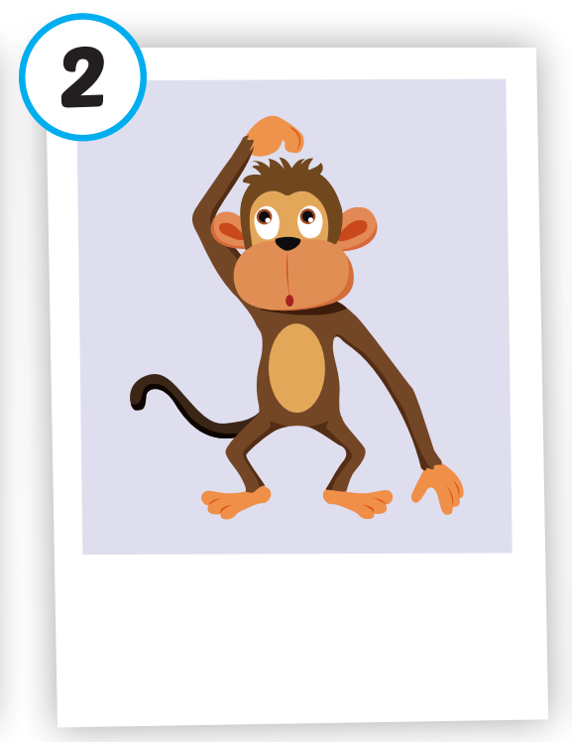
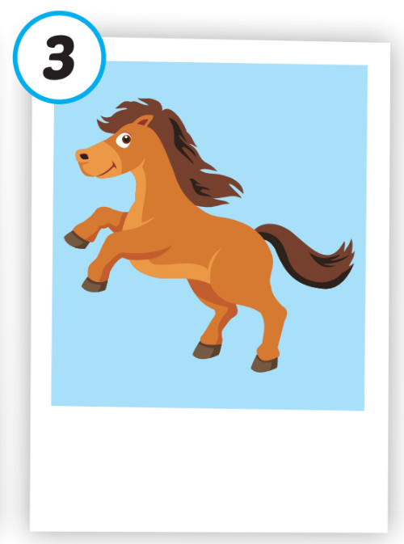
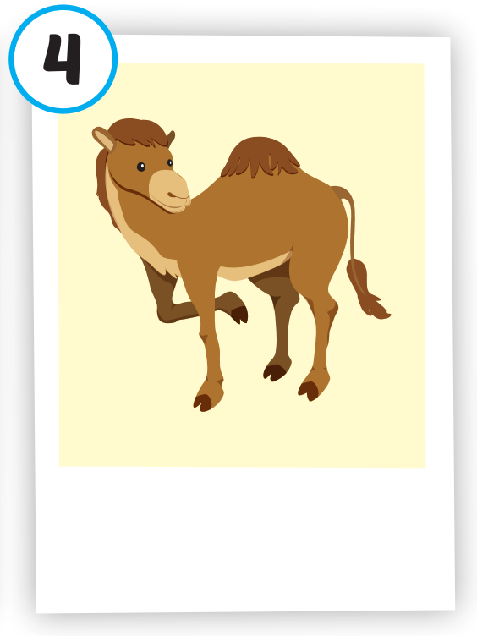
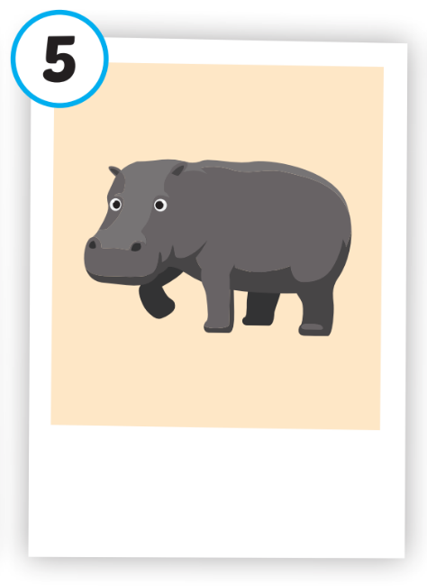
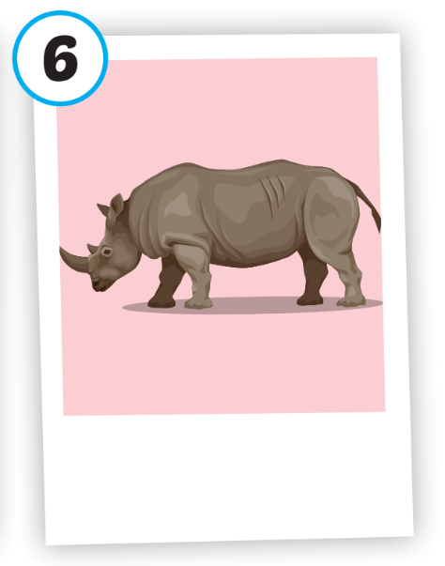
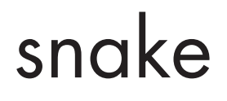





Click on each picture to hear the sound.
/hɔːrs/
con ngựa
/ˈkæməl/
con lạc đà
/ˈhɪpoʊ/
con hà mã
/ˈraɪnoʊ/
con tê giác
/sneɪk/
con rắn
/ˈmʌŋki/
con khỉ

Slide 19
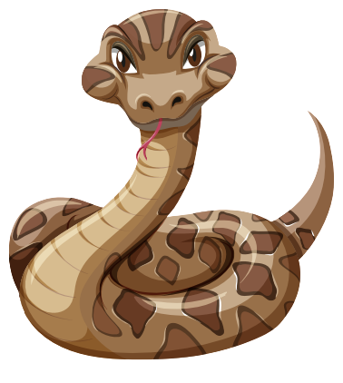
Click on each picture to hear the sound.
/sneɪk/
con rắn

Slide 20

Click on each picture to hear the sound.
/ˈmʌŋki/
con khỉ
Notes:
Click vào hình A. 1. Listen and point. Repeat để cho cả audio full chạy

Slide 21

Click on each picture to hear the sound.
/hɔːrs/
con ngựa
Notes:
Click vào hình A. 1. Listen and point. Repeat để cho cả audio full chạy

Slide 22
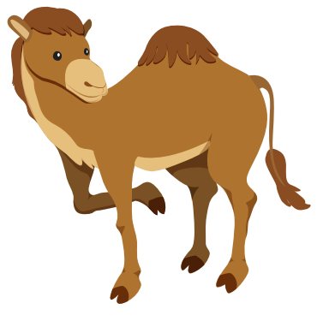
Click on each picture to hear the sound.
/ˈkæməl/
con lạc đà

Slide 23

Click on each picture to hear the sound.
/ˈhɪpoʊ/
con hà mã
Notes:
Click vào hình A. 1. Listen and point. Repeat để cho cả audio full chạy

Slide 24

Click on each picture to hear the sound.
/ˈraɪnoʊ/
con tê giác

Slide 25
Practice

Slide 26
Check your memory

Slide 27


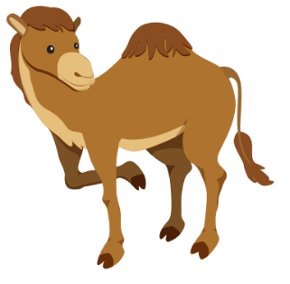

Listen and choose
A
B
C

Slide 28

Listen and choose
A
B
C

Slide 29



Listen and choose
A
B
C

Slide 30
Listen and choose
A
B
C

Slide 31

Listen and choose
A
B
C

Slide 32


Listen and choose
A
B
C

Slide 33



Slide 34
Structure
This is a monkey.
These are monkeys.
That's a snake.
Those are snakes

Slide 35
Presentation

Slide 36
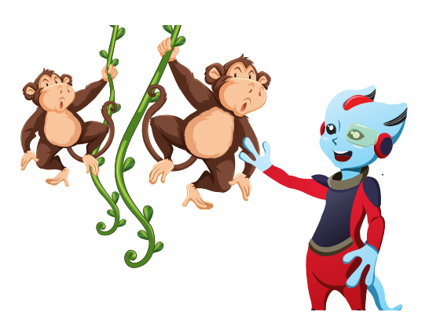
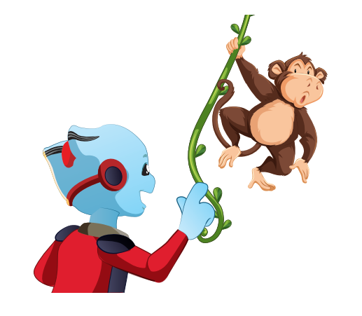

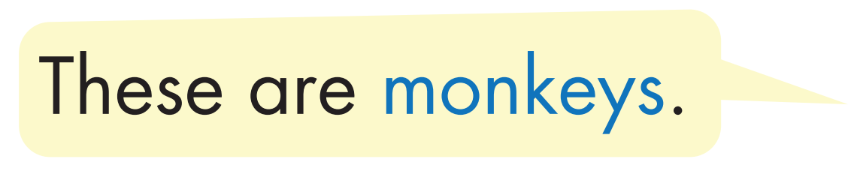

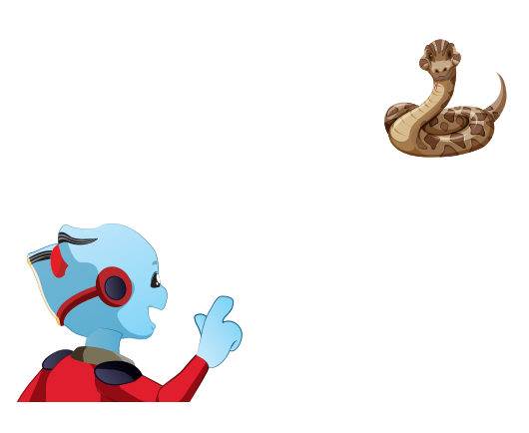
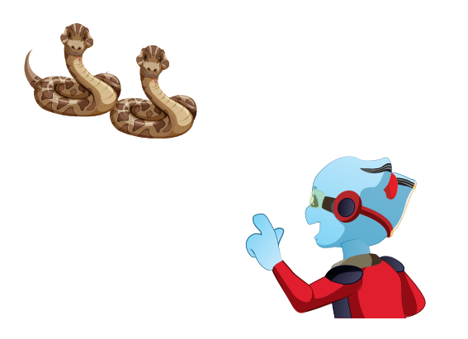


Structure

Slide 37

Practice

Slide 38


Slide 39
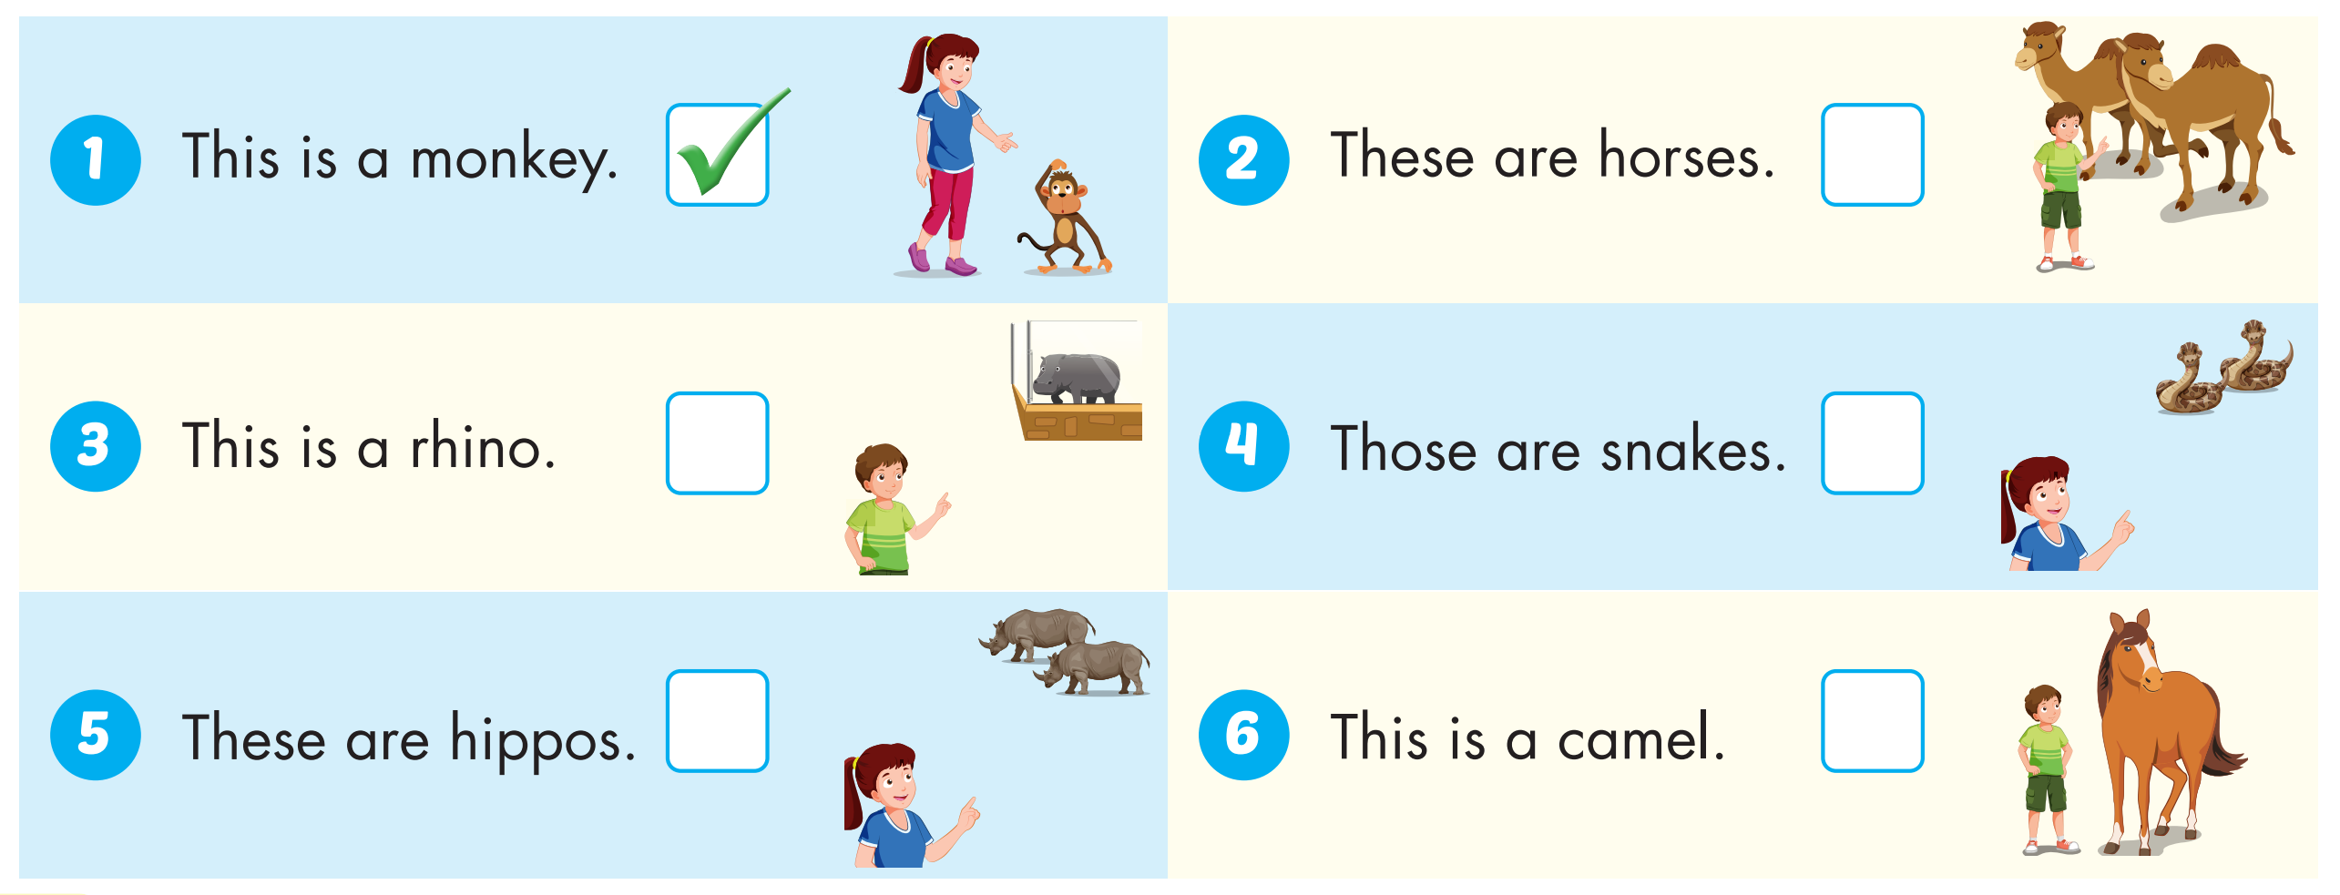



Slide 40

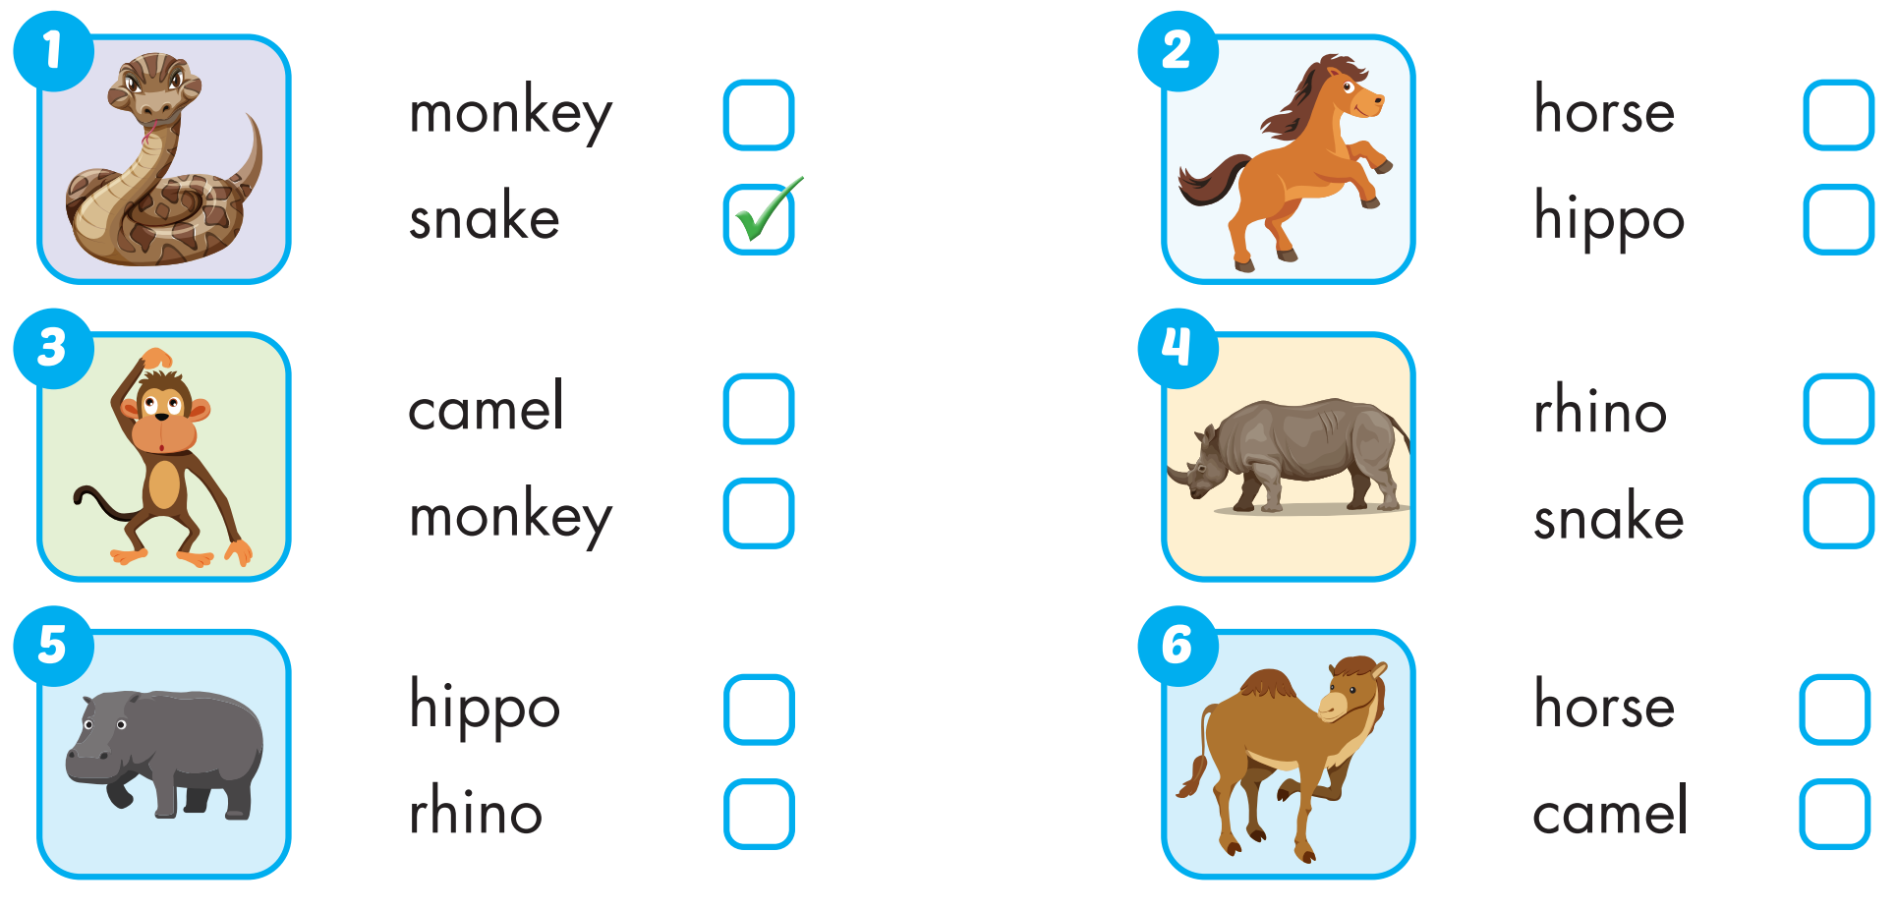
Extra Practice
WB, page 2

Slide 41

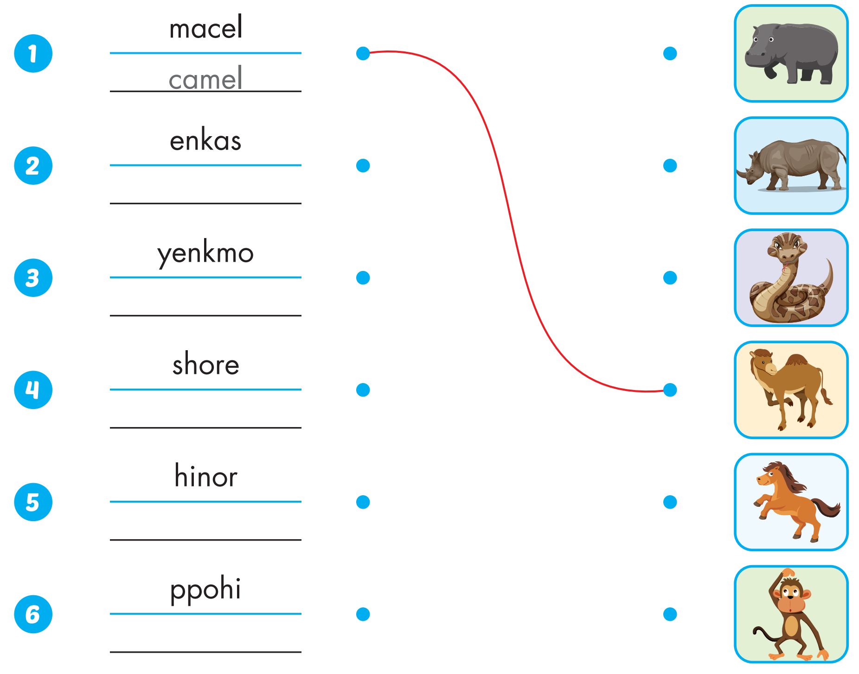
Extra Practice
WB, page 2
snake
monkey
horse
rhino
hippo

Slide 42

Production

Slide 43

CONSOLIDATION

Slide 44

WRAP-UP

Slide 45
Today’s lesson
Vocabularies
snake, monkey, horse, camel, hippo, rhino.
Structures/ Sentence patterns
This is a monkey.
These are monkeys.
That's a snake.
Those are snakes

Slide 46
Homework
Practice the vocabularies and structure; and make sentences using them.
Do the exercises in Tiếng Anh 4 i-Learn Smart Start WB (page 2)
Do the exercises in Tiếng Anh 4 i-Learn Smart Start Notebook (page 4)
Prepare the next lesson (page 7 SB)
Play the consolidation games in Tiếng Anh 4 i-Learn Smart Start DHA App on www.eduhome.com.vn

Slide 47

Enjoy your day!

Slide 48

Lesson 3
Stay positive and have a nice day!

