Slide 1



Unit 1
What’s your address?
Lesson 2
Teacher: Mrs. Thúy Nga

Slide 2
VOCABULARY

Slide 3

Vocabulary
Big
/big/
Small
/smɔːl/
(a) nhỏ

Slide 4

Vocabulary
Noisy
/ˈnɔɪzi/
(a) Ồn ào
quiet
/ˈkwaɪət/
(a) Yên tĩnh

Slide 5
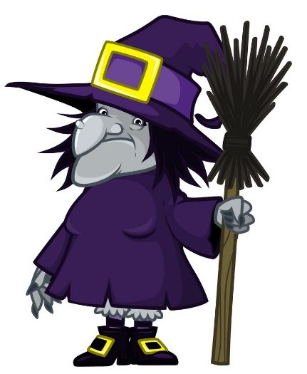

Vocabulary
beautiful
/ˈbjuːtɪfl/
(a) đẹp, xinh

Slide 6
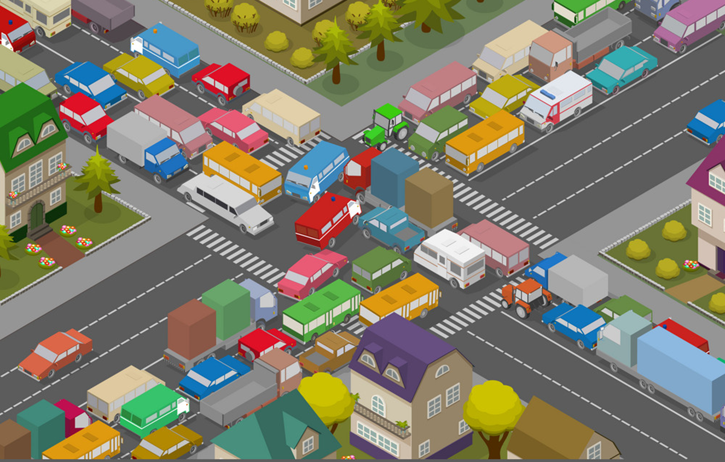
Vocabulary
crowded
/ˈkraʊdɪd/
(a) Đông đúc

Slide 7

Vocabulary
busy
/ˈbɪzi/
(a) bận rộn

Slide 8

Vocabulary
large
/lɑːrdʒ/
(a) rộng

Slide 9

Vocabulary
far
/fɑː/
(a) xa

Slide 10


Vocabulary
hometown
/ˈhəʊmtaʊn/
(n) quê

Slide 11

Vocabulary
mountain
/ˈmaʊntən/
(n) núi

Slide 12

Vocabulary
island
ˈaɪlənd/
(n) Hòn đảo

Slide 13




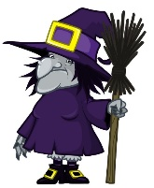

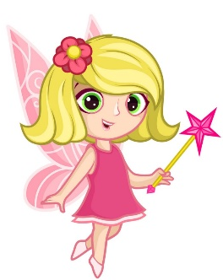
Vocabulary
island
mountain
hometown
far
noisy
big
large
quiet
small
beautiful
crowded

Slide 14
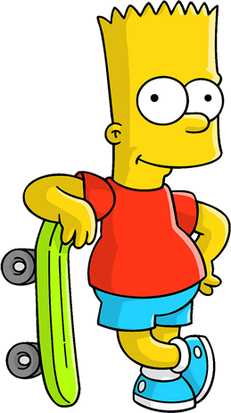

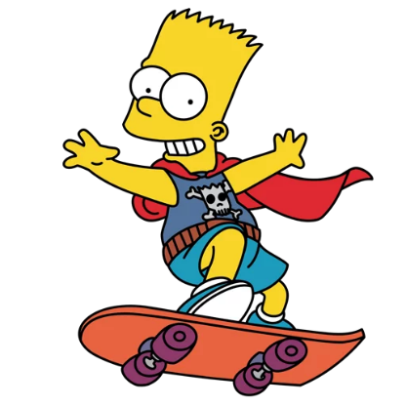

WHERE IS
BART
?

Slide 15





TIME’S UP
NEXT
A
I live on an village.
B
I live on an Island.
C
I live on an mountain.

Slide 16

TIME’S UP
NEXT
A
Hai Phong is my mountain.
B
Hai Phong is my island.
C
Hai Phong is my hometown.

Slide 17
TIME’S UP
NEXT
A
Near
B
Far
C
Small

Slide 18

TIME’S UP
NEXT
A
moutain
B
city
C
village

Slide 19


TIME’S UP
NEXT
A
Crowded
B
Beautiful
C
Quiet

Slide 20

TIME’S UP
NEXT
A
Large
B
Small
C
Noisy

Slide 21
TIME’S UP
NEXT
A
Noisy
B
Busy
C
Quiet

Slide 22
TIME’S UP
NEXT
A
Noisy
B
Small
C
Big

Slide 23
TIME’S UP
NEXT
A
Crowded
B
Quiet
C
Moutain

Slide 24
TIME’S UP
NEXT
A
Big
B
Small
C
Noisy

Slide 25
Welldone!
END

Slide 26

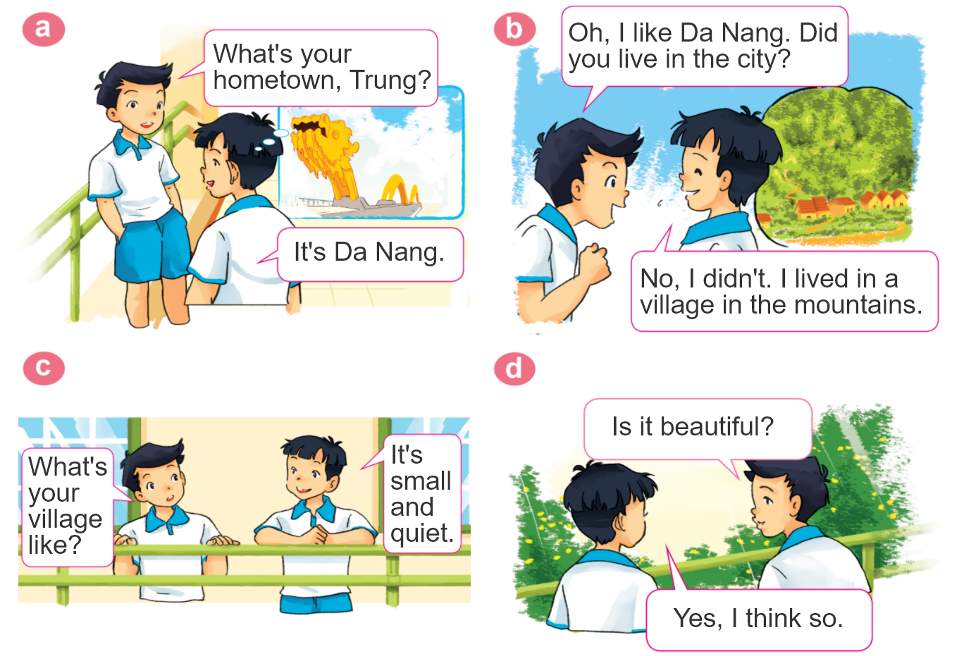
1. Look, listen and repeat.

Slide 27
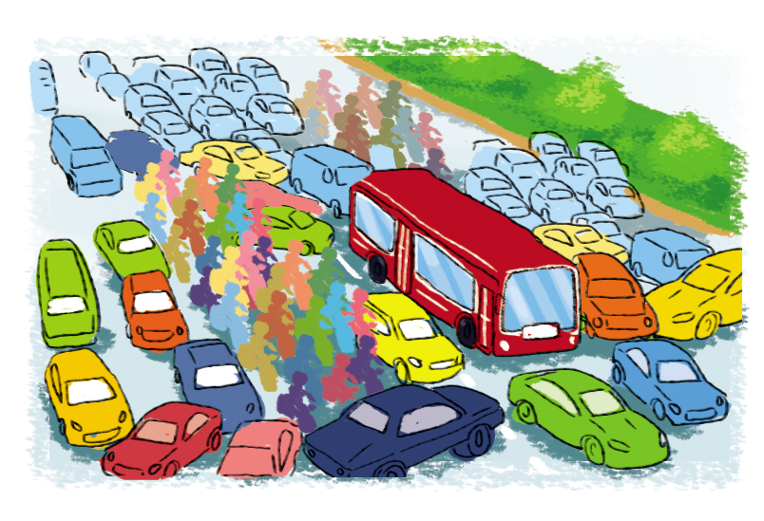

2. Point and say
city,
big and busy
What's the ________ like?
city
It's __________________.
big and busy

Slide 28
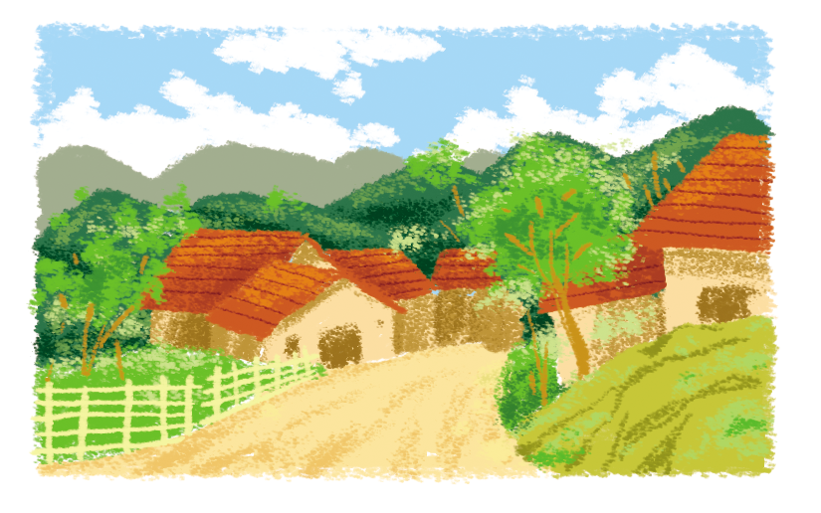
2. Point and say
village,
far and quiet
What's the ________ like?
village
It's __________________.
far and quiet

Slide 29
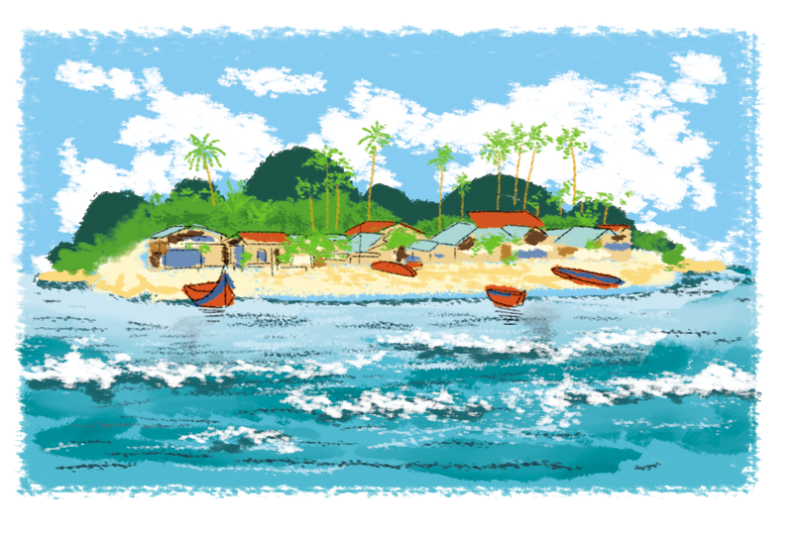
2. Point and say
island,
small and pretty
What's the ________ like?
island
It's __________________.
small and pretty

Slide 30
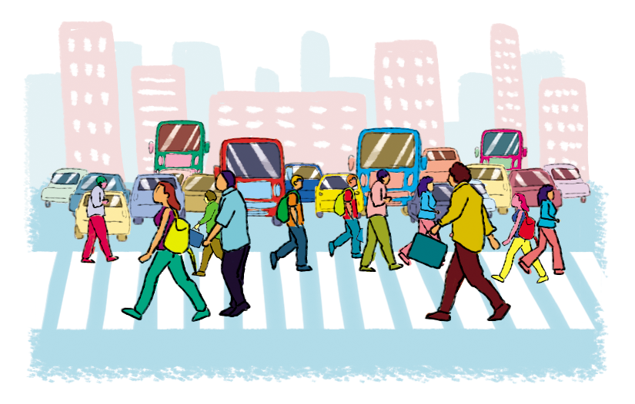
2. Point and say
town,
large and crowded
What's the ________ like?
town
It's __________________.
large and crowded

Slide 31




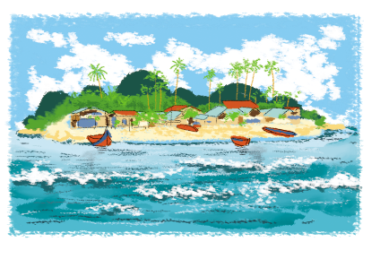
2. Point and say
What's the ________ like?
It's ___________.
city,
big and busy
town,
large and crowded
village,
far and quiet
island,
small and pretty

Slide 32
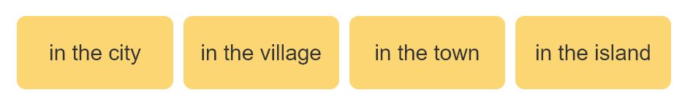
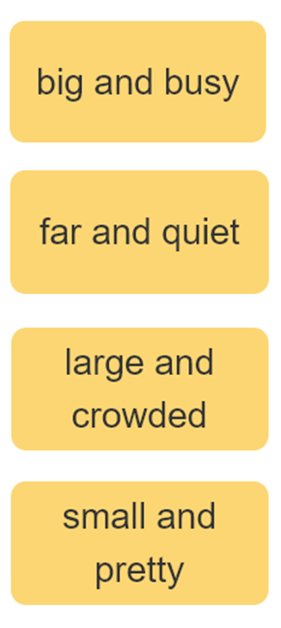

3. Let’s talk
I live ____________.
Where do you live?
What's it like?
It’s ______.
Who do you live with?
I live with ________.
parents
grandparents

Slide 33
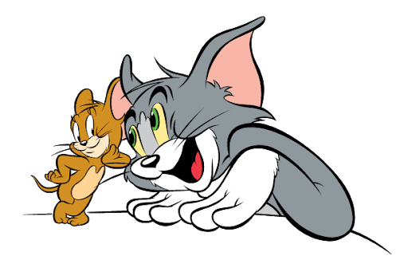






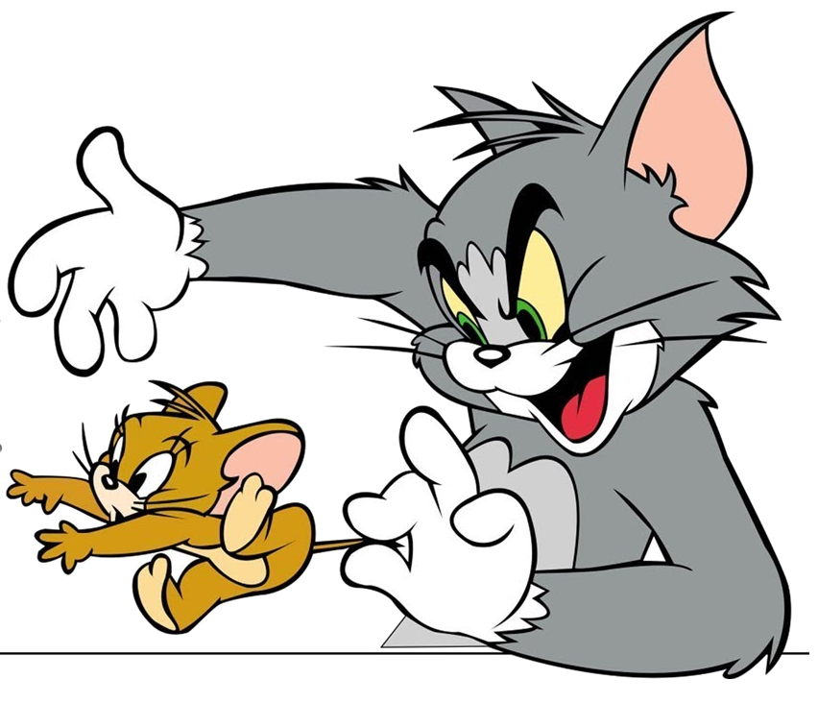

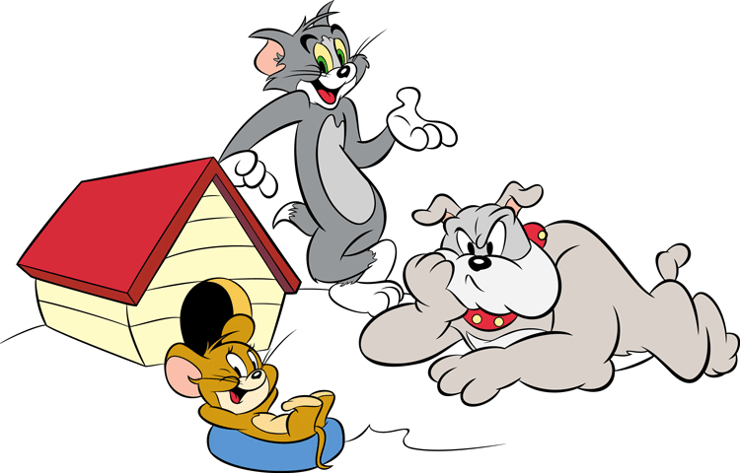
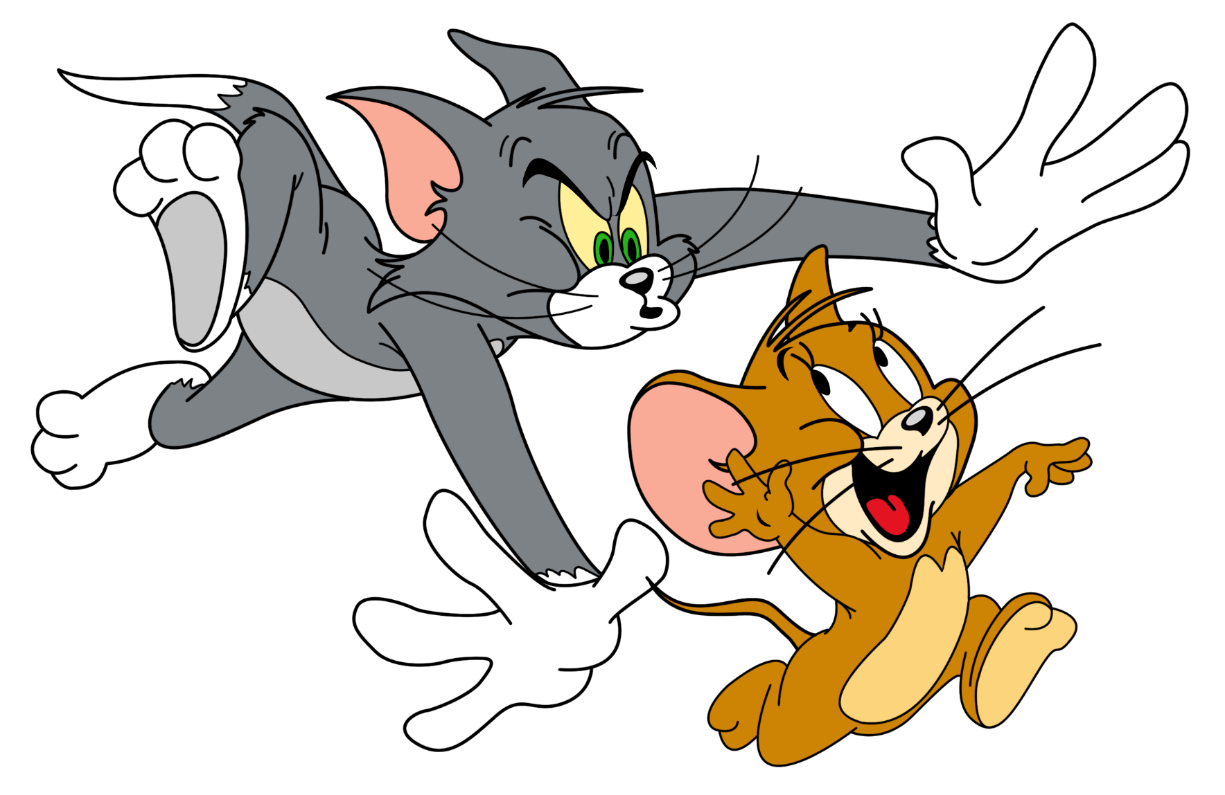



GAME
Notes:
Ms Huyền Phạm - 0936.082.789 – YOUTUBE: MsPham. Facebook: Dạy và học cùng công nghệ.

Slide 34










Where do you live?
I live in Quang Ninh.
I live ____________.
What's it like?
It’s ______.
Who do you live with?
I live with ________.
Notes:
Ms Huyền Phạm - 0936.082.789 – YOUTUBE: MsPham. Facebook: Dạy và học cùng công nghệ.

Slide 35
Mai: (1) your address?
Trung: (2) 81, Tran Hung Dao Street.
Mai: (3) do you live with?
Trung: My grandparents.
Mai: Do you (4) living in Ha Noi?
Trung: Yes, very much.
Mai: (5) your hometown like?
Trung: It's small and quiet.
What’s your hometown like? It’s large and far.
I live ____________.
It’s ______.
I live with ________.
Notes:
Ms Huyền Phạm - 0936.082.789 – YOUTUBE: MsPham. Facebook: Dạy và học cùng công nghệ.

Slide 36
What’s your flat like?
It’s beautiful.
Notes:
Ms Huyền Phạm - 0936.082.789 – YOUTUBE: MsPham. Facebook: Dạy và học cùng công nghệ.

Slide 37
Check
Who do you live with?
I live in a village.
Where do you live?
Notes:
Ms Huyền Phạm - 0936.082.789 – YOUTUBE: MsPham. Facebook: Dạy và học cùng công nghệ.

Slide 38
Check
Where’s your address? It’s 81, Orange street.
What’s
Notes:
Ms Huyền Phạm - 0936.082.789 – YOUTUBE: MsPham. Facebook: Dạy và học cùng công nghệ.

Slide 39
Check
How’s the village like? It’s small and quiet.
What’s
Notes:
Ms Huyền Phạm - 0936.082.789 – YOUTUBE: MsPham. Facebook: Dạy và học cùng công nghệ.

Slide 40
Mai: Who do you live with?
Trung: My grandparents
Notes:
Ms Huyền Phạm - 0936.082.789 – YOUTUBE: MsPham. Facebook: Dạy và học cùng công nghệ.

Slide 41
What’s the like?
It’s small and pretty.
Notes:
Ms Huyền Phạm - 0936.082.789 – YOUTUBE: MsPham. Facebook: Dạy và học cùng công nghệ.

Slide 42
Where do you live?
It’s in Quang Ninh.
Check
I live
Notes:
Ms Huyền Phạm - 0936.082.789 – YOUTUBE: MsPham. Facebook: Dạy và học cùng công nghệ.

Slide 43


Good job!
Notes:
Ms Huyền Phạm - 0936.082.789 – YOUTUBE: MsPham. Facebook: Dạy và học cùng công nghệ.

Slide 44
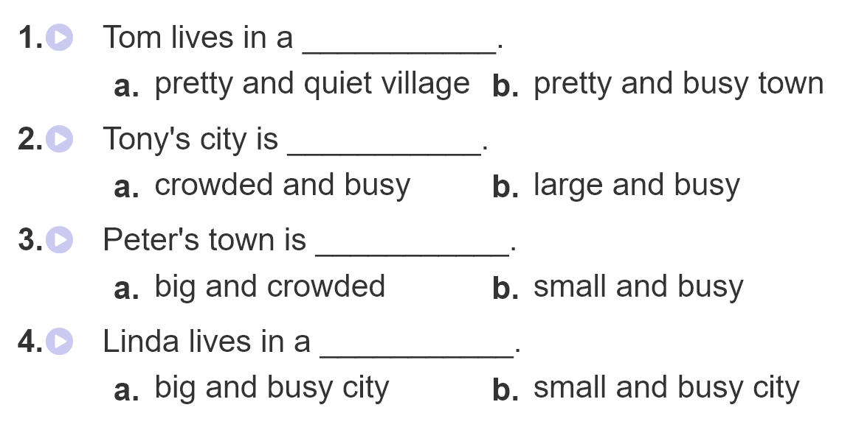
4. Listen and circle

Slide 45
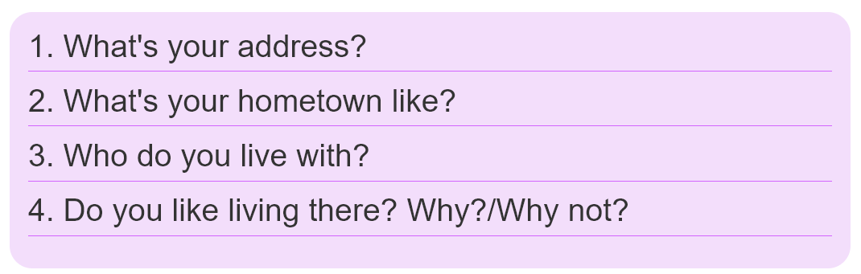
5. Write about you.

Slide 46
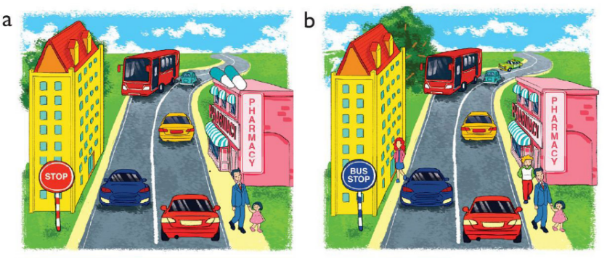
6. Let’s play
Spot the difference
(Click the different spot)

