Slide 1


Long Bien Primary School
Welcome to our class
Teacher: Duong Thi Hong Van

Slide 2






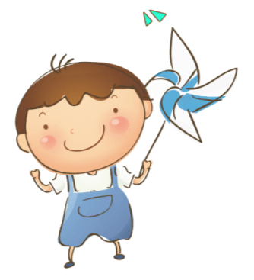


Slide 3






Warm up

Slide 4

Movement chant: Go, go, banana!
Notes:
https://www.youtube.com/watch?v=o6gHL1LJ-HQ
Chant Go, go, banana to warm up and energize the class.

Slide 5


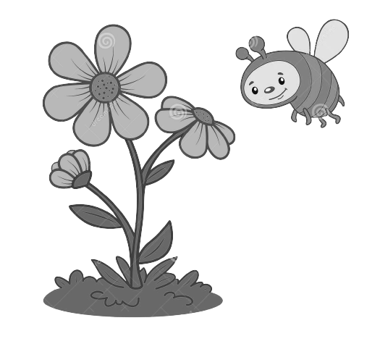
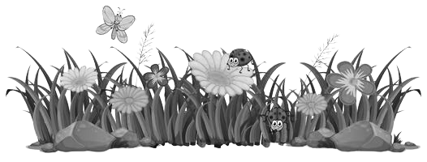
Notes:
Life is so beautiful with colours.
Lead in: introduce colours.

Slide 6



Notes:
Life is so beautiful with colours.
Lead in: introduce colours.

Slide 7

Presentation
Task 1: Listen and repeat.

Slide 8
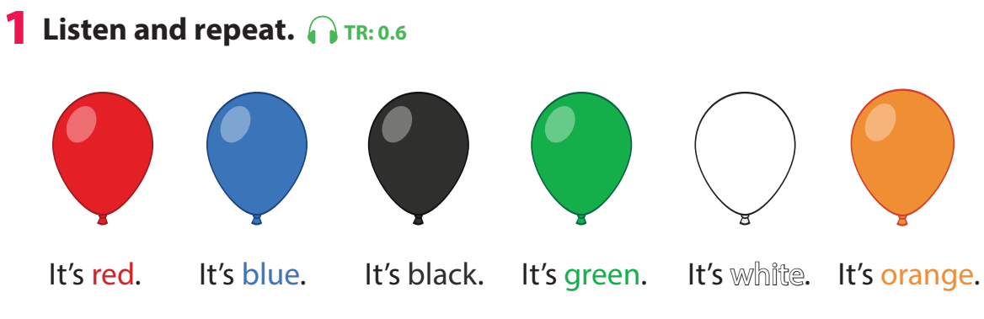
Notes:
- Introduce the colors one by one: red, blue, black, green, white, orange. Use balloons to teach colours. (ppt or paper balloons)
- Play the recording and ask students to point to the words in their books. Play the recording again and ask students to repeat what they hear. Do this as a class a few times. Then ask volunteers to repeat on their own.

Slide 9

Notes:
- Introduce the colors one by one: red, blue, black, green, white, orange. Use balloons to teach colours. (ppt or paper balloons)
- Play the recording and ask students to point to the words in their books. Play the recording again and ask students to repeat what they hear. Do this as a class a few times. Then ask volunteers to repeat on their own.
-Ask volunteers to say in front of the class.

Slide 10
Game: What’s missing?

Slide 11
Game: What’s missing?

Slide 12
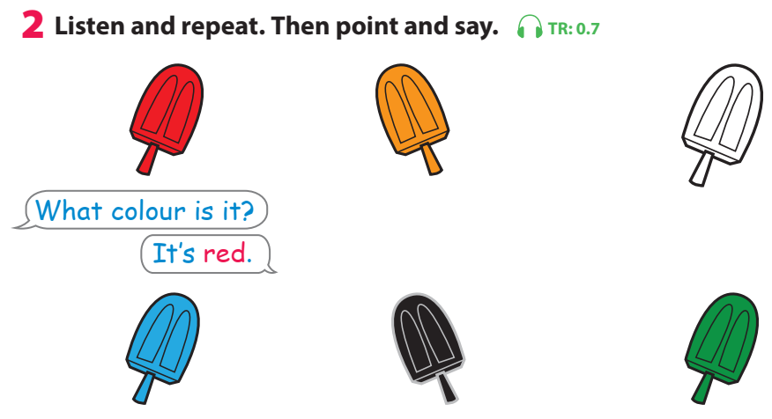
Notes:
- Tell students to look at the first picture and the prompts. Tell them they are going to learn how to ask and answer about colours.
- Play the recording and ask students to follow the question and answer as they listen.
- Play the recording again and ask students to repeat what they hear. Do this as a class a few times. Then ask volunteers to repeat on their own.
- Ask students to look at the other five pictures and elicit the colours (blue, black, green, white, orange).
- Ask students to work in pairs to practise asking and answering questions about those five pictures. Tell them to point at the pictures as they speak.
- Ask volunteers to ask and answer questions about colours in front of the class.

Slide 13

Notes:
THIẾT KẾ HOẠT ĐỌNG TƯƠNG TÁC VỚI CÂU HỎI DÙNG CHUNG CHO 6 BỨC TRANH LÀ: What colour is it? – It’s ____. Câu trả lời là màu của từng que kem (red, yellow, white, blue, black, green)
- Tell students to look at the first picture and the prompts. Tell them they are going to learn how to ask and answer about colours.
- Play the recording and ask students to follow the question and answer as they listen.
- Play the recording again and ask students to repeat what they hear. Do this as a class a few times. Then ask volunteers to repeat on their own.
- Ask students to look at the other five pictures and elicit the colours (blue, black, green, white, orange).
- Ask students to work in pairs to practise asking and answering questions about those five pictures. Tell them to point at the pictures as they speak.
- Ask volunteers to ask and answer questions about colours in front of the class.

Slide 14

Game: Choose and say!

Slide 15
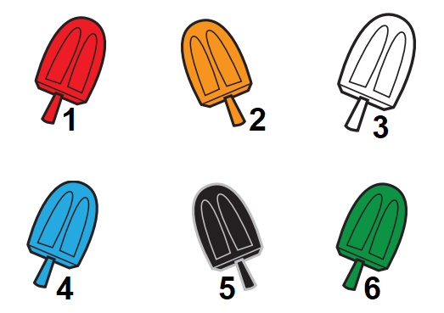

Next

Slide 16


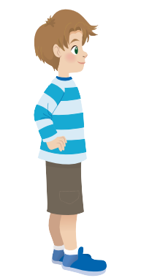
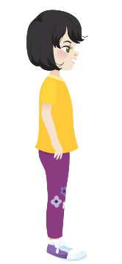


Slide 17



Slide 18

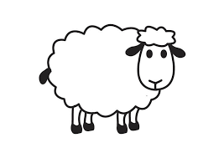

Slide 19


Slide 20


Slide 21


Slide 22

Production
Task 3: Let’s play

Slide 23
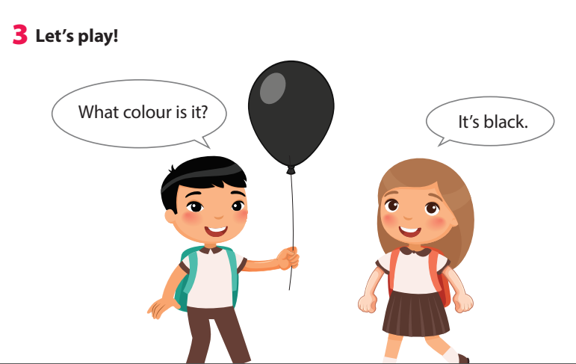
Notes:
- Tell students they are going to play a game to ask and answer about colours.
- Tell students to look at the picture and the sample sentences. Read out the sample sentences and ask students to repeat.
- Explain to students that they’re going to play the game in pairs. One student holds up an object (or crayons) and asks What colour is it? The other student then answers the question.
- Give an example by asking a student to do the activity with you.
- Ask students to work in pairs to play the game.
- Ask volunteers to play it in front of the class.

Slide 24


Slide 25

Assessment
Let’s colour!

Slide 26
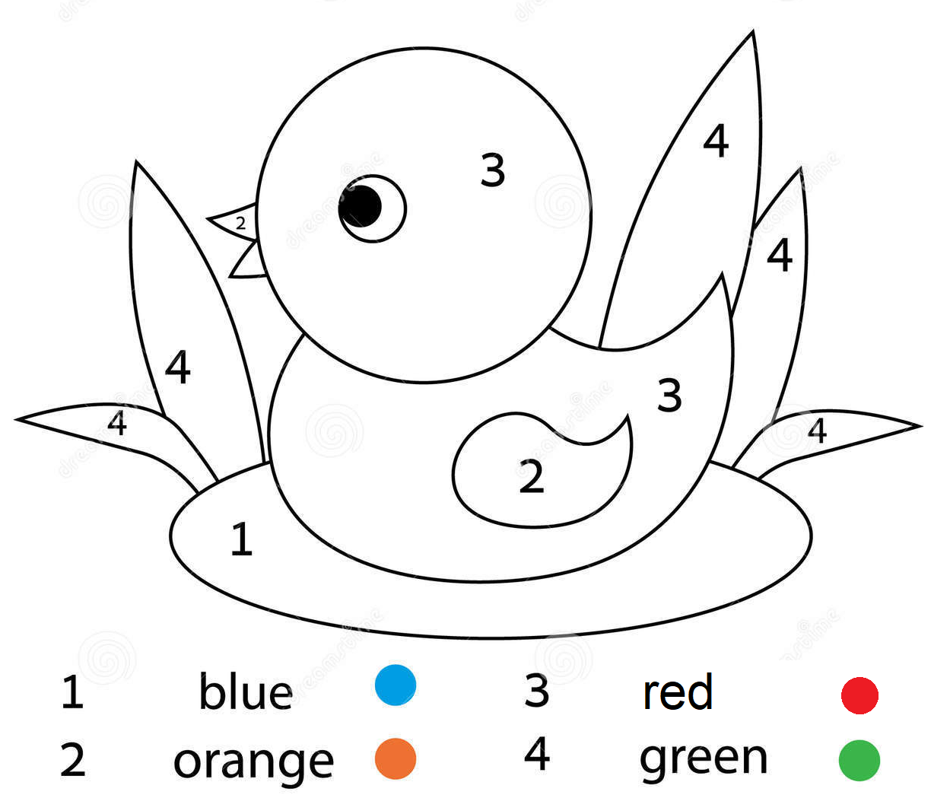
Notes:
Show a picture for sts to colour. Ask the sts to say the colours that they need to use to make the picture more beautiful.
Show the pictures to their classmates and practice the sentence: What colour is it? It’s …

Slide 27

Goodbye!

