Slide 1




















Review4
PART 2 – Task 1,2,3
Notes:
Để nguyên trang bìa như này, chỉ thay đổi tên bài trong quá trình làm. Logo của sách Wonderful World

Slide 2











1 Warm-up

Slide 3


GUESSING GAME

Slide 4

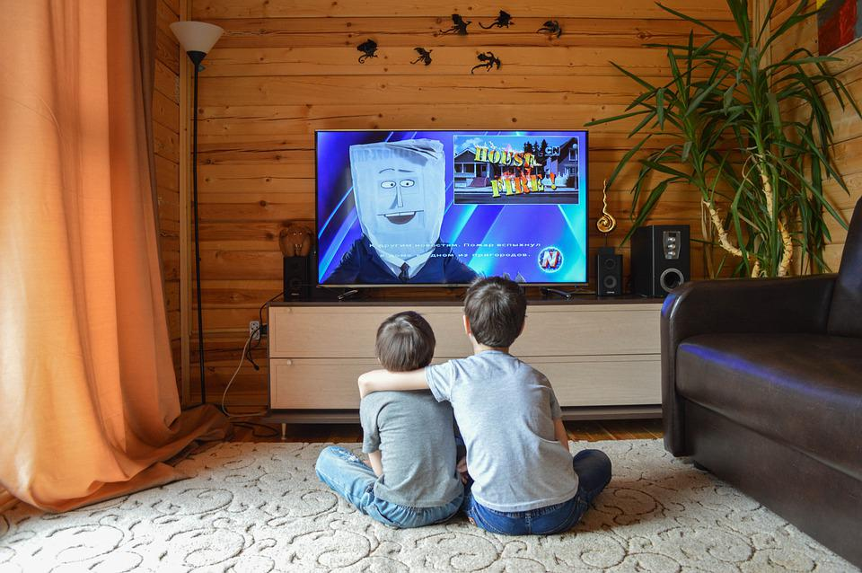

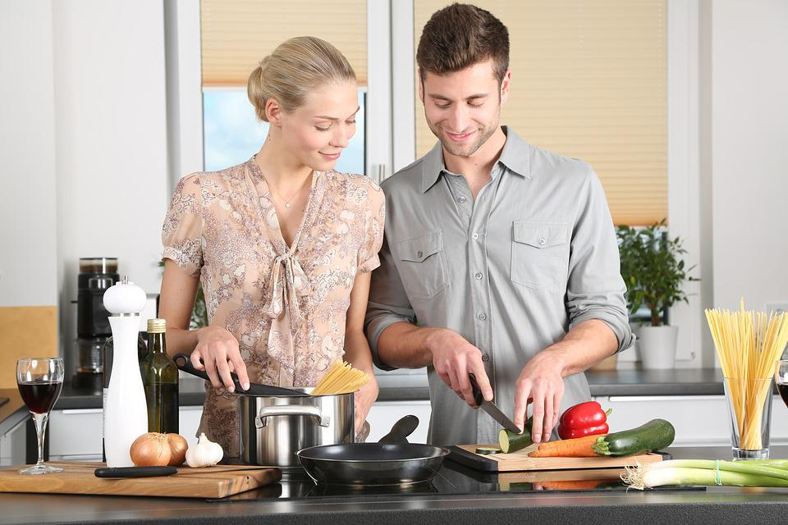
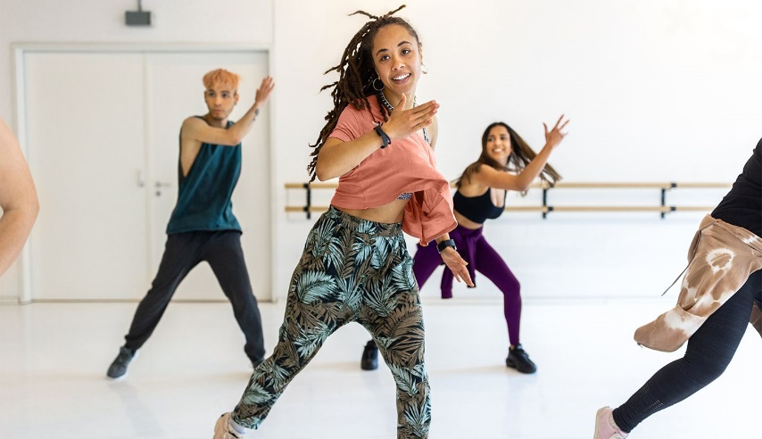
reading
playing
watching
cooking
dancing

Slide 5

reading
playing
watching
cooking
dancing

Slide 6
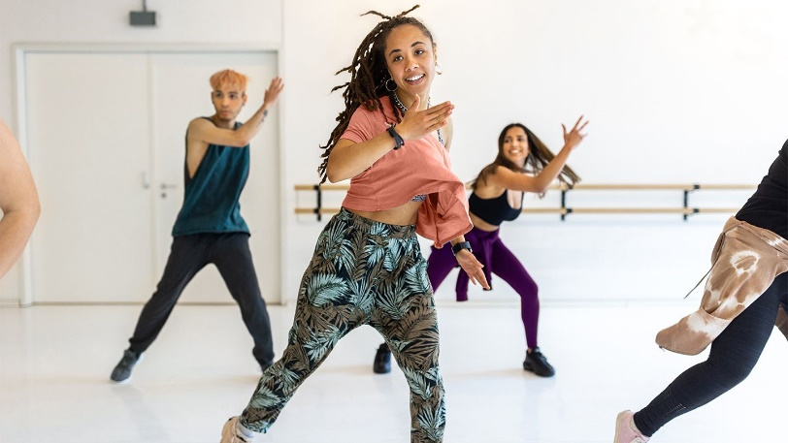
reading
playing
watching
cooking
dancing

Slide 7
reading
playing
watching
cooking
dancing

Slide 8
reading
playing
watching
cooking
dancing

Slide 9
2 Review
Activity 1

Slide 10
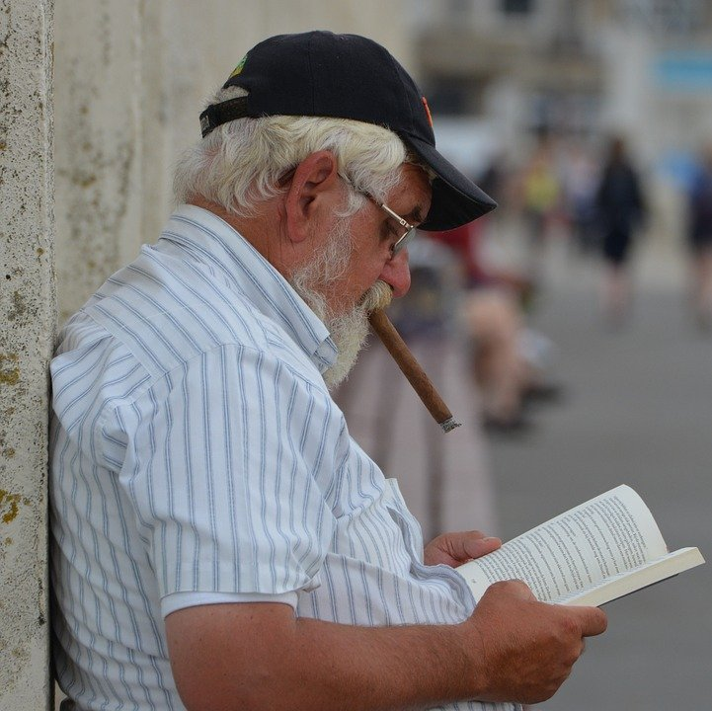

Yes or No
1. Is your grandpa reading a book?
Yes
No

Slide 11
Yes or No
2. Are you playing video game
with your brother?
Yes
No

Slide 12
Yes or No
3. My dad is watching TV.
Yes
No

Slide 13
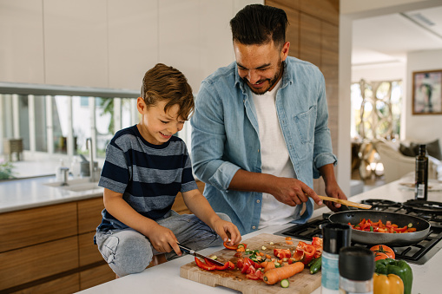
Yes or No
4. I am cooking with my dad.
Yes
No

Slide 14
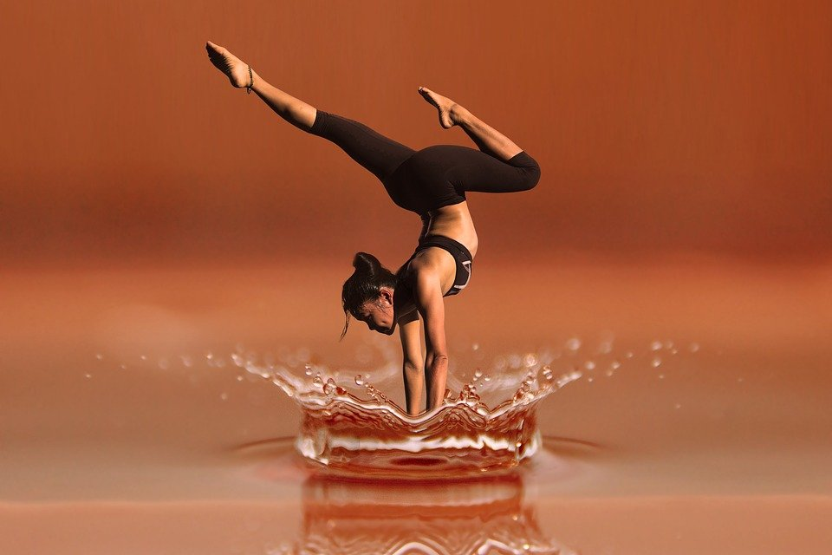
Yes or No
5. She is dancing.
Yes
No

Slide 15
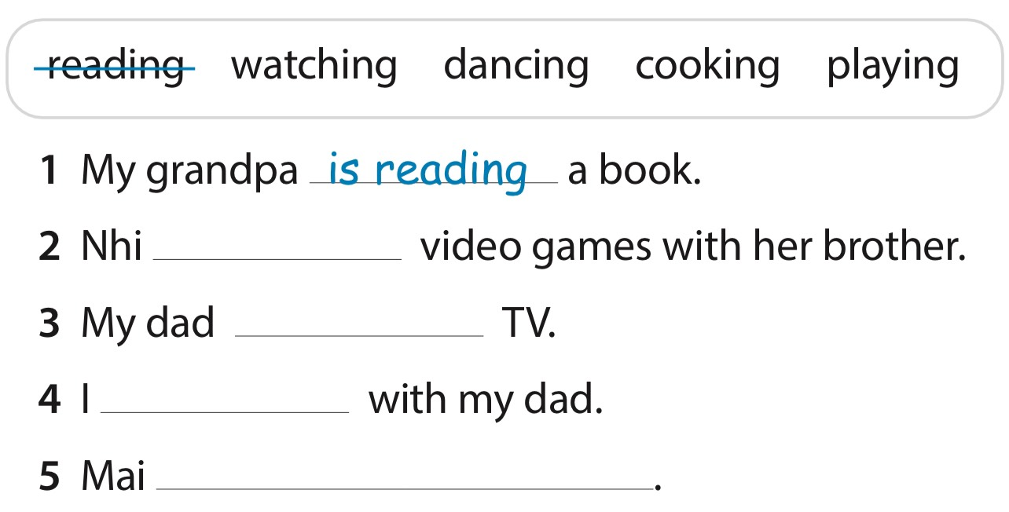
Look and write
is playing
is watching
am cooking
is dancing

Slide 16
Review
Activity 2

Slide 17

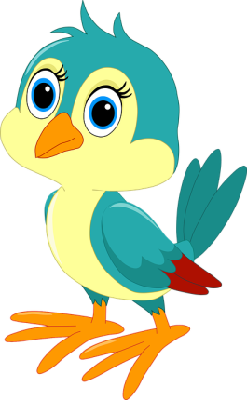

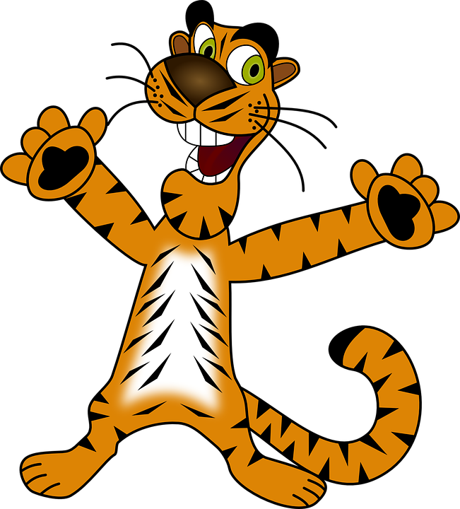


NEXT
RESCUE THE ANIMALS

Slide 18









Fill in the blank.
01
She is cooking in the __.
A. kitchen.
B. bedroom.
5 stars
C. bathroom.
BACK

Slide 19
Fill in the blank.
02
He __ reading a book.
A. is.
B. isn’t.
3 stars
BACK

Slide 20

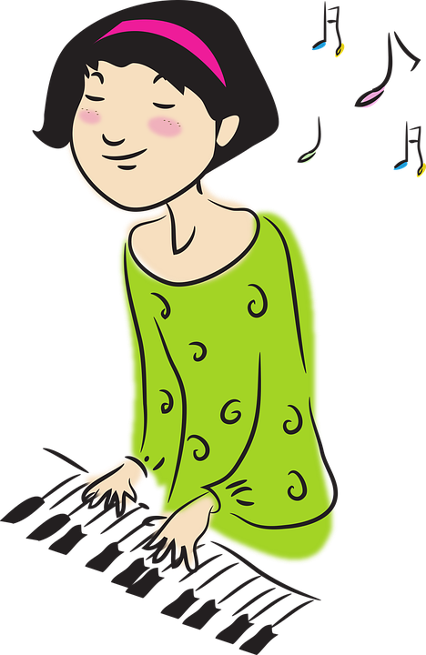
03
Look and choose
A. I am cooking.
B. I am playing the piano.
5 stars
C. I am painting.
BACK

Slide 21

Look and choose.
04
A. He is running.
B. He is hitting.
3 stars
C. He is dancing.
BACK

Slide 22


Look and choose
05
A. My sister is learning English.
B. My sister is not learning English.
4 stars
BACK

Slide 23
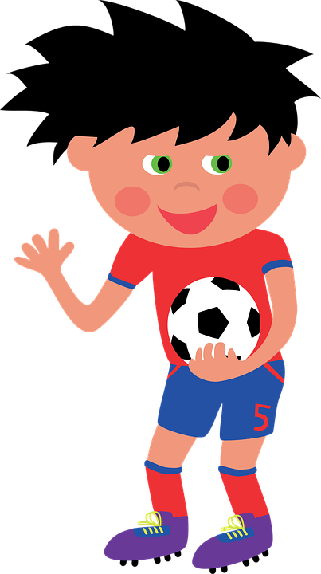
Fill in the blank
06
The football player ____ the ball.
A. is kicking
6 stars
B. isn’t kicking
BACK

Slide 24
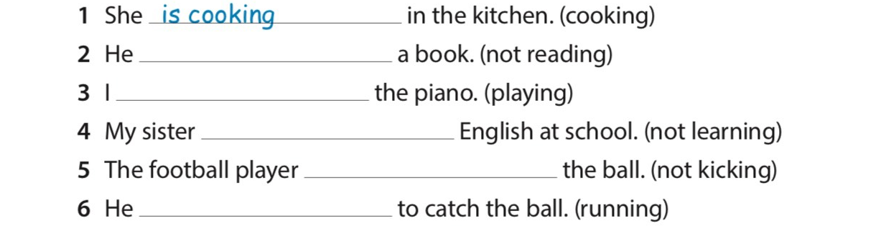
Read and write
isn’t reading
am playing
isn’t learning
isn’t kicking
is running

Slide 25
3 Extra Activity

Slide 26

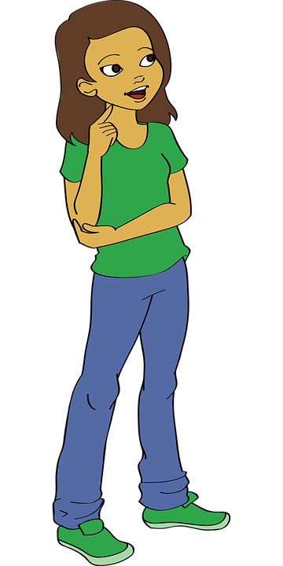

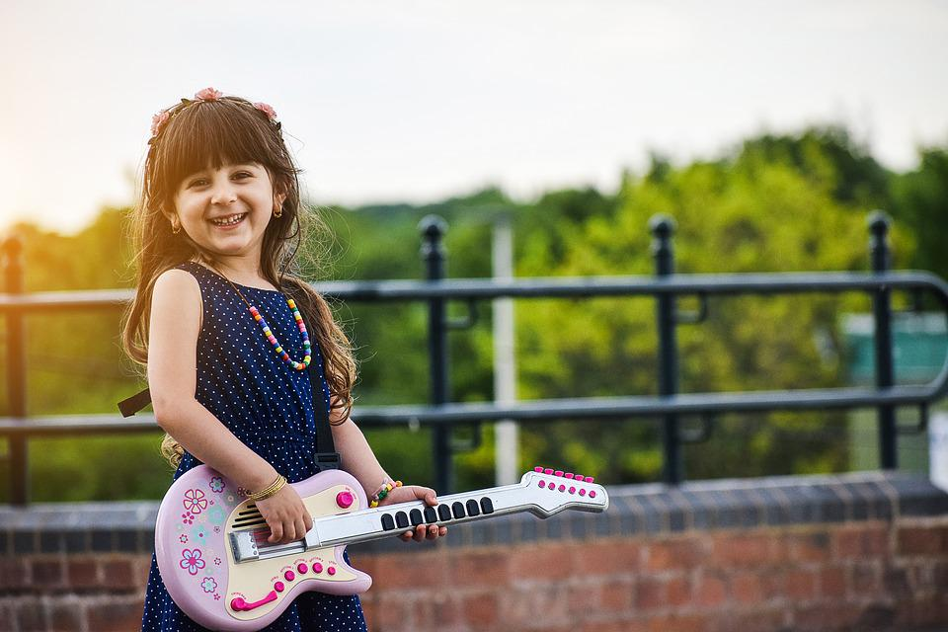
Draw a picture
about what you can do or what you are doing. Then, make conversation about it.

Slide 27
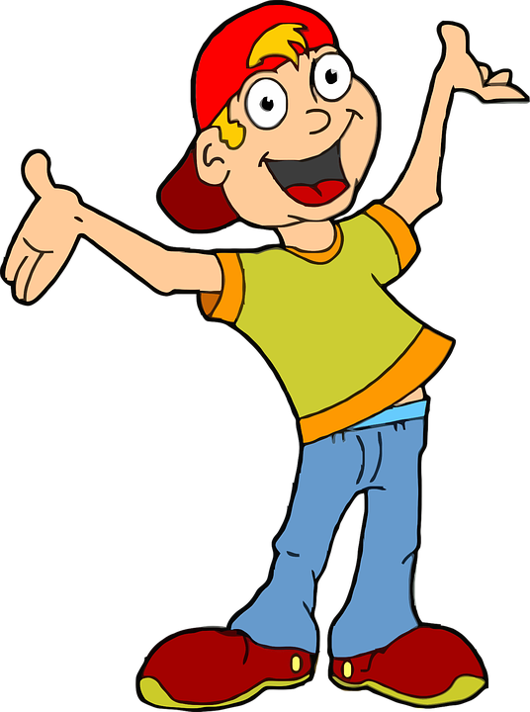
You can see my drawing about what I can do.
Can you speak English?
No, I can’t
Can you play the guitar?
Oh, it’s nice!
Yes, I can.
Yes, I can.
No, I can’t.

Slide 28

She is playing tennis.
Is your mom playing football?
Are you playing tennis?
Yes, I am
No, she isn’t.
No, I’m not. I’m learning English now.
Oh, I see
Yes, she is.

Slide 29
5 Wrap-up

Slide 30




Thank you & goodbye!

