Slide 1








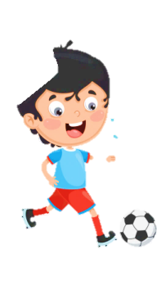
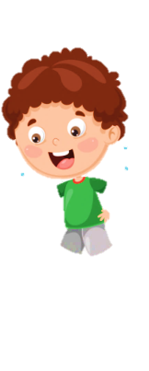












Slide 2

Guessing game.
1 WARM UP

Slide 3
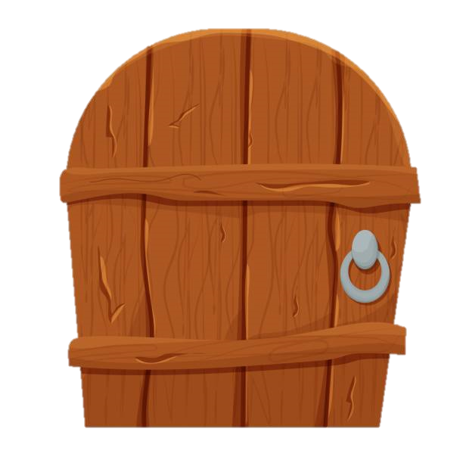


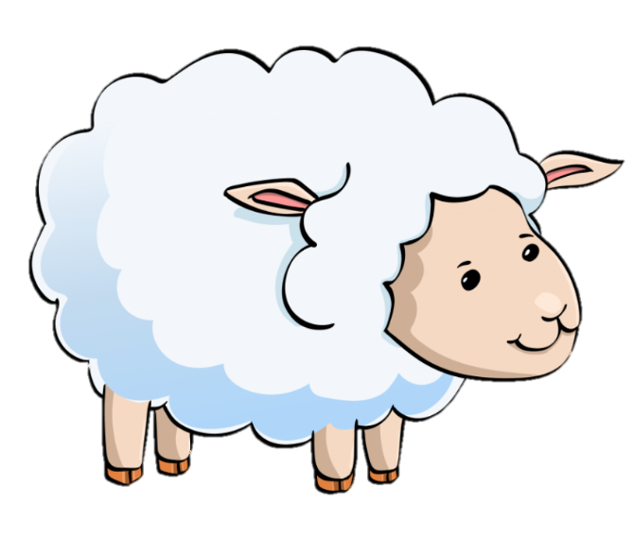
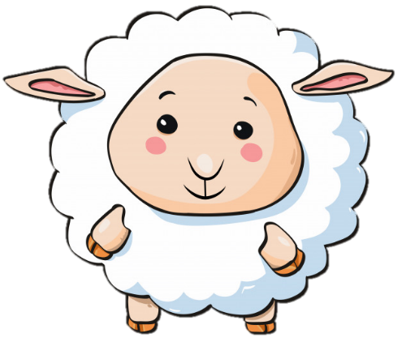
What can she do?
She can read.

Slide 4
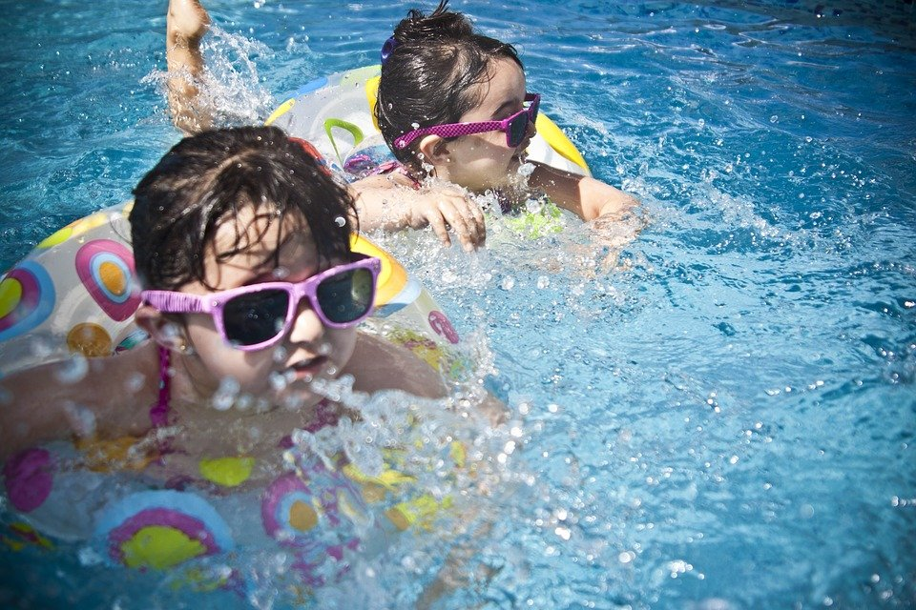
They can _____ .
They can swim

Slide 5
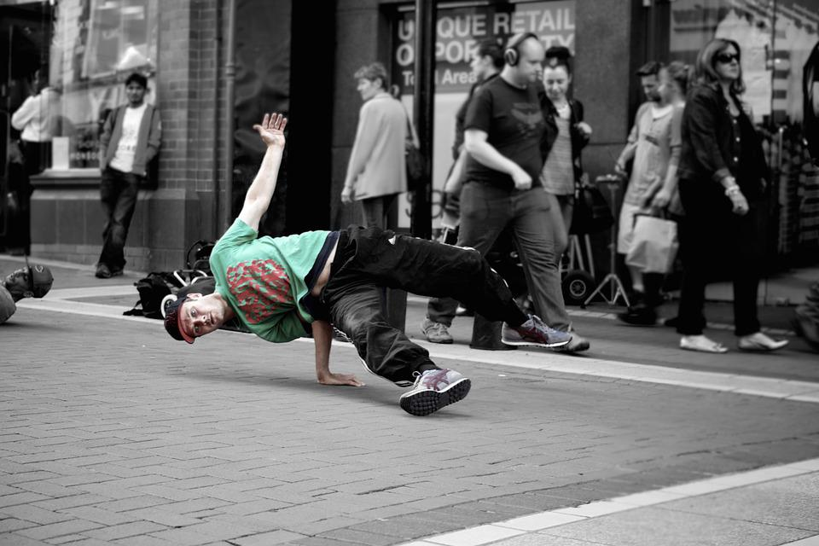
He can _____.
He can dance.

Slide 6
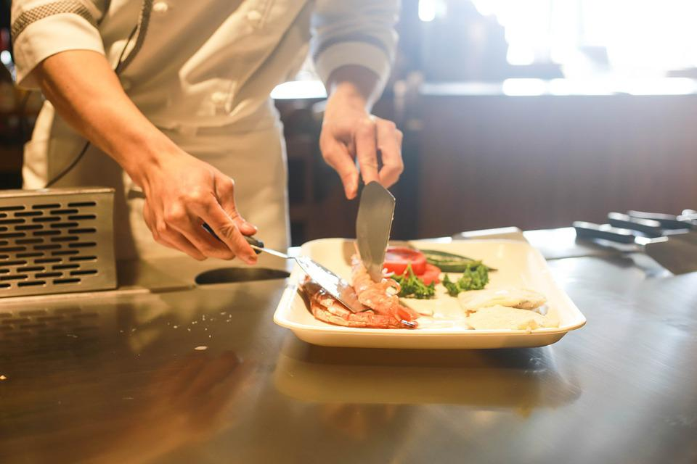

What can he do?
He can cook.

Slide 7
REVIEW
ACTIVITY 1.
Look and say

Slide 8
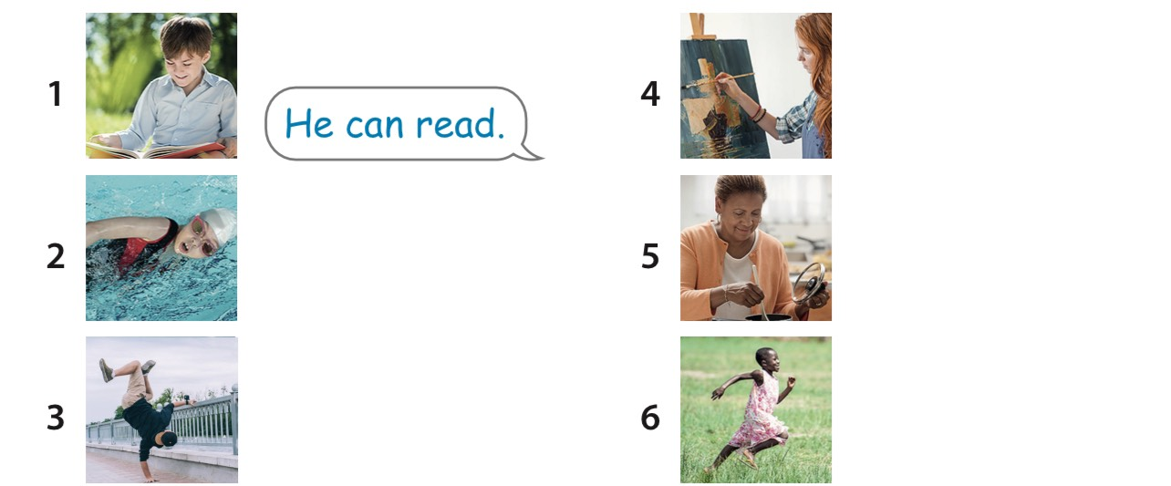
Look and say
She can paint.
She can swim.
She can cook.
She can run.
He can dance.

Slide 9
REVIEW
ACTIVITY 2

Slide 10


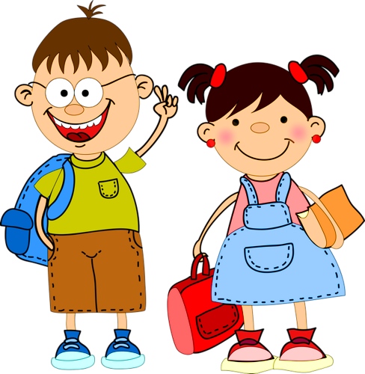
THE BIG WHEEL GAME
0
1
2
3
questions
SPIN
1
0
1
4
2
4
2
5
50
3
6

Slide 11

HOME
Is he reading book?
Yes
No
Yes, he is.

Slide 12
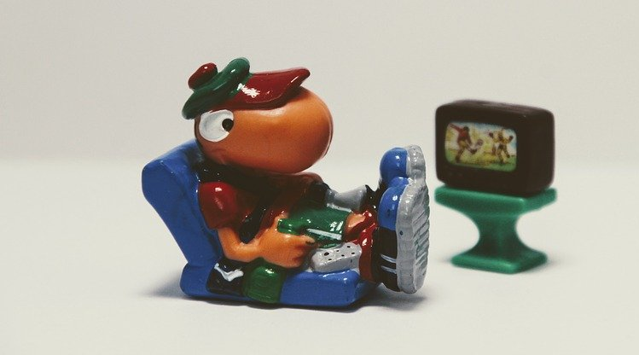
HOME
2. Are you swimming?
Yes
No
No, I am not. I am watching TV.

Slide 13
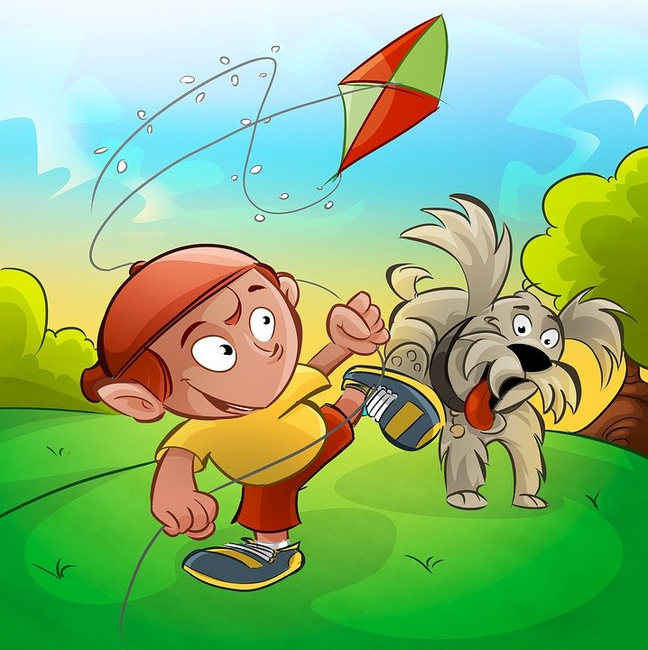
HOME
3. He is ______
a kite.
flying
riding
He is flying a kite.

Slide 14



HOME
4. She ____
ride a bike.
can
can’t
She can ride a bike.

Slide 15




HOME
5. Can he paint?
Yes
No
No, he can’t. He can play the guitar.

Slide 16
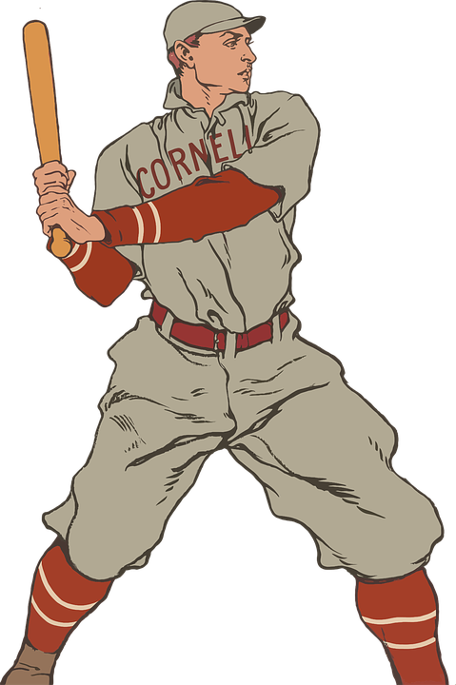
6. Can he catch
baseball?
HOME
Yes
No
No, he can’t.

Slide 17
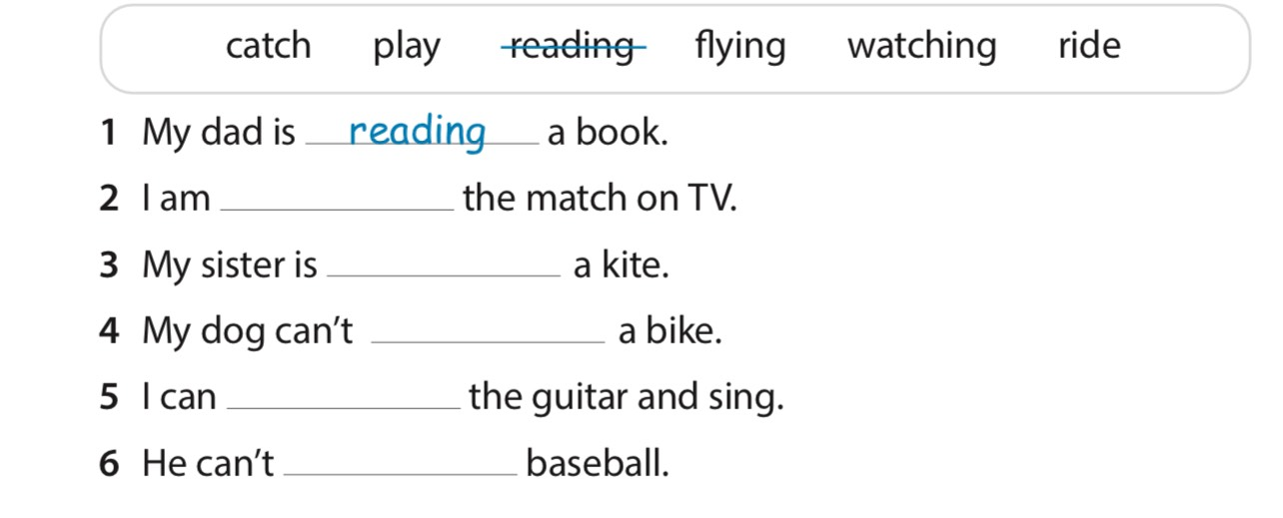
watching
flying
ride
play
catch

Slide 18
EXTRA ACTIVITY
Making paper animals

Slide 19
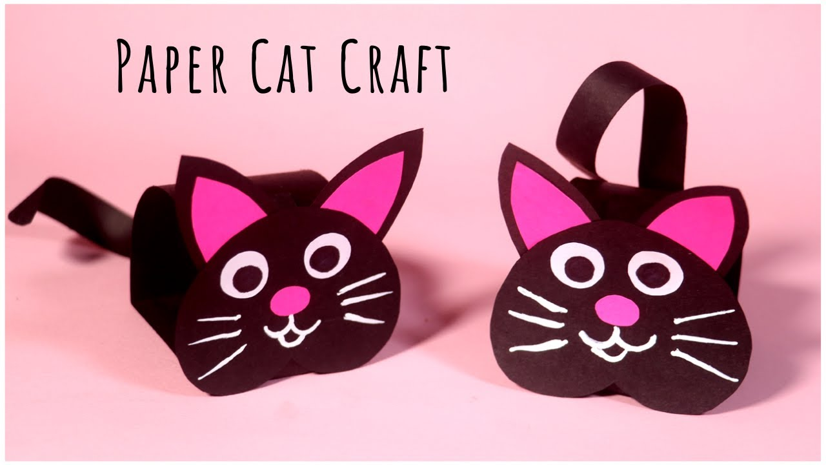
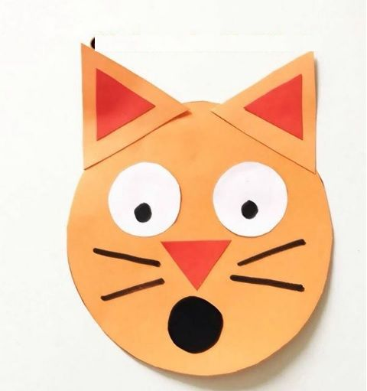
https://www.youtube.com/watch?v=_ik62O91Fn0
Watch the videos

Slide 20
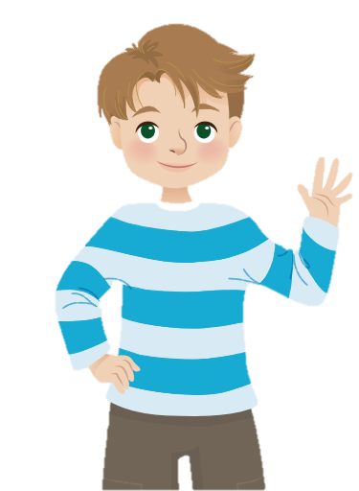
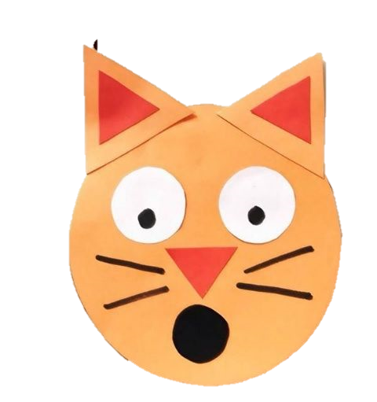
The cat can run and jump, but it can’t speak.

Slide 21




Thank you & goodbye!

