Slide 1








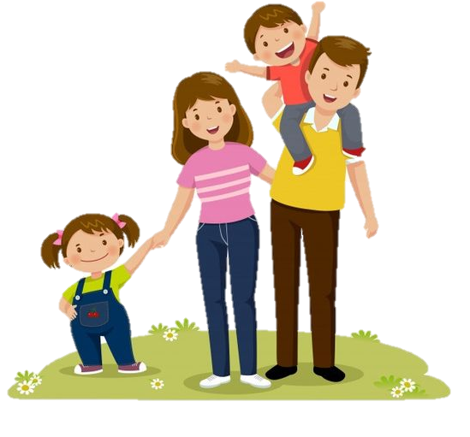
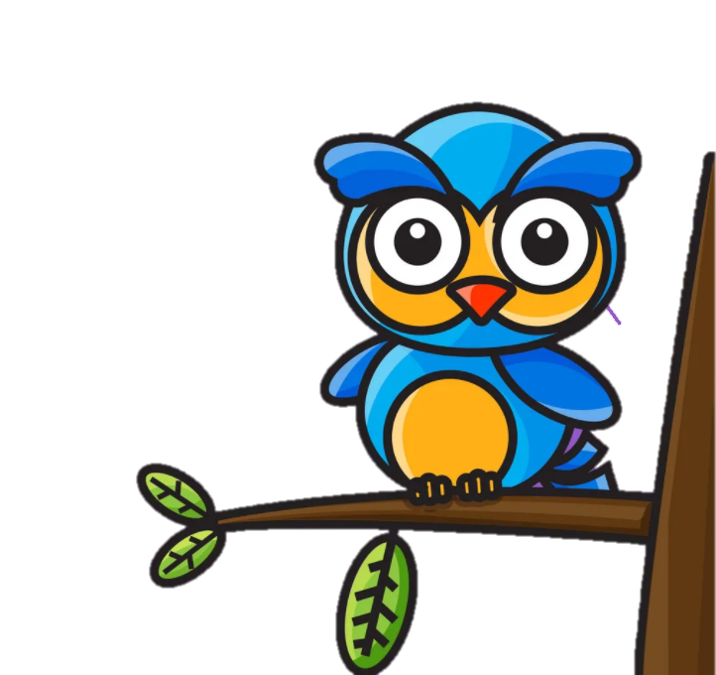

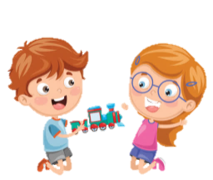
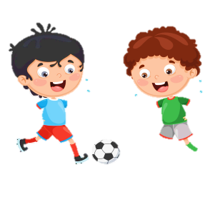


Unit 4: Food and Drinks
Lesson 2: Task 4 5 6

Slide 2
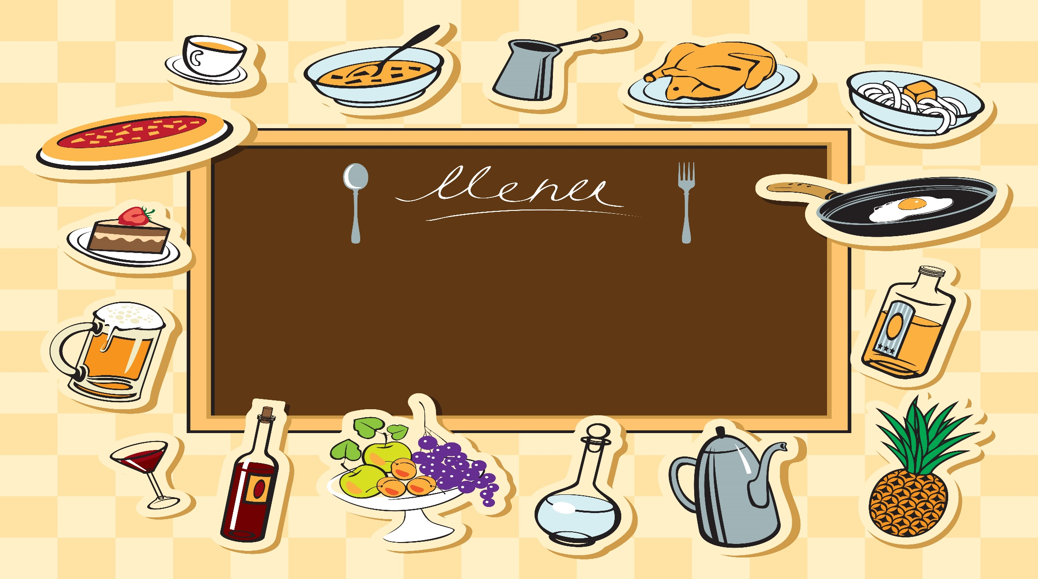
1
Warm up
Notes:
Warm-up: Play a small game “ Puzzle game”
The teacher asks SS to identify different colors and choose a color to guess the image behind the puzzles.
T calls Ss to answer and check their answers.
T asks Ss to repeat names of objects in the image.
Answer keys:
1. rope
2. horse
3. seesaw
4. hide-and-seek

Slide 3
2
Presentation

Slide 4
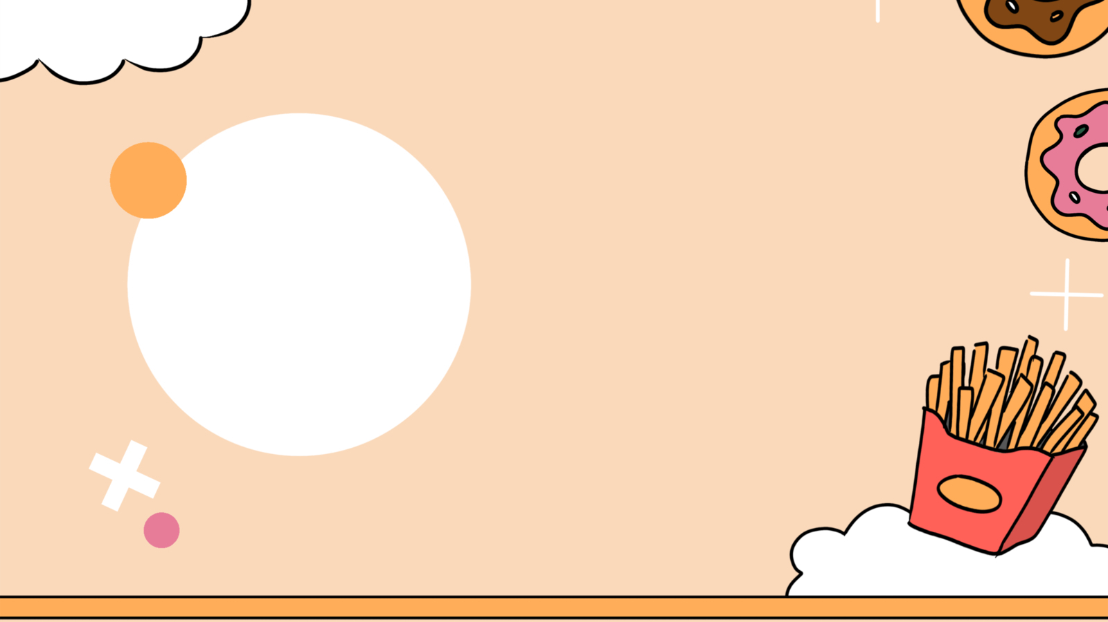
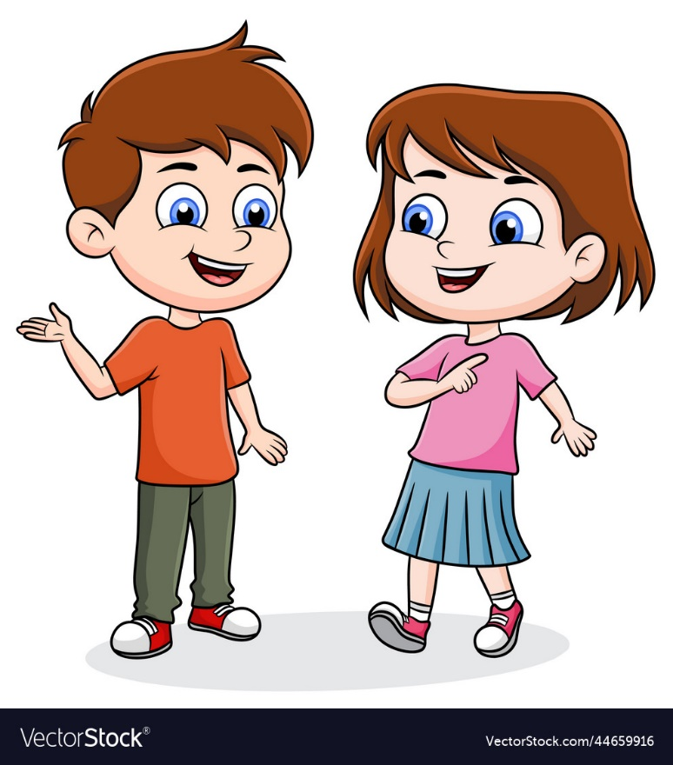

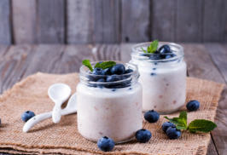
4. Listen and repeat.(track 4.11)
What’s your favourite food?
My fαvourite food is yoghurt.

Slide 5
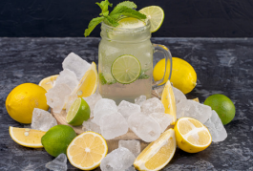
4. Listen and repeat.(track 4.11)
What’s your favourite drink?
My fαvourite drink is lemonade.

Slide 6
3
Practice

Slide 7
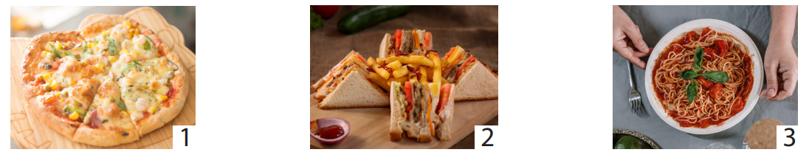
5. Look and say.
What’s your favourite food?
My favourite food is ….

Slide 8
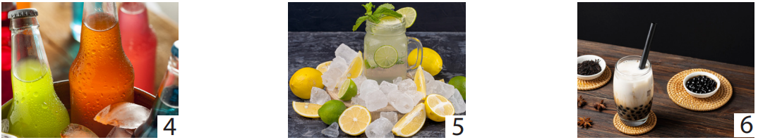
5. Look and say.
What’s your favourite drink?
My favourite drink is ….

Slide 9
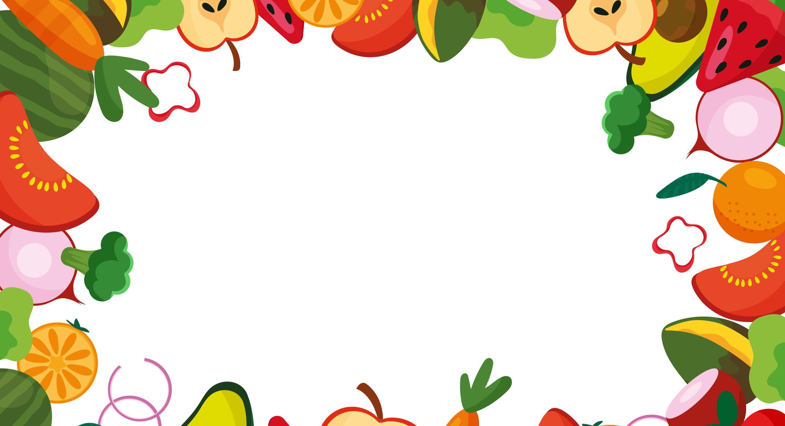
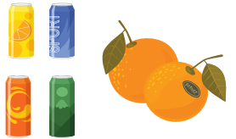
6. Drαw αnd write. Sαy.
My fαvourite food is...
And my fαvourite drink is...

Slide 10
4
Production

Slide 11

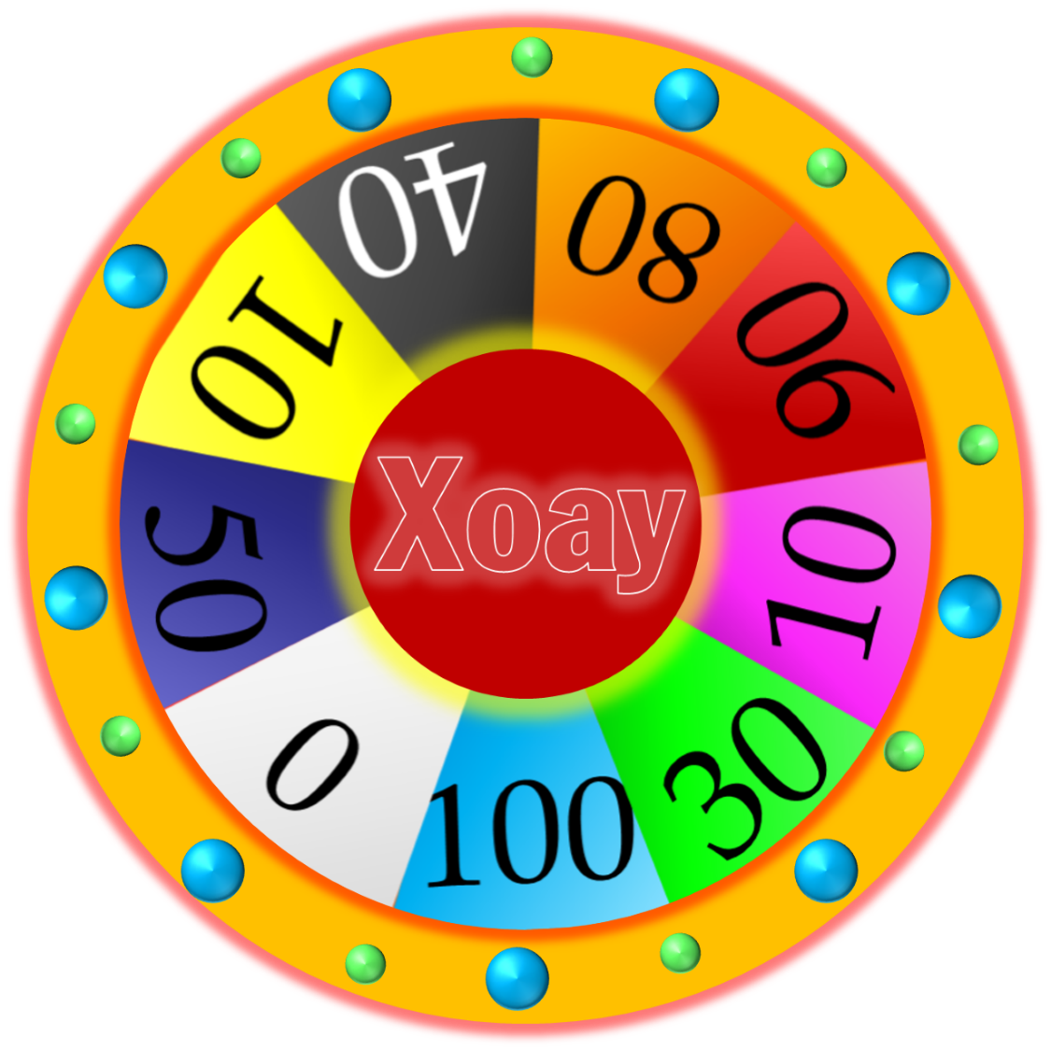

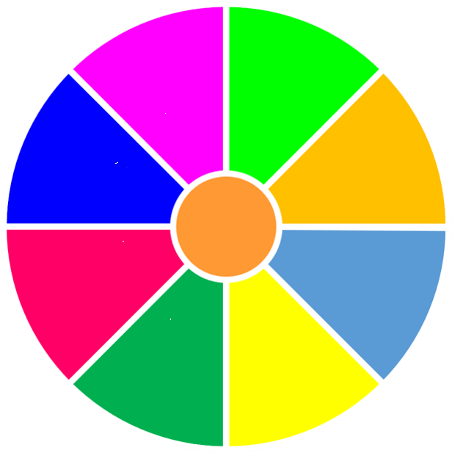


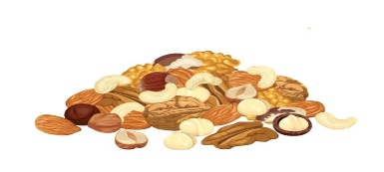
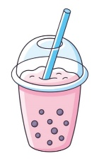
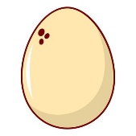

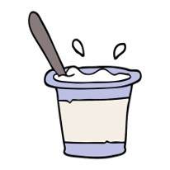
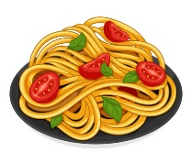

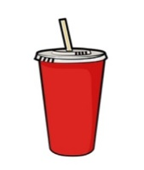
Let’s say.
What’s your favourite food/ drink?
My favourite food/ drink is….
START
STOP

Slide 12



ASSESSMENT
TEAM 1
TEAM 2
TEAM 3
TEAM 4
Vận dụng xuất sắc những kiến thức đã học vào thực hành
Vận dụng tốt những kiến thức đã học vào thực hành
Biết cách vận dụng những kiến thức đã học vào thực hành

Slide 13




5
Assessment

Slide 14
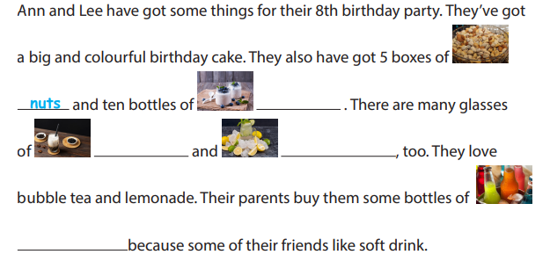
Write.
yoghurt
bubble tea
lemonade
soft drink

Slide 15

UNIT 4: Food and Drinks
LESSON 2: task 4 5 6
What we learnt today
Review vocabulary: bubble tea, lemonade, soft drink, nuts, yoghurt
Structure: What’s your favourite food/drink?
- My favourite food/ drink is…… .

Slide 16
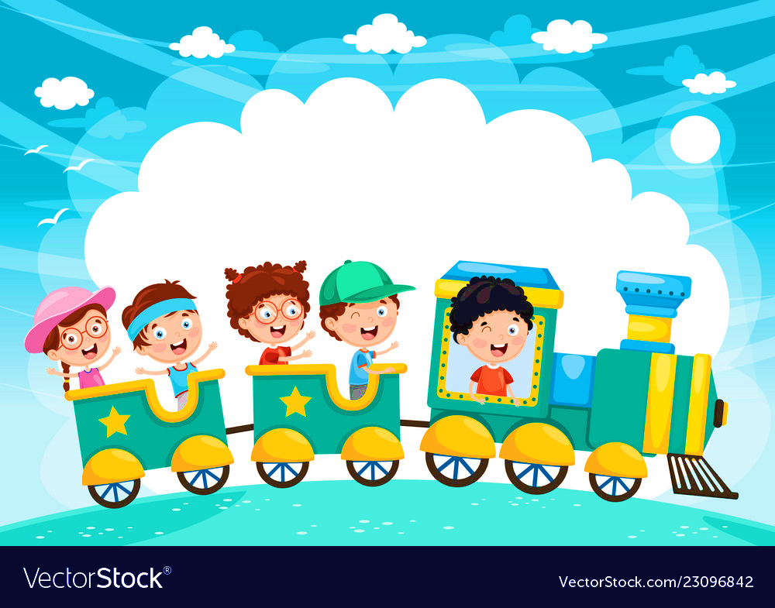







and

