Slide 1

Unit 4:
FOOD AND DRINKS
Lesson 3 – Task 1, 2, 3

Slide 2




1 WARM UP
Let’s sing !

Slide 3



1 WARM UP
Guess the food

Slide 4
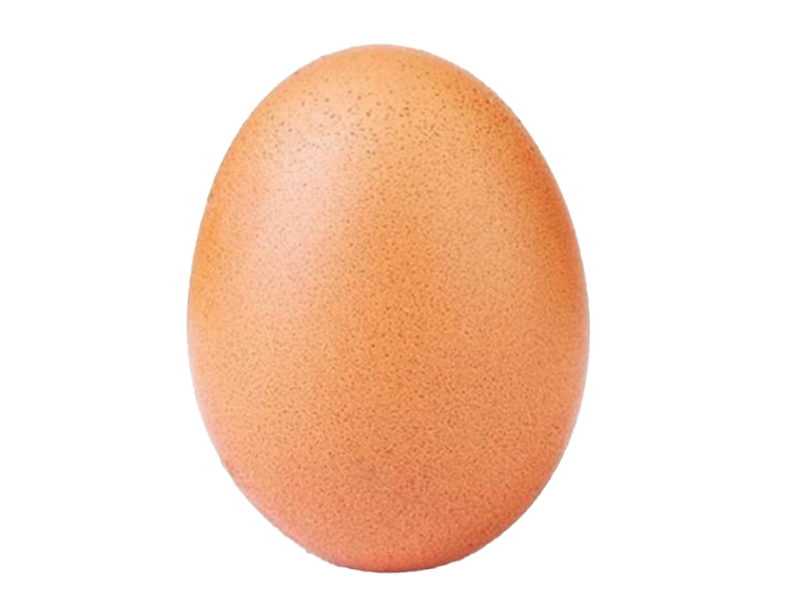
an egg
Notes:
Click vào dấu hỏi chấm để hình xuất hiện nhanh

Slide 5
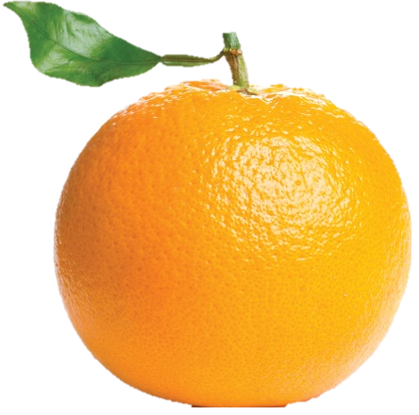
an orange
Notes:
Click vào dấu hỏi chấm để hình xuất hiện nhanh

Slide 6
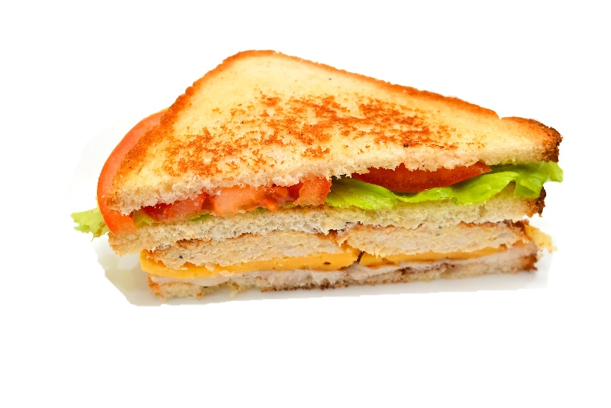
sandwich
Notes:
Click vào dấu hỏi chấm để hình xuất hiện nhanh

Slide 7
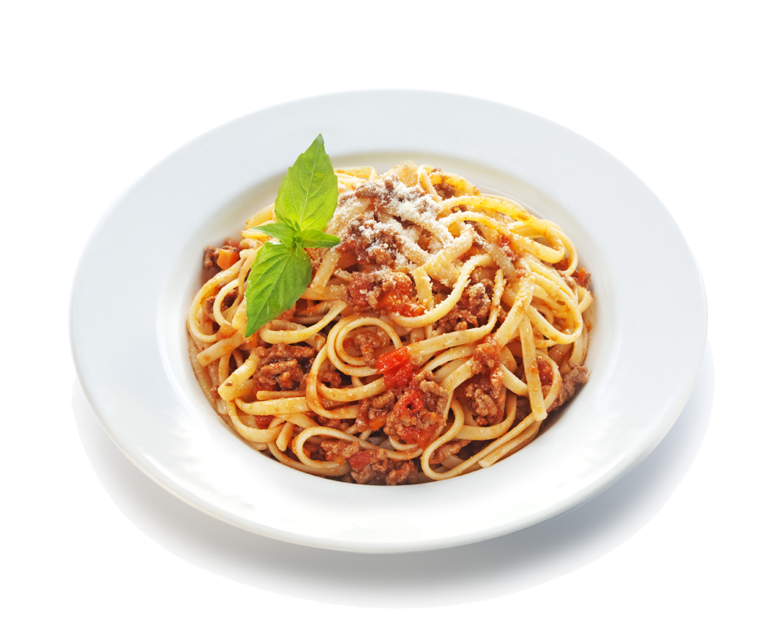
spaghetti
Notes:
Click vào từng ô để mở

Slide 8
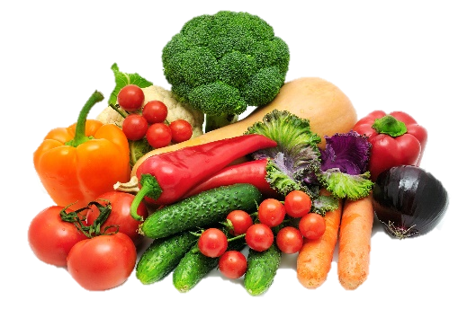
vegetables
Notes:
Click vào từng ô để mở

Slide 9


2 PRESENTATION
Task 1 Listen and point. Repeat.

Slide 10
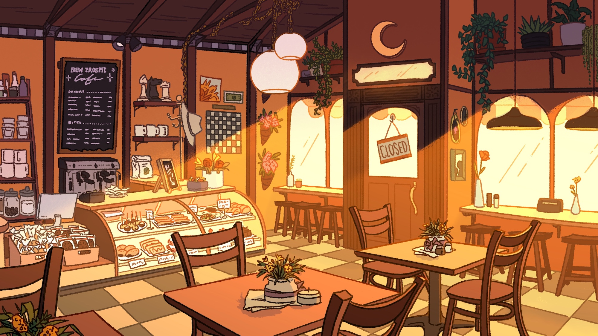
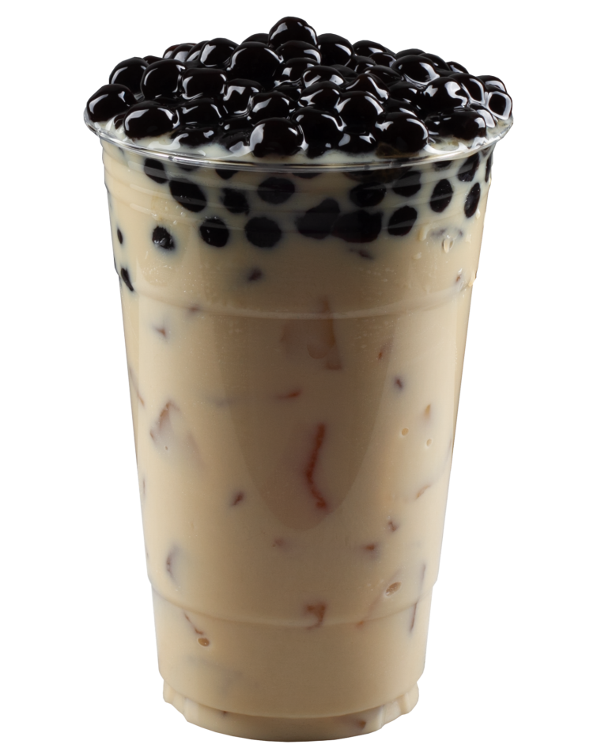


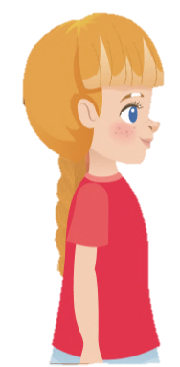
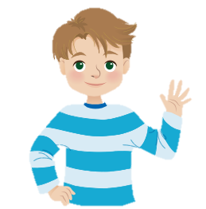
New words
bubble tea

Slide 11
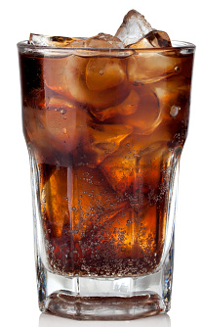
New words
soft drinks
Notes:
Nếu số nhiều thì phải 2 hoặc 3 cốc như hình ảnh SGK

Slide 12
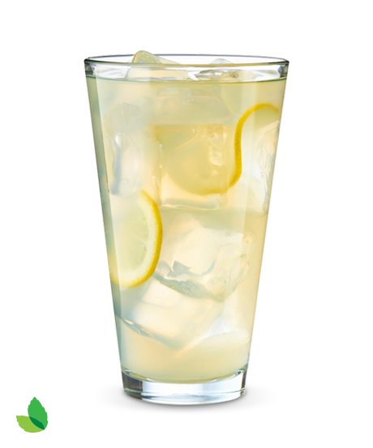
New words
lemonade

Slide 13
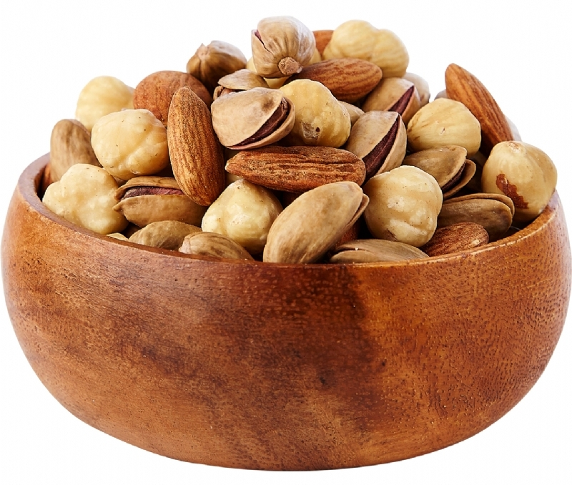
New words
nuts

Slide 14
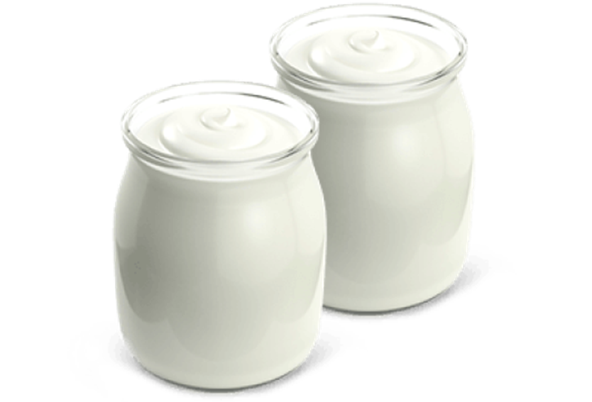
New words
yoghurt

Slide 15
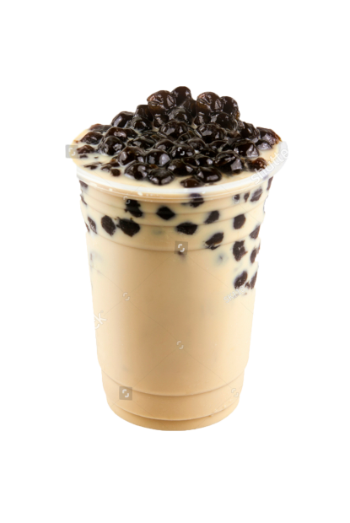
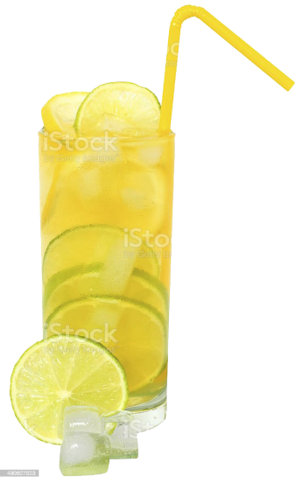
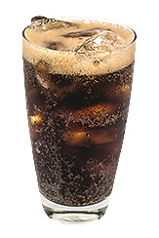
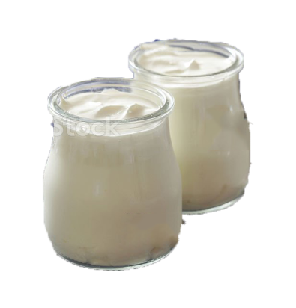
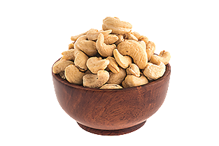

Listen and point. Repeat.
bubble tea
soft drink
lemonade
nuts
yoghurt

Slide 16

3 PRACTICE
Task 2 Listen and tick.

Slide 17
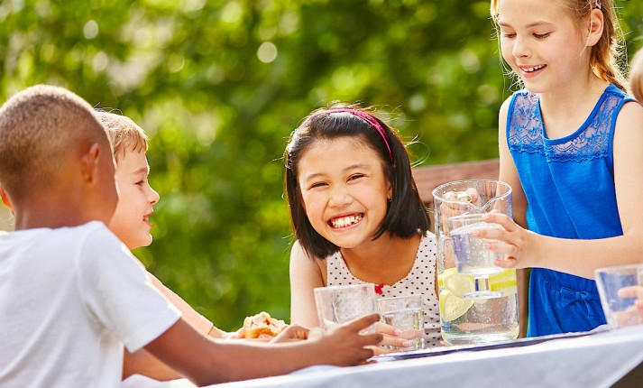
✓
✓
✓
Sandy’s got soft drinks nuts yoghurt lemonade
for her birthday party.

Slide 18


3 PRACTICE
Task 3 Look and say.

Slide 19
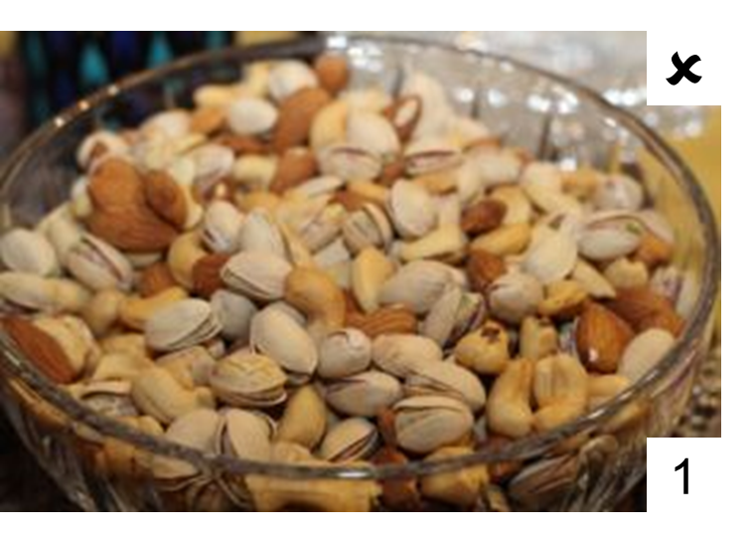
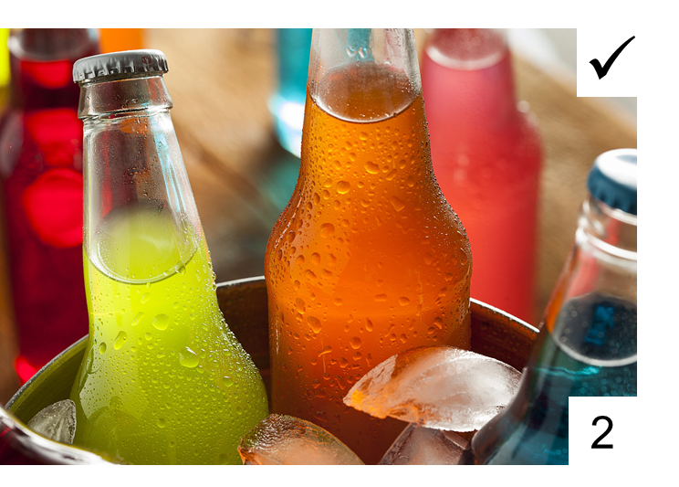
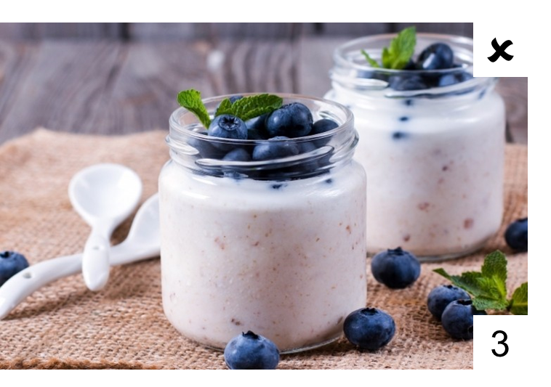
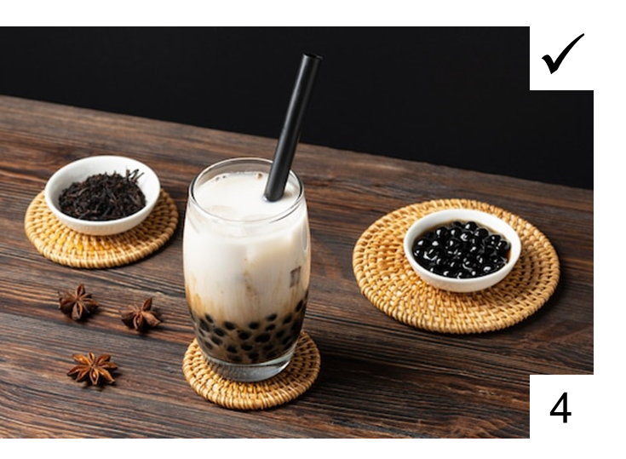
Look and say!
Would you like some nuts?
No, thanks

Slide 20
4 PRODUCTION
GAME: GREAT MEMORY .

Slide 21
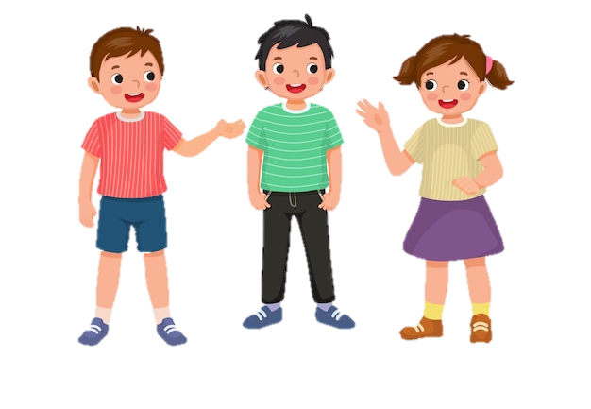
No, thanks.
Would you like some nuts and bubble tea?
Yes, please.
Would you like some nuts and bubble tea and ……..?
Would you like some nuts?

Slide 22



5 ASSESSMENT
Look, match and fill in the blanks.
1
y_gh_rt
o u
2
so_t dr_nks
f i
3
n_ts
u
4
bub_le _ea
b t
5
le _ on_de
m a

Slide 23
………………….., ……………………, 202…
UNIT 4: Food and Drinks
LESSON 3 – PERIOD 1
What we learnt today
Vocabulary:
soft drinks,
lemonade,
bubble tea,
nuts,
yoghurt,
Structure:
Would you like some....?
Yes, please./ No, thanks.

Slide 24




Thank you & goodbye!

