Slide 1
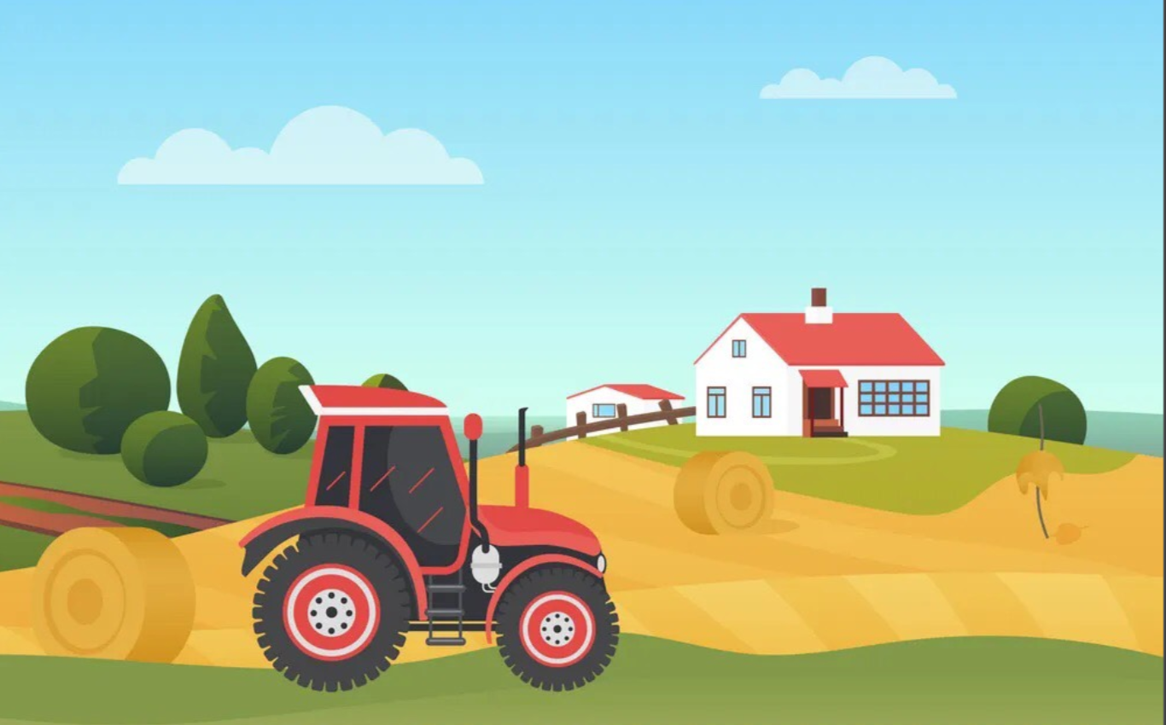


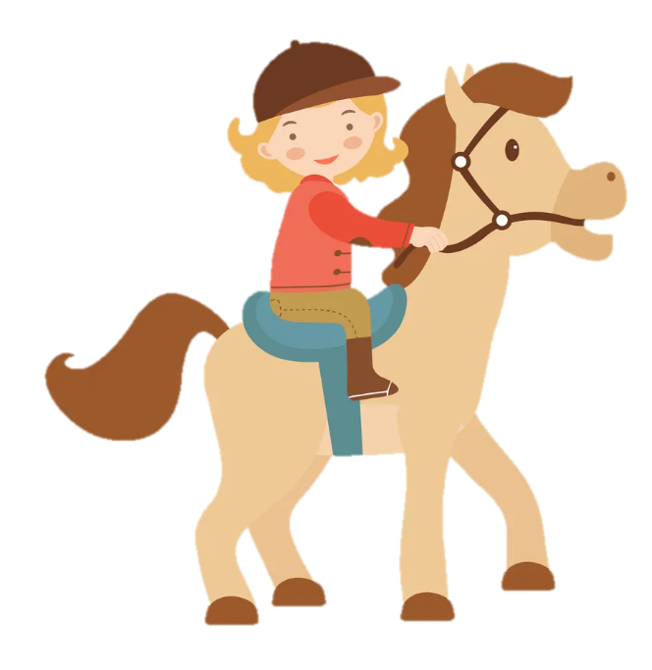
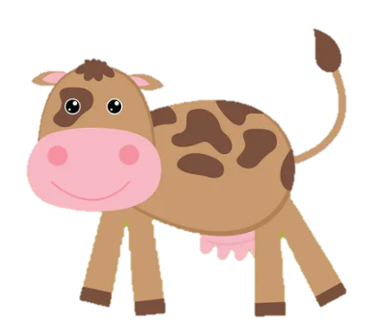
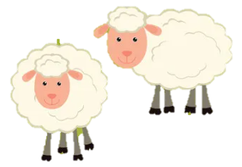
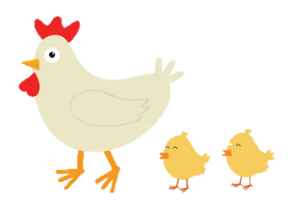
Unit 3: On the farm
Funtime and Project

Slide 2
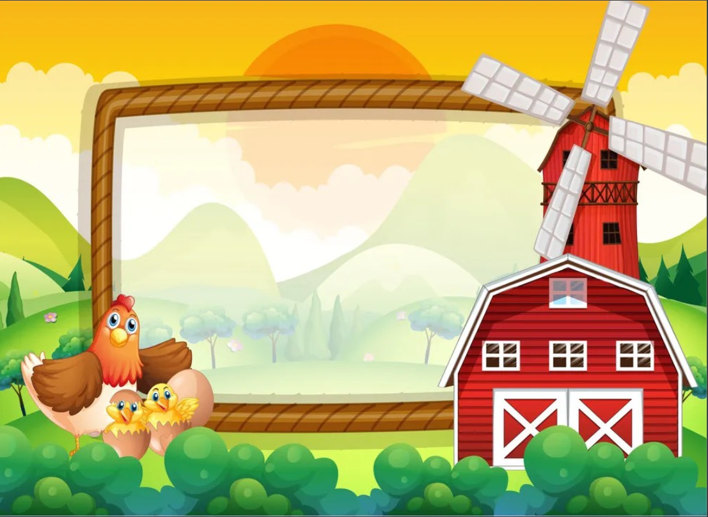
1
Warm Up

Slide 3
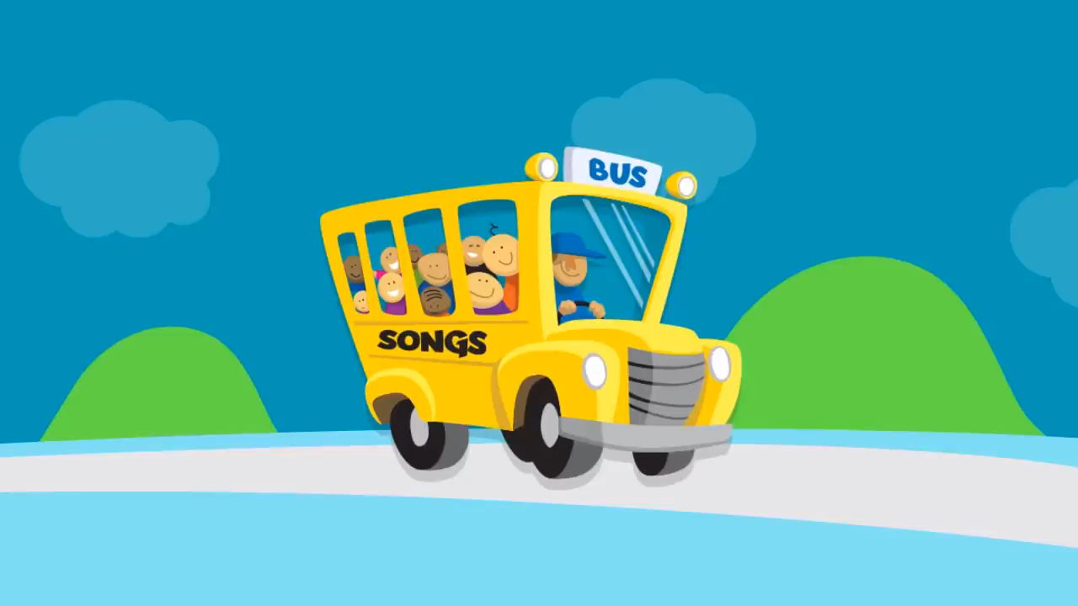
Listen and sing!

Slide 4
2
Fun time

Slide 5
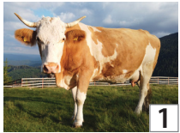
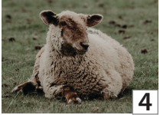
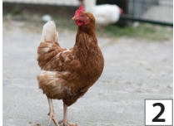
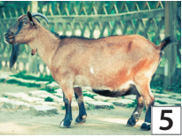
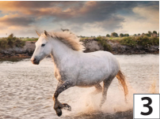
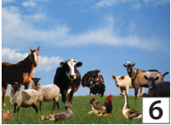
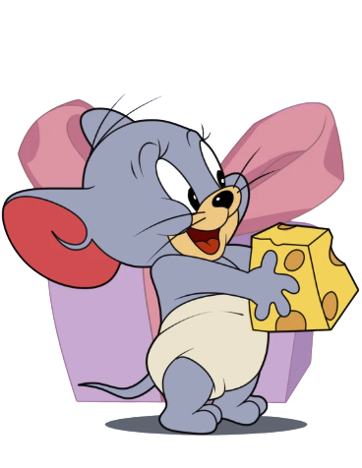
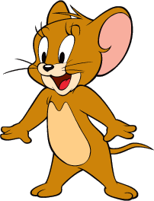
1. Find and Circle!
A | N | I | M | A | L | S | G | N | O
U | H | A | V | G | O | A | T | R | T
C | O | W | R | G | A | R | B | T | M
K | R | A | V | A | O | W | N | R | Q
A | S | H | E | E | P | U | N | O | F
U | E | V | C | H | I | C | K | E | N
I | B | E | W | O | Y | X | Y | E | M
1
2
3
4
5
6
1
2
3
4
5
6

Slide 6
3
Project

Slide 7
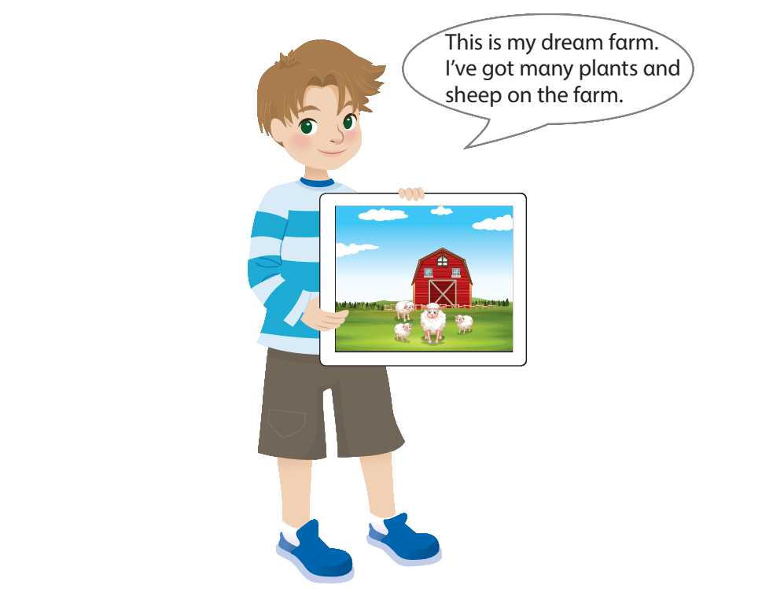
My dream farm

Slide 8
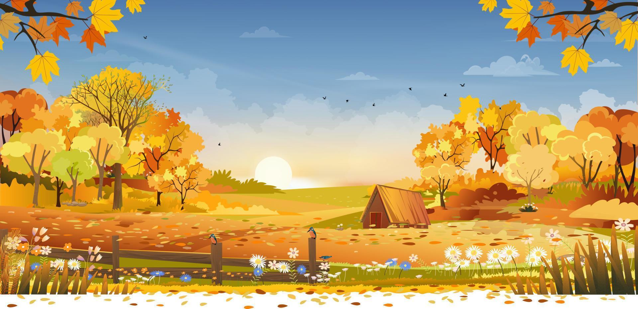
Let’s draw your dream farm!

Slide 9
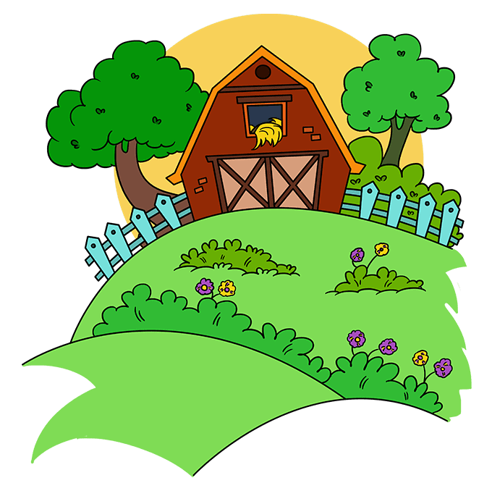
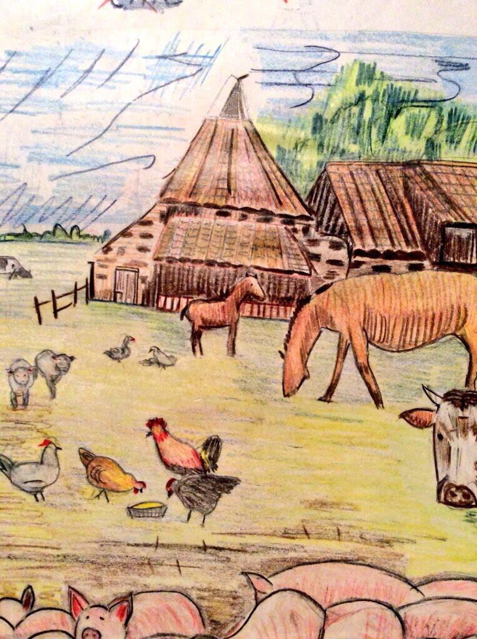
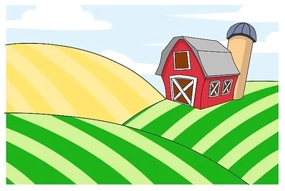
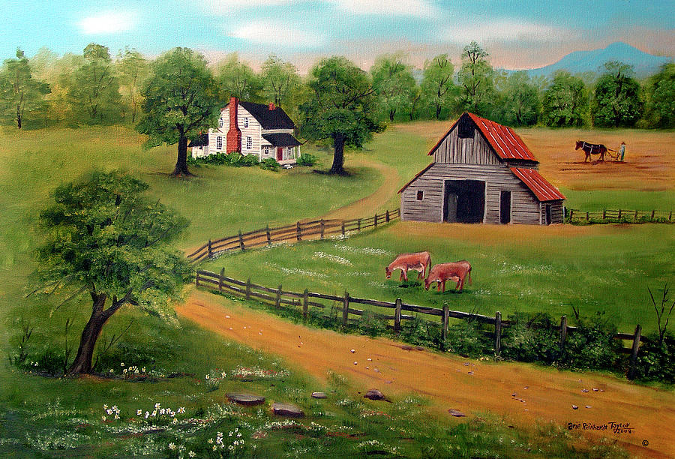
Imagine. What will your dream farm be like?

Slide 10

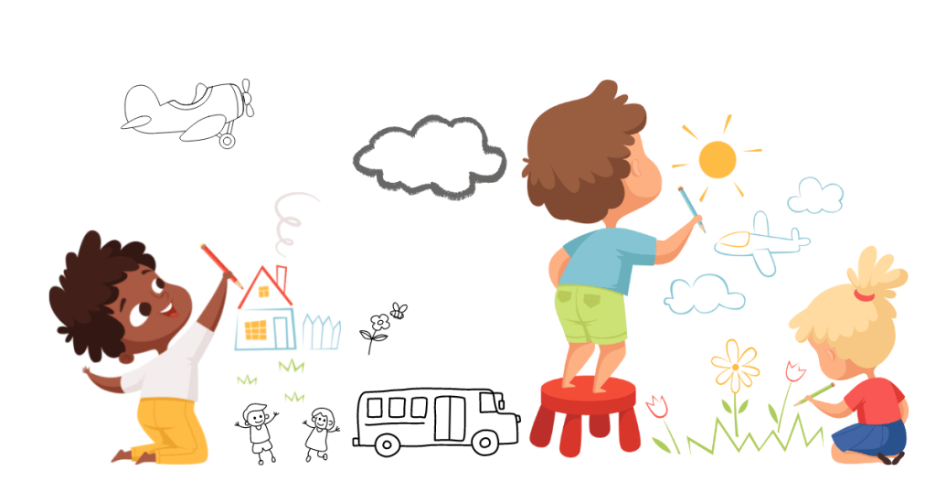
It’s time to draw!

Slide 11
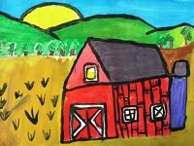
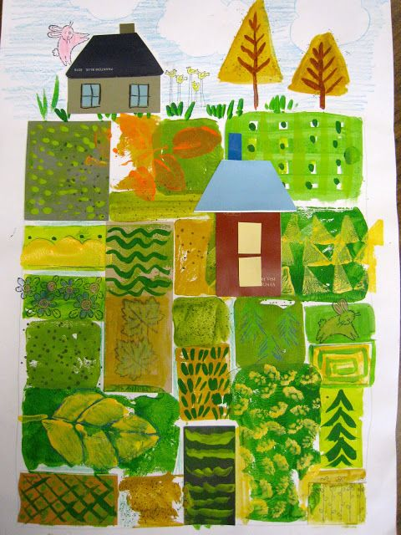
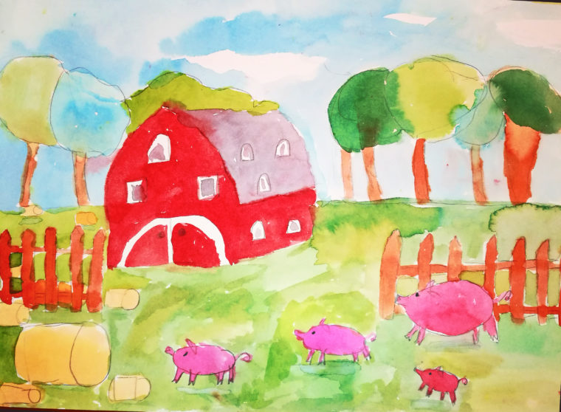
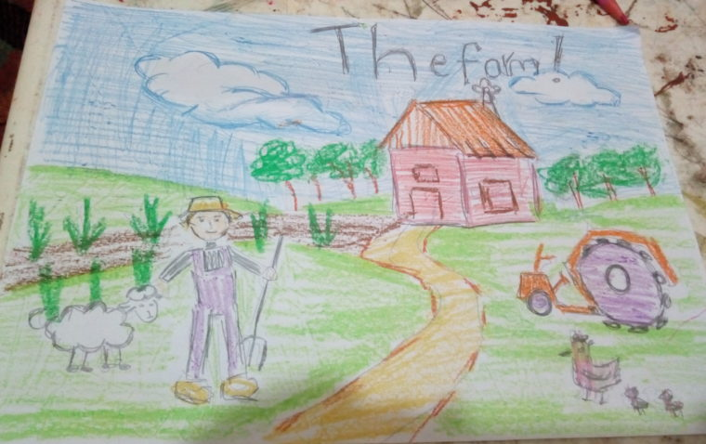
Show off your drawings!

Slide 12
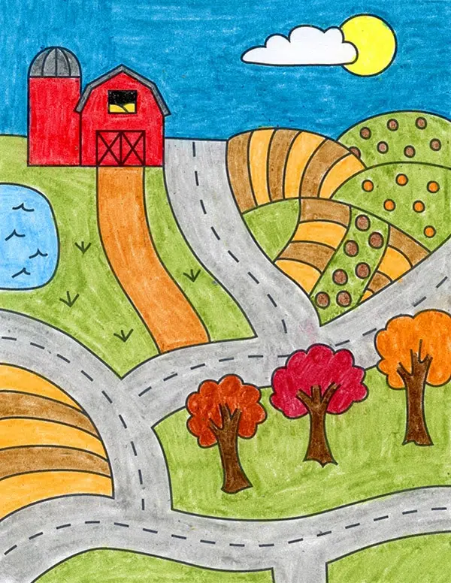
Describe your farm!
This is my farm. I’ve got many plants on my farm.
This is my farm. I’ve got cows on my farm.

Slide 13
Ask and answer.
Have you got plants on the farm?
Have you got chickens on the farm?
Yes, we have.
No, we haven’t.
Have you got horses on the farm?
Yes, we have.

Slide 14
3
Wrap up
&Assessment

Slide 15

2
REMEMBER !
Have you got animals on the farm?
Yes, we have. / No, we haven’t.

Slide 16
REMEMBER !
I’ve got plants on my farm.
A horse hasn’t got hands.

Slide 17


Thank you
& goodbye!

