Slide 1





















Notes:
Để nguyên trang bìa như này, chỉ thay đổi tên bài trong quá trình làm. Logo của sách Wonderful World

Slide 2

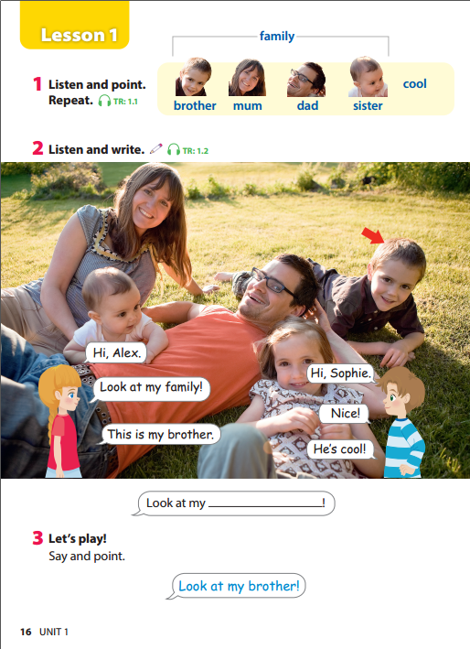


Slide 3




1. Warm up
Warm up

Slide 4


Notes:
https://www.youtube.com/watch?v=G6k7dChBaJ8

Slide 5



Notes:
Lead in: Photo time!
- Teacher holds up a photo of his/her family.
- Point at you and ask "Who is this?". Elicit that it is you (teacher), then elicit and teach the family vocabulary and stick the photo in one of the circle and write the word (e.g. "mum") under the photo. Do the same with other members.
- Encourage your students to bring in photos of their family.
- Write on the board Family and introduce the lesson.

Slide 6
2. Presentation
Presentation

Slide 7
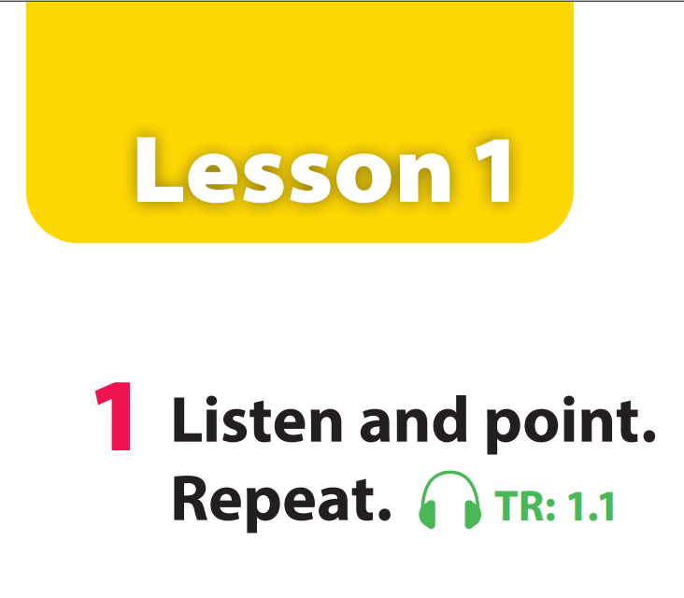

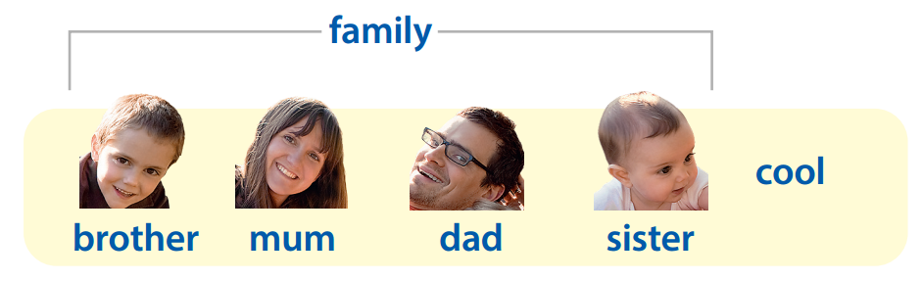

Notes:
Task 1: Listen and repeat. (Track 1.1)
- Use flashcards to introduce the vocabulary and structure of lesson.
- Say the words/sentences for students to repeat in chorus.
- Say a word/sentence for students to repeat then point.
- Play the track 1.1 for the students to listen to, point to, and repeat the words in chorus, group.
- Show pictures in random order and ask students to read out the correct words.

Slide 8


Slide 9
Notes:
Show pictures in random order and ask students to read out the correct words.

Slide 10

Who’s missing?
Notes:
Mini game: Who’s missing?
Ask students to close their eyes.
Then teacher takes away one of the flashcards.
- The first student spot and say the missing one wins.

Slide 11
Notes:
Mum

Slide 12
Notes:
Brother

Slide 13
Notes:
Family

Slide 14
Notes:
Dad

Slide 15
Notes:
Missing word.

Slide 16
Notes:
Mum

Slide 17
Practice
3. Practice

Slide 18

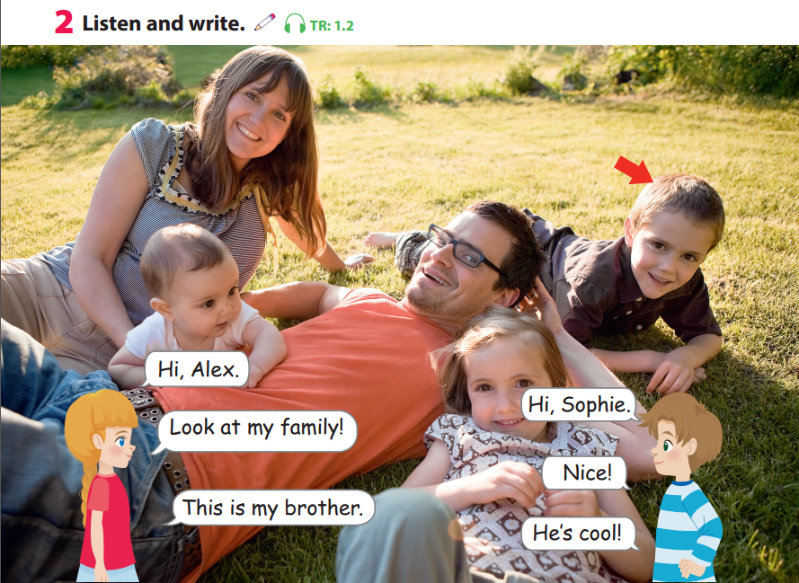

%
%
%
%
%
Notes:
Task 2: Listen and write. (Track 1.2)
- Point and read the new words in the dialogue. Ask students to repeat.
- Play the Track 1.2. Tell students to look at the picture, listen and follow the text with their fingers.

Slide 19
Notes:
Task 2: Listen and write. (Track 1.2)
- Point and read the new words in the dialogue. Ask students to repeat.
- Play the Track 1.2. Tell students to look at the picture, listen and follow the text with their fingers.

Slide 20

family
Let’s write!

Slide 21
family

Slide 22
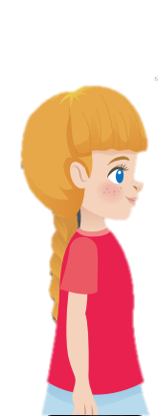
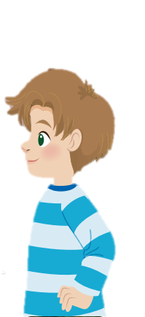
Role play!
Notes:
Role play
- Model a conversation to introduce family by having two students come up to the front of the classroom. - Each student takes turn to ask and asnwer. - Ask students to act out the dialogue in pairs. Ask some volunteers to act it out in front of the whole class.
- Tell students to listen again and fill in the gap.
- Elicit the correct answer.
- Ask students to read a sentence again.

Slide 23
Hi, Alex.
Hi, Sophie.
Look at my family!
Nice!
Notes:
Role play
- Model a conversation to introduce family by having two students come up to the front of the classroom. - Each student takes turn to ask and asnwer. - Ask students to act out the dialogue in pairs. Ask some volunteers to act it out in front of the whole class.
- Tell students to listen again and fill in the gap.
- Elicit the correct answer.
- Ask students to read a sentence again.

Slide 24
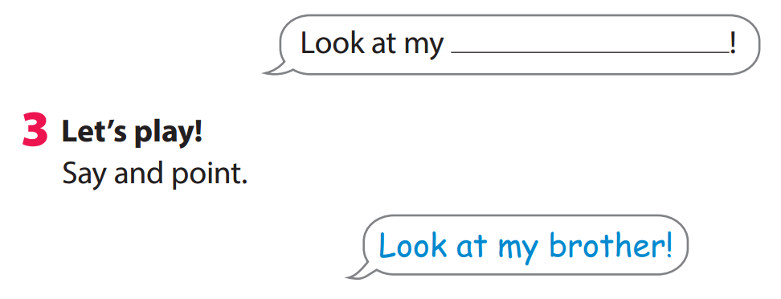


START
Notes:
Game: Point and say
- Ask students to work groups of four.
- One student looks at the photo in activity 2 and say Look at my ...! (e.g. Look at my mum!), and the other students have to quickly point at the person (e.g. mum) in the photo.
- The fastest student who points at the right person gets a point.
- Ask students to play in groups. Walk around and give help if necessary.
- Ask some volunteers to play in front of the whole class.

Slide 25
4. Production
Production
Let’s make and play with Finger Puppets
Notes:
Make and play with Finger Puppets
- Teacher can print and cut out the finger puppets.
- Ask students to draw faces and color in the puppets. Attach the puppets to each students' fingers by taping the straps around the finger.
- Check students’ understand which puppet is which.
- Play a quick game: Teacher says "Wiggle the sister" and everyone has to quickly wiggle the right one.

Slide 26

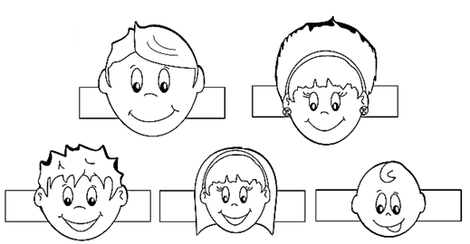

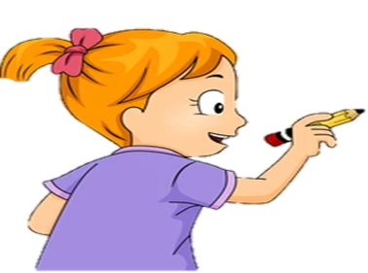
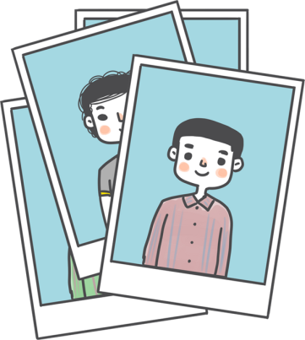
paper
1
draw and color
2

Slide 27

3
make family puppets

Slide 28
4
Let’s sing and play!

Slide 29
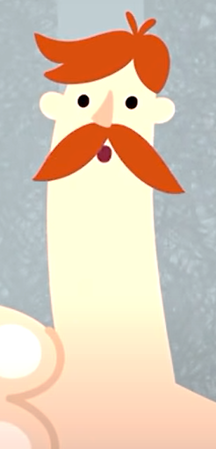


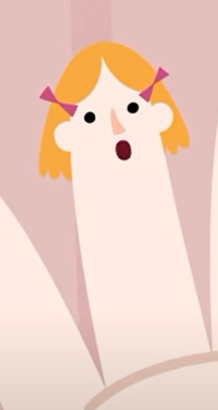
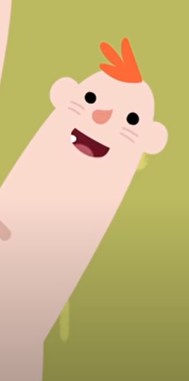

Slide 30



5 . Assessment
Assessment
Notes:
THIẾT KẾ HOẠT ĐỘNG TƯƠNG TÁC CHO CÁC CÂU HỎI TỪ SLIDE 31 ĐẾN 35
Game: Choose the correct answer

Slide 31




A. mum
B. dad
C. cool
D. sister
Notes:
Key: A

Slide 32

A. sister
B. brother
C. dad
D. family
Notes:
Key: C

Slide 33
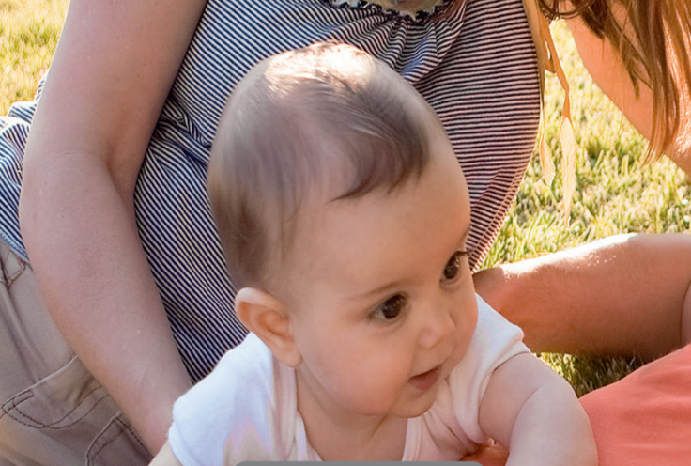
A. sister
B. brother
C. dad
D. family
Notes:
Key: A

Slide 34
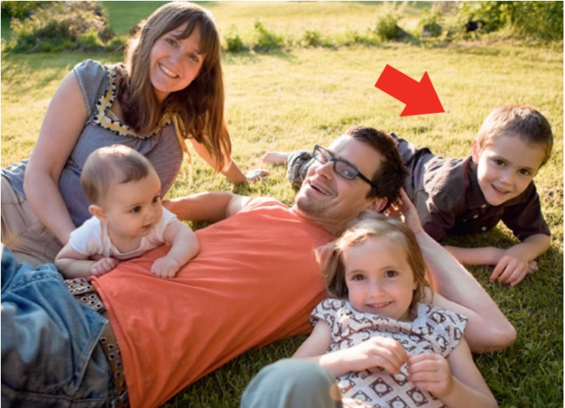
A. cool
B. family
C. mum
D. brother
Notes:
Key: B

Slide 35
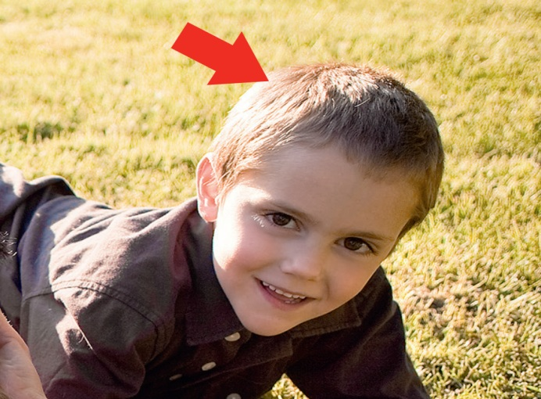
A. mum
B. sister
C. dad
D. brother
Notes:
Key: D

Slide 36


Bring your family photo!

Slide 37
Goodbye!

