Slide 1
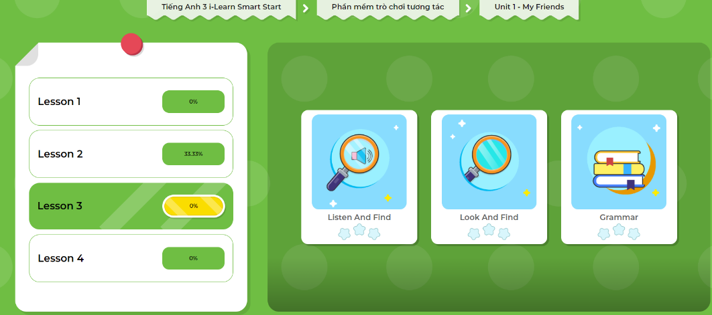
Extra- DHA app.
Click here to play the games

Slide 2
Lesson Outline
Warm-up
Structure
Consolidation
Wrap-up

Slide 3
Objectives
By the end of this lesson, students will be able to ask what their friends like doing, using:
Vocabulary: dancing, singing, drawing, reading, painting
Structure: Do your friends like dancing?
Yes, they do./No, they don't.

Slide 4

WARM UP

Slide 5
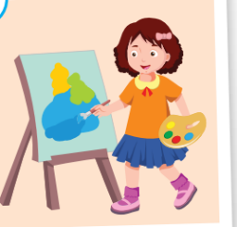


Save the animals!
Notes:
Click the sun so show picture.
Click the first box to drop them down.
Click the animal to let it go through the boxes.
Ask students to say the word, make question and answer.
Aim: review vocabs and structures.

Slide 6



Save the animals!
Notes:
Click the sun so show picture.
Click the first box to drop them down.
Click the animal to let it go through the boxes.
Ask students to say the word, make question and answer.
Aim: review vocabs and structures.

Slide 7
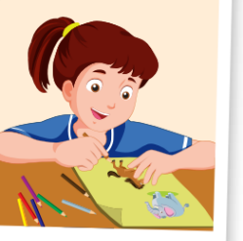


Save the animals!
Notes:
Click the sun so show picture.
Click the first box to drop them down.
Click the animal to let it go through the boxes.
Ask students to say the word, make question and answer.
Aim: review vocabs and structures.

Slide 8



Save the animals!
Notes:
Click the sun so show picture.
Click the first box to drop them down.
Click the animal to let it go through the boxes.
Ask students to say the word, make question and answer.
Aim: review vocabs and structures.

Slide 9
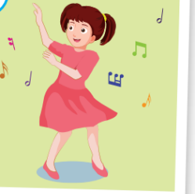


Save the animals!
Notes:
Click the sun so show picture.
Click the first box to drop them down.
Click the animal to let it go through the boxes.
Ask students to say the word, make question and answer.
Aim: review vocabs and structures.

Slide 10

Structures
Do your friends like dancing?
Yes, they do.
Do your friends like singing?
No, they don’t.

Slide 11







Let’s go to the beach!
1
2
3
4
5
Notes:
Click the numbers to lead to diffferent pictures

Slide 12

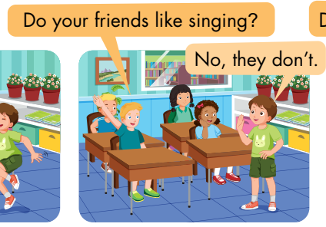
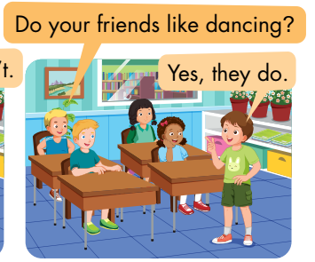
Activity 1
F
Play the Pretend game.
A student does the action for a word.
Other students guess by asking questions.
The student answer “Yes” when others guess it right.
Notes:
Click the stars to show pictures quickly. Get students to pay attention and fill in the blank to ask question about the picture.

Slide 13
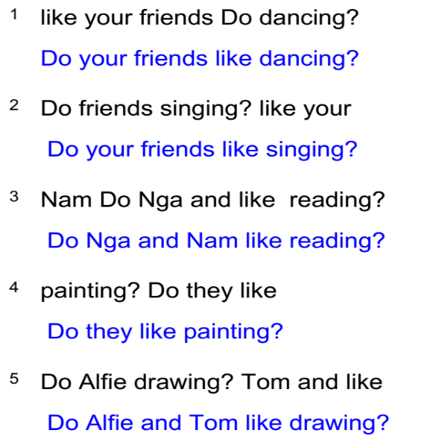
Activity 2
Unscramble the sentences.
Notes:
Click the stars to show pictures quickly. Get students to pay attention and fill in the blank to ask question about the picture.

Slide 14
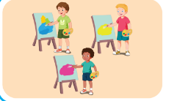



Activity 3
Look, read and fill in the blanks.
1
These are my friends Nick, Tom and Alex.
They like …………...
2
They are Kim and Lucy. They are in the classroom.
They like ………………
painting
drawing
3
Quan and Tom are my friends. They are …………….. books.
They like………………
4
Can you see two people in this picture? They are………………
Nick and Lucy like………………
reading
singing
reading
singing
Notes:
Click to show one by one part.

Slide 15
Extra- DHA app.
Click here to play the games

