Slide 1

Unit 1: My Friends
Lesson 2
Page 15

Slide 2
Lesson Outline
Warm-up
Structure
Consolidation
Wrap-up

Slide 3
Objectives
By the end of this lesson, students will be able to practice and use …..
Vocabulary: the USA, the UK, Italy, India, Japan, Alpha
Structure: Where are you from?
I'm from the USA.
Where's she from?
She's from Japan.
Aim: Students will be able to ask where people are from.

Slide 4

WARM UP

Slide 5






Mystery Circles





1
2
3
4
5

Slide 6

It’s time to learn …

Slide 7

Structure
Where are you from?
I’m from…
Where’s she/he from?
She’s/He’s from…

Slide 8

Welcome to Fruit World!
1
7
6
2
3
4
5
Notes:
Instructions:
Introduce that this is a magic tree with a lot of fruit. They will choose one by one to open the question and they have to answer is to get points.
There’s an extra question related to the lesson. Who can open and answer it get the most point.
Click on the numbers to move to the questions.

Slide 9

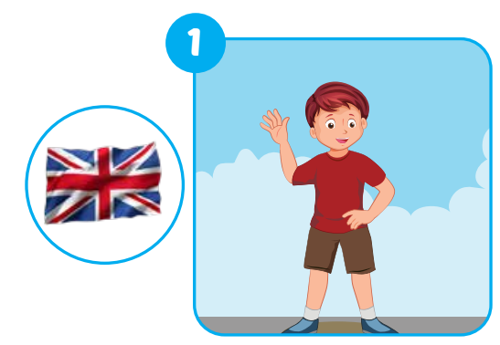



E
Point, ask and answer.
Where’s he from?
He’s from the UK.
Notes:
Instructions:
Ask “ Is it a girl or a boy?”
If it’s a boy, Students say: a boy -> teacher open the boy’s picture and get students to say: “Where’s he from?” -> let students guess where the person is from.
If it’s a girl, Students say: a girl -> teacher open the girl’s picture and get students to say: “Where’s she from?”-> let students guess where the person is from.
Teacher open the picture of the flag and check students’ answer.
Get all students to practice asking and answering the question.
Click the button to comeback
Click on the icons to show question and answer.

Slide 10
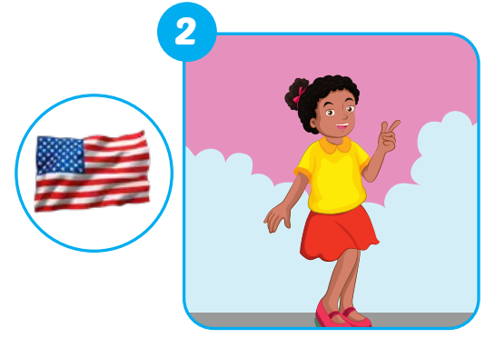


E
Point, ask and answer.
Where’s she from?
She’s from the USA.
Notes:
Instructions:
Ask “ Is it a girl or a boy?”
If it’s a boy, Students say: a boy -> teacher open the boy’s picture and get students to say: “Where’s he from?” -> let students guess where the person is from.
If it’s a girl, Students say: a girl -> teacher open the girl’s picture and get students to say: “Where’s she from?”-> let students guess where the person is from.
Teacher open the picture of the flag and check students’ answer.
Get all students to practice asking and answering the question.

Slide 11
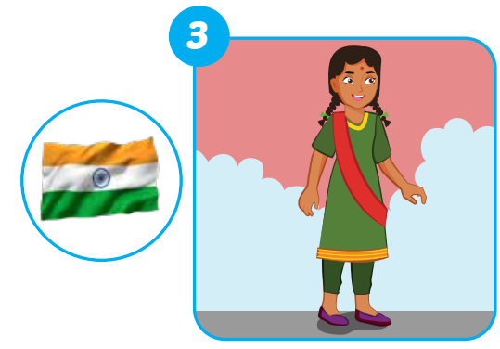


E
Point, ask and answer.
Where’s she from?
She’s from India.
Notes:
Instructions:
Ask “ Is it a girl or a boy?”
If it’s a boy, Students say: a boy -> teacher open the boy’s picture and get students to say: “Where’s he from?” -> let students guess where the person is from.
If it’s a girl, Students say: a girl -> teacher open the girl’s picture and get students to say: “Where’s she from?”-> let students guess where the person is from.
Teacher open the picture of the flag and check students’ answer.
Get all students to practice asking and answering the question.

Slide 12
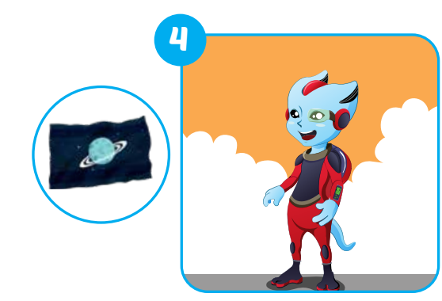


E
Point, ask and answer.
Where’s he from?
He’s from Alpha.
Notes:
Instructions:
Ask “ Is it a girl or a boy?”
If it’s a boy, Students say: a boy -> teacher open the boy’s picture and get students to say: “Where’s he from?” -> let students guess where the person is from.
If it’s a girl, Students say: a girl -> teacher open the girl’s picture and get students to say: “Where’s she from?”-> let students guess where the person is from.
Teacher open the picture of the flag and check students’ answer.
Get all students to practice asking and answering the question.

Slide 13
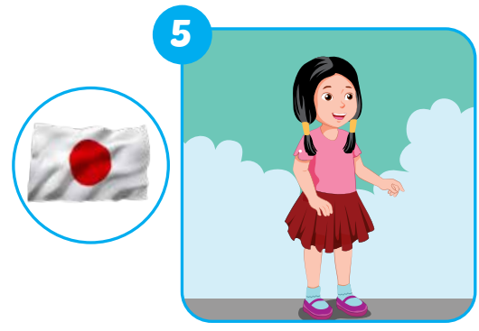


E
Point, ask and answer.
Where’s she from?
She’s from Japan.
Notes:
Instructions:
Ask “ Is it a girl or a boy?”
If it’s a boy, Students say: a boy -> teacher open the boy’s picture and get students to say: “Where’s he from?” -> let students guess where the person is from.
If it’s a girl, Students say: a girl -> teacher open the girl’s picture and get students to say: “Where’s she from?”-> let students guess where the person is from.
Teacher open the picture of the flag and check students’ answer.
Get all students to practice asking and answering the question.

Slide 14
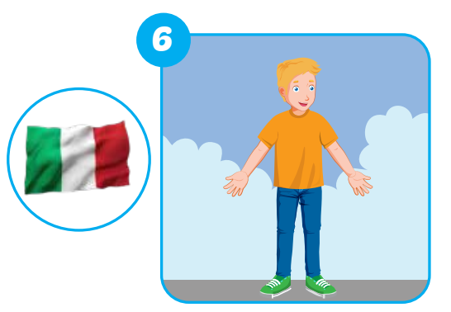
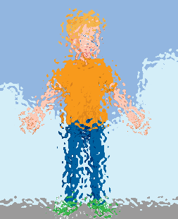

E
Point, ask and answer.
Where’s he from?
He’s from Italy.
Notes:
Instructions:
Ask “ Is it a girl or a boy?”
If it’s a boy, Students say: a boy -> teacher open the boy’s picture and get students to say: “Where’s he from?” -> let students guess where the person is from.
If it’s a girl, Students say: a girl -> teacher open the girl’s picture and get students to say: “Where’s she from?”-> let students guess where the person is from.
Teacher open the picture of the flag and check students’ answer.
Get all students to practice asking and answering the question.

Slide 15

E
Point, ask and answer.
Where are you from?
I’m from Vietnam.
Notes:
This is the extra question from this part.
They can choose to be in any country as they want. It doesn’t have to be in Vietnam.

