Slide 1

Unit 5: Sports and hobbies
P.E. Lesson 4.3
Page 79

Slide 2
Lesson Outline
Warm-up
Reading
Writing
Consolidation
Wrap-up

Slide 3
Objectives
By the end of this lesson, students will be able to talk about what they can use and what they can do / can’t do in some sports, using
Vocabulary: hand, arm, foot/feet, leg, head, body
Structure:
I use my legs and feet in soccer.
I can kick the ball in soccer.
I can't kick the ball in basketball.

Slide 4

WARM UP

Slide 5


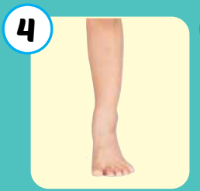

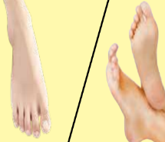
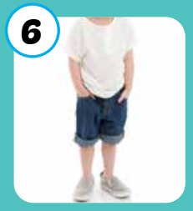
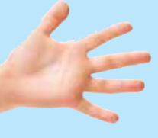
1
2
3
4
Click on the square to see the picture
5
6
7
8
Click on the button to close the picture
9
10
11
12
Notes:
Memory game. GV nhấn vào ô để mở, nếu HS chọn 2 hình không giống nhau, GV nhấn vào hình tròn để đóng hình lại, HS phải nhớ những hình đã mở.

Slide 6

It’s time to learn …

Slide 7

Reading

Slide 8
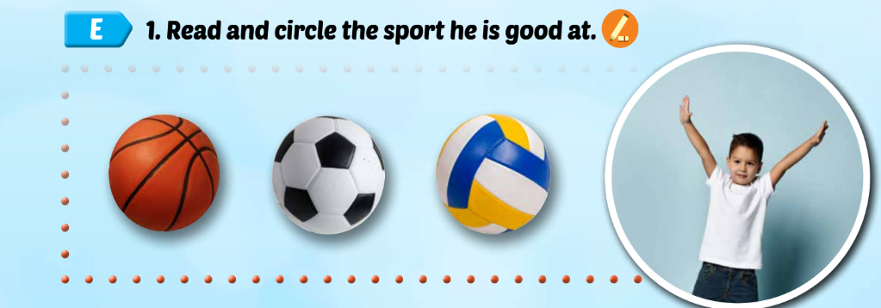


My favorite sport is basketball. I am good at playing basketball. I use my hands and arms. I can catch and throw the ball in basketball. I can’t kick the ball.

Slide 9

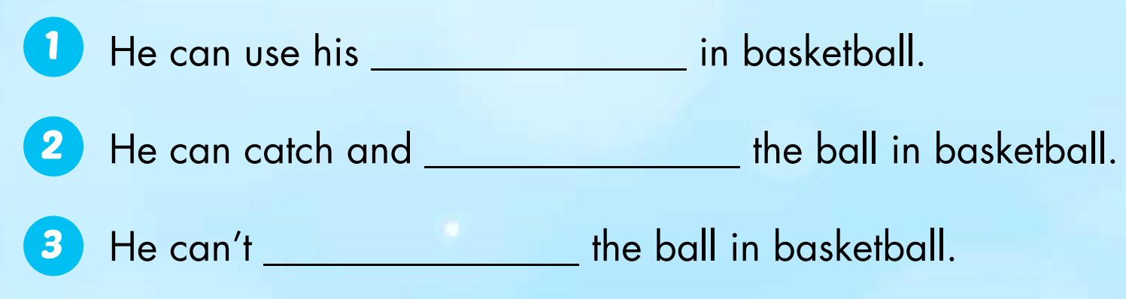
hands and arms
throw
kick

Slide 10

Writing

Slide 11

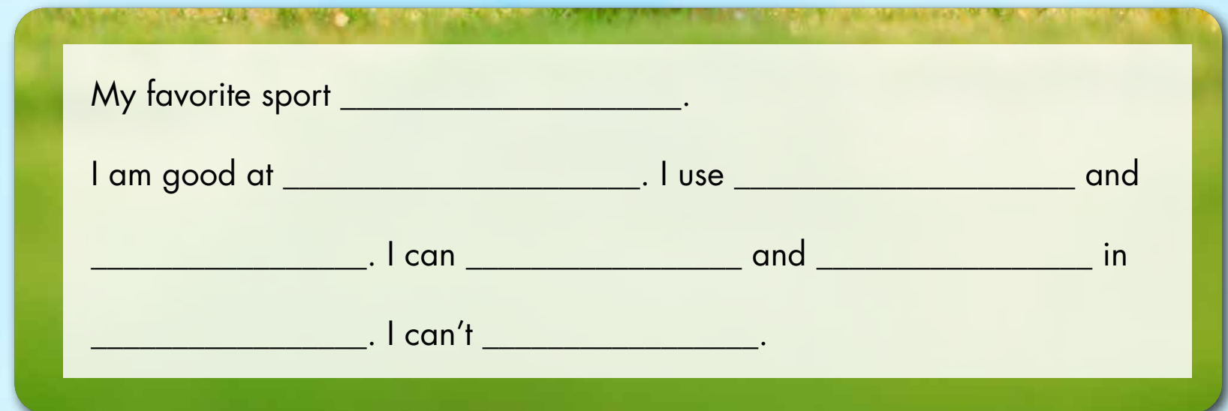

Slide 12

Production

Slide 13
1. Divide the class into fours.
2. Have students read their sentences to their group.
3. Afterwards, have some students read their sentences in front of the class.

Slide 14
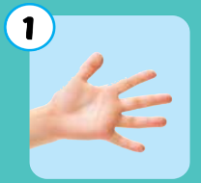
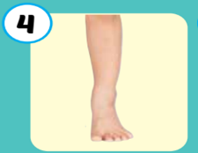

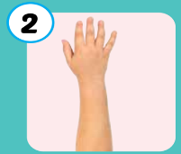

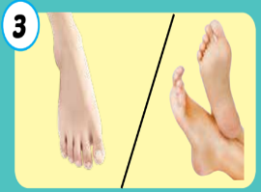
Practice writing sentences.
I use my ____in ____.
6
1
SPIN
5
2
4
3
Notes:
GV dùng vòng quay để HS chọn số ngẫu nhiên. Khi chọn vào ô số nào thì sẽ làm câu cho số đó

Slide 15

CONSOLIDATION

