Slide 1

Unit 5: Sports and hobbies
P.E. Lesson 4.1
Page 77

Slide 2
Lesson Outline
Warm-up
Vocabulary
Structure
Consolidation
Wrap-up

Slide 3
Objectives
By the end of this lesson, students will be able to talk about what they can use in some sports, what they can / can’t do, using
Vocabulary: hand, arm, foot/feet, leg, head,
body
Structure:
I use my legs and feet in soccer.
I can kick the ball in soccer.
I can't kick the ball in basketball.

Slide 4

WARM UP

Slide 5

I told
“I told”

Slide 6
HOW TO PLAY
The teacher said: "I told! I told!"
The students replied: "Told what? Told what?"
The teacher chooses an action: For example, "I told you to change positions.”
Students will follow the requested action by the teacher that begins with: "I told ...". As in this example, the students will exchange places.
If the teacher don't say “I told”, the students won't follow.
Anyone who does not follow the rules will be punished.

Slide 7

It’s time to learn …

Slide 8
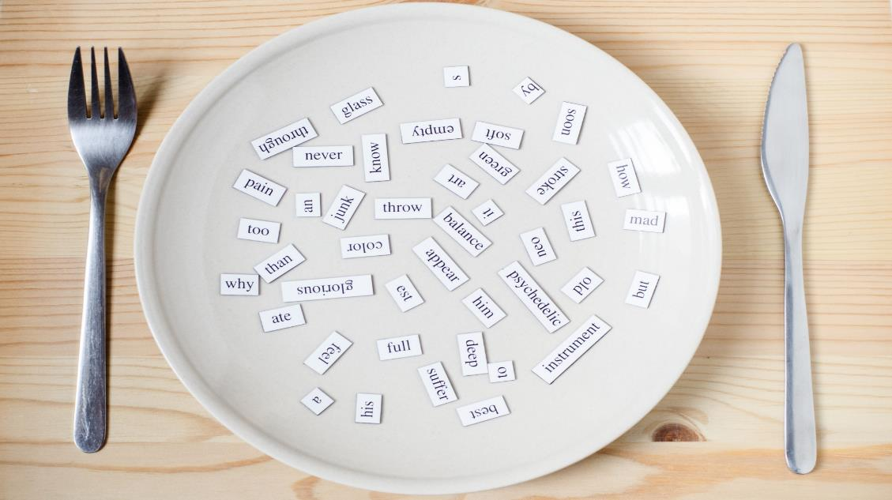
New words
hand
arm
foot/feet
leg
head
body

Slide 9

Presentation

Slide 10

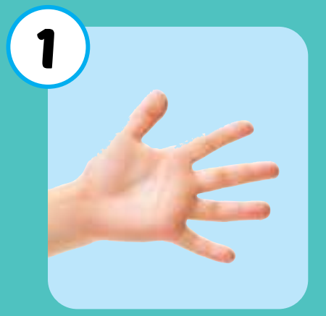

hand
/hænd/
bàn tay
Click on each word to hear the sound.

Slide 11
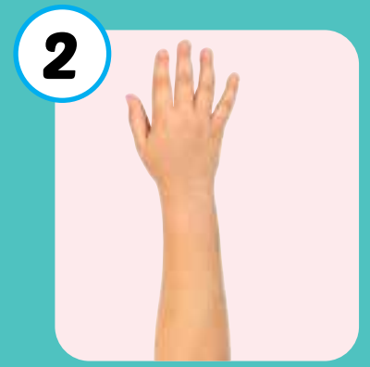
arm
/ɑːrm/
cánh tay
Click on each word to hear the sound.

Slide 12
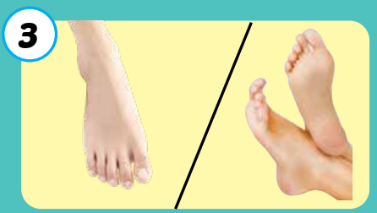
foot/feet
/fʊt/ /fiːt/
đôi bàn chân
Click on each word to hear the sound.

Slide 13
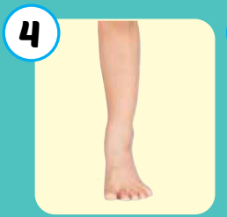
leg
/leɡ/
chân
Click on each word to hear the sound.

Slide 14

head
/hed/
đầu
Click on each word to hear the sound.

Slide 15
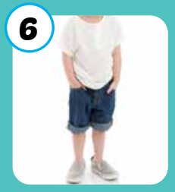
body
/ˈbɑːdi/
cơ thể
Click on each word to hear the sound.

