Slide 1

Unit 5: Sports and hobbies
Lesson 3.2
Page 75

Slide 2
Lesson Outline
Warm-up
Listening
Consolidation
Wrap-up

Slide 3
Objectives
By the end of this lesson, students will be able to pronounce the sound /tʃ / and talk about their school timetables.
Phonic: /tʃ /
Structure: May I watch TV?
- Yes, you may./No, you may not

Slide 4

WARM UP

Slide 5

Hidden
Pictures
Guessing
Game

Slide 6
HOW TO PLAY
Hidden Picture Games
- Ask students to choose a color.
Click on the colored shapes. This will reveal the hidden picture.
As the shapes disappear, students should try to guess the word.

Slide 7
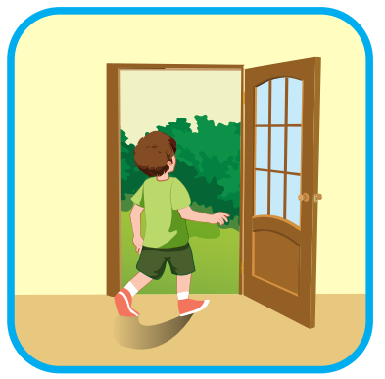

go out
SHOW

Slide 8

watch TV
SHOW

Slide 9

go swimming
SHOW

Slide 10
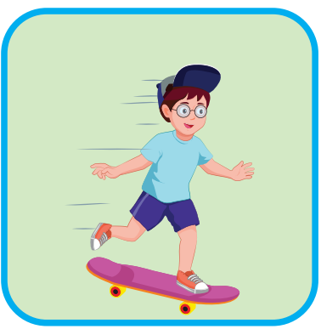
go skateboarding
SHOW

Slide 11

It’s time to learn …

Slide 12

Phonics
/tʃ/

Slide 13
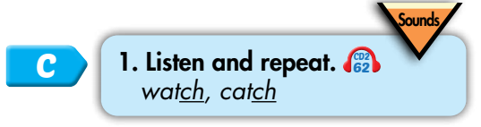

/tʃ/
watch
catch

Slide 14


/tʃ/, /tʃ/, /tʃ/,
/tʃ/, /tʃ/, /tʃ/,
watch, catch,
/tʃ/, /tʃ/, /tʃ/.
/tʃ/, /tʃ/, /tʃ/, /tʃ/, /tʃ/, /tʃ/, watch, catch, /tʃ/, /tʃ/, /tʃ/.
Click to follow the lyrics.
Notes:
GV click lần 1 để follow lyric 1
Gv click lần 2 để follow lyric 2

Slide 15

Listening

