Slide 1

Unit 5: Sports and hobbies
Lesson 2.3
Page 72

Slide 2
Lesson Outline
Warm-up
Listening
Consolidation
Wrap-up

Slide 3
Objectives
By the end of this lesson, students will be able to pronounce the sound /θ / and talk about their school timetables.
Phonic: /θ /
Structure: When do you have English? - I have English on Wednesdays and Fridays.

Slide 4

WARM UP

Slide 5


Choose a number and fill in the blank.
c_tching
thr_w_ng
1
2
a
o
i
k_c_ing
_itting
Click on each word to hear the sound.
3
i k
4
h
Click here to show answers.
1
2
3
4

Slide 6
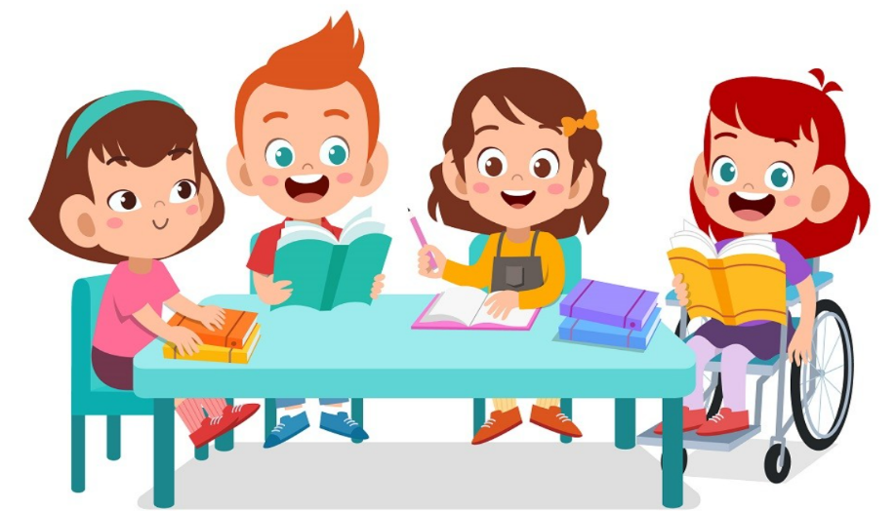
It’s time to learn …

Slide 7

Phonics
/θ/

Slide 8

/θ/
throwing
three
Click on each word to hear the sound.

Slide 9


/ θ /, / θ /, / θ /,
/ θ /, / θ /, / θ /,
throwing, three,
/ θ /, / θ /, / θ /
/ θ /, / θ /, / θ /,
/ θ /, / θ /, / θ /,
throwing, three,
/ θ /, / θ /, / θ /
Click to follow the lyrics.
Notes:
GV click lần 1 để follow lyric 1
Gv click lần 2 để follow lyric 2

Slide 10
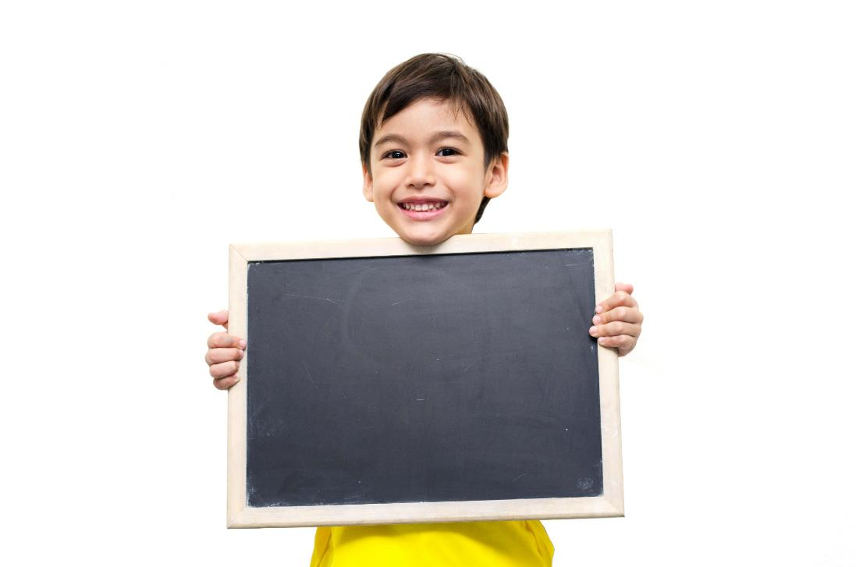
Listening

Slide 11

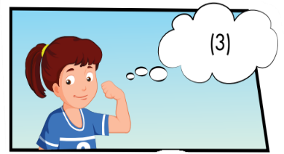
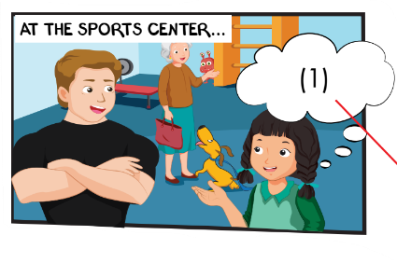
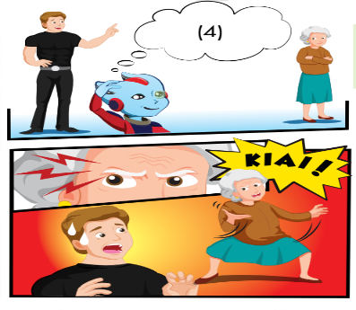
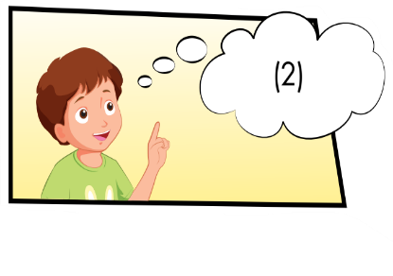
What actions can you see?
Who can you see?
What actions can you see?
How does the man feel?

Slide 12
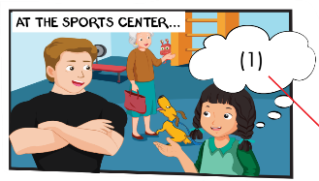
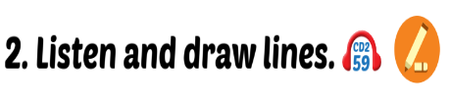
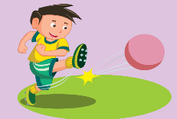
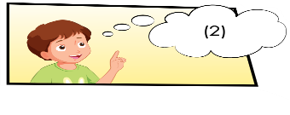
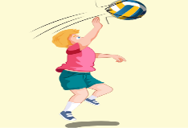
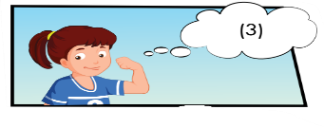
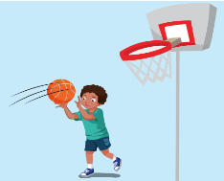
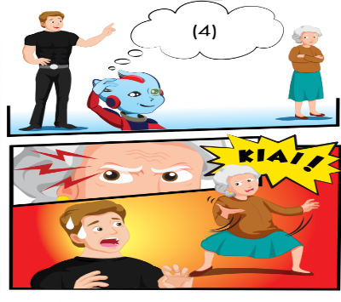
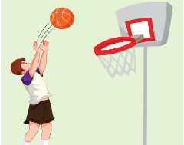
kicking, soccer
hitting balls, volleyball
catching, basketball
throwing,basketball

Slide 13
Click on the number to hear the sound
James: What are you good at, Mai? Mai: I’m good at James: Good. You can play with the team
1
Kicking.
soccer
James: What are you good at, Tom? Tom: I’m good at James: OK. for you.
2
catching.
Basketball

Slide 14
James: What about you, Lucy? Lucy: I’m good at .See? James: Lucy, the team.
3
hitting balls
volleyball
Click on the number to hear the sound

Slide 15
James: Alfie, what are you good at? Alfie: I’m good at balls. James: Good. team. OK, Grandma? What are you good at? Grandma: I’m good at doing this! Kiai! Children: Wow!
throwing
Basketball
4
Click on the number to hear the sound

