Slide 1

Unit 5: Sports and hobbies
Lesson 2.1
Page 71

Slide 2
Lesson Outline
Warm-up
Vocabulary
Structure
Consolidation
Wrap-up

Slide 3
Objectives
By the end of this lesson, students will be able to…
Vocabulary: hitting, kicking, catching, throwing
Structure: What are you good at?
- I'm good at kicking.

Slide 4

WARM UP

Slide 5

Swap positions

Slide 6
How to play
The students stand in a circle (or sit on the circle of chairs), except for one student (or the teacher), who stands in the middle. Each student must have a fixed position.
The person in the middle says a sentence that starts with Change positions if you… and ends with some condition (e.g. …have curly hair).
If that condition is true for a student, they have to stand up and find a new position as quickly as possible.
Students who can't find swap positions will be penalized.

Slide 7
1. Change positions if you’re wearing black shoes.
2. Change positions if you have short hair.
3. Change positions if you’re wearing a watch.
4. Change positions if you have curly hair.
5. Change positions if you’re wearing glasses.

Slide 8
6. Change positions if the first letter of your name is H.
7. Change positions if the last letter of your name is N.
8. Change positions if you’re wearing a white shoes.
9. Change positions if you have long hair.
10. Change positions if you love your teacher.

Slide 9

It’s time to learn …

Slide 10
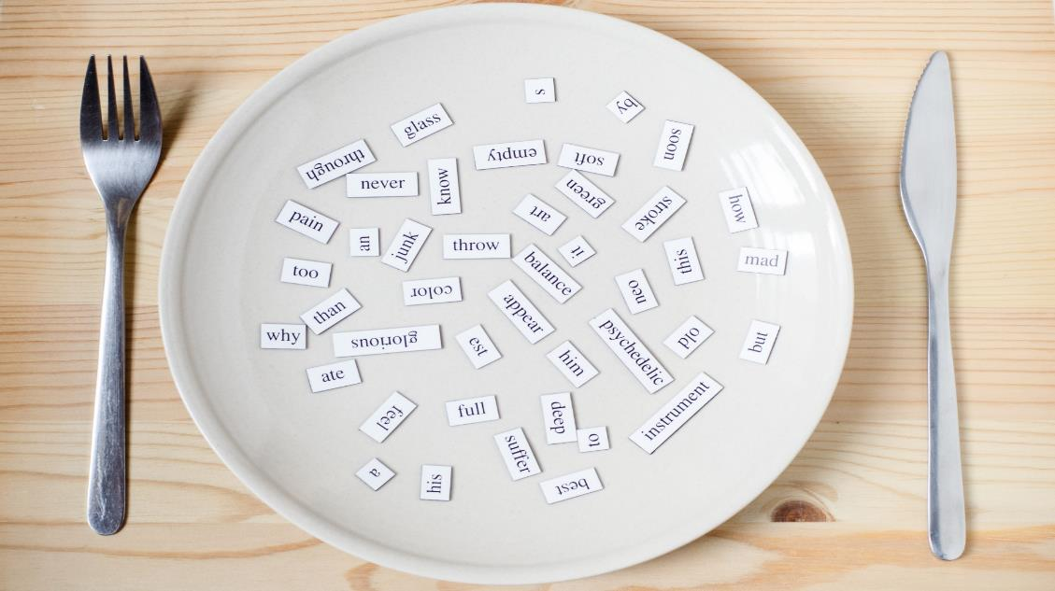
New words
hitting
kicking
catching
throwing

Slide 11

Presentation

Slide 12


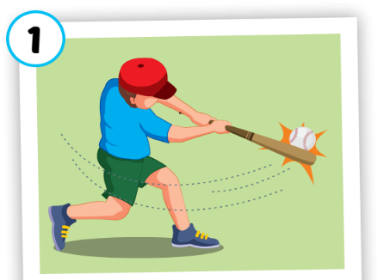
hitting
/ˈhɪtɪŋ/
đánh
Click on each word to hear the sound.

Slide 13
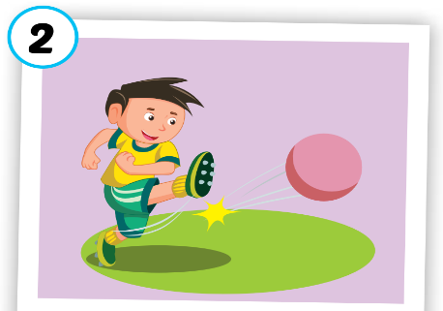
kicking
/ˈkɪkɪŋ/
đá
Click on each word to hear the sound.

Slide 14
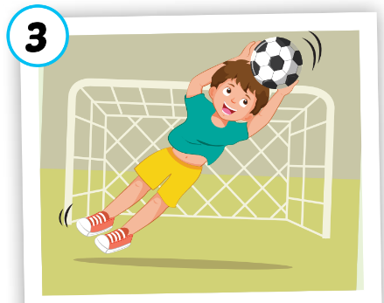
catching
/ˈkætʃɪŋ/
bắt
Click on each word to hear the sound.

Slide 15
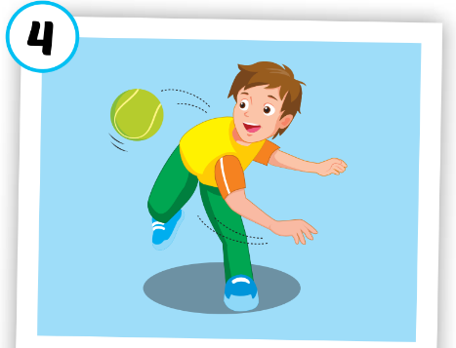
throwing
/ˈθrəʊɪŋ/
ném
Click on each word to hear the sound.

