Slide 1

Unit 5: Sports and hobbies
Lesson 1.3
Page 70

Slide 2
Lesson Outline
Warm-up
Practice
Speaking
Consolidation
Wrap-up

Slide 3
Objectives
By the end of this lesson, students will be able to…
Vocabulary: badminton, tennis, volleyball, basketball, soccer
Structure: Can you play soccer?
- Yes, I can./No, I can't.

Slide 4

WARM UP

Slide 5

Hidden
Pictures
Guessing
Game

Slide 6
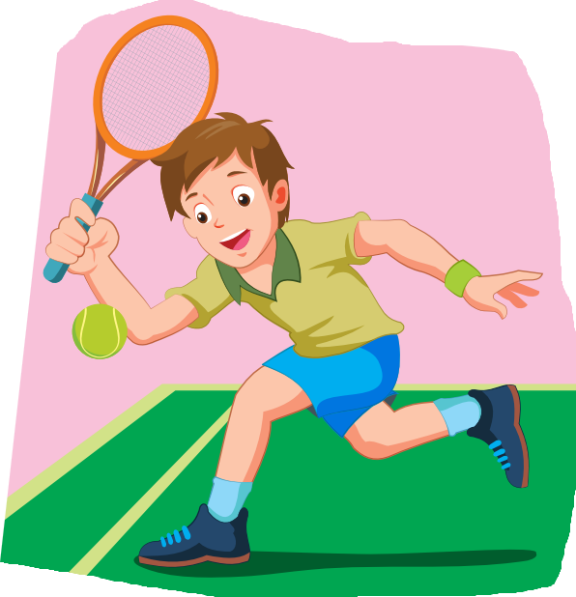
tennis

Slide 7
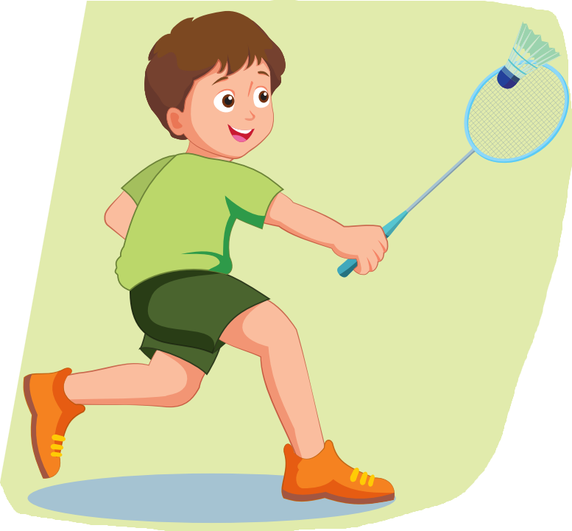
badminton

Slide 8
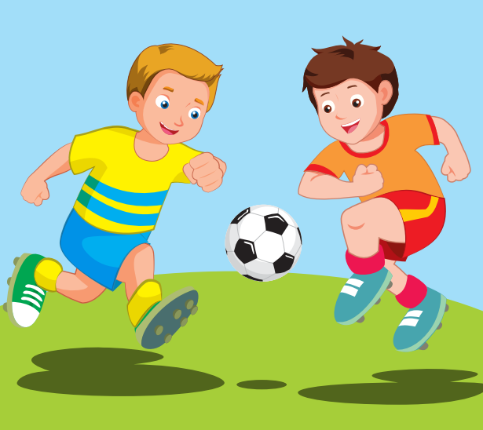
soccer

Slide 9

basketball

Slide 10
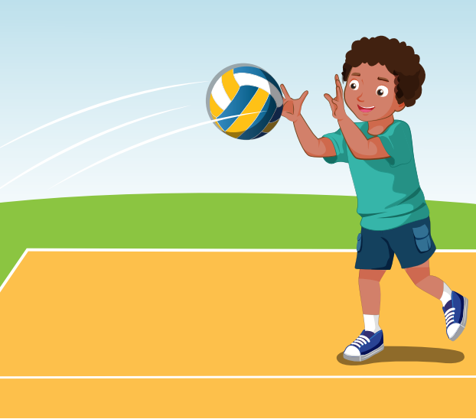
volleyball

Slide 11

It’s time to learn …

Slide 12

Practice

Slide 13

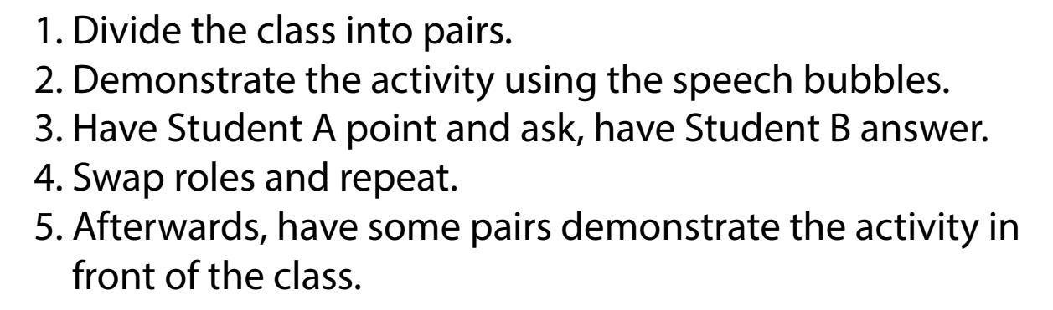

Slide 14

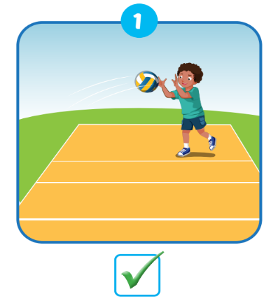
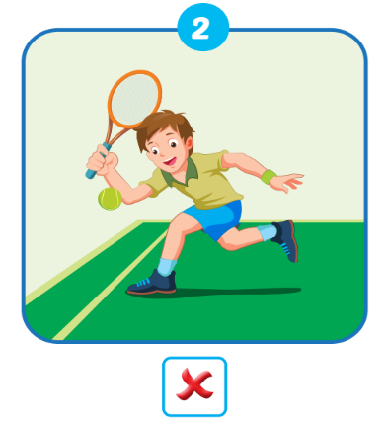
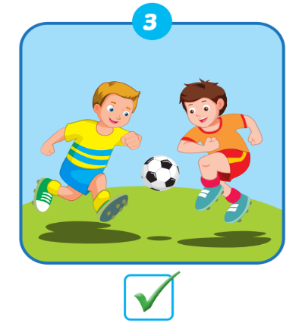

Slide 15
