Slide 1

Unit 5: Sports and hobbies
Lesson 1.2
Page 69

Slide 2
Lesson Outline
Warm-up
Listening
Consolidation
Wrap-up

Slide 3
Objectives
By the end of this lesson, students will be able to…
Vocabulary: badminton, tennis, volleyball, basketball, soccer
Structure: Can you play soccer?
- Yes, I can./No, I can't.

Slide 4

WARM UP

Slide 5
Vocabulary Review

Slide 6
iodmbntan
b | a | d | m | i | n | t | o | n

Slide 7
cosrec
s | o | c | c | e | r

Slide 8
tsnnie
t | e | n | n | i | s

Slide 9
ovlblylale
v | o | l | l | e | y | b | a | l | l

Slide 10
absletbakl
b | a | s | k | e | t | b | a | l | l

Slide 11

It’s time to learn …

Slide 12

Listening

Slide 13
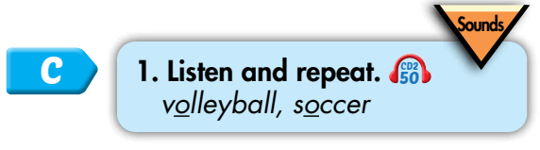

/ɑː/
volleyball
soccer
Click on each word to hear the sound.

Slide 14



/ɑː/, /ɑː/, /ɑː/, /ɑː/, /ɑː/, /ɑː/, volleyball, soccer, /ɑː/, /ɑː/, /ɑː/.
/ɑː/, /ɑː/, /ɑː/,
/ɑː/, /ɑː/, /ɑː/,
volleyball, soccer,
/ɑː/, /ɑː/, /ɑː/.
Click to follow the lyrics.

Slide 15
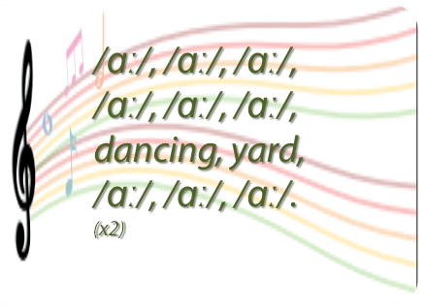
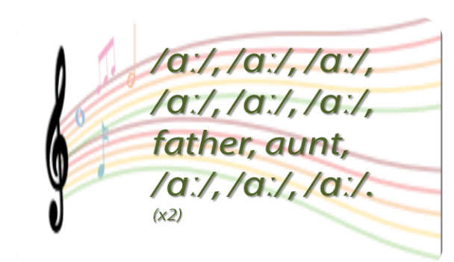
Do a similar chant. 🎤
Click on the circle to open the chant
/ɑː/
🎤
🎤

