Slide 1

Unit 5: Sports and hobbies
Lesson 1.1
Page 68

Slide 2
Lesson Outline
Warm-up
Vocabulary
Structure
Consolidation
Wrap-up

Slide 3
Objectives
By the end of this lesson, students will be able to…
Vocabulary: badminton, tennis, volleyball, basketball, soccer
Structure: Can you play soccer?
- Yes, I can./No, I can't.

Slide 4

WARM UP

Slide 5




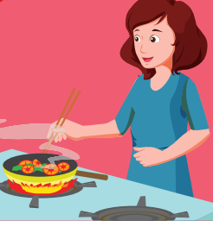
Crossword Puzzle
1
H | O | U | S | E
Click the boxes to show the answer.
2
W | A | K | E | U | P
3
C | O | O | K | I | N | G
4
M | O | T | H | E | R
5
N | O | T | E | B | O | O | K
Double click on the number to open the hint.
Click again on the number to close the hint.
KEYWORD

Slide 6

It’s time to learn …

Slide 7
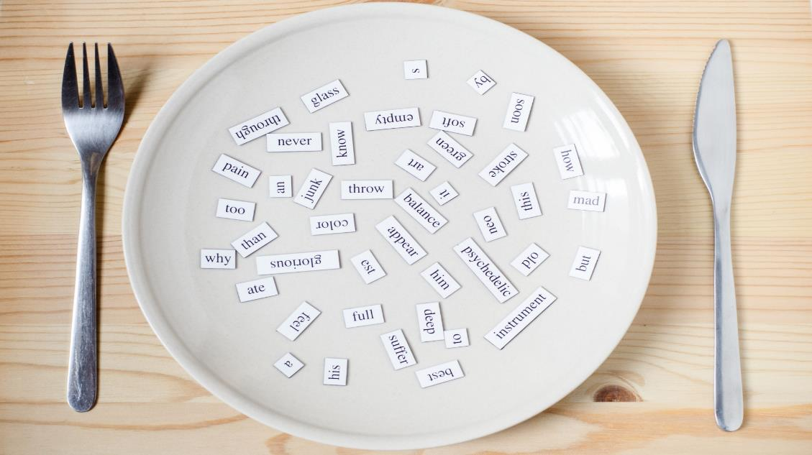
New words
badminton
tennis
volleyball
basketball
soccer

Slide 8

Presentation

Slide 9


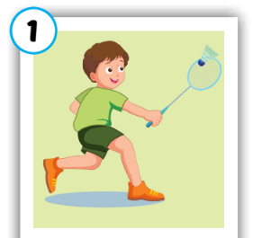
Click on each word to hear the sound.
badminton
/ˈbædmɪntən/
cầu lông

Slide 10
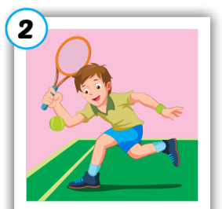
Click on each word to hear the sound.
tennis
/ˈtenɪs/
quần vợt

Slide 11
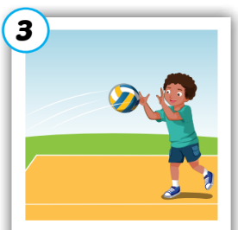
Click on each word to hear the sound.
volleyball
/ˈvɑːlibɑːl/
bóng chuyền

Slide 12
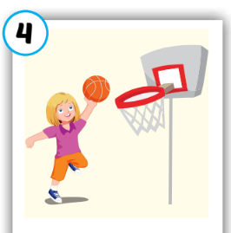
Click on each word to hear the sound.
basketball
/ˈbæskɪtbɑːl/
bóng rổ

Slide 13
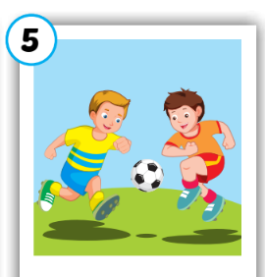
Click on each word to hear the sound.
soccer
/ˈsɑːkər/
bóng đá

Slide 14
Click on each word to hear the sound.
badminton
tennis
volleyball
basketball
soccer
/ˈbædmɪntən/
cầu lông
/ˈtenɪs/
quần vợt
/ˈvɑːlibɑːl/
bóng chuyền
/ˈbæskɪtbɑːl/
bóng rổ
/ˈsɑːkər/
bóng đá

Slide 15

Practice

