Slide 1
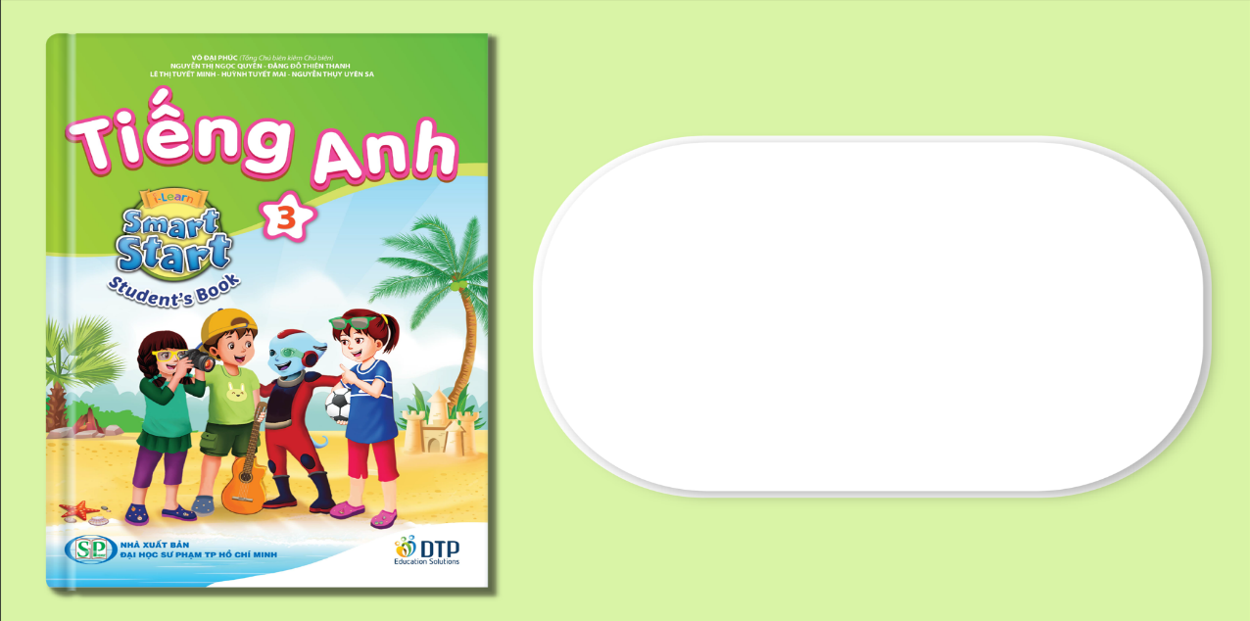
Unit 4: HOME
Lesson 4.3
Page 63

Slide 2
Lesson Outline
Warm-up
Reading
Writing
Consolidation
Wrap-up

Slide 3
Objectives
By the end of this lesson, students will be able to read a text about one’s home and write a short paragraph about their home.
Vocabulary:
Revision (words about colors and things in a house).
Structure: - I have a desk in my bedroom.
- I love my bedroom. It is pink.
It has a picture in it.

Slide 4

WARM UP

Slide 5
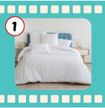
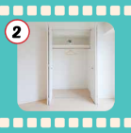
Guessing game.
Where is a bed ?
Notes:
Choose which safe to get the right answer. E.g.: (Where is a bed? It’s in the brown safe.) That’s right. What color is it? It’s blue.

Slide 6
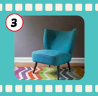

Guessing game.
Where is a chair ?

Slide 7
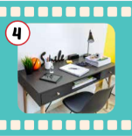
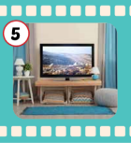
Guessing game.
Where is a TV ?

Slide 8

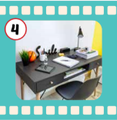
Guessing game.
Where is a desk?

Slide 9

It’s time to learn …

Slide 10

Reading

Slide 11

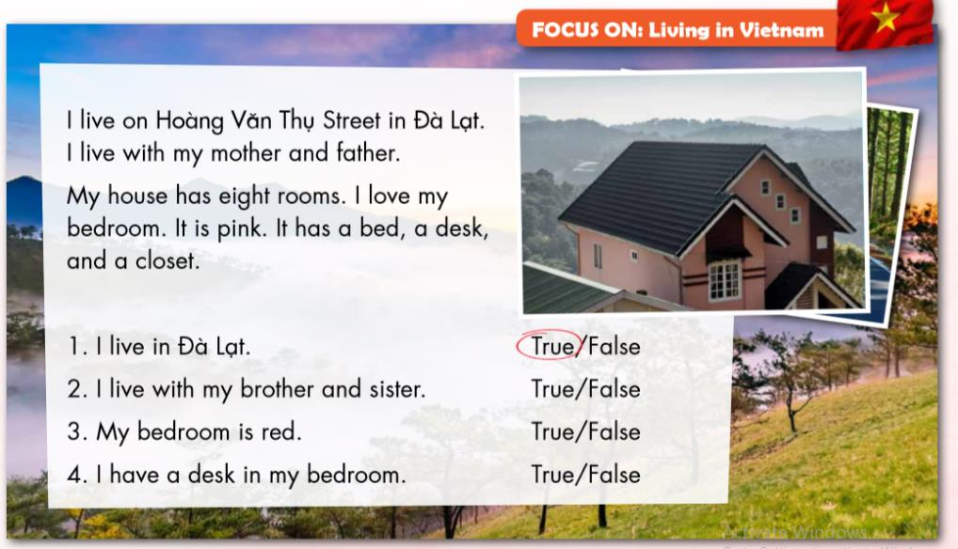

Slide 12


