Slide 1

Unit 4: HOME
Lesson 3.3
Page 60

Slide 2
Lesson Outline
Warm-up
Practice
Speaking
Consolidation
Wrap-up

Slide 3
Objectives
By the end of this lesson, students will be able to ask where people are.
Vocabulary: Revision (bedroom, bathroom, living room, kitchen, yard).
Structure: Where’s Tom? He’s in the living room.
Where’s Grandma? She’s in the bathroom.

Slide 4

WARM UP

Slide 5
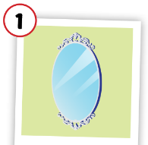
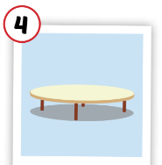
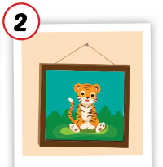
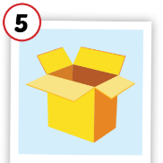
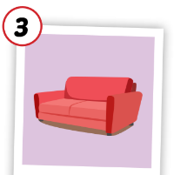
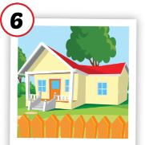
Matching the picture with its meaning.
table
picture
house
mirror
sofa
box

Slide 6

It’s time to learn …

Slide 7

Practice

Slide 8

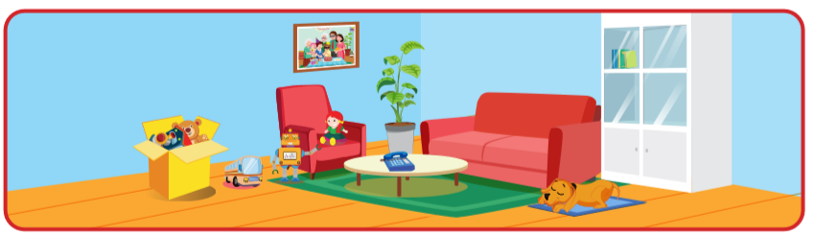
Is the table in the living room?
Yes, it is.

Slide 9
Is the mirror in the living room?
No, it isn’t.

Slide 10
Is the box in the living room?
Yes, it is.

Slide 11
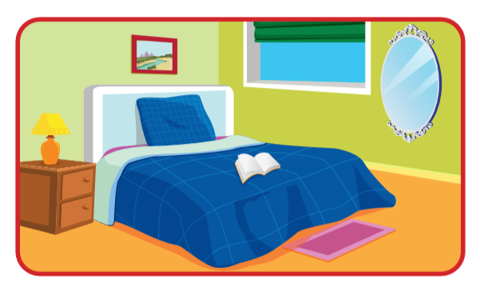
Is the mirror in the living room?
Yes, it is.

Slide 12
Is the picture in the bedroom?
Yes, it is.

Slide 13
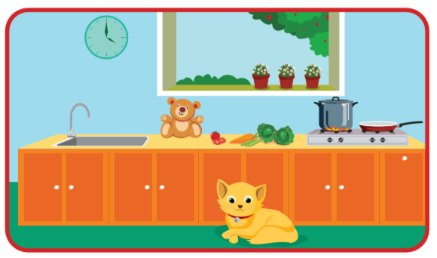
Is the cat in the kitchen?
Yes, it is.

Slide 14

Speaking

Slide 15
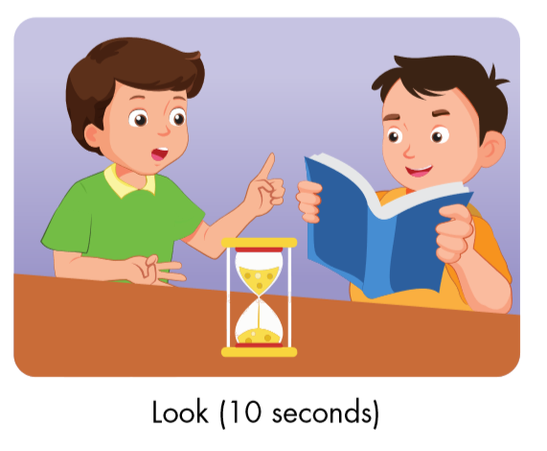
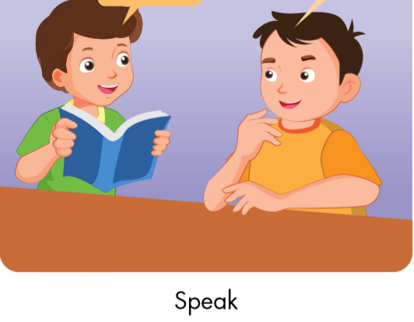
Is the cat in the bedroom?
No, it isn’t.
Correct.

