Slide 1

Unit 4: HOME
Lesson 3.2
Page 59

Slide 2
Lesson Outline
Warm-up
Listening
Consolidation
Wrap-up

Slide 3
Objectives
By the end of this lesson, students will be able to ask where things are.
Vocabulary: Revision
mirror, picture, sofa, table, box, house.
Structure: Revision
Is the picture in the living room? Yes, it is.
Is the cat in the house? No, it isn’t.

Slide 4

WARM UP

Slide 5
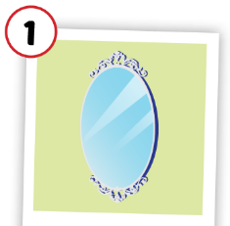
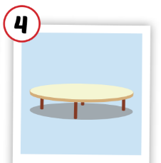
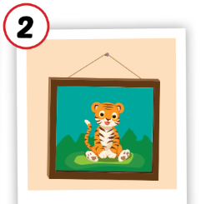
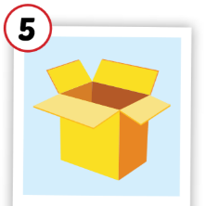
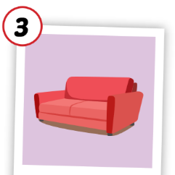
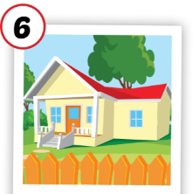
1
4
6
1
2
5
SPIN
5
2
3
4
3
6

Slide 6

It’s time to learn …

Slide 7

Listening

Slide 8

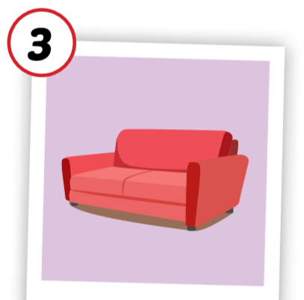
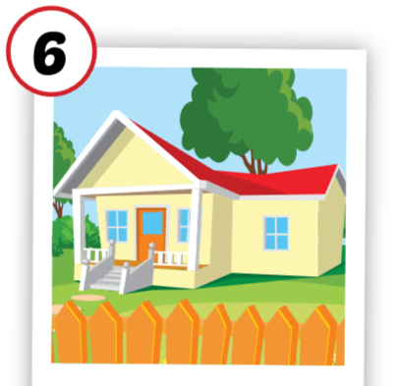

C. 1. Listen and repeat.
1
2
sofa
house

Slide 9


C. 2. Chant.
Click on the earphone to practice the chant.
/əʊ/, /aʊ/, /əʊ/
sofa
/əʊ/, /aʊ/, /əʊ/
house
/əʊ/, /aʊ/, /əʊ/

Slide 10

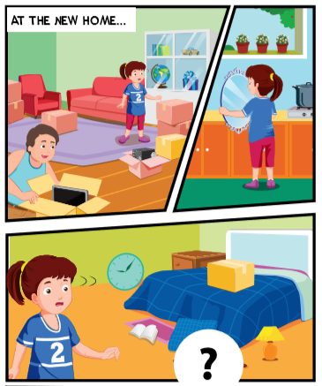
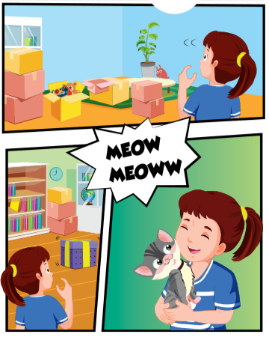

Slide 11



1
4
3
2

Slide 12


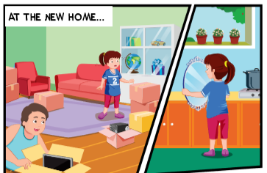
Can I help you, Daddy?
Yes, please, Lucy. Can you help me find some things?
Sure, Daddy.
Is the in the kitchen, Lucy ?
mirror
Yes, it is. Here you are ?

Slide 13
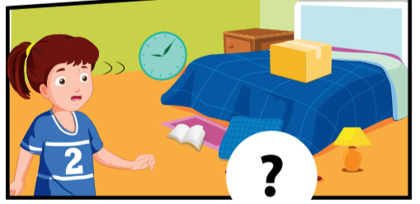
Is the in the bedroom ?
picture
Let me see. Yes, it is.
That’s great.

Slide 14
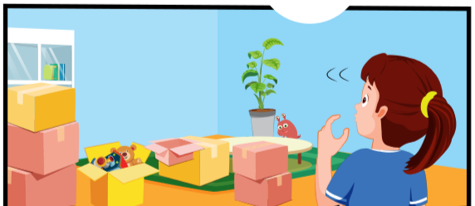
Is the in the living room ?
sofa
Oh, no, it isn’t.
That’s OK. We can find it later.

Slide 15
Is the in the living room ?
table
No, it isn’t.
OK. Do you see a box?
Yes.
Look in the box, Lucy.
Wow! Daddy! There’s a little cat.
It’s for you! Welcome to our new house!

