Slide 1

Unit 4: HOME
Lesson 2.3
Page 57

Slide 2
Lesson Outline
Warm-up
Practice
Speaking
Consolidation
Wrap-up

Slide 3
Objectives
By the end of this lesson, students will be able to ask where people are.
Vocabulary: Revision (cleaning, playing, eating, sleeping, cooking).
Structure: Revision
Where’s Dan? He’s in the yard.
What’s he doing? He’s sleeping.

Slide 4

WARM UP

Slide 5
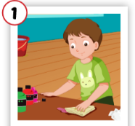
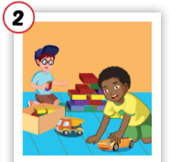
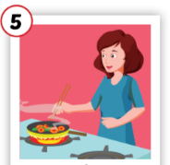
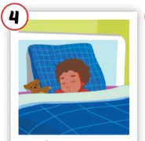
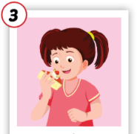
1
2
3
4
5
eating
cleaning
6
8
9
7
10
playing
sleeping
cooking

Slide 6

It’s time to learn …

Slide 7

Practice

Slide 8

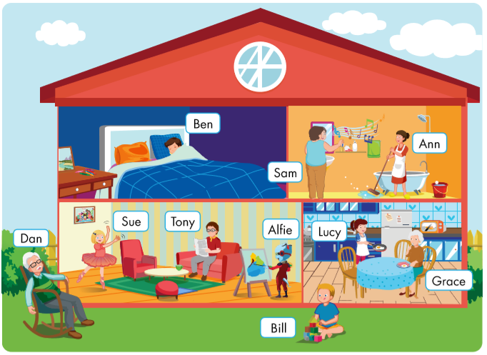
Where’s Dan?
What’s he doing?
He’s in the yard.
He’s sleeping.

Slide 9
Where’s Bill?
What’s he doing?
He’s in the yard.
He’s playing.

Slide 10
Where’s Ben?
What’s he doing?
He’s in the bedroom.
He’s sleeping.

Slide 11
Where’s Sue?
What’s she doing?
She’s in the living room.
She’s dancing.

Slide 12
Where’s Tony?
What’s he doing?
He’s in the living room.
He’s reading.

Slide 13
Where’s Alfie?
What’s he doing?
He’s in the living room.
He’s drawing.

Slide 14
Where’s Sam?
What’s she doing?
She’s in the bathroom.
She’s singing.

Slide 15
Where’s Ann?
She’s in the bathroom.
What’s she doing?
She’s cleaning.

Slide 16
Where’s Lucy?
She’s in the kitchen.
What’s she doing?
She’s cooking.

Slide 17
Where’s Grace?
She’s in the kitchen.
What’s she doing?
She’s eating.

