Slide 1

Unit 4: HOME
Lesson 2.2
Page 56

Slide 2
Lesson Outline
Warm-up
Listening
Consolidation
Wrap-up

Slide 3
Objectives
By the end of this lesson, students will be able to ask What are you doing?
Vocabulary: eating, sleeping.
Structure: What’s he doing? He’s sleeping.

Slide 4

WARM UP

Slide 5
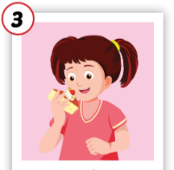
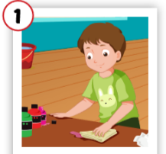
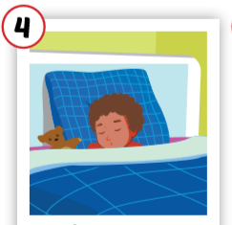
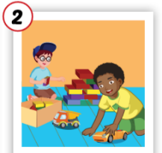
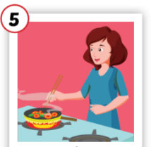
3
1
4
1
4
SPIN
3
2
2
2
5
5

Slide 6

It’s time to learn …

Slide 7


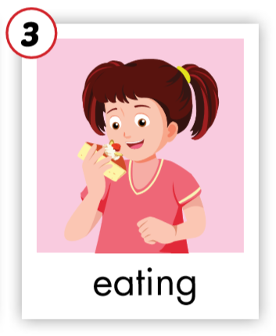
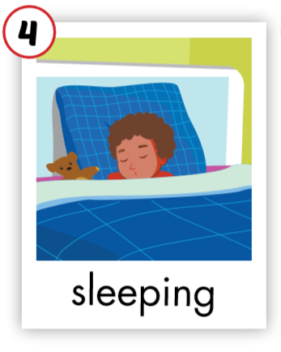
C. 1. Listen and repeat.
1
2

Slide 8
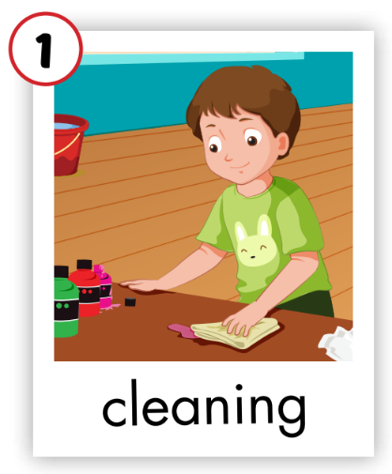
C. 1. Listen and repeat.

Slide 9


C. 2. Chant.
Click on the earphone to practice the chant.
/i:/ /i:/ /i:/
sleeping
eating
/i:/ /i:/ /i:/
/i:/ /i:/ /i:/

Slide 10

Listening

